Slide 1
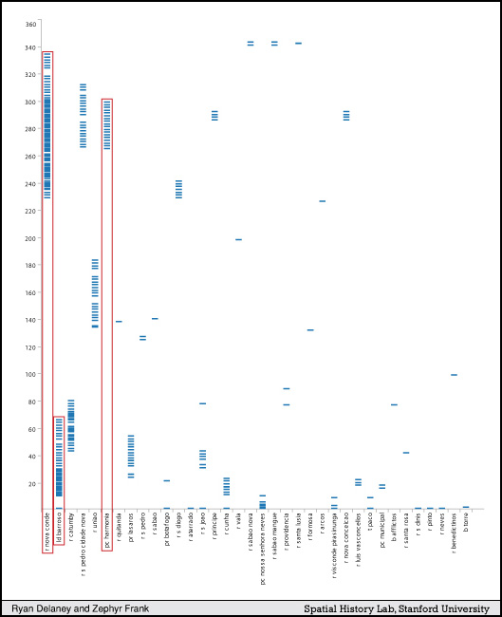
Figure 3. Street Ranges
Notes:
Delaney, Ryan, “Backend Visualizations: Tools for Helping the Research Process,” The Spatial History Project August 2009 <http://www.stanford.edu/group/spatialhistory/cgi-bin/site/pub.php?id=11> (30 August 2009).
par 13

