Slide 1
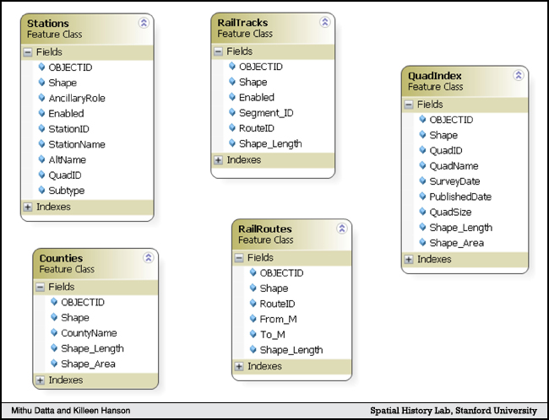
Figure 1. Feature Classes
Notes:
Shnayder, Evgenia, Killeen Hanson, and Mithu Datta, “A Data Model for Spatial History: Shaping the West,” The Spatial History Project August 2009 <http://www.stanford.edu/group/spatialhistory/cgi-bin/site/pub.php?id=23> (1 September 2009).
par 11

