Slide 1


BLUETOOTH low energy (BLE)
Final project - Carlos estay
ANDROID DEVELOPMENT – dmit2504

Slide 2
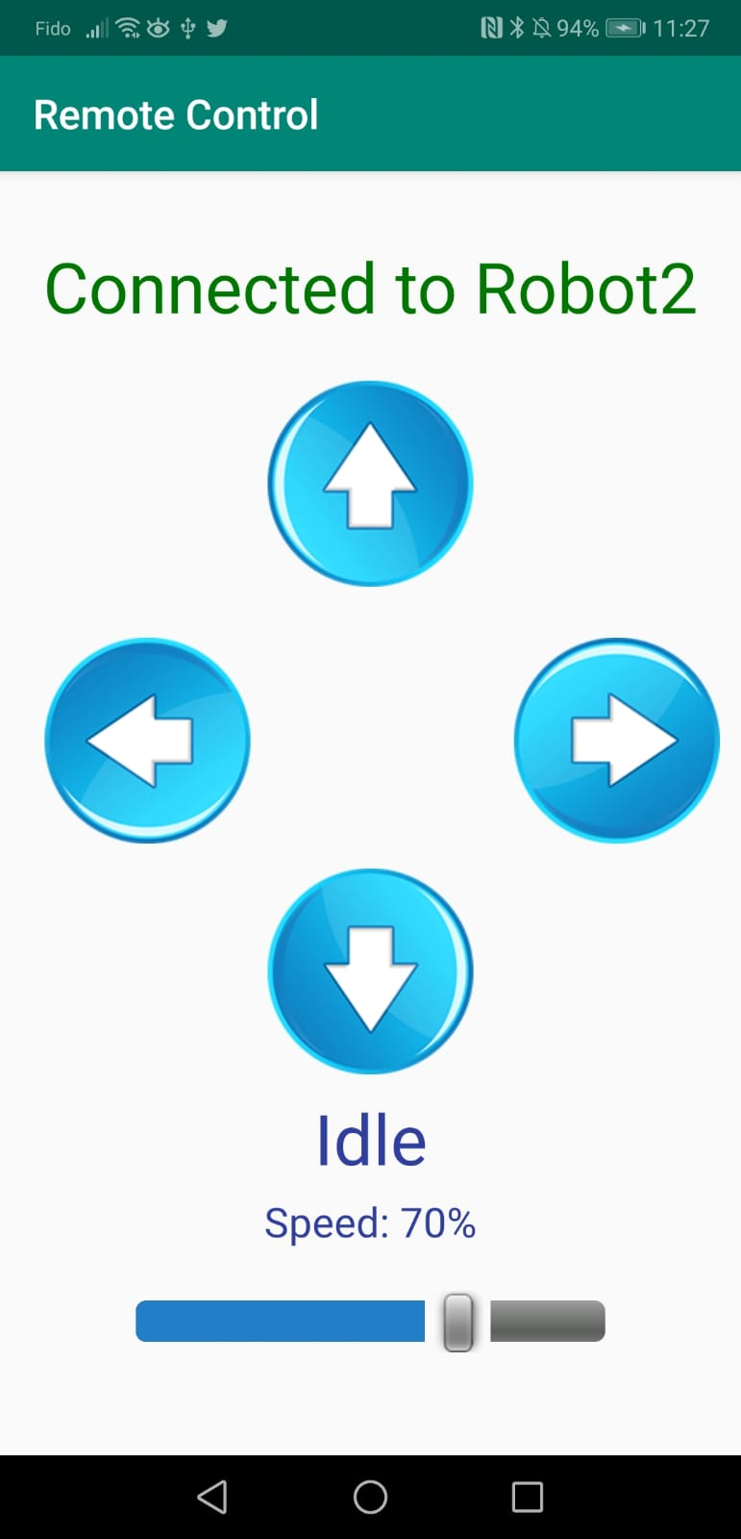
Project objective
Build an android app to remotely control a 4 wheel robot using BLE
Control speed using slider (SeekBar)
Control 4 possible moves with 4 buttons:
Forward
Reverse
Turn right
Turn left

Slide 3
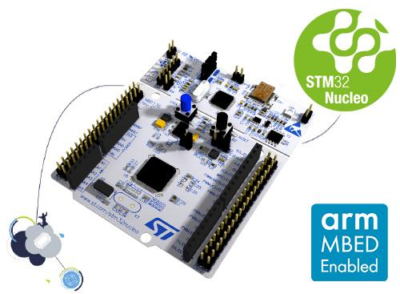
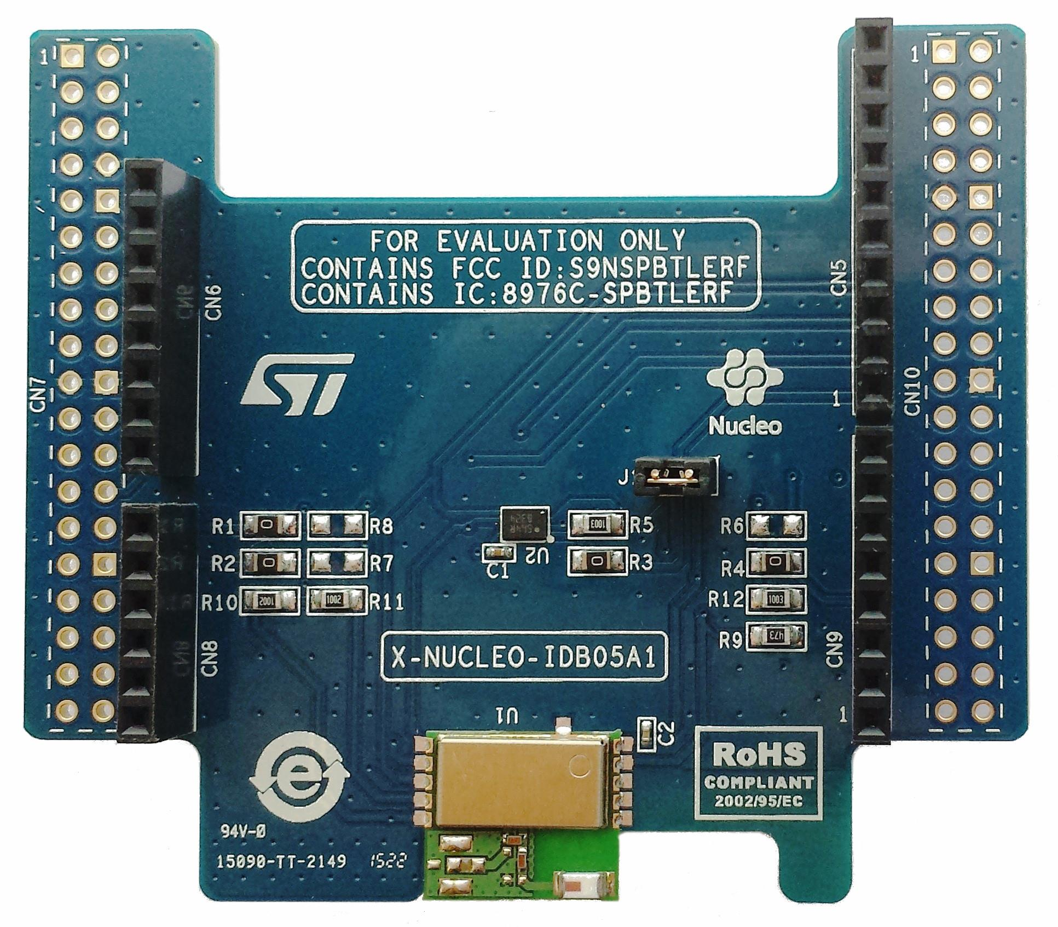
Project objective
Components to use:
Android Phone
Custom modified robot
Microcontroller module: NUCLEO-L476RG
https://www.st.com/en/evaluation-tools/nucleo-l476rg.html
BLE module: X-NUCLEO-IDB05A1
https://www.st.com/en/ecosystems/x-nucleo-idb05a1.html

Slide 4
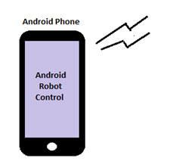
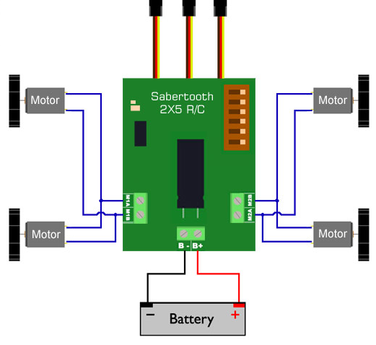
Interaction diagram
https://www.dimensionengineering.com/appnotes/simple_robot/

Slide 5
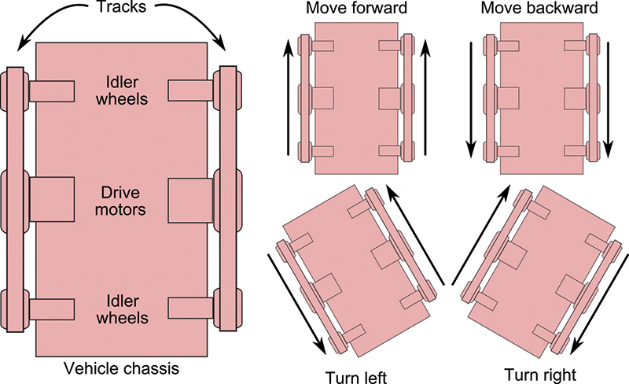
basic control of a 4 wheel robot
https://www.servomagazine.com/magazine/article/may2014_McComb

Slide 6
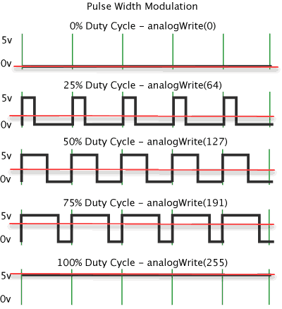
Pulse width modulation (PWM)
https://www.analogictips.com/pulse-width-modulation-pwm/

Slide 7
BLE FEATURES
Transmit small amounts of data between devices
It is designed for low power consumption
Normally used for:
Proximity sensors
Heart rate monitors
Fitness devices
Remote control

Slide 8
BLE ACTORS
GATT : Generic Attribute Profile
GATT Server
GATT Client
Services: unique UUID identifier
Characteristics: a service can have many characteristics. Also identified by a UUID

Slide 9

BLE ACTORS EXAMPLE
GATT SERVER
SERVICE
SERVICE
CHARACTERISTIC
CHARACTERISTIC
CHARACTERISTIC
CHARACTERISTIC
CHARACTERISTIC
CHARACTERISTIC
GATT CLIENT

Slide 10
STEPS TO CONNECT TO A GATT SERVER
STEP 1: enable permissions in android manifest
<uses-permission android:name="android.permission.BLUETOOTH_ADMIN" /> <uses-permission android:name="android.permission.BLUETOOTH" /> <uses-permission android:name="android.permission.ACCESS_COARSE_LOCATION" />

Slide 11
STEPS TO CONNECT TO A GATT SERVER
STEP 2: Request for permission in run time, if not yet enabled
//Check and request permission if necessary if (ContextCompat.checkSelfPermission(this, Manifest.permission.ACCESS_COARSE_LOCATION) != PackageManager.PERMISSION_GRANTED) { // Permission is not granted if (ActivityCompat.shouldShowRequestPermissionRationale(this, Manifest.permission.ACCESS_COARSE_LOCATION)) { } else { // No explanation needed; request the permission ActivityCompat.requestPermissions(this, new String[]{Manifest.permission.ACCESS_COARSE_LOCATION}, 1); // result of the request. } } else { // Permission has already been granted }

Slide 12
STEPS TO CONNECT TO A GATT SERVER
Classes to utilize to scan devices and to connect
BluetoothManager
BluetoothAdapter
BluetoothGattServer : if you are setting device as a server
BluetoothGatt
BluetoothGattCharacteristic
BluetoothDevice
BluetoothLeScanner
Handler: to handle the Scan function

Slide 13
STEPS TO CONNECT TO A GATT SERVER
STEP 3: initialize the Bluetooth adapter
//Initialize Bluetooth adapter bluetoothManager = (BluetoothManager) getSystemService(Context.BLUETOOTH_SERVICE); bluetoothAdapter = bluetoothManager.getAdapter();
//Enable Bluetooth if not yet enabled if(bluetoothAdapter == null || !bluetoothAdapter.isEnabled()){ Intent enableBtIntent = new Intent(BluetoothAdapter.ACTION_REQUEST_ENABLE); startActivityForResult(enableBtIntent, REQUEST_ENABLE_BT); }

Slide 14
STEPS TO CONNECT TO A GATT SERVER
STEP 4: Scan for devices – call scanLeDevice() function (or any name)
@TargetApi(21) private void scanLeDevice(final boolean enable) { final BluetoothLeScanner bluetoothLeScanner = bluetoothAdapter.getBluetoothLeScanner(); if (enable) { statusTextView.setText("Scanning..."); // Stops scanning after a pre-defined scan period. handler.postDelayed(new Runnable() { @Override public void run() { mScanning = false; bluetoothLeScanner.stopScan(leScanCallback); statusTextView.setText("Scan stopped"); } }, SCAN_PERIOD); mScanning = true; bluetoothLeScanner.startScan(leScanCallback); } else { mScanning = false; bluetoothLeScanner.stopScan(leScanCallback); } }

Slide 15
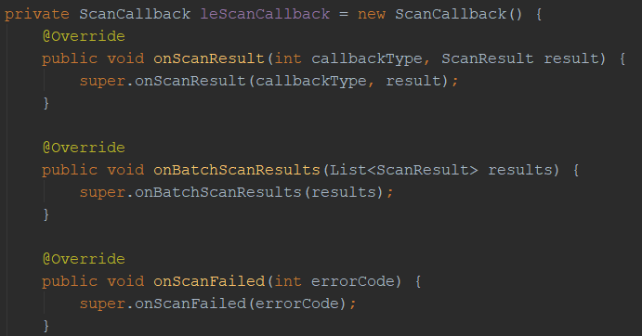
STEPS TO CONNECT TO A GATT SERVER
STEP 4: Scan for devices – Handle callback

Slide 16
STEPS TO CONNECT TO A GATT SERVER
STEP 4: Scan for devices – Handle results
The result.getDevice() will return the Bluetooth Device to connect to.
BluetoothDevice myDevice = result.getDevice();
String myDeviceName = myDevice.getName;
String myDeviceAddress = myDevice.getAddress;

Slide 17
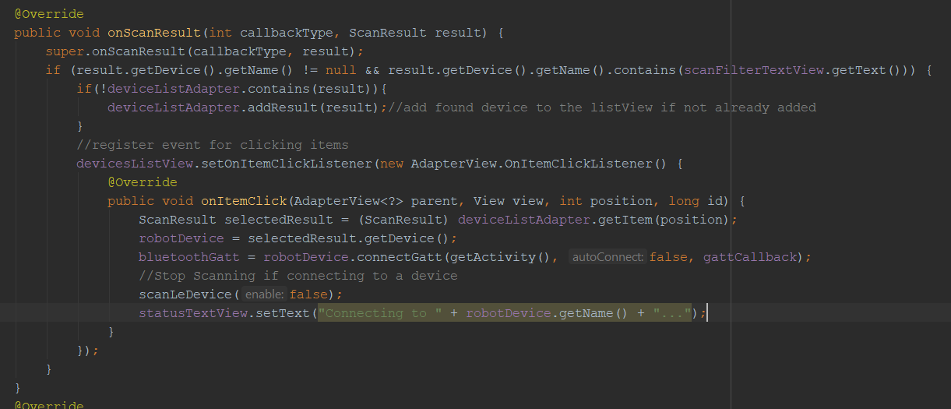
STEPS TO CONNECT TO A GATT SERVER
STEP 4: Scan for devices – Handle results

Slide 18
STEPS TO CONNECT TO A GATT SERVER
STEP 5: Select a device and connect to the Gatt server
myDevice.connectGatt(thisActivity, false, gattCallback);

Slide 19
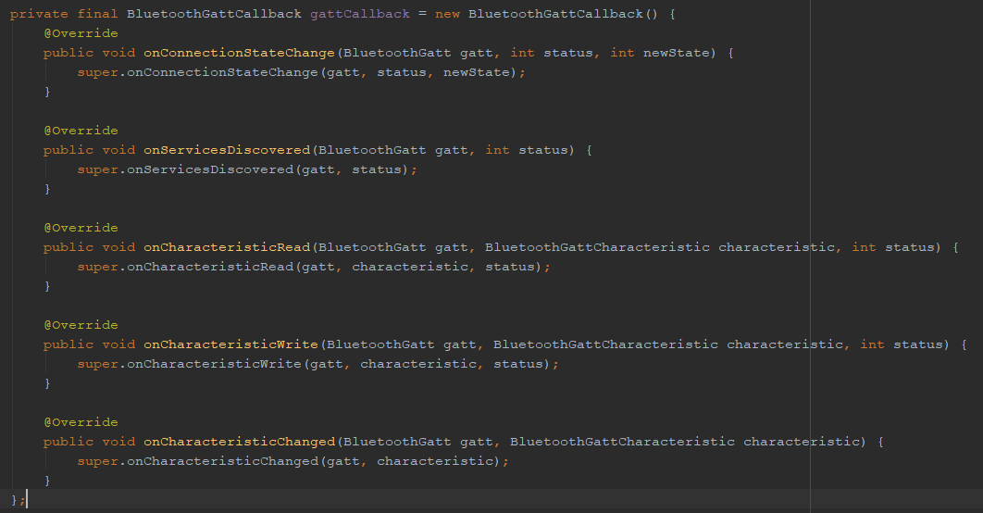
STEPS TO CONNECT TO A GATT SERVER
STEP 6: Handle gattCallback results

Slide 20
STEPS TO CONNECT TO A GATT SERVER
STEP 6: Handle gattCallback results - Discover services if connected
@Override public void onConnectionStateChange(BluetoothGatt gatt, int status, int newState) { //super.onConnectionStateChange(gatt, status, newState); connectedDevice = gatt.getDevice(); switch(newState ){ case BluetoothProfile.STATE_CONNECTED: bluetoothGatt.discoverServices(); break; case BluetoothProfile.STATE_DISCONNECTED: break; default: break; }

Slide 21
STEPS TO CONNECT TO A GATT SERVER
STEP 7: Get service and characteristic to use
@Override public void onServicesDiscovered(BluetoothGatt gatt, int status) { //super.onServicesDiscovered(gatt, status); List<BluetoothGattService> services = gatt.getServices(); String serviceUUID = "D973f2E0-B19E-11E2-9E96-0800200C9A66"; String charUUID = "D973f2E2-B19E-11E2-9E96-0800200C9A66"; BluetoothGattService service = gatt.getService(UUID.fromString(serviceUUID)); customCharacteristic = service.getCharacteristic(UUID.fromString(charUUID)); }

Slide 22

STEPS TO CONNECT TO A GATT SERVER
STEP 8: Write into custom characteristic
customCharacteristic.setValue("@MF0"); bluetoothGatt.writeCharacteristic(customCharacteristic);
Pass Bluetooth device to a different activity if desired
//Robot connected, open remote control activity Intent intent = new Intent(getApplicationContext(), RemoteControlActivity.class); intent.putExtra("ROBOT", robotDevice); startActivity(intent);

Slide 23
COMMANDS IMPLEMENTED FOR ROBOT
“@MF0” : Move Forward
“@MB0” : Move Reverse
“@MR0” : Turn Right
“@ML0” : Turn Left
“@SXX” : Set speed to XX-> from 00 to 10

Slide 24
SUMMARY OF STEPS
Enable permissions in android manifest
Request permission ACCESS_COARSE_LOCATION in run time
Initialize Bluetooth Adapter
Scan devices: bluetoothLeScanner.startScan(leScanCallback);
Declare and handle (leScanCallback)
If onScanResult is called, add result to a list view
Once a result (device) is selected, go to step 5

Slide 25
SUMMARY OF STEPS
5. Connect to Gatt Server: myDevice.connectGatt(thisActivity, false, gattCallback);
6. Declare and handle gattCallback
if onConnectionStateChange is called and new state is STATE_CONNECTED, go to step 7
7. Get service and characteristic
If onServiceDiscovered is called, get desired service, if discovered, and characteristic
8. Write to custom characteristic selected
onCharacteristicWrite will be called as an acknowledge that the characteristic was written properly.

Slide 26
POSSIBLE OTHER IMPLEMENTATIONS OF BLE
Create a Bluetooth Chat between 2 android devices, one configured as a Gatt Client and other one as a Gatt Server
Create a chat between an android device and a computer that as a microcontroller with BLE module, which outputs the messages received in a terminal such as Tera Term, for instance
Read other standard BLE devices/profiles. For instance, a heart rate monitor
Use the android device as an extra or custom controller for a game

Slide 27

Contact details - questions
carlos.estayo@gmail.com
cestayoyarzo1@studentmail.nait.ca
GitHub: cestayoyarzo1

