Slide 1
Alexander College - Vancouver Campus
CPSC 111BV Introduction to Computation by Dr. Ahmed Malki
Winter 2018
Algorithms are the heart of all computation

Slide 2
Type Coercion, Functions, and Arguments & Parameters
Lecture 4:
Functions and Parameters (Chapter 4)

Slide 3
Objectives
You should be able:
To define Type coercion
To understand the important role of functions and why programmers divide programs up into sets of cooperating functions
To define new functions in Python as well as to understand the way to use them
To understand the details of function calls and parameter passing in Python
To understand Flow of Execution

Slide 4
Type Coercion
Type Coercion : means “automatic type conversion”
Type Conversion | Type Coercion
minute = 59 float(minute) / 60 | minute = 59 minute / 60.0

Slide 5
The idea of functions
We have already been using function definitions to allow us to write and test many small "programs" within a single file.
However, most "real-world" programs are longer than those we have written so far.
Typically, a program is a collection of several function definitions.

Slide 6
Why a function?
a function is a way for a programmer to organize a program
a programmer organizes a program into Files and into functions in a similar way a book writer organizes a book into Chapters and into paragraphs
one difference (benefit) between functions and paragraphs is that a function can be “re-used”

Slide 7
The task of Functions
Having similar or identical code in more than one place has some drawbacks:
Issue one: writing the same code twice or more
Issue two: This same code must be maintained in two separate places
Functions can be used to reduce code duplication and make programs more easily understood and maintained.
The purpose of using functions is:
to help break a large problem into smaller parts;
to improve the readability of code; and
to avoid writing similar code over-and-over again.

Slide 8
Built-in Functions
You’ve learned how to use i.e., “call”, several of Python’s built-in functions that can be used in any program.
input(“Enter text: “)
int(35.4), float(45), str(34) return 35, 45.0, ’34’
len(“This is a string”) returns 16
len(“”) returns 0
round can take one or two arguments
If the only argument is a number round returns the number rounded to the nearest integer
round(22.3) returns 22.0
round(34.6) returns 35.0
A second optional argument in “round” indicates how many decimal places to round to
round(12.3456,2) returns 12.35
round(12.3456,3) returns 12.346
round(12.3456) returns 12.0
Notes:
Built-in Functions: https://docs.python.org/2/library/functions.html

Slide 9
More Built-in Functions
Functions can be part of an expression:
x = 9 + math.sqrt(7**2 - 6*1*(-7))
Variables can be used as arguments for a function
name=“Linda”
nameLength=len(name)
Any expression can be used as an argument
round(12.1+1.6) is 14.0
x = 12 + round(22.6)

Slide 10
Built-in Functions Examples
abs(x)
Return the absolute value of a number. The argument may be a plain or long integer or a floating point number. If the argument is a complex number, its magnitude is returned
cmp(x, y) Compare the two objects x and y and return an integer according to the outcome. The return value is negative if x < y, zero if x == y and strictly positive if x > y.
id(object)
Return the “identity” of an object. This is an integer (or long integer) which is guaranteed to be unique and constant for this object during its lifetime. Two objects with non-overlapping lifetimes may have the same id() value. (Implementation note: this is the address of the object.)

Slide 11
Count the arguments
Example - no arguments | Example – one argument | Example – two arguments
object() | hex(x) | cmp(x, y)

Slide 12
Return Statement
The return instruction/command is used within a function to “return a result”
The return instruction (command) is used to identify the function result
The returned value of a function may be assigned to a variable or used in a print

Slide 13
Functions without results
Some function do not “yield a result” (return a result); likely such a function will simply output information using a print instruction/command (or similar)
Some “Functions without results “ may produce a “side-effect”; meaning that it may make changes outside of itself (i.e. a function may store or change data in a file)
Some programming languages have a name for “Functions without results”; procedures

Slide 14
Defining Functions
In math we could define a function such as:
f(x) = x²
What is the value of f(3), f(5), or f(8)?
In Python, we can achieve a similar effect:
def f(x):
return x ** 2
Now, what does the function call f(3) do?

Slide 15
Functions and Parameters
A function definition looks like this: def <name>(<formal-parameters>): <body>
The name of the function must be an identifier and must follow the rules of variable names
Formal-parameters is a possibly empty list of variable names

Slide 16
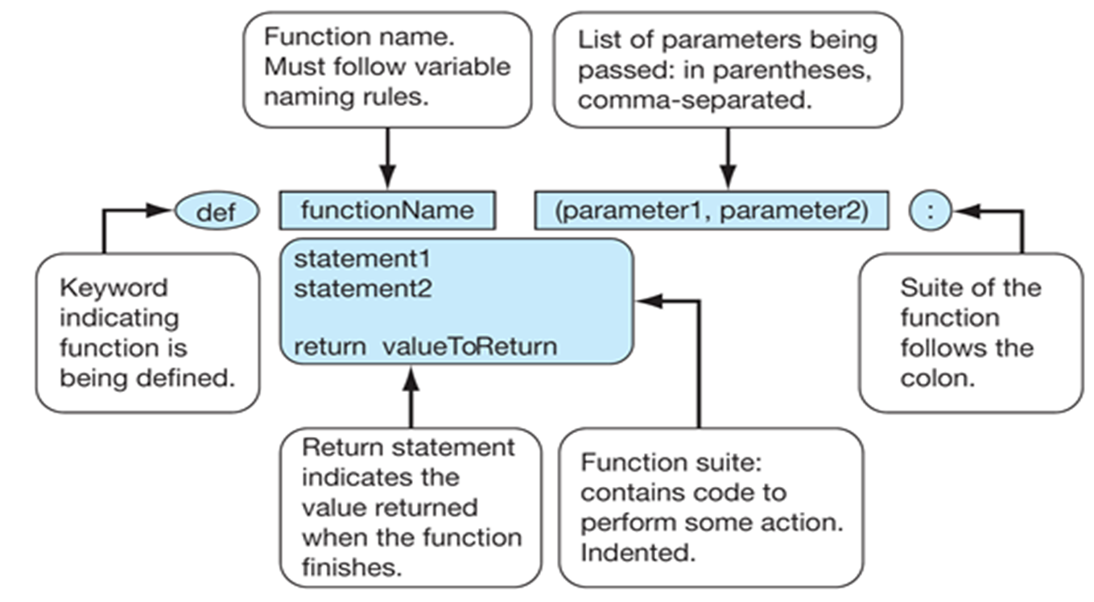
Function Parts
2011 Pearson Addison-Wesley. All rights reserved.

Slide 17
Functions that return Values
Sometimes a function needs to return more than one value.
To do this, simply list more than one expression in the return statement.
def sumDiff(x, y): sum = x + y diff = x – y return sum, diff

Slide 18
More Functions that return Values
When calling this function, use simultaneous assignment.
num1 =float(input("Enter first number "))
num2 =float(input("Enter second number "))
s,d = sumDiff(num1, num2)
print ("The sum is", s, "and the difference is", d)

Slide 19
Variable Scope
You can think of each function as a ‘black box’. From the outside, you can’t see what it is doing. From the inside, you can’t see what’s going on outside.
When writing the function, you don’t have to worry about anything going on outside. Just define the input you need and return the proper output.
When calling the function, just assume you are give inputs to the ‘black box’ and that it will give you the right output; there’s no reason to be concerned with the workings inside.

Slide 20
Functions and Parameters: The Details
Formal parameters, like all variables used in the function, are only accessible in the body of the function. Variables with identical names elsewhere in the program are distinct from the formal parameters and variables inside of the function body.
A function is called by using its name followed by a list of actual parameters or arguments. <name>(<actual-parameters>)
When Python comes to a function call, it initiates a four-step process
The calling program (Caller) suspends execution at the point of the call.
The formal parameters of the function (Callee) get assigned the values supplied by the actual parameters in the call.
The body of the function is executed.
Control returns to the point just after where the function was called

Slide 21
Functions with parameters
Imagine that we want to display greetings to several different people. We might write the following:
def main():
print ("Hello, Blackberry.“)
print ("How are you today?“)
print ("Hello, Nokia“)
print ("How are you today?“)
This would work, but it contains a lot of repeated code: the only difference between the greetings is the person's name.
We define a function that has the name as a parameter …

Slide 22
Functions with Parameters
Function definition
def greet(name):
print ("Hello", name + ".“)
print ("How are you today?“)
The parameter name is a special variable whose value is initialised when the function is invoked or called.
When we call this function we supply an argument (a value for the parameter):
>>> greet(“Samsung")
Hello Samsung.
How are you today?

Slide 23
Functions with Parameters (Cont. 1)
Commentary - Assume function main has been called
Callee
def greet(name):
print ("Hello", name + ".“)
print ("How are you today?“)
Caller
def main():
greet(“Zoe")
myName = “Jennifer"
greet(myName)
main()

Slide 24
Functions cannot change argument values
Commentary - Assign temperature the value 15
Callee
def turnUpHeat(temp):
temp = temp + 10
Caller
def main():
temperature = 15
turnUpHeat(temperature)
print (temperature)
main()
Question: What’s the value of temperature? Why?

Slide 25
Flow of control (Flow of Execution)
the order in which statements are executed
execution always begins at the first statement (of the main program)
statements are executed one at a time (in order from top to bottom)
the program terminates once we reach the end of the program (the last/bottom line)

Slide 26


Flow of control - Example
main program
sing function
def main(): sing(“Zhan") print() sing(“Leeza")
main()
def happy(): print("Happy birthday to you!")
def sing(person): happy() happy() print("Happy birthday, dear", person + ".“) happy()

Slide 27
Reading & next lecture
We have now dealt with:
Python's basic types (numbers and strings); and
Code structuring techniques (functions).
We are now in the position to begin studying those parts of programming that enable us to develop more realistic algorithms.
In particular, we will see how to write programs that:
make decisions; and
execute repeatedly.
If you wish to prepare for the first of these lectures, read:
Chapters 4 & 6 of Downey et al.

Slide 28
?
Questions
http://www.openbookproject.net/books/bpp4awd/ch05.html

