Slide 1
Alexander College - Vancouver Campus
CPSC 111BV Introduction to Computation by Dr. Ahmed Malki
Winter 2018
Algorithms are the heart of all computation

Slide 2
Digital Information - A Bit about bits
Lecture 7:
Important role of Digital Information

Slide 3
Objectives
You should be able to:
define: what is information?
understand the ways used to store and manage data
understand the important role of Digital Information
Representing Text Digitally using Binary Number System
understand the way negative integers are represented using 2's complement

Slide 4
What Computers Do
Receive input: Accept information from the outside world
Process information: Perform arithmetic or logical (decision- making) operations on information
Produce output: Communicate information to the outside world
Store information: Store and retrieve information from memory and storage devices

Slide 5
What is Information?
Information
Communication that has value because it informs
Anything that can be communicated, whether it has value or not
Information comes in many forms
Words, numbers, pictures
Sound, movies
In computer terminology the terms data and information are more or less interchangeable.

Slide 6
Analog vs. Digital
There are two basic ways to store and manage data:
Analog
continuous, in direct proportion to the data represented
A mercury thermometer is an analog device for measuring temperature. The mercury rises in direct proportion to temperature outside the tube
music on a record album - a needle rides on ridges in the grooves that are directly proportional to the voltages sent to the speaker
Digital
the information is broken down into pieces, and each piece is represented separately
music on a compact disc - the disc stores numbers representing specific voltage levels sampled at specific times

Slide 7
Digital Information
Computers store all information digitally:
– numbers
– text
– graphics and images
– video
– audio
– program instructions
In some way, all information is digitized ‐ broken down into pieces and represented as numbers

Slide 8
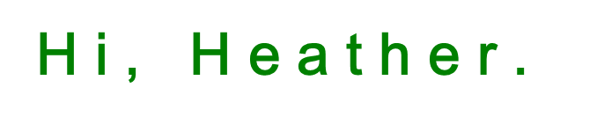
Representing Text Digitally
For example, every character is stored as a number, including spaces, digits, and punctuation
Corresponding upper and lower case letters are separate characters
72 105 44 32 72 101 97 116 104 101 114 46

Slide 9
Binary Numbers
Digitized information is represented and stored in memory using the binary number system (base 2 system). This simple binary system goes hand‐in‐hand with the digital hardware devices seen earlier
A single binary digit (0 or 1) is called a bit (a contraction of binary digit).
Devices that store and move information are cheaper and more reliable if they have to represent only two states
A single bit can represent two possible states, like a light bulb that is either On (1) or Off (0). Binary means 'two'; True/False or Hot/Cold or Open/Closed etc.
Permutations of bits are used to store values

Slide 10
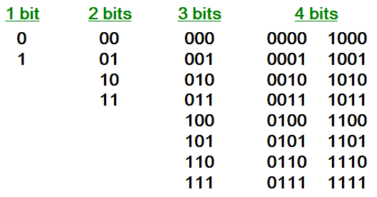
Bit Permutations
possible permutations

Slide 11
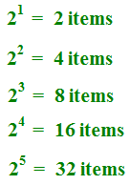
More Bit Permutations
Each permutation can represent a particular item
There are 2^{N} permutations of N bits
Therefore, N bits are needed to represent 2^{N} unique items
1 bit ?
2 bits ?
3 bits ?
4 bits ?
5 bits ?
How many
items can be
represented by

Slide 12
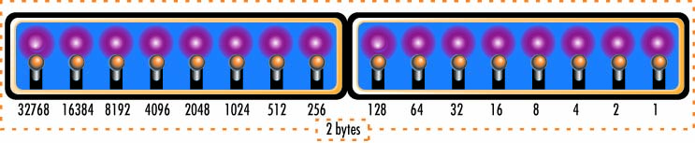
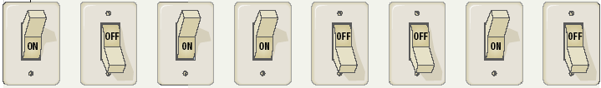
A Bit About Bits
Bit Basics
Bit, or binary digit
The smallest unit of information
Can have one of two values: 1 or 0
Can represent numbers, codes, or
instructions
Byte: a collection of eight bits

Slide 13
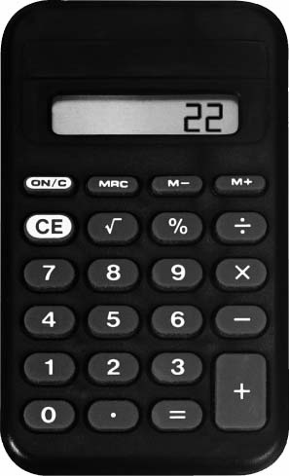
A Bit About Bits (Cont. 1)
Using two symbols all numbers can be represented on a
calculator as well as performing arithmetic.
A calculator translates the touch on the numeric keypad into series of 0s and 1s.
Each number then is looked at as a component of its positional values (each a power of two).
00010011 = (128*0+64*0+32*0+6*1+8*0+4*0+2*1+1*1) = 19

Slide 14
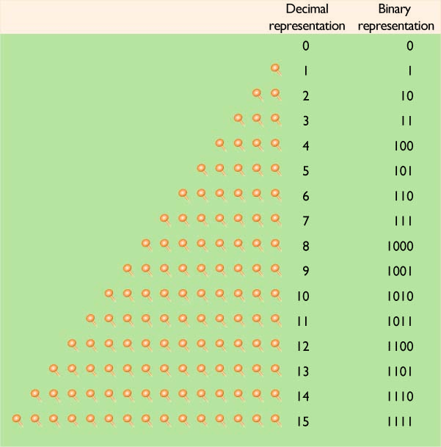
A Bit About Bits (Cont. 2)
Building with Bits
Bits As Numbers
Binary denotes all numbers with a combination of 0s and 1s.
Decimal numbers are automatically converted into binary numbers and vice versa.
Binary number processing is completely hidden from the user.

Slide 15
A Bit About Bits (Cont. 3)
Building with Bits
Bits As Codes
ASCII
The most widely used code
An abbreviation of American Standard Code for Information Interchange
Unicode
Uses 2 bytes, or 16 bits, to encode a character

Slide 16
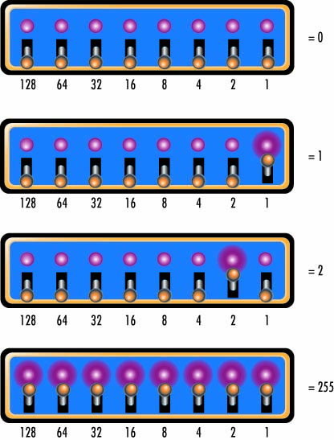
A Bit About Bits (Cont. 4)
Building with Bits (cont.)
Bits as Instructions in Programs
Programs are stored as collections of bits.
Program instructions can tell a computer what to do, where to locate information, or where to store a result.

Slide 17
Bits, Bytes, and Buzzwords
Byte = 8 bits or one character in ASCII
Kilobyte (KB, K)
Kibibyte* (KiB)
Megabyte (meg, MB)
Gigabyte (gig, GB)
Gibibyte (GiB)
Terabyte (TB)
Petabyte (PB)
Exabyte (EB)
≈ 1,000 bytes
= 1024 bytes
≈ 1,000 KB or 1 million bytes
≈ 1,000 MB or 1 billion bytes
= 1,073,741,824 bytes
≈ 1 million MB or 1 trillion bytes
≈ 1 quadrillion bytes
≈ 1000 Petabyte
*: In1998, the International Electronic Commission (IEC)
Notes:
The Web site http://www.computerhope.com/issues/chspace.htm explains the different bit related terms and examples of each storage capacity.

Slide 18
2's complement negative notation of an integer
The computer stores a negative binary number in two’s complement format. This permits the machine to accomplish subtraction by performing an addition operation. The rule for forming the two’s complement of a number, is to “flip the bits and add 1”. This means first, to invert the bits (substitute a 0-bit for each 1-bit and vice versa), forming the one’s complement, and then, to add 1 to this result.
Two's Complement is a representation of negative integers using positive integers.

Slide 19
2's complement negative notation of an integer (Cont. 1)
Two's complement is the way every computer I know of chooses to represent integers. To get the two's complement negative notation of an integer, you write out the number in binary. You then invert the digits, and add one to the result.
Suppose we're working with 8 bit quantities (for simplicity's sake) and suppose we want to find how -28 would be expressed in two's complement notation. First we write out 28 in binary form as 00011100

Slide 20
2's complement negative notation of an integer (Cont. 2)
Then we invert the digits. 0 becomes 1, and 1 becomes 0.
11100011
Then we add 1.
11100100
That is how one would write -28 in 8 bit binary.

Slide 21
?
Questions

