Slide 1
CPSC 111BV Introduction to Computing by Dr. Ahmed Malki
Alexander College - Vancouver Campus
Winter 2018
Algorithms are the heart of all computation

Slide 2
Python Modules - turtles
Lecture 8:
Hello, little turtles
Chapter 3

Slide 3
Objectives
You should be able:
To import modules
To create turtles and get them to draw shapes and patterns.
To understand Instances — a herd of turtles
(Each instance has its own state and behaviour.)
To understand the concepts of:
Attributes and methods
Python for loop and its terminating condition
Flow of Execution of the for loop
To understand more turtle methods and tricks

Slide 4
Creating a new turtle
There are many modules in Python that provide very powerful features that we can use in our own program.
Want a Python program to create a new turtle and start drawing shapes such as a rectangle.
The variable that refers to our first turtle is called alex

Slide 5
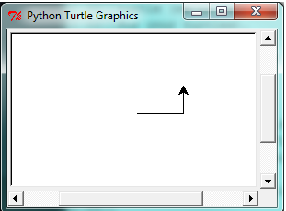
Our first turtle program
import turtle # Allows us to use turtles
wn = turtle.Screen() # Creates a playground for turtles
alex = turtle.Turtle() # Create a turtle, assign to alex
alex.forward(50) # Tell alex to move forward by 50 units
alex.left(90) # Tell alex to turn by 90 degrees
alex.forward(30) # Complete the second side of a rectangle
wn.mainloop() # Wait for user to close window
When we run this program, a new window pops up:

Slide 6
Our first turtle program (Cont. 1)
An object can have various methods — things it can do — and it can also have attributes — (sometimes called properties). For example, each turtle has a color attribute. The method invocation alex.color("red") will make alex red, and drawing will be red too.
The color of the turtle, the width of its pen, the position of the turtle within the window, which way it is facing, and so on are all part of its current state.
Similarly, the window object has a background color, and some text in the title bar, and a size and position on the screen. These are all part of the state of the window object.

Slide 7
Our first turtle program (Cont. 2)
Quite a number of methods exist that allow us to modify the turtle and the window objects.
import turtle
wn = turtle.Screen()
wn.bgcolor("lightgreen") # Set the window background color
wn.title("Hello, Tess!") # Set the window title
tess = turtle.Turtle()
tess.color("blue") # Tell tess to change her color
tess.pensize(3) # Tell tess to set her pen width
tess.forward(50)
tess.left(120)
tess.forward(50)
wn.mainloop()

Slide 8
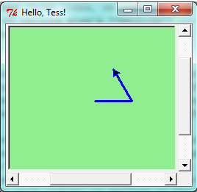
Our first turtle program (Cont. 3)
When we run this program, this new window pops up, and will remain on the screen until we close it.
Q: Modify this program so that before it creates the window, it prompts the user to enter the desired background color. It should store the user’s responses in a variable, and modify the color of the window according to the user’s wishes.
Notes:
http://www.tcl.tk/man/tcl8.4/TkCmd/colors.htm

Slide 9
Instances — a herd of turtles
Just like we can have many different integers in a program, we can have many turtles.
Each of them is called an instance.
Each instance has its own attributes and methods

Slide 10
Instances — a herd of turtles
import turtle
wn = turtle.Screen() # Set up the window and its attributes
wn.bgcolor("lightgreen")
wn.title("Tess & Alex")
tess = turtle.Turtle() # Create tess and set some attributes
tess.color("hotpink")
tess.pensize(5)
alex = turtle.Turtle() # Create alex
tess.forward(80) # Make tess draw equilateral triangle
tess.left(120)
tess.forward(80)
tess.left(120)
tess.forward(80)
tess.left(120) # Complete the triangle
tess.right(180) # Turn tess around
tess.forward(80) # Move her away from the origin
(Continued)
Notes:
http://www.tcl.tk/man/tcl8.4/TkCmd/colors.htm

Slide 11
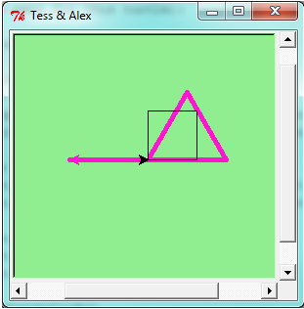
Instances: a herd of turtles (Cont …)
…
alex.forward(50) # Make alex draw a square
alex.left(90)
alex.forward(50)
alex.left(90)
alex.forward(50)
alex.left(90)
alex.forward(50)
alex.left(90)
wn.mainloop()
Here is what happens when alex completes his rectangle, and tess completes her triangle:

Slide 12
The for loop
Looking at the previous code, When we drew the square, it was quite tedious. We had to explicitly repeat the steps of moving and turning four times.
So a basic building block of all programs is to be able to repeat some code, over and over again.
Python’s for loop solves this for us. Let’s say we have some friends, and we’d like to send them each an email inviting them to our party. We don’t quite know how to send email yet, so for the moment we’ll just print a message for each friend:
for f in ["Joe","Zoe","Brad","Angelina","Zuki","Thandi","Paris"]:
invite = "Hi " + f + ". Please come to my party on Saturday!"
print(invite)
# more code can follow here ...

Slide 13
Flow of Execution of the for loop
f is called the loop variable
Loop body has two statements
Terminating condition of the loop (if there are no items left to be processed)
As a program executes, the interpreter always keeps track of which statement is about to be executed. We call this the control flow, of the flow of execution of the program.

Slide 14
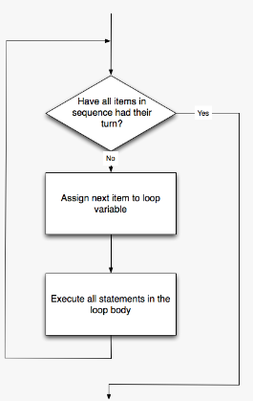
Flowchart of a for loop
Control flow is often easy to visualize and understand if we draw a flowchart. This shows the exact steps and logic of how the for statement executes.

Slide 15
The loop simplifies our turtle program
We previously used 8 lines to have alex draw the four sides of a square. This does exactly the same, but using just three lines:
for i in [0,1,2,3]: # make the loop body execute 4 times
alex.forward(50)
alex.left(90)
In fact, they are so popular that Python gives us special built-in range objects
for i in range(4):
# Executes the body with i = 0, then 1, then 2, then 3
for x in range(10):
# Sets x to each of ... [0, 1, 2, 3, 4, 5, 6, 7, 8, 9]
So the square drawing code above becomes:
for i in range(4):
alex.forward(50)
alex.left(90)

Slide 16
Questions
What would happen if we made this change?
for c in ["yellow", "red", "purple", "blue"]:
alex.color(c)
alex.forward(50)
alex.left(90)
# Assign a list to a variable
clrs = ["yellow", "red", "purple", "blue"]
for c in clrs:
alex.color(c)
alex.forward(50)
alex.left(90)

Slide 17
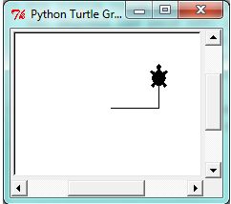
A few more turtle methods and tricks
A turtle’s pen can be picked up or put down. This allows us to move a turtle to a different place without drawing a line. The methods are
alex.penup()
alex.forward(100) # This moves alex, but no line is drawn
alex.pendown()
Every turtle can have its own shape. The ones available “out of the box” are arrow, blank, circle, classic, square, triangle, turtle.
alex.shape("turtle")

Slide 18
A few more turtle methods and tricks
We can speed up or slow down the turtle’s animation speed. (Animation controls how quickly the turtle turns and moves forward). Speed settings can be set between 1 (slowest) to 10 (fastest). But if we set the speed to 0, it has a special meaning — turn off animation and go as fast as possible.
alex.speed(10)
A turtle can “stamp” its footprint onto the canvas, and this will remain after the turtle has moved somewhere else. Stamping works, even when the pen is up.
Let’s do an example that shows off some of these new features:

Slide 19
A few more turtle methods and tricks
import turtle
wn = turtle.Screen()
wn.bgcolor("lightgreen")
tess = turtle.Turtle()
tess.shape("turtle")
tess.color("blue")
tess.penup() # This is new
size = 20
for i in range(30):
tess.stamp() # Leave an impression on the canvas
size = size + 3 # Increase the size on every iteration
tess.forward(size) # Move tess along
tess.right(24) # ... and turn her
wn.mainloop()
Further Readings - Turtle graphics: https://docs.python.org/3.2/library/turtle.html
http://www.eg.bucknell.edu/~hyde/Python3/TurtleDirections.html
http://projects.codeclubworld.org/en-GB/09_python_archive/04/Turtle%20Power.html

Slide 20
?
Questions

Slide 21
Want to have fun?
PythonTurtle
A learning environment for Python programming suitable for beginners and children, inspired by Logo.
PythonTurtle strives to provide the lowest-threshold way to learn (or teach) software development in the Python programming language. Students command an interactive Python shell (similar to the IDLE development environment) and use Python functions to move a turtle displayed on the screen. An illustrated help screen introduces the student to the basics of Python programming while demonstrating how to move the turtle.
http://pythonturtle.org/
Notes:
http://pythonturtle.org/

Slide 22
Some kind of picture
from turtle import *
tanenbaum = Turtle()
tanenbaum.hideturtle()
tanenbaum.speed(20)
for i in range(350):
tanenbaum.forward(i)
tanenbaum.right(98)

