Slide 1
CPSC 111BV Introduction to Computing by Dr. Ahmed Malki
Alexander College - Vancouver Campus
Winter 2018
Algorithms are the heart of all computation

Slide 2
Course Overview & Python Basics
Lecture 1:
The way of the program
Chapter 1
Why Programming Is Fun

Slide 3
Course Main Outcomes
▪▪ Fluency in (Python) procedural programming
Usage of assignments, conditionals, and loops
Ability to create Python modules and programs
▪▪ Competency in object-oriented programming
Ability to recognize and use objects and classes
▪▪ Knowledge of searching and sorting algorithms
Practicing your algorithmic knowledge through coding

Slide 4
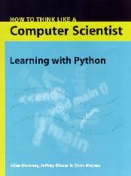
Resources
Your textbook is:
How to Think Like a Computer Scientist
Learning with Python 3
by Peter Wentworth, Jeffrey Elkner, Allen B. Downey, and Chris Meyers (October 2012)
Book available for free

Slide 5
Class Materials
Your textbook:
How to Think Like a Computer Scientist Learning with Python 3
by Peter Wentworth, Jeffrey Elkner, Allen B. Downey, and Chris
Meyers (October 2012)
manuscript available for download at http://openbookproject.net/thinkcs/python/english3e/
Also, Think Python 2nd Edition by Allen B. Downey (Download)
SFU CMPT 120 Python Guide - http://www.cs.sfu.ca/CC/120/ggbaker/guide
http://www.bitsbook.com/ (Your Blown to Bits by Hal Abelson, Ken Ledeen, and Harry Lewis)
More Python free books: http://www.computer-books.us/python.php

Slide 6
Objectives
You should be able:
To understand the respective roles of hardware and software in a computing system.
To understand the basic design of a modern computer.
To understand the respective roles of Compiler and Interpreter.
Getting Started with Python

Slide 7
Prior to this Course…
No prior programming experience is assumed
This course will teach you basic programming constructs that will allow you to develop your own applications software.
In other words, you can succeed here even if you have never ever written a computer program.
Study the material every day; review the material every weekend; do the assignments in advance; score as many points as possible in each category. Factors such as class participation could contribute to your final grade, especially if yours is a borderline case.

Slide 8
What is Python?
Python, a reference to the 1970s British comedy sketch television show called Monty Python's Flying Circus, is a freely available, very-high-level, interpreted language developed by Guido van Rossum
It is an open-source scripting language that is extremely flexible and powerful.
Why is Python cool?
Notes:
Monty Python Argument Clinic: https://www.youtube.com/watch?v=kQFKtI6gn9Y

Slide 9
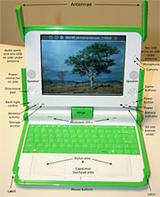
Some cool places where Python is used
Python programs can be run in very many contexts, including
Nokia 6630 smartphone
One Laptop Per Child project $100 (or $200) computer
iPod, Palm, Pocket PCs
Web servers
In browsers with Microsoft's new Silverlight
Almost any operating system environment

Slide 10
Some cool places where Python is used (more …)
Empowering Google popular Web development framework (Actually, many companies, including Google, YouTube, and Yahoo use it extensively)
Widely used in scientific computation by mathematicians and physicists (NASA)
Available on embedded platforms, for instance Nokia mobile phones.
Available on large portions of games (such as Battlefield 2, Crystal Space, Star Trek Bridge Commander, The Temple of Elemental Evil, Vampire: The Masquerade: Bloodlines, Civilization 4, QuArK (Quake Army Knife))

Slide 11
Why Programming in Python?
Python is easier for beginners
▪▪ A lot less to learn before you start “doing”
▪▪ Designed with “rapid prototyping” in mind
Python is more relevant to non-CS majors
▪▪ NumPy and SciPy heavily used by scientists
Python is a more modern language
▪▪ Popular for web applications (e.g. Facebook apps)
▪▪ Also applicable to mobile app development
Notes:
http://www.engr.ucsb.edu/~shell/che210d/numpy.pdf

Slide 12
Class Structure
We'll cover the basic knowledge (e.g. programming techniques, the Python language) during the lectures.
You'll get a Lab each week (on Fridays) with a range of programming exercises from previous lectures:
help and feedback on Labs will be given during Lab sessions.
Mandatory - Missing more than 1 lab lowers your final grade
You'll also get some practice during the lectures.

Slide 13
Your Task for next lecture(s)
By Wednesday, you should start reading
Chapter 1- The way of the program
Section A2 in the study guide appendix pgs. 168-170
http://www.cs.sfu.ca/CC/120/ggbaker/guide/parts/guide08
Unit 1 - Algorithms & Pseudo-code pg. 19
http://www.cs.sfu.ca/CC/120/ggbaker/guide/parts/guide01
Start Downloading, installing and testing your Python tool at home if you have a computer

Slide 14
The Universal Machine and
Computers are very literal and they must be told what to do
They are machines after all (turn them on/off )
Machines that store and manipulate information under the control of a changeable program
If we change the program, then the computer performs a different task
The machine stays the same, but the program changes!

Slide 15
… its basic design
The Central Processing Unit (CPU) is the “brain” of a computer.
Locates program instructions in memory and executes them
Carries out all the basic operations on the data.
Examples: simple arithmetic operations like adding two numbers
Exchanges data with storage devices and input/output devices

Slide 16
… its basic design (cont. 1)
Memory stores programs and data.
CPU can only directly access information stored in main memory (RAM or Random Access Memory).
Main memory is fast, but volatile, i.e. when the power is interrupted, the contents of memory are lost.
Secondary memory provides more permanent storage: magnetic (hard drive, floppy), optical (CD, DVD)

Slide 17
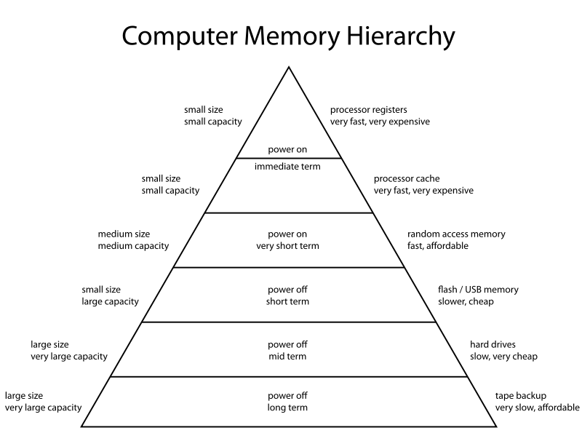
… its basic design (cont. 2)

Slide 18
… its basic design (cont. 3)
Input devices
Information is passed to the computer through keyboards, mice, scanners, etc…
Output devices
Processed information is presented to the user through the monitor, printer, etc…

Slide 19
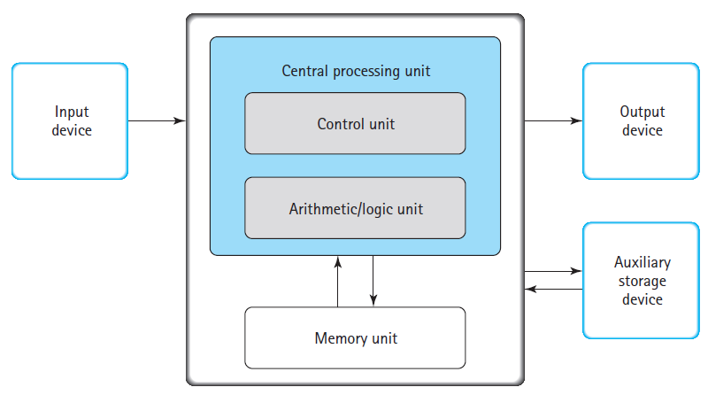
Functional View of a computer

Slide 20
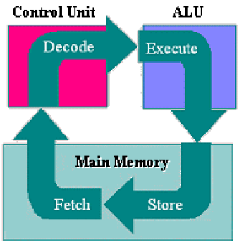
CPU Fetch-Execute (Fetch-Decode-Execute) Cycle
When a program (a set of instructions that performs a task) is executing, the computer proceeds through a series of steps, the fetch-execute cycle:
The Control Unit (CU) retrieves (fetches) the next coded instruction from memory.
The instruction is translated into control signals (decode)
The control signals tell the appropriate unit (Arithmetic/Logic Unit (ALU), memory, I/O device) to perform (execute) the instruction.
The sequence repeats from Step 1.

Slide 21
What is programming?
We are interested in computer programs (scripts): sets of instructions to be carried out by a computer.
Programming is the process of writing computer programs.
For a computer to carry out (or execute) our programs, we have to write them in a programming language.
In this course, we'll write our programs in the Python programming language, to learn the basics of programming. And if you are interested to learn object-oriented programming, then take Java Class; CPSC 112 (next time)

Slide 22
Learning how to program
Programming is a skill (like painting or playing soccer).
Like these other skills, programming:
can be hard to learn;
can only be learnt properly through practice;
can be fun!
This unit aims to give you the:
basic knowledge; and
guidance/help
to enable you to learn how to program (by practising!).

Slide 23
Programming Languages
There are many, many programming languages used today.
Different languages offer different ways to write programs, and are suited to different application areas.
High-level computer languages (Python, C++, C#, Java, Visual Basic, Pascal, and Ada, for example)
Designed to be used and understood by humans
These languages are used to write the everyday applications we see
Programs take less time to write, they are shorter and easier to read, and they are more likely to be correct.
Use complex instructions that can’t be “directly” understood by a computer’s hardware

Slide 24

More Programming Languages
We do not understand machine code.
Computers do not understand natural language.
Compromise: so we create something in between
a programming language:

Slide 25
Programming Languages (cont. 1)
Low-level language
Computer hardware can only understand a very low level language known as machine language (or machine code)
Add two numbers:
Load the number from memory location 101 into the CPU
Load the number from memory location 102 into the CPU
Add the two numbers in the CPU
Store the result into location 103
In reality, these low-level instructions are represented in binary (1’s and 0’s)

Slide 26
Programming Languages (cont. 2)
High-level language z = x + y
This needs to be translated into machine language that the computer can execute.
Compilers convert programs written in a high-level language into the machine language of some computer
A program written in a high-level language can run on any computer that has the appropriate compiler. This is possible because most high-level languages are standardized, which means that an official description of the language exists.

Slide 27
Programming Languages (cont. 3)
A benefit of standardized high-level languages is that they allow you to write portable (or machine independent) code.
The text of an algorithm written in a high-level language is called source code (Program Source File i.e., *.py)
To the compiler, source code is just input data
It translates the source code into a machine language form called object code (*.obj)

Slide 28
Programming Languages (cont. 4)
a program written in assembly language (the native language of a microprocessor) or machine language is not portable from one computer to another.
Because each computer family has its own machine language, a machine language program written for computer A may not run on computer B.

Slide 29
Compiling vs. Interpreting
Once a program is compiled, it can be executed over and over without the source code or compiler. If it is interpreted, the source code and interpreter are needed each time the program runs
Compiled programs generally run faster since the translation of the source code happens only once.
Compiled code translation consumes or wastes time
Alternative is to “interpret “ source code (slower)

Slide 30
Advantages of
Compiling
Faster at runtime, no translation to machine code needed
Interpreting
More flexibility when editing, don’t have to recompile every time you want to test a change

Slide 31
Python Compiler or Interpreter
Python takes a somewhat different approach than what we have described. Python uses a hybrid compiling/interpreting process. When run, the program is first read and “compiled” into more primitive instructions in memory
Not a true compilation to native machine instructions
Python source code converted to Bytecode (platform-independent) file i.e.; *.pyc (Python companion file)
Some optimizations are performed, e.g.
eliminating unreachable code
reducing constant expressions
loading library definitions

Slide 32
Python Compiler or Interpreter (cont. 1)
However, there are no computers that actually use Bytecode as their machine language.
Second stage is line-by-line execution via the interpreter PVM (Python Virtual Machine)–analogous to Java VM (JVM)

Slide 33
Getting Started
The steps to build (develop) a program (software executable)
Design & Build
How to enter, compile, and link your first Python program
Program Source files
Program Executable files

Slide 34
Design and Build software
Building software (developing software) is similar to many other “building” process
Part 1 – Design
Part 2 – Build (follow the “Development Cycle”)
Software development usually is an iterative process
Repeat Design & Build until you are happy with results
Next Design begins where last one left off

Slide 35
Writing a Program
Basic set of steps for writing a program
Define the problem.
Create an algorithm to solve the problem and write it out in pseudo-code
Convert this algorithm into actual code, testing small parts of it along the way
When finished converting the algorithm to code, test for errors
Debug any errors and go back to the previous step

Slide 36
Development Cycle
Edit
Compile
Link
Run
Debug

Slide 37


Software Development Process
Using an interpreter:
Using a Compiler

Slide 38
Program Logic
A program is a sequence of instructions that specifies how to perform a computation (solving a system of equations, finding the roots of a polynomial, searching and replacing text in a document or (strangely enough) compiling a program).
The details look different in different languages, but a few basic instructions appear in just about every language.
These three basic constructs represent the logic, or flow of control in an algorithm:
Sequence (Statements, Steps, Instructions): input (get data), output (display data), Math operations
Repetition (Loops)
Conditional Execution (Alternation or Decisions)

Slide 39
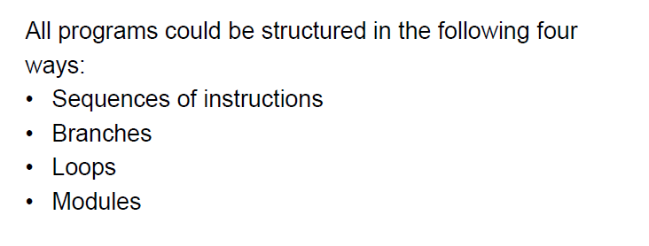
Common Features of all programs

Slide 40
What is debugging/troubleshooting?
A bug is a mistake in a program. Debugging means to find the mistake(s) and to fix it (them).
Computer programs are very complex systems. Debugging is similar to an experimental science: You experiment, form hypotheses, and verify them by modifying your program.
Kinds of errors:
Syntax error. Python cannot understand your program, and refuses to execute it.
Runtime error (exceptions). When executing your program (at runtime), your program suddenly terminates with an error message.
Semantic error. Your program runs without error messages, but does not do what it is supposed to do.

Slide 41
Getting Started with Python
Designed to be used from the “command line”
▪▪ OS X/Linux: Terminal
▪▪ Windows: Command Prompt
▪▪ Purpose of the first lab
Once installed type “python”
▪▪ Starts an interactive shell
▪▪ Type commands at >>>
▪▪ Shell responds to commands
Can use it like a calculator
▪▪ Use to evaluate expressions
>>>5 + 7
12
>>>’Hello’+’World’
‘HelloWorld’
>>> print("Hello World!") Hello World!
>>> print ("Hello, World!“)
Hello, World!
>>>
print(…) #print function
This class uses Python 3.5.x

Slide 42
Comments
A comment is a text that is intended only for the human reader — it is completely ignored by the interpreter.
#-------------------------------------------------------------------------
# This demo program shows off how elegant Python is!
# Written by Ahmed Malki, August 05, 2017
#-------------------------------------------------------------------------
This is a Blank line ignored by the interpreter
print("Hello, World!") # Isn't this easy!
print() is a built-in Python function

Slide 43
Course Overview & Python Basics
Python Tutorial
http://www.w3resource.com/python/python-tutorial.php
Codingbat -- A useful site full of Python practice problems http://codingbat.com/python

Slide 44
?
Questions

