Slide 1

Vacation Advisor

Slide 2
Motivation
We are creating this website with the intention of helping travelers discover new places of interest
Oftentimes, when traveling, we know where we want to go but not necessarily what we want to do
Not re-inventing the wheel, website will be comparable Expedia, Travelocity, etc.

Slide 3
Software Process
Divide workload into three groups
Frontend
Kaleem Azamy
Aiden Houlihan
Prince John Okodua-Oboh
Backend
Thiri Hsu Myat Aung
David Wise
Charles Lejtman
Carlton Etchison
Database
Kidist Gsilassie
Greg Stephens

Slide 4
Use Cases
Search for “Things To Do” in a specified city
Create a list of places a user wishes to visit (Baltimore Favorites)
Be able to view lists created by other users
Provide hotel recommendations with web links to hotels
Send a trip inquiry email regarding any questions
Website should have filters to organize searches
Users should be able to create an account
Users should be able to leave feedback on places they have been to

Slide 5
What have we done so far?
Most work has come from front-end, the skeleton for our website is in place but now it needs functionality
Sections of website are: Home, About, Things To Do, Cities, Contact, and Sign In

Slide 6
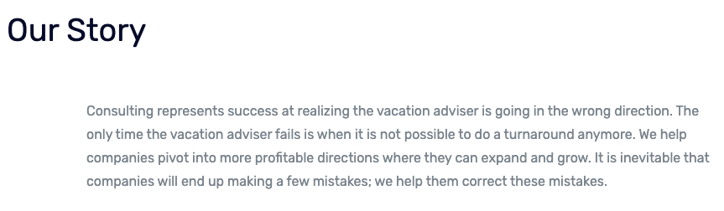
About Page
Explains general goal of the website

Slide 7
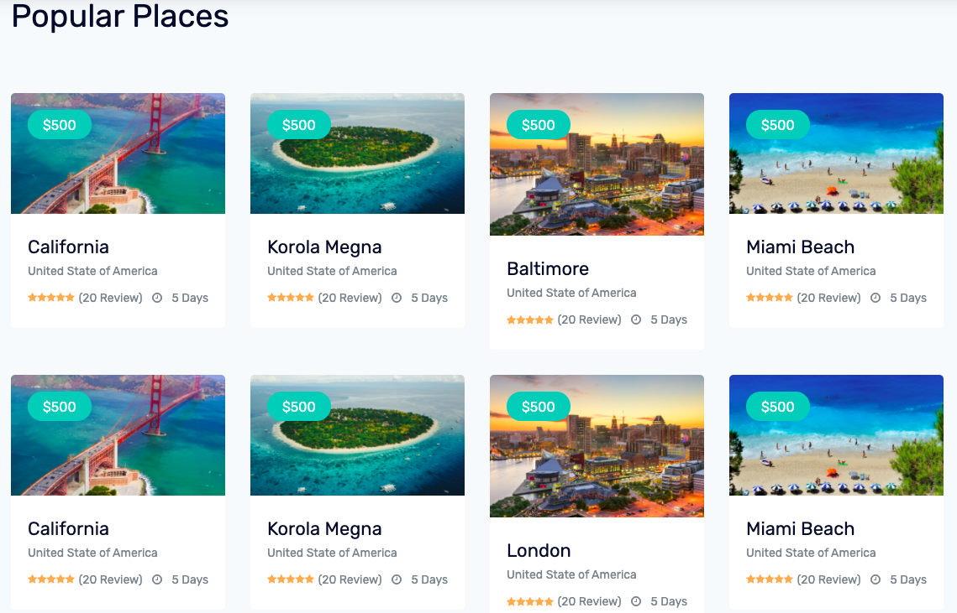
Things To Do Page
Search places by category such as: Restaurants, Movies, Parks, etc
Choose a city to view recommended places

Slide 8
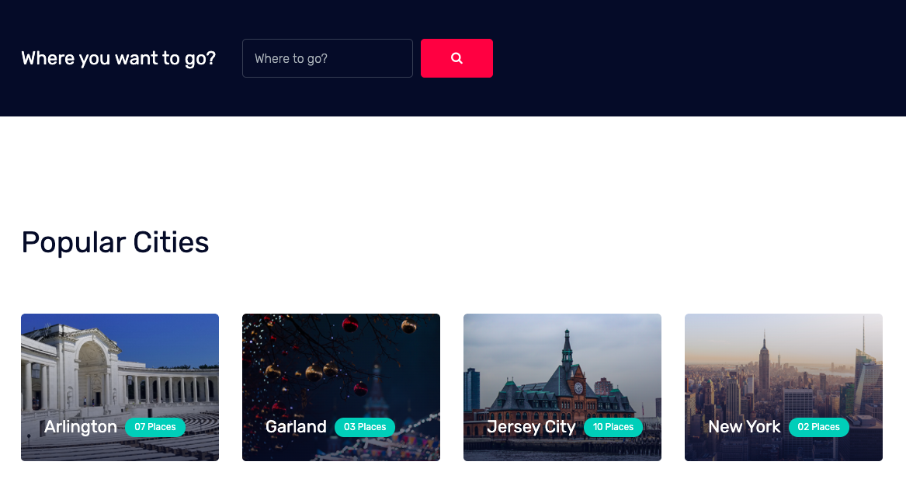
Cities Page
List cities available to user for browsing
Search desired city

Slide 9
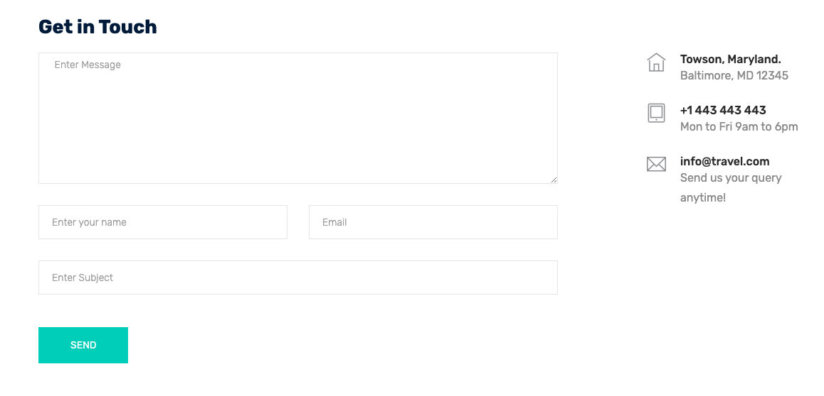
Contact Page
Send our company an e-mail regarding any concerns

Slide 10
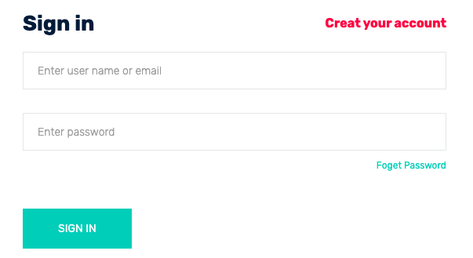
Sign In Page
Be able to sign-in or create a new account
Usernames and passwords stored in database

Slide 11
Moving Forward
We need to give our website more functionality. This includes:
Account creation and login
City Search
Add places to visit in each city
Provide hotel recommendations
Set-up database to store data such as user information and places to visit
Review places visited

