Slide 1
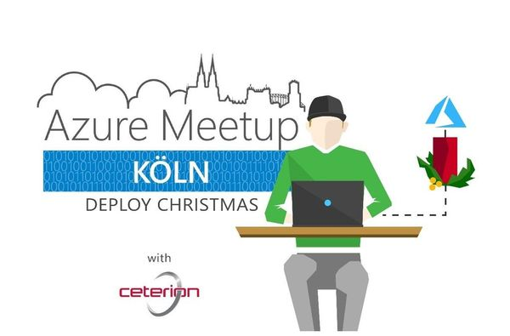

Slide 2
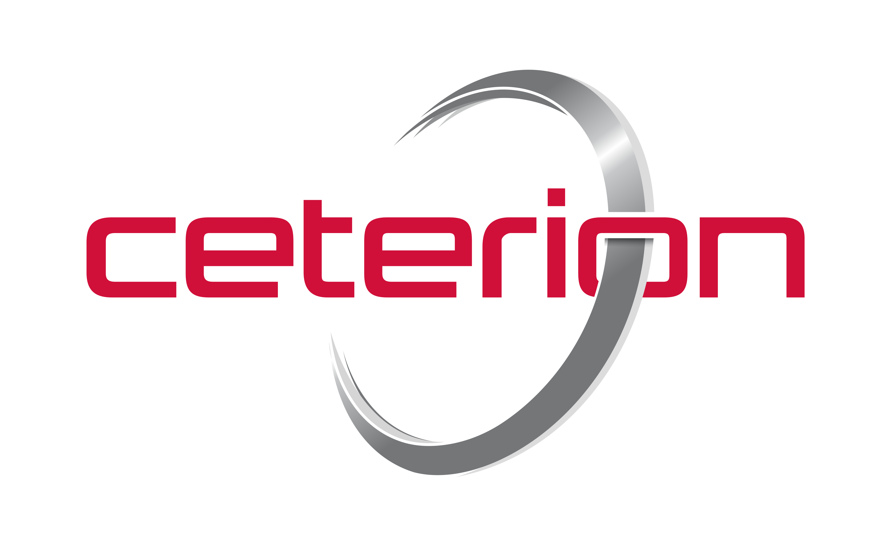
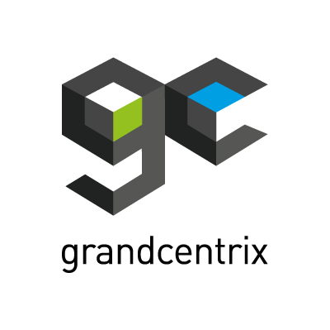

Unsere Sponsoren

Slide 3
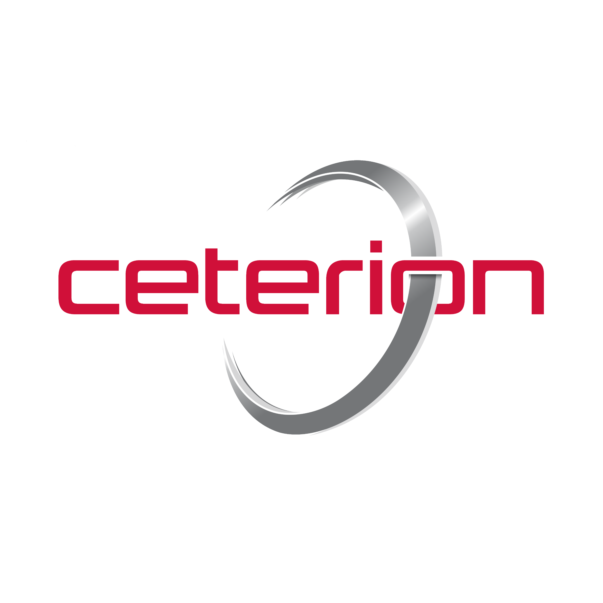



Profil
Fabian Flanhardt
@fabianflanhardt
Fabian Flanhardt
fabian.flanhardt@outlook.com
fabian.flanhardt@ceterion.com

Slide 4

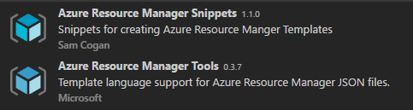


Prerequisites
Vscode extensions
Visual Studio Code
Azure Powershell Module – Install-Module Azure
Notes:
Haftung: Jacken & Laptops

Slide 5
Agenda
Übersicht – Azure Infrastruktur
Simple Resource Template from Scratch
KeyVault Deployment
Nested Deployment (Cross Resource Group)
Notes:
Haftung: Jacken & Laptops

Slide 6
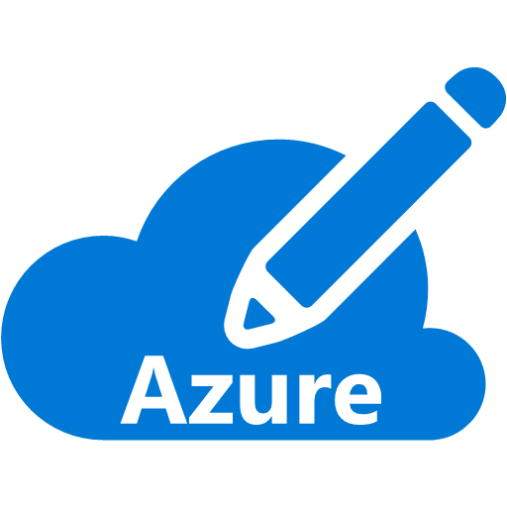
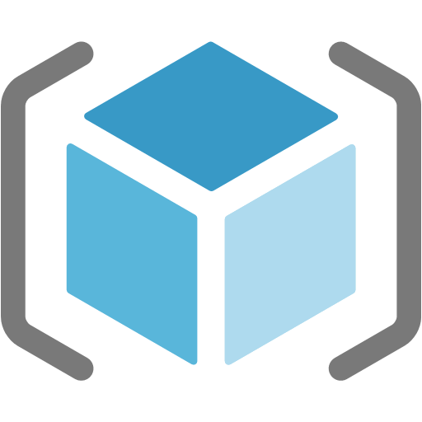
Subscription & ResourceGroups
Azure Subscription
Azure Resource Group
Notes:
A Windows Azure Subscription grants access to Azure Resources.
Billing is done by Microsoft on subscription Level. In Addittion, Subscription Owners have and can control access to all Resources in a Subscription, which includes giving Access to external Users.
Resource Groups are used to logically arrange Resources in Azure, that share the same Lifecycle. You deploy, update and delete them together.
A good practice is, to create a Resource group per service.
You can also control access to resources in azure on Resource Group Level.

Slide 7
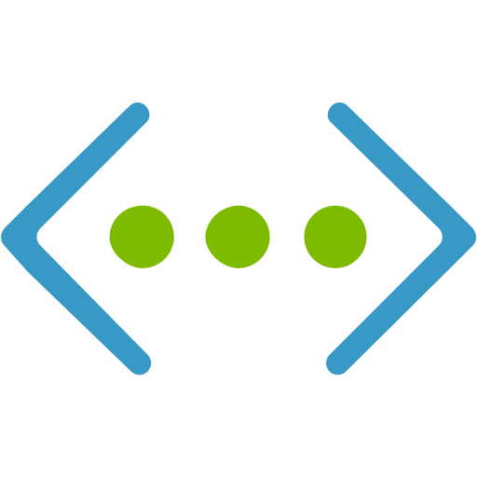
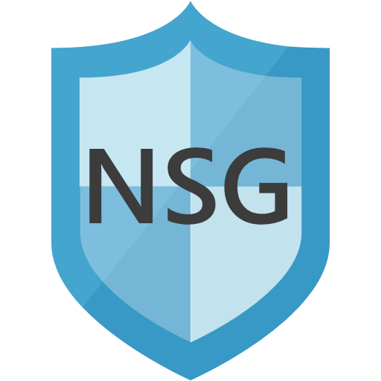

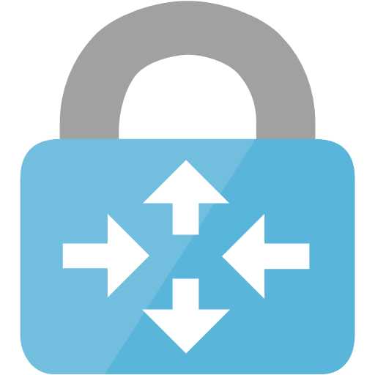
Azure Network Resources
Virtual Network
Network Security Group (NSG)
Network Interface
Public IP
VPN Gateway
Load Balancer
Notes:
Azure Virtual Network (vNet)
A vNet represents a Network for your Azure Resources. It can contain Subnets, custom routing, DNS Settings and can be secured with Network Security Groups. Setting up a custom DHCP Server is not allowed inside a vNet in Azure. Instead, IP-Addresses are managed via the Azure Portal or the various Azure APIs.
Every vNet is isolated from each other, while communication between different subnets inside a vNet is possible by default. However, vNets can be connected to other vNets in Azure or even on Premises Networks by using VPN Gateways.
Virtual Network Interface Card
A vNIC is used to provide Network Connectivity to Azure virtual Machines. vNICs can be assigned private and public IP Adresses and can be secured with Network Security Groups.
Each vNIC can be assigned one Virtual Machine, while Virtual Machines can be connected to multiple vNICs
Network Security Group (NSG)
NSGs are used to secure traffic to Azure Network interfaces or Subnets. Each NSG can contain multiple Security Rules and be connected to multiple NICs or Subnets.
But each NIC or Subnet can only be connected to one NSG.
Public IP Address
Public IP Addresses in Azure provide connectivity to Azure resources from the public Internet. It can serve as frontend Address for external Load Balancers or directly enabled on Azure virtual Network Interface Cards
Azure VPN Gateway
An Azure VPN Gateway is used to connect multiple Networks. This can be Azure Virtual Networks or On-Premises Networks.
To connect an Azure Virtual Network with your On-Premises Network, you also need a VPN Device in your On-Premises Network
Azure Load Balancer
Azure Load Balancers are used to provide a single access point (internal or external) and forward traffic to Machines in an availability Set.

Slide 8
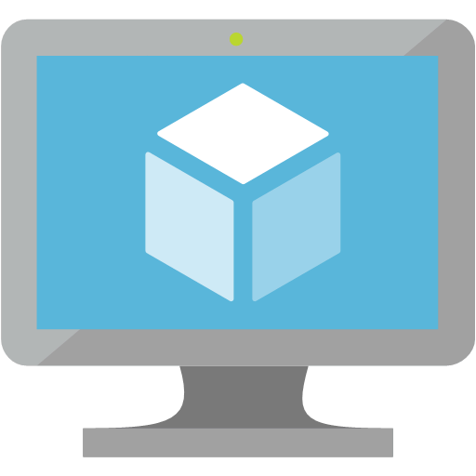
Azure Storage & Compute Resources
Storage Account
Managed Disk
Availability Set
Virtual Machine
Notes:
Storage Account
Storage Accounts are containers for different types of Data stored in Azure.
A Storage account can contain Blob, Table and File Storage. The most commonly used in Infrastructure Scenarios is Blob Storage, which is also the type, VHDs are stored in.
Since managed disks were introduced, nowadays, Storage Accounts are most likely used to store Diagnostics and Backup data.
Managed Disk
HA-Mechanisms for managed Disks are maintained automatically by Azure. If using Storage accounts with non-managed Disks, you have to ensure to use at least two different storage accounts to not have your disks on the same physical storage
Storage Account
A vNIC is used to provide Network Connectivity to Azure virtual Machines. vNICs can be assigned private and public IP Adresses and can be secured with Network Security Groups.
Each vNIC can be assigned one Virtual Machine, while Virtual Machines can be connected to multiple vNICs
Availability Set
Availability Sets provide Update and fault Domains to ensure, that at least one Machine is available at a time
Fault Domains ensure, virtual machines are running on different physical Hosts, while Update Domains ensure, That not every VM reboots the same time when installing Updates.
Having at least two Machines in an availability Set per Service is essential to make use of Microsoft’s SLA of 99,95%

Slide 9
Basic VM Deployment
vNet
Boot Diagnostics
OS
Disk
NIC
Public IP

Slide 10

Naming Conventions
Storage Account
Public IP
name.type.core.windows.net
name.region.cloudapp.azure.com
Globally unique name
Lower case letters only
No special characters
Location/Region unique name
Key Vault
name.vault.azure.net
Globally unique name
containing only (0-9, a-z, A-Z, and -)
Azure best Practices Naming Conventions

Slide 11
Hands On!

Slide 12
Infrastructure Deployment - Overview
Notes:
https://rakoellner-my.sharepoint.com/personal/raphael_koellner_rakoellner_com/_layouts/15/guestaccess.aspx?folderid=1c4f1691acbd84edf948ef88456e64e25&authkey=AclPyIMF4JE_1JaqF9dzYgI&expiration=2018-03-13T15%3A52%3A17.000Z&e=3373313e678b425e9f36df0cdaa155b4

Slide 13
HA Scenarios
Public IP
Availability Set
Load Balancer
Managed Disks
Virtual Network

Slide 14
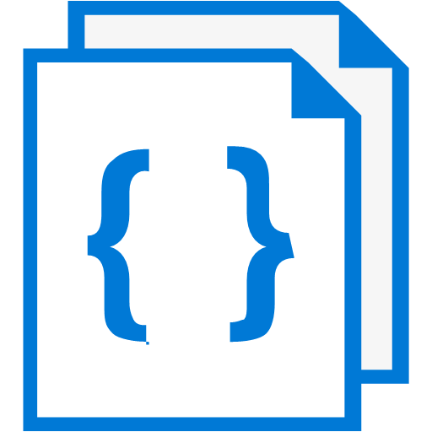
Nested deployments
Parent Template
Template Links
VM
VM
Network
Service 1
Service 2
Network

Slide 15
Hands On!

Slide 16
Template Deployment Process

