Slide 1



Keystone Engine
Assembler
Capstone Engine
Disassembler
Unicorn Engine
CPU Emulator

Slide 2
Keystone Engine
Assembler
Capstone Engine
Disassembler
Unicorn Engine
CPU Emulator
INC ECX;
DEC EDX;
INC ECX;
DEC EDX;
/x41/x4A
memory
ECX = 0x000009
EDX = 0x000005
/x41/x4A
/x41/x4A
ECX = 0x00000A
EDX = 0x000004

Slide 3
Supported Architectures
ARM, ARM64 (AArch64/Armv8)
Hexagon
MIPS
PowerPC
Sparc
SystemZ
X86 (16, 32, and 64bit)
Keystone Engine
Assembler

Slide 4
Available Bindings
C/C++ (native implementation)
PowerShell
Perl
Python
NodeJS
Ruby
Go
Rust
Haskell
OCaml
Keystone Engine
Assembler

Slide 5
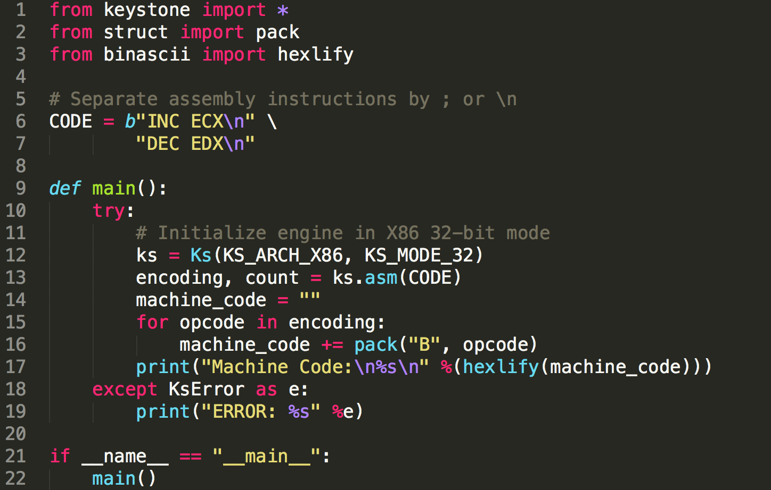
Keystone Engine Assembler

Slide 6
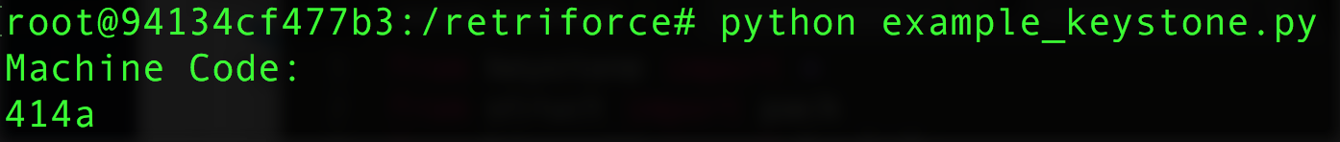
Keystone Engine Assembler

Slide 7
Supported Architectures
ARM, ARM64 (AArch64/Armv8)
MIPS
PowerPC
Sparc
SystemZ
XCore
X86 (16, 32, and 64bit)
Capstone Engine
Disassembler

Slide 8
Available Bindings
C (native implementation)
C++
PowerShell
Emacs
Haskell
Perl
Python
Ruby
C#
NodeJS
Java
Go
Ocaml
Lua
Rust
Delphi
Free Pascal
Vala
Capstone Engine
Disassembler

Slide 9
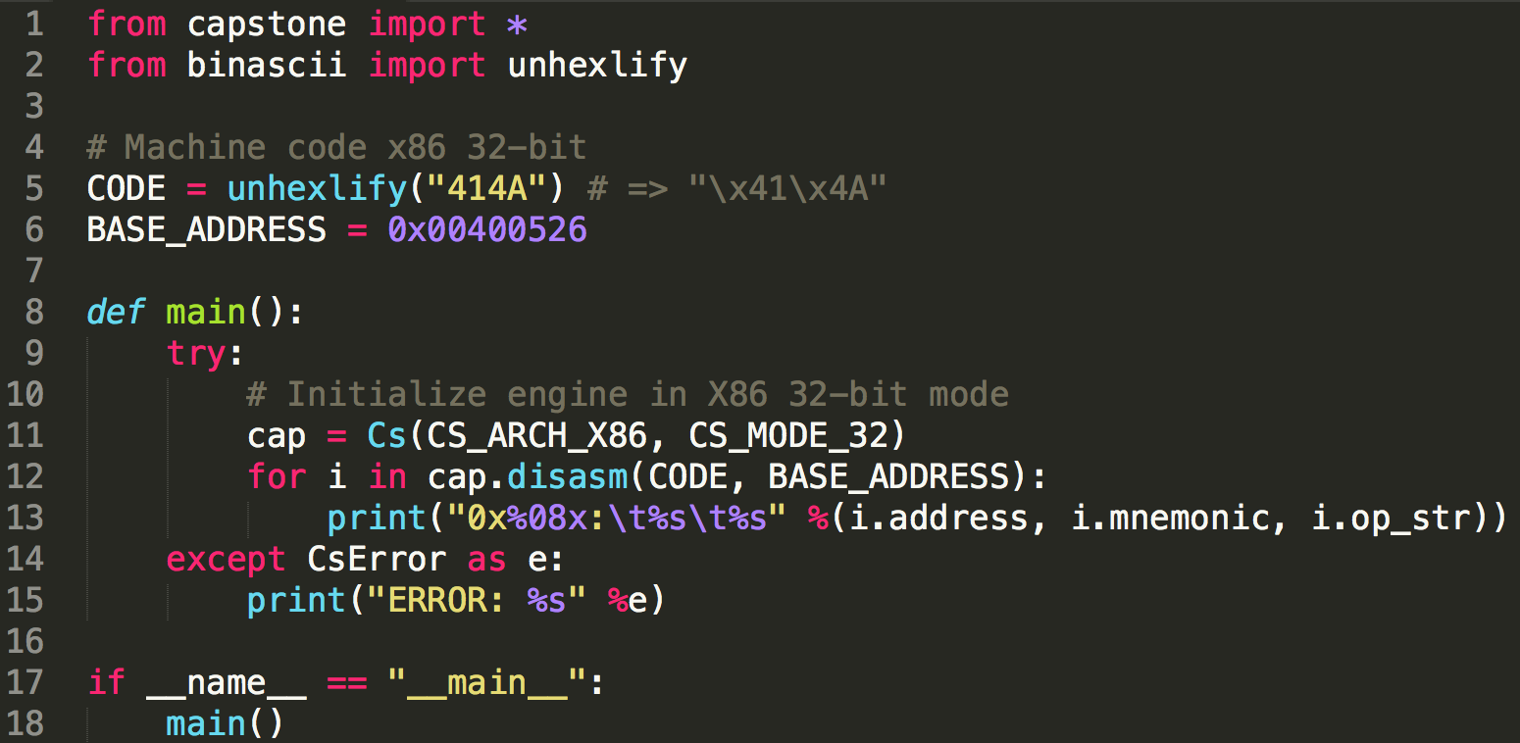
Capstone Engine Disassembler

Slide 10
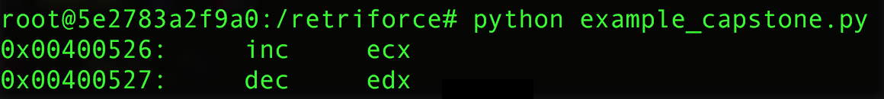
Capstone Engine Disassembler

Slide 11
Supported Architectures
ARM, ARM64 (Armv8)
M68K
MIPS
Sparc
X86 (16, 32, and 64bit)
Unicorn Engine
CPU Emulator

Slide 12
Available Bindings
C (native implementation)
Visual Basic
Perl
Rust
Haskell
Ruby
Python
Java
Go
C#
Delphi
Free Pascal
Unicorn Engine
CPU Emulator

Slide 13
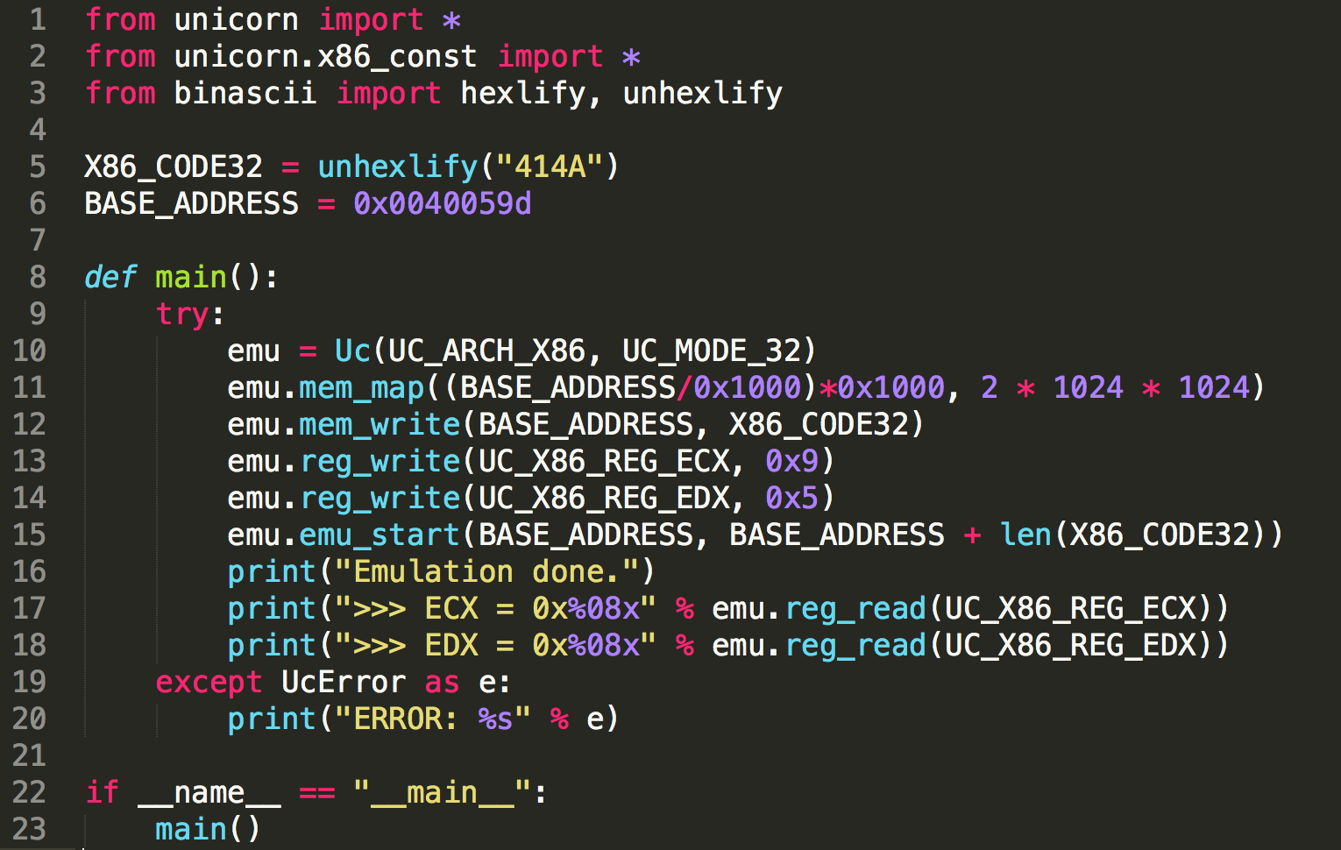
Unicorn Engine CPU Emulator

Slide 14
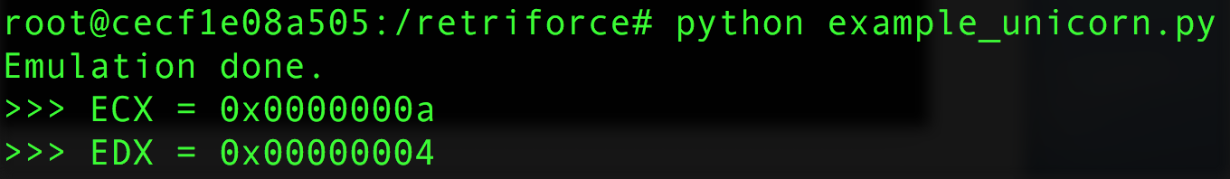
Unicorn Engine CPU Emulator

