Slide 1
building effective
language parsers for
penetration testers
columbus owasp
28 march 2019
john toterhi
cetfor@gmail.com

Slide 2





i like
breaking
software.
i’ve done it
for these organizations.

Slide 3
analyzing source code for bugs is hard for many reasons.
lexical ambiguity
variable state considerations
grammar complexity
variable scope
knowledge of source / sinks
effects of sanitization

Slide 4
before we jump into code parsing, let’s explore some fundamentals with english.

Slide 5
What does this sentence mean?
“I shot the elephant
in my pajamas.”

Slide 6
What does this sentence mean?
“I shot the elephant
in my pajamas.”
The shooter wore pajamas while shooting the elephant.
The elephant was wearing the shooter’s pajamas.

Slide 7
What does this sentence mean?
“He drove down the street in the car.”

Slide 8
What does this sentence mean?
“He drove down the street in the car.”
He was driving a car on the street.
The street he drove down was actually in his car.

Slide 9
What does this sentence mean?
“The complex houses married and single soldiers and their families.”

Slide 10
What does this sentence mean?
“The complex houses married and single soldiers and their families.”
1. The housing complex contains both married and single soldiers, as well as their families.

Slide 11
What does this sentence mean?
“Buffalo buffalo buffalo buffalo buffalo buffalo buffalo buffalo.”

Slide 12
What does this sentence mean?
“Buffalo buffalo buffalo buffalo buffalo buffalo buffalo buffalo.”
1. Bison from Buffalo,
New York, who are intimidated by other bison in Buffalo, New York also happen to intimidate other bison in Buffalo New York.

Slide 13
Some fun examples of lexical ambiguity
Kids make nutritious snacks
Milk drinkers are turning to powder
Drunk musician gets nine months in violin case
Man eating piranha mistakenly sold as pet fish
Include your children when baking cookies
Red tape holds up new bridge

Slide 14
linguistic principles: context-free grammars

Slide 15
formal definition of a context-free grammar
A context-free grammar can be defined as G = (N, Σ, R, S) where:
N is a set of non-terminal symbols
Σ is a set of terminal symbols
R is a set of rules
S ∈ N is a distinguished start symbol

Slide 16
A Simplified Context-free Grammar for English
G = (N, Σ, R, S) where:
N = { S, NP, VP, PP, DT, Vi, Vt, NN, IN, PR }
Σ = { sleeps, saw, man, woman, telescope, the, with, in }
R is the set of rules (or “derivations”) shown below
S = S
N
S | sentence
VP | verb phrase
NP | noun phrase
PP | prepositional phrase
DT | determiner
Vi | intransitive verb
Vt | transitive verb
NN | noun
IN | preposition
PR | pronoun
Σ
Vi | → | sleeps
Vt | → | saw
NN | → | man
NN | → | woman
NN | → | telescope
DT | → | the
IN | → | with
IN | → | in
PR | → | he
R
S | → | NP VP
VP | → | Vi
VP | → | Vt NP
VP | → | VP NP
NP | → | PR
NP | → | DT NN
NP | → | NP PP
PP | → | IN NP

Slide 17
Parse Tree for this Simplified Grammar
R
Σ
S | → | NP VP
VP | → | Vi
VP | → | Vt NP
VP | → | VP NP
NP | → | PR
NP | → | DT NN
NP | → | NP PP
PP | → | IN NP
Vi | → | sleeps
Vt | → | saw
NN | → | man
NN | → | woman
NN | → | telescope
DT | → | the
IN | → | with
IN | → | in
PR | → | he
S
NP VP
DT NN Vi
the man sleeps

Slide 18
Parse Tree for this Simplified Grammar
R
Σ
S | → | NP VP
VP | → | Vi
VP | → | Vt NP
VP | → | VP NP
NP | → | PR
NP | → | DT NN
NP | → | NP PP
PP | → | IN NP
Vi | → | sleeps
Vt | → | saw
NN | → | man
NN | → | woman
NN | → | telescope
DT | → | the
IN | → | with
IN | → | in
PR | → | he
S
NP VP
DT NN Vi
the man sleeps

Slide 19
ambiguity - “he drove down the street in the car”
S
parse tree 1
VP
NP
VP
PP
VP
PP
PR
IN
NP
IN
NP
Vi
DT
NN
DT
NN
he
drove
down
the
street
in
the
car

Slide 20
ambiguity - “he drove down the street in the car”
S
parse tree 1
VP
NP
VP
PP
VP
PP
PR
IN
NP
IN
NP
Vi
DT
NN
DT
NN
he
drove
down
the
street
in
the
car

Slide 21
ambiguity - “he drove down the street in the car”
S
parse tree 2
VP
NP
PP
VP
IN
NP
PR
NP
PP
Vi
IN
NP
DT
NN
DT
NN
he
drove
down
the
street
in
the
car

Slide 22
ambiguity - “he drove down the street in the car”
S
parse tree 2
interpreted as:
the street was in the car
VP
NP
PP
VP
IN
NP
PR
NP
PP
Vi
IN
NP
DT
NN
DT
NN
he
drove
down
the
street
in
the
car

Slide 23
lexing & parsing using context-free grammars

Slide 24
lexing / tokenization
lexing is the process of breaking an input stream into discrete components (lexemes) and applying defining characteristic information to them.
lexing is a fancy word for tokenization, lexeme is a fancy word for token
var
fruit
= “apple”;
type: Literal
start: 14
end: 21
value: “apple”
raw: “\“apple\””
type: Identifier
start: 6
end: 11
name: “fruit”
type: VariableDeclaration
start: 0
end: 22
kind: “var”

Slide 25
parsing
Program
parsing is the process of applying structure to an input token stream.
Statement
var fruit = “apple”;
VariableDeclaration
identifier
literal
var
fruit
apple

Slide 26
question:
can you spot the vulnerability in this javascript code?

Slide 27
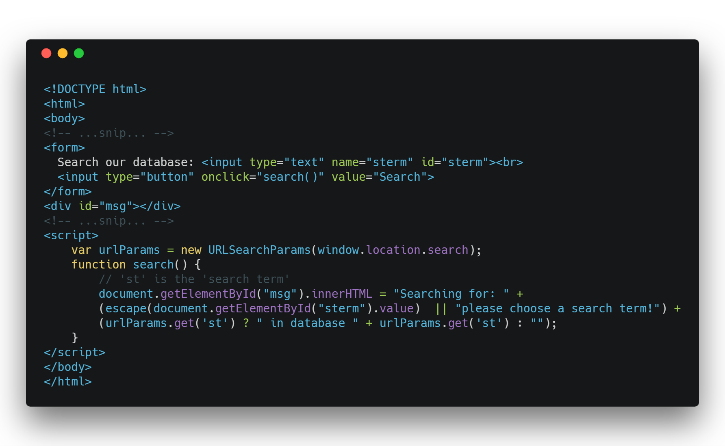

Slide 28
var urlParams = new URLSearchParams(window.location.search);
function search() {
// 'st' is the 'search term'
document.getElementById("msg").innerHTML = "Searching for: " +
(escape(document.getElementById("sterm").value) || "please choose a search term!") + (urlParams.get('st') ? " in database " + urlParams.get('st') : "");
}

Slide 29
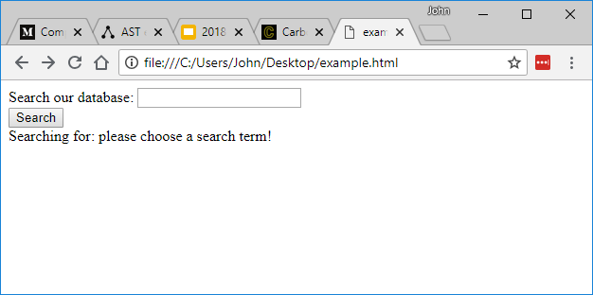

Slide 30
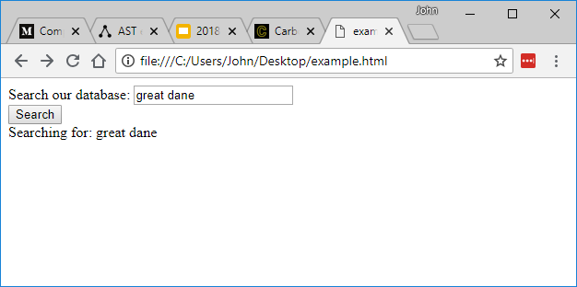

Slide 31
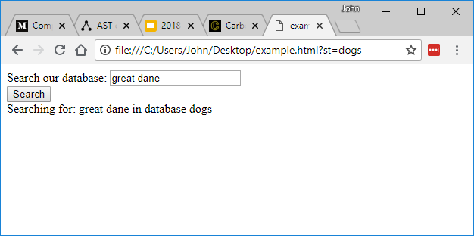

Slide 32
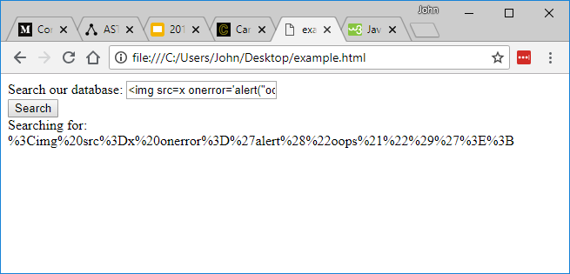
this is
escape()
at work

Slide 33
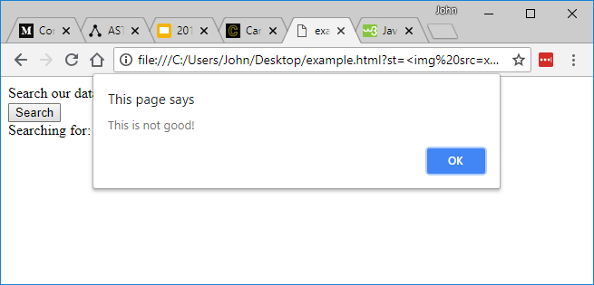

Slide 34
source
sink
sanitize

Slide 35
var urlParams = new URLSearchParams(window.location.search);
function search() {
// 'st' is the 'search term'
document.getElementById("msg").innerHTML = "Searching for: " +
(escape(document.getElementById("sterm").value) || "please choose a search term!") + (urlParams.get('st') ? " in database " + urlParams.get('st') : "");
}
source
sink
sanitize

Slide 36
can you automate this process using grep or regex?

Slide 37
can you automate this process using grep or regex?
you can:
find sources of user-controlled data
find vulnerable sinks
look for sanitization functions
you cannot:
determine the relationships between sources, sinks, and sanitizers
resolve variable scope easily
deconflict ambiguous variable names

Slide 38
automating this process using parsing strategies.

Slide 39

let’s use ANTLR as our lexer / parser generator, to build parse trees and walk them looking for issues.

Slide 40
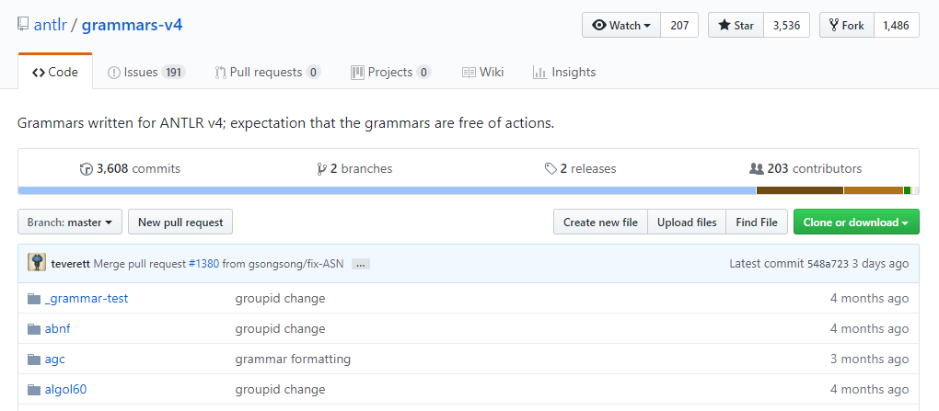
currently 190 grammars available

Slide 41
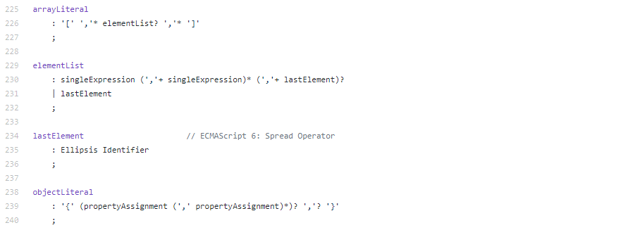
extended backus-naur form (EBNF)

Slide 42
1.
CONTEXT-FREE GRAMMAR
(EBNF)
2.
ANTLR
(Java)
3.
4.
SOURCE CODE
5.
LEXER
Token 1
7.
PARSER
6.
Token 2
Token N
Step 9 is where the real work begins
Parse Tree -> AST -> UAST
Key / Pattern Matching
Stack evaluation / management
Global symbol table evaluation / management
Source, Sink Analysis
Taint Analysis
Symbolic Execution
Constraint Solving
8.
PARSE TREE
9.
YOUR
CUSTOM
ANALYSIS
TOOLING

Slide 43


demo:
fun with improvisational parsers (fwip)
github.com/cetfor/fwip

Slide 44
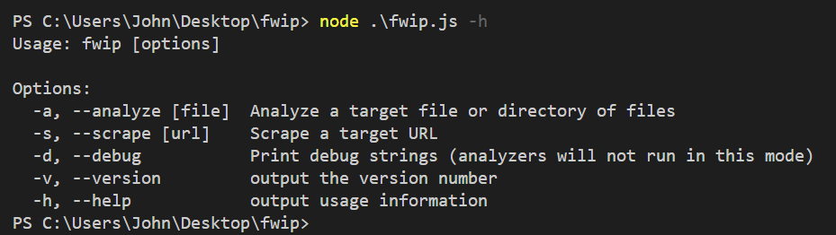
using fwip: help

Slide 45
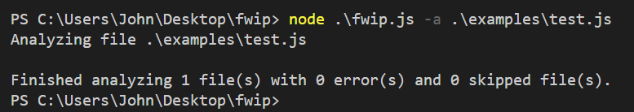
using fwip: analyzing a file

Slide 46
Program
remember this example parse tree?
Statement
VariableDeclaration
identifier
literal
var
fruit
apple

Slide 47
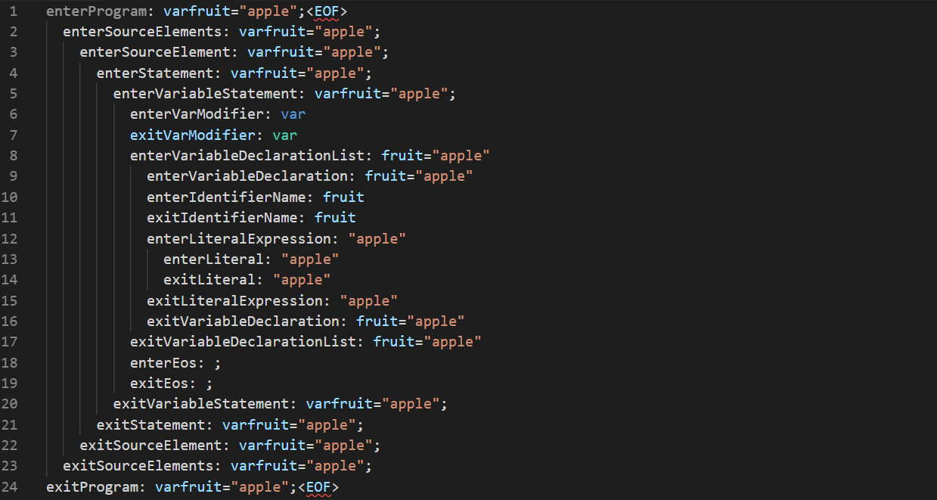
this is the result of
node .\fwip.js -a test.js --debug
where
test.js
is just
var fruit = “apple”;

Slide 48
let’s revisit our example vulnerable code and build an analyzer.

Slide 49
what we want to check for:
is a dangerous sink used?
is data from a user-controlled source passed to the sink?
iff, is a sanitize function used on the source data?

Slide 50
we’ll use the
fwip --debug switch to see what elements we should check.

Slide 51
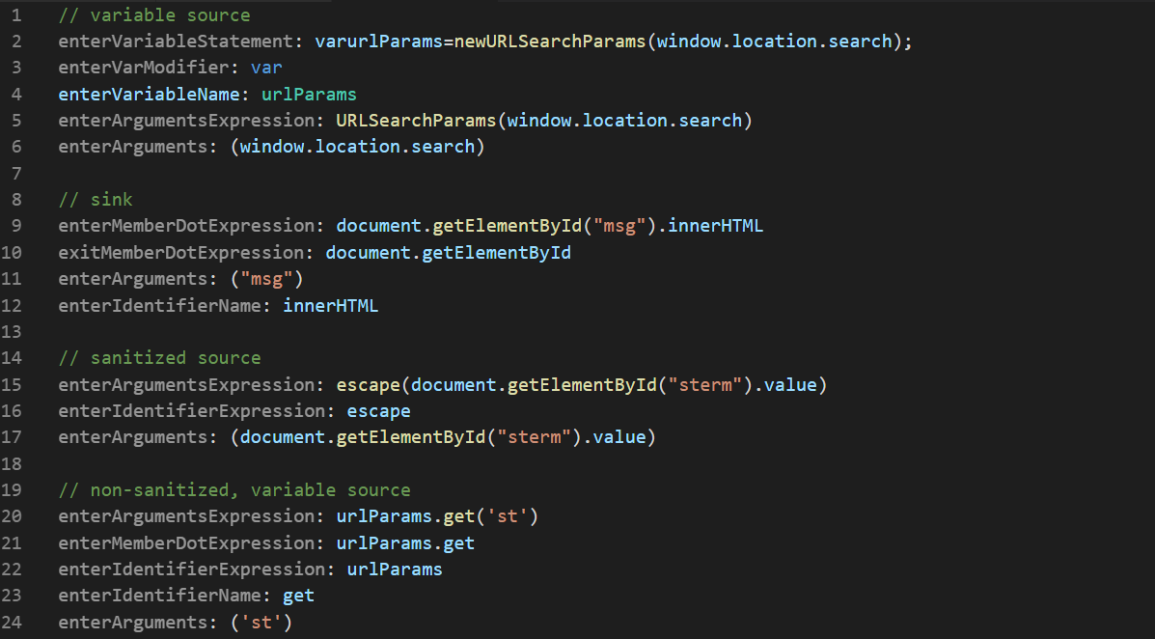
select results of
node .\fwip.js -a owasp.html --debug

Slide 52
there are many ways we could analyze this code. we’ll go really simple by using a stack (an array)
const stack = [
// interesting stuff goes here
]

Slide 53
whenever we enter interesting conditions, we’ll push select leaf nodes to the stack.
const stack = [
// interesting stuff goes here
]
enterMemberDotExpression:
document.getElementById(“msg”).innerHTML
…
enterIdentifierName:
innerHTML
…
exitMemberDotExpression:
document.getElementById(“msg”).innerHTML
stack.push(‘innerHTML’)
stack = [
‘innerHTML’,
]

Slide 54
when parsing completes we’ll call our analyzers on the program “state” we’ve built using stacks.

Slide 55
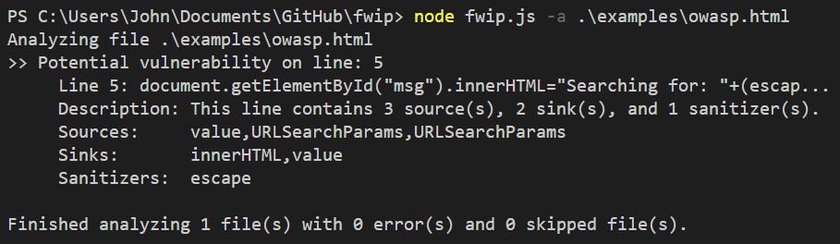
now onto demos and code.

