Slide 1


CYBERWAL
Date 15/12/22
Cours sur les tests
Travaux Pratiques
G. Ginis, X. Devroey
https://cyberwal.be
https://cyberexcellence.be

Slide 2
Agenda
Use case
Certification
The Use Case Protection Profile
Impact analysis : Update of the Firewall
What type of certification?
What type of evidence to provide?
Fuzzing
Random Fuzzing
Let’s spy communication
Frame decoding
Mutation Fuzzing
Fuzzing with grammar

Slide 3
But First
For the fuzzing test, you will need the ubuntu VM on the Dashboard
Download it directly or I can give you a USB key with the ova file
The ova file can be imported in Oracle virtualbox or VMWare Fusion
Before booting, ensure :
The network card of the VM is configured as NAT
The amount of CPU/Memory is compatible with your computer
After the first boot, empty the fie /home/ws/.ssh/known_hosts
echo > /home/ws/.ssh/known_hosts

Slide 4

Use Case
Continuous Assessment in Polymorphous Environments

Slide 5
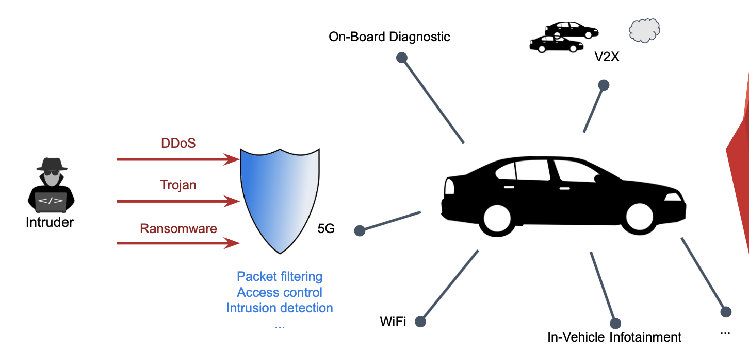
Connected Vehicule

Slide 6
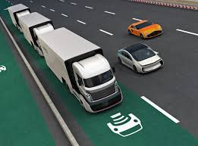
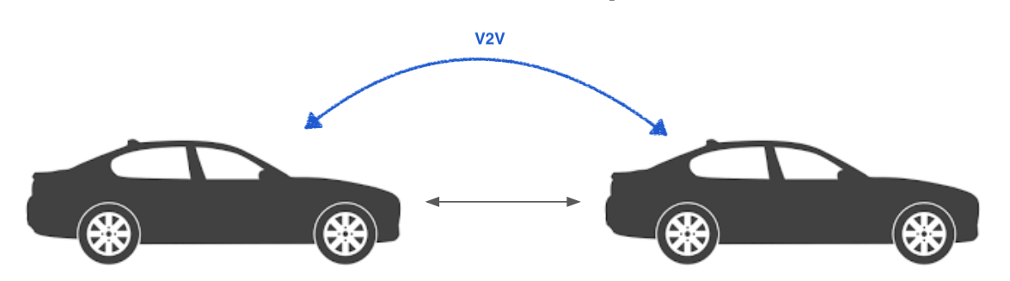
Platooning
One leader vehicule is followed by X other vehicules automatically following.
The vehicules can exchange information on a V2V (vehicule to vehicule) interface or the follower uses sensors to keep distance and direction.

Slide 7
Attack example
See Google Ppt

Slide 8
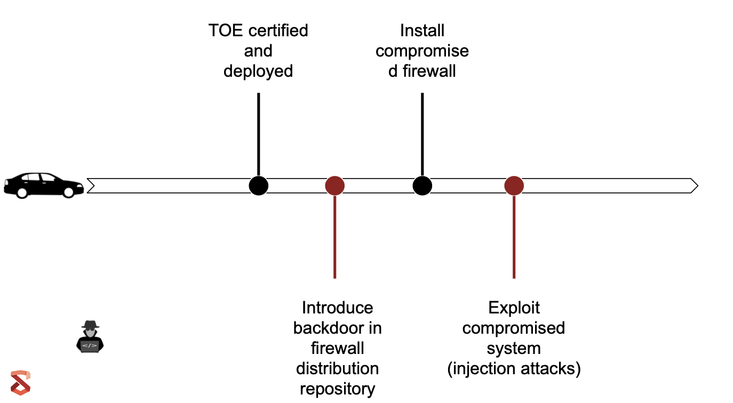
Attack example

Slide 9

Certification

Slide 10
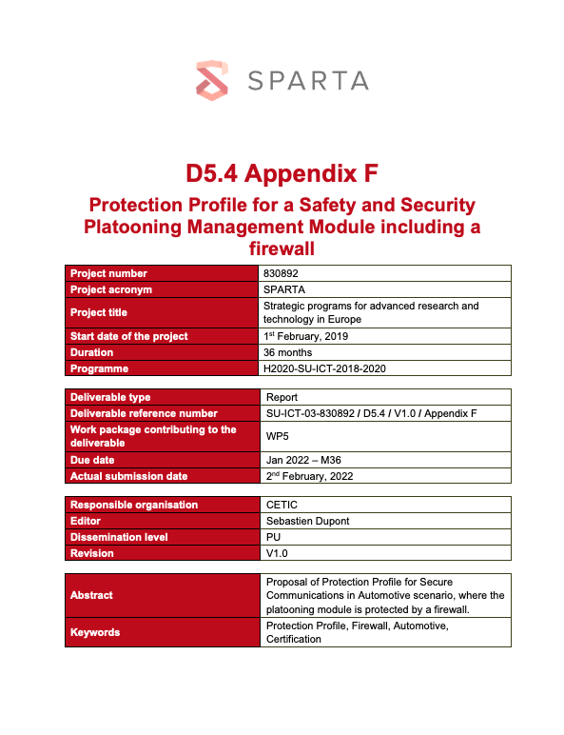
Certification
Reading of the initial Protection Profile / Security Target
All the files are available in the following git :
https://github.com/cetic/certif-tp.git
git clone https://github.com/cetic/certif-tp.git

Slide 11
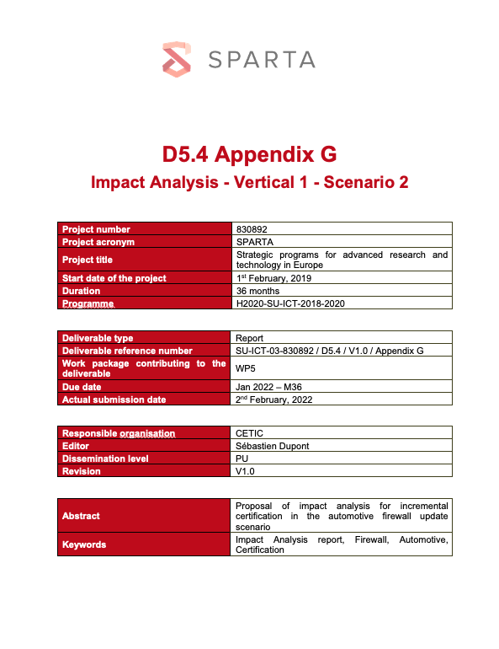
Certification
Impact Analysis : What type of certification to choose?
See file Impact Analysis part1
Answer the questions and identify correctly the impact of the update to be done

Slide 12
Certification
Impact Analysis : What type of evidences to provide?
See Impact Analysis part 2

Slide 13
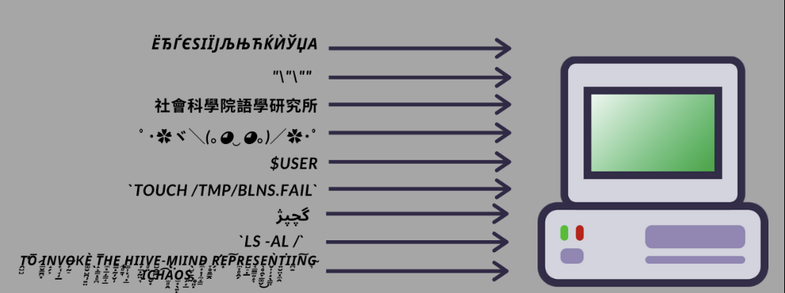
Fuzzing
Vulnerability discovery using Fuzzing on ROS protocol

Slide 14


Fuzzing
What is Fuzz?
Sending random or pseudo-random input to programs or systems and see how they behave (correctly vs incorrectly vs crash).
« Akezh49iehcç&éç! »§ »
« Akezh49iehcç&éç! »§ »
Error (« System not responding »)
Error (« System not responding »)

Slide 15
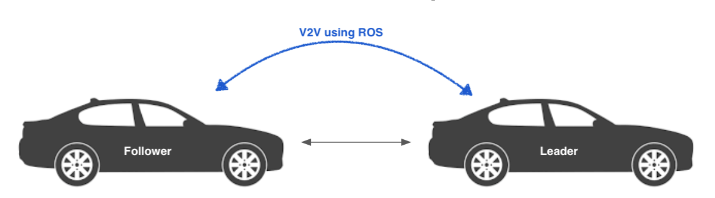
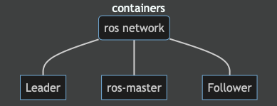
Fuzzing
Let’s do the V2V communication using Ros Protocol
Ros Protocol v1 :
Publish/Subscribe mechanism with topics
Use a master to manage communication
No encryption
No authentication
Basically No security

Slide 16
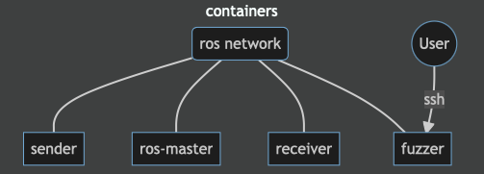
Fuzzing
Random Fuzzing
Let’s start by setting up the exercise
Either start the Ubuntu VM and go to the fuzzing folder on the desktop of the Virtual Machines
Or clone the git repository :
git clone https://github.com/cetic/winterschool-tp.git
Build the setup :
Either use the RebuildTP Script then StartTP script in the VM (launch in a command line or Right-Click run as a program)
Or use the launchTP scripts in the cloned repository
Exercise Password : WS_pwd2022

Slide 17
Fuzzing
Let’s verify the setup :
Either use the Verify script in the VM
Or use tail to see if the logs are updated :
tail –f /var/log/ros/test.log
You should also be able to connect to the fuzzer container now :
Use the Connect script in the VM or
ssh –p 11322 ws@localhost
Let’s Fuzz
The fuzzer that was created for the exercises fuzzes the ROS protocol and is called “Rachel”
To fuzz using random inputs we can use the following call:
python3.9 rachel.py –t sender –r 1 –a
What result do you see?
Try to see the logs of the receiver : docker logs ﻿winterschool-tp_receiver_1
Exercise Password : WS_pwd2022

Slide 18
Fuzzing
Let’s Fuzz smarter
What does the communication looks like? Maybe it’s time to spy…
Use Ettercap to make an ARP Man-in-The-Middle and capture the communications between the sender and the receiver
Can you catch the Flag?
﻿ettercap help :
Usage: ettercap [OPTIONS] [TARGET1] [TARGET2]
TARGET is in the format MAC/IP/IPv6/PORTs (see the man for further detail)
Sniffing and Attack options:
-M, --mitm <METHOD:ARGS> perform a mitm attack
User Interface Type:
-T, --text use text only GUI
-q, --quiet do not display packet contents
-s, --script <CMD> issue these commands to the GUI
Logging options:
-w, --write <file> write sniffed data to pcapfile <file>
-L, --log <logfile> log all the traffic to this <logfile>
-l, --log-info <logfile> log only passive infos to this <logfile>
-m, --log-msg <logfile> log all the messages to this <logfile>
-c, --compress use gzip compression on log files
…
Exercise Password : WS_pwd2022
Hint : Sender and Receiver shall have 172.18.0.4 and 172.18.0.5 addresses

Slide 19
Fuzzing
Let’s Fuzz smarter
We can use a parameter to provide anything we want to the Rachel fuzzer and it will be used as the basis for mutation fuzzing. The mutation strategy chosen is the coverage of the message. That means mutations will happen on the original message and not on the already mutated message.
python3.9 rachel.py –t sender –r 1 –m “<message to mutate>” –s <number of mutations>
Use here as message to mutate, what you get from spying communication. It should be a string so special character may nedd to be escaped with \
What result do you see?
Try to see the logs of the receiver : docker logs ﻿winterschool-tp_receiver_1
Exercise Password : WS_pwd2022
Hint : Sender and Receiver shall have 172.18.0.4 and 172.18.0.5 addresses

Slide 20
Fuzzing
Let’s Fuzz even smarter
Have a look at the grammar.py file
It defines a message structure to allow Rachel to Fuzz only some part of the messages
﻿EXAMPLE: Grammar = {
"<start>": ["<phone-number>"],
"<phone-number>": ["(<area>)<exchange>-<line>"],
"<area>": ["<lead-digit><digit><digit>"],
"<exchange>": ["<lead-digit><digit><digit>"],
"<line>": ["<digit><digit><digit><digit>"],
"<lead-digit>": ["2", "3", "4", "5", "6", "7", "8", "9"],
"<digit>": ["0", "1", "2", "3", "4", "5", "6", "7", "8", "9"]
}
Try to define your own grammar and start Fuzzing :
python3.9 Rachel.py -t sender -r 1 -g 10
Exercise Password : WS_pwd2022
Hint : Sender and Receiver shall have 172.18.0.4 and 172.18.0.5 addresses

Slide 21
Merci de votre attention

