Slide 1
Diffusion
Overview of today’s lecture

Slide 2
What is diffusion?
Reactions and processes in materials are based on mass transportation which is carried out in a solid or come towards to a solid from a liquid/gas or from a different solid phase.
Phenomenon of material/matter transport by atomic motion.
Often think of diffusion in a medium where atoms are relatively free to move around such as liquids and gases…
So, why do we care about diffusion in solids?
e.g. Materials processing
Many materials are heat treated to achieve necessary properties: prefer to develop methods that will allow relatively high diffusion rates to achieve an efficient/cost-effective process (e.g. alloying, casehardening etc…)

Slide 3
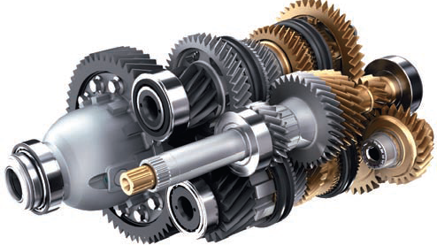

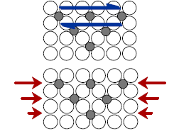
PROCESSING USING DIFFUSION (1)
• Case Hardening:
--Diffuse carbon atoms
into the host iron atoms
at the surface.
--Example of interstitial
diffusion is a case
hardened gear.
Case-hardened steel gears are used in automobile transmissions
Result: The "Case" is:
--hard to deform: C atoms
"lock" planes from shearing.
--hard to crack: C atoms put
the surface in compression.

Slide 4
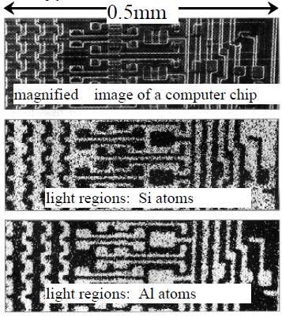
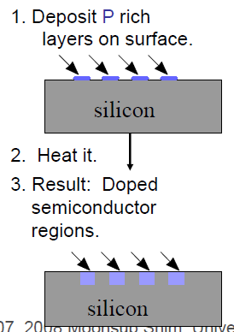
PROCESSING USING DIFFUSION (2)
Doping Silicon with Al for semiconductors:
Process:
Al

Slide 5
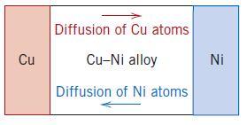
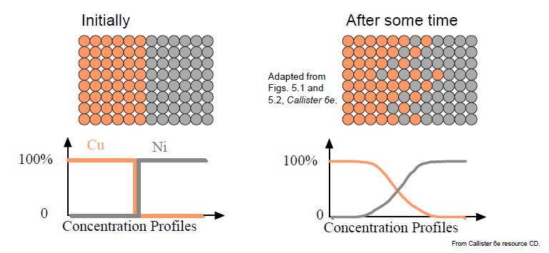
DIFFUSION: THE PHENOMENON
joining bars of copper and nickel
This couple is heated for an extended period at an elevated temperature (but below the melting temperature of both metals) and cooled to room temperature.
interdiffusion, or impurity diffusion.

Slide 6
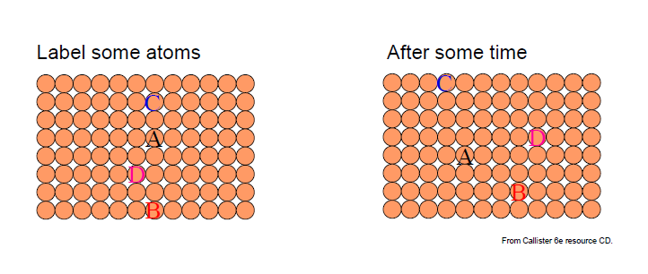
DIFFUSION: THE PHENOMENON
Self-diffusion: Atoms within one material exchanging positions. (i.e. in an elemental solid, atoms also migrate).
After heat treatment and cooling

Slide 7
DIFFUSION MECHANISMS
How do atoms move in a crystalline solid?
For diffusion to occur:
1. Adjacent site needs to be empty (vacancy or interstitial).
2. Sufficient energy must be available to break bonds and overcome lattice distortion.
(At a specific temperature some small fraction of the total number of atoms is capable of diffusive motion, due to the magnitudes of their vibrational energies. This fraction increases with rising temperature.)
There are many possible mechanisms but let’s consider the simple cases:
1. Vacancy diffusion.
2. Interstitial diffusion.

Slide 8
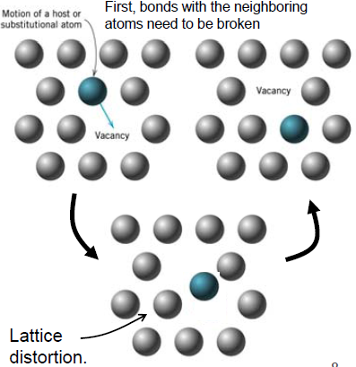
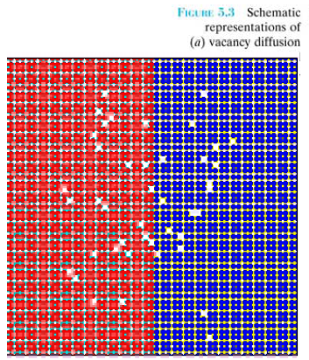
1-Vacancy diffusion
The interchange of an atom from a normal lattice position to an adjacent vacant lattice site or vacancy.
Significant concentrations of vacancies may exist in metals at elevated temperatures

Slide 9
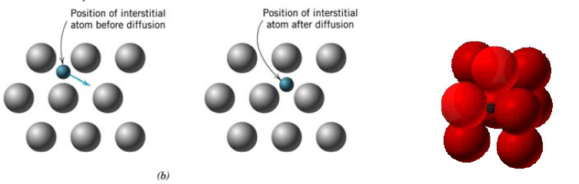
2-Interstitial Diffusion
migration from one interstitial site to another (mostly for small atoms that can be interstitial impurities: e.g. H, C, N, and O).
In many metal alloys:
interstitial diffusion occurs much more rapidly than diffusion by the vacancy mode
because interstitial atoms are very small and have high tendency to move.
there are more empty interstitial positions than vacancies; hence, the probability of interstitial atomic movement is greater than for vacancy diffusion.

Slide 10
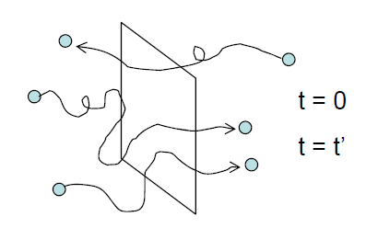
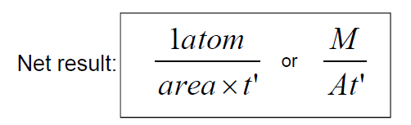
MODELING DIFFUSION: FLUX
Consider atoms (or mass, M) going through a plane
-
+
! Diffusion is a function of time.
2 atoms passed from left to
right (+ direction)
1 atom passed from right
to left (- direction)

Slide 11
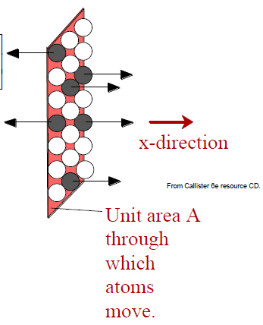
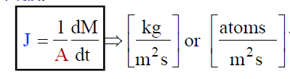
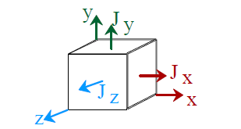
MODELING DIFFUSION: FLUX
Diffusion flux (J): defined as the mass (or, equivalently, the number of atoms) M diffusing through and perpendicular to a unit cross-sectional area of solid per unit of time.
A: area across which diffusion is occurring;
t: diffusion time. M: mass
Directional Quantity
Flux can be measured for:
--vacancies
--host (A) atoms
--impurity (B) atoms
In general: diffusion flux may or may not be the same over time

Slide 12
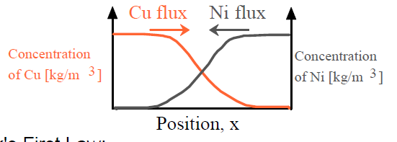
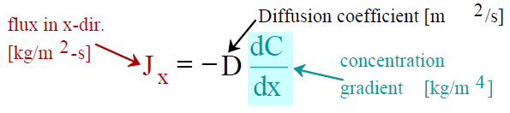
MODELING DIFFUSION: FLUX
What causes net flow of atoms?
• Concentration Profile, C(x): [kg/m³]
Slope at one point of this curve gives concentration gradient.
Fick's First Law (rate of diffusion )
J is proportional with concentration gradient.
Driving force is concentration gradient.
The steeper the concentration profile, the greater the flux!

Slide 13
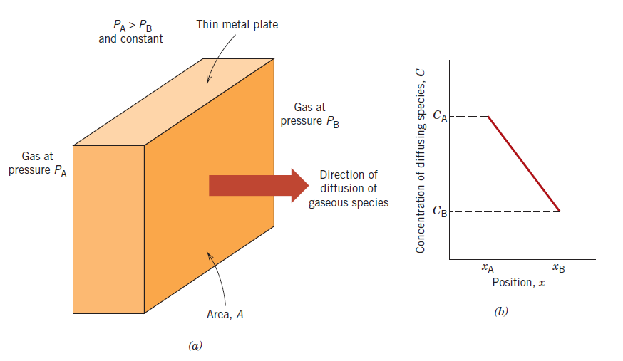

STEADY-STATE DIFFUSION (J= constant)
If the diffusion flux does not change with time, a steady-state condition exists.
One common example: atoms of a gas through a plate of metal for which the concentrations (or pressures) of the diffusing species on both surfaces of the plate are held constant.
e.i: the purification of hydrogen gas via palladium metal plate.
Concentration gradient
$$\frac{∆C}{∆x}=\frac{CA−CB}{xA−xB}$$
(a) Steady-state diffusion across a thin plate. (b) A linear concentration profile for the diffusion situation in (a).

Slide 14
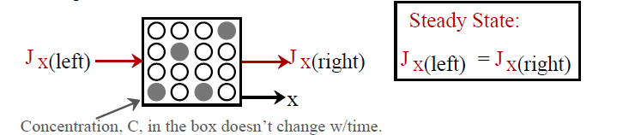
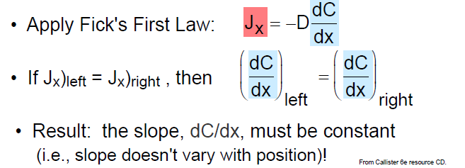
STEADY-STATE DIFFUSION

Slide 15
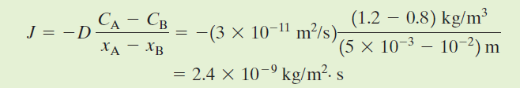
Example : STEADY-STATE DIFFUSION
A plate of iron is exposed to a carburizing (carbon-rich) atmosphere on one side and a decarburizing (carbon-deficient) atmosphere on the other side at 700°C (1300F).
If a condition of steady state is achieved, calculate the diffusion flux of carbon through the plate if the concentrations of carbon at positions of 5 and 10 mm beneath the carburizing surface are 1.2 and 0.8 kg/m³, respectively. Assume a diffusion coefficient of 3 x10⁻¹¹ m²/s at this temperature.

Slide 16
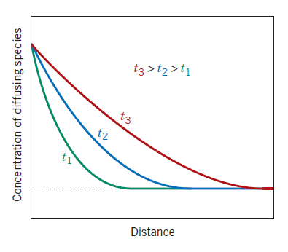

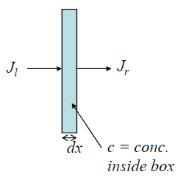
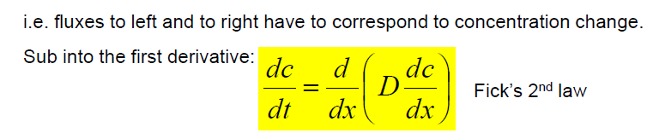



NONSTEADY-STATE DIFFUSION
Most practical diffusion situations
the diffusion flux and the concentration gradient at some particular point in a solid vary with time, with a net accumulation or depletion of the diffusing species resulting
Concentration profiles for nonsteady-state diffusion taken at three different times, t1, t2, and t3.
(steady-state)
Take the first derivative w.r.t. x:
Conservation of mass:
Partial differential equation. We’ll need boundary conditions to solve…

Slide 17


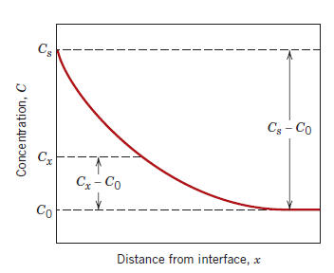
NONSTEADY-STATE DIFFUSION
These boundary conditions are simply stated as
For t =0, C =C₀ at 0 ≤x≤ ∞
For t > 0, C=Cs (the constant surface concentration) at x 0
C = C₀ at x = ∞
Application of these boundary conditions to
Cx : the concentration at depth x after time t.
erf(x/2√Dt): Gaussian error function
The relationship between concentration, position, and time—namely, that Cx, being a function of the dimensionless parameter x/√Dt which may be determined at any time and position if the parameters C₀, C_{S}, and D are known.
Concentration profile for nonsteady-state diffusion

Slide 18
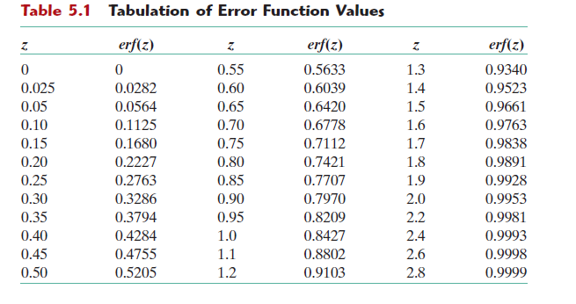
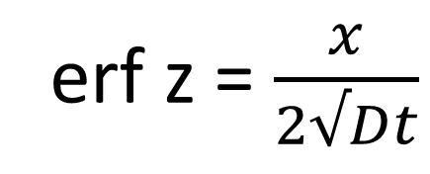
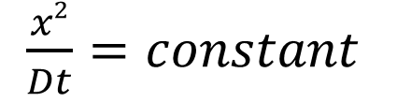
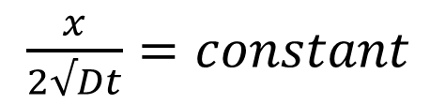
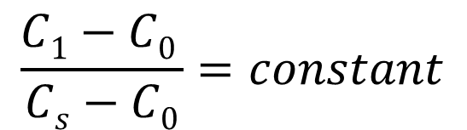
erf z = $\frac{x}{2√Dt}$
if some specific concentration of solute (C₁) is desired in an alloy:
$$\frac{C1−C0 }{Cs−C0}=constant$$
$\frac{x}{2√Dt}=constant$
$\frac{x2}{Dt}=constant$

Slide 19
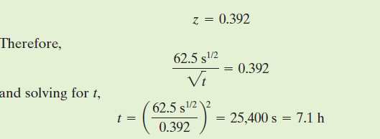
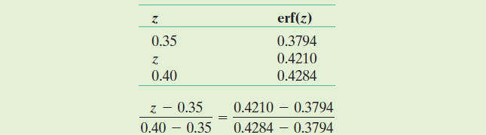
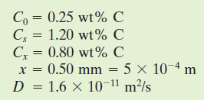
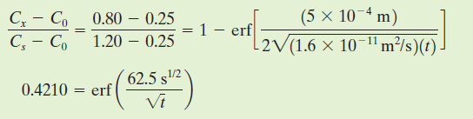

NONSTEADY-STATE DIFFUSION
EXAMPLE PROBLEM:
For some applications, it is necessary to harden the surface of a steel (or iron–carbon alloy) above that of its interior. One way this may be accomplished is by increasing the surface concentration of carbon in a process termed carburizing; the steel piece is exposed, at an elevated temperature, to an atmosphere rich in a hydrocarbon gas, such as methane (CH₄).
Consider one such alloy that initially has a uniform carbon concentration of 0.25 wt% and is to be treated at 950°C (1750F). If the concentration of carbon at the surface is suddenly brought to and maintained at 1.20 wt%, how long will it take to achieve a carbon content of 0.80 wt% at a position 0.5 mm below the surface? The diffusion coefficient for carbon in iron at this temperature is 1.6x10⁻¹¹ m²/s; assume that the steel piece is semi-infinite.
Solution

Slide 20




EXAMPLE PROBLEM: The diffusion coefficients for copper in aluminum at 500 and 600°C are 4.8×10⁻¹⁴ and 5.3×10⁻¹³ m²/s, respectively. Determine the approximate time at 500°C that will produce the same diffusion result (in terms of concentration of Cu at some specific point in Al) as a 10 h heat treatment at 600° C.
The composition in both diffusion situations will be equal at the same position.

Slide 21
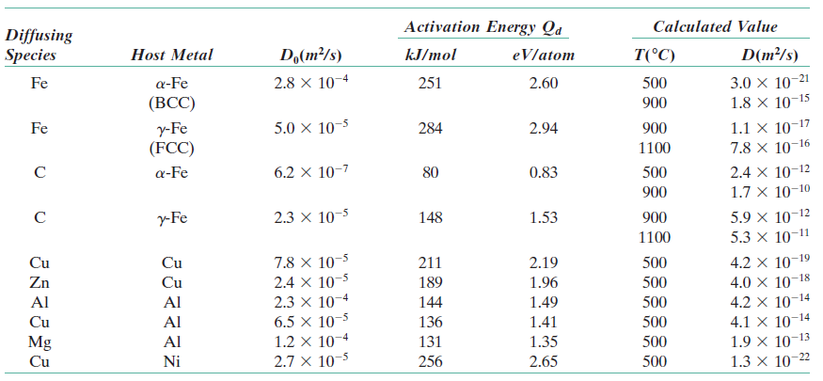
FACTORS THAT INFLUENCE DIFFUSION
1- Diffusing Species
The magnitude of the diffusion coefficient D is indicative of the rate at which atoms diffuse.
The diffusion coefficient is function of species as well as the host material influence
D_{C→Fe} >>D_{Fe→Fe} => interstitial diffusion is easier than self-difusion ( many interstitial sides compared to vacancies.)

Slide 22

FACTORS THAT INFLUENCE DIFFUSION
2- Temperature
The most profound influence on the coefficients and diffusion rates
D₀ = a temperature-independent material constant (m²/s)
Q_{d} = the activation energy for diffusion (J/mol or eV/atom)
R = the gas constant, 8.31 J/mol.K or 8.62×10⁻⁵ eV/atom.K
T = absolute temperature (K)
The activation energy may be thought of as that energy required to produce the diffusive motion of one mole of atoms.
A large activation energy results in a relatively small diffusion coefficient

Slide 23
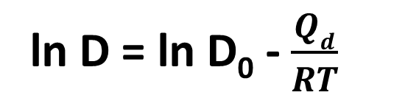
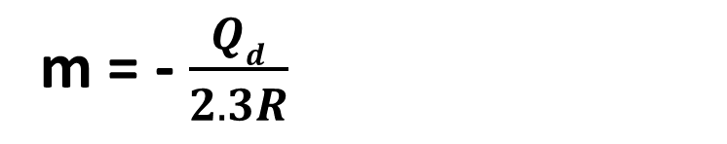

ln D = ln D₀ - $\frac{Qd}{RT}$
log D = log D₀ - $\frac{Qd}{2.3RT}$
y = b + mx
if log D – 1/T cuve is plotted
b = log D_{o}
m = - $\frac{Qd}{2.3R}$

Slide 24
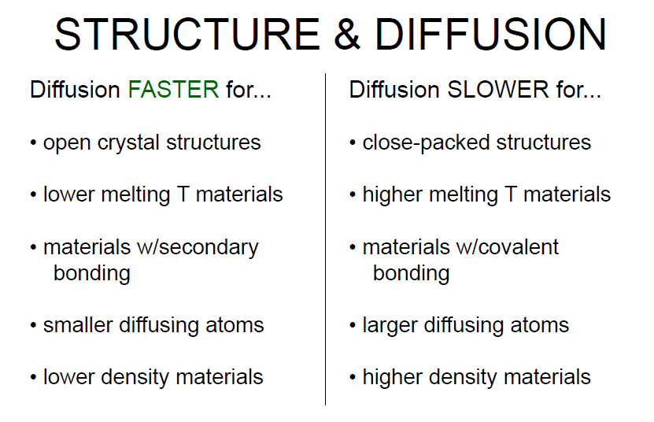
FACTORS THAT INFLUENCE DIFFUSION

Slide 25

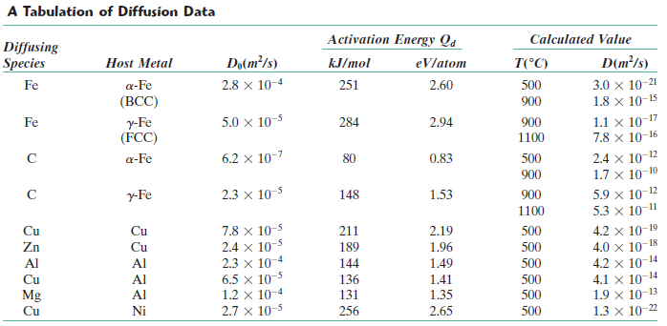

EXAMPLE PROBLEM: Using the data in the Table, compute the diffusion coefficient for magnesium in aluminum at 550°C.

Slide 26
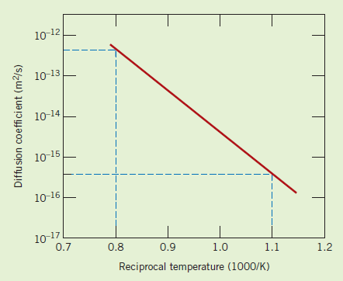

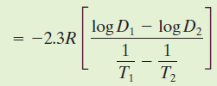


EXAMPLE PROBLEM: A plot of the logarithm (to the base 10) of the diffusion coefficient versus reciprocal of absolute temperature is shown below, for the diffusion of copper in gold. Determine values for the activation energy and the pre-exponential.
log D = log D₀ - $\frac{Qd}{2.3RT}$
Slope = - $\frac{Qd}{2.3R}$

Slide 27
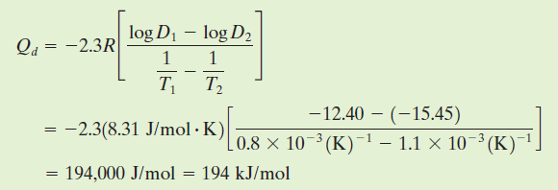

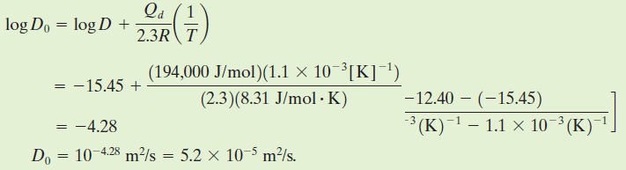

Slide 28
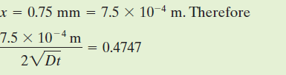
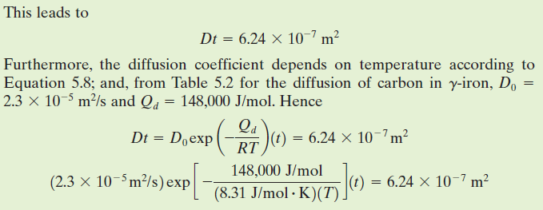

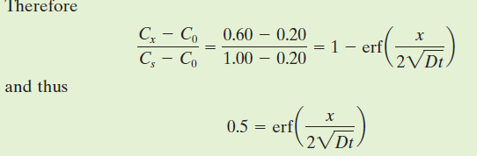

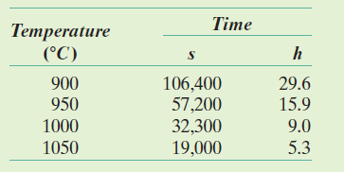
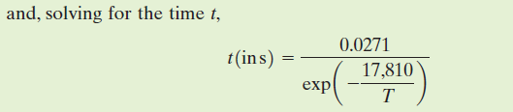
Example : Diffusion Coefficient Determination
The wear resistance of a steel gear is to be improved by hardening its surface. This is to be accomplished by increasing the carbon content within an outer surface layer as a result of carbon diffusion into the steel; the carbon is to be supplied from an external carbon-rich gaseous atmosphere at an elevated and constant temperature. The initial carbon content of the steel is 0.20 wt%, whereas the surface concentration is to be maintained at 1.00 wt%. For this treatment to be effective, a carbon content of 0.60 wt% must be established at a position 0.75 mm below the surface. Specify an appropriate heat treatment in terms of temperature and time for temperatures between 900 and 1050C. Use data in Table 5.2 for the diffusion of carbon in Ὑ-iron.
Solution
this is a nonsteady-state diffusion situation

Slide 29

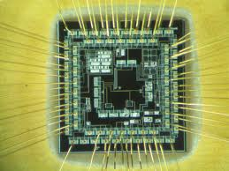

DIFFUSION IN SEMICONDUCTING MATERIALS
One technology that applies solid-state diffusion is the fabrication of semiconductor integrated circuits (ICs)
Each IC chip is a thin square wafer having dimensions on the order of 6 mm × 6 mm × 0.4 mm and millions of interconnected electronic devices and circuits are embedded in one of the chip faces.
Single-crystal silicon is the base material for most Ics with very precise concentrations of an impurity
two heat treatments are used in this process
1- Predeposition step, impurity atoms are diffused into the silicon, often from a gas phase, Cs of impurity is constant with time, shorter than 1 h and in the range of 900 - 1000°C
2- Drive-in diffusion, to transport impurity atoms further into the silicon to provide a more suitable concentration distribution without increasing the overall impurity content. @ higher temperatures 1200°C , and also in an oxidizing atmosphere so as to form an oxide layer on the surface. Diffusion rates through this SiO₂ layer are relatively slow, such that very few impurity atoms diffuse out of and escape from the silicon.

Slide 30




DIFFUSION IN SEMICONDUCTING MATERIALS
Schematic concentration profiles taken after (1) predeposition and (2) drive-in diffusion treatments for semiconductors. Also shown is the junction depth, x_{j}.
during the predeposition treatment, the impurity atoms introduced are confined to a very thin layer at the surface of the silicon, so Fick’s second law;
Q₀ = the total amount of impurities in the solid that were introduced during the predeposition treatment (in number of impurity atoms per unit area)
For drive-in diffusion=> x_{j} : junction depth (the depth at which the diffusing impurity concentration is just equal to the background concentration of that impurity in the silicon (C_{B}).
C_{s} : the surface concentration for the predeposition step ( held constant);D_{p}:the diffusion coefficient
t_{p} :the predeposition treatment time.

Slide 31
OTHER DIFFUSION PATHS
Atomic migration may also occur along dislocations, grain boundaries, and external surfaces. “short-circuit”
These are sometimes called “short-circuit” diffusion paths >>much faster than for bulk diffusion.
However, in most situations short-circuit contributions to the overall diffusion flux are insignificant because the crosssectional areas of these paths are extremely small

