Slide 1
Homomorphic Encryption: What Is It and How Can It Help Secure Healthcare Systems
Carlos E. Torres
Class Project – Milestone II Presentation CS 5920 Intro to Applied Cryptography
Spring 2023 – 04/26/2023

Slide 2
Homomorphic Encryption
Classification
Partially Homomorphic Encryption (PHE)
One operation, unlimited times.
Additive (Paillier 1999)
Multiplicative (Elgamal 1985)
Somewhat Homomorphic Encryption (SWHE)
Both operations, limited times.
Fully Homomorphic Encryption (FHE)
Both operations, unlimited times.
Lattice-based (Gentry 2009)
Integer based
(R)LWE
NTRU
Libraries
PythonPaillier
Implements Paillier (1999) additive
PHE scheme in Python.
Elgamal-Python
Implementation of Elgamal (1985)
multiplicative PHE scheme in Python.
OpenFHE
Open source FHE implementation in C++, community maintained.
TFHE
Fast Fully Homomorphic Encryption
for C/C++. (not production ready)
Intel
Paillier cryptosystem
Microsoft
SEAL (simple encrypted arithmetic library)
IBM
HELib (FHE library supports an "assembly language for HE")
Pros
Computations in ciphertexts
Secure and efficient cloud use
Regulatory compliance
Data sharing
Post quantum cryptography (Lattice)
E-Health, E-cash, E-voting, Ad privacy
Cons
FHE not efficient yet
Need a lot of computing power
Lack of maturity
No support for multiple users
High data noise
PHE can only use addition or multiplication, not both
Future
Elgamal Cryptosystem Scheme
HE will empower machine learning
Post quantum cryptography with Lattice based and FHE
More practical when computer power gets cheaper
More libraries need to appear to make performance better
A public-private key PHE scheme that allows multiplication of ciphertexts. It was proposed by Taher Elgamal in 1985 and is based on the discrete logarithm problem.
Public key generation: The public key consists of a prime number p, a generator g of the multiplicative group of integers modulo p, and an element Y = g^x mod p, where x is a randomly chosen secret integer. The private key is the secret integer x.
Encryption a message m: the sender chooses a random integer k and computes the ciphertext (c1, c2), where c1 = g^k mod p and c2 = Y^k * m mod p. The ciphertext (c1, c2) can be sent securely to the receiver.
Decryption of ciphertext (c1, c2): the receiver uses their private key x to compute c1^x mod p, which equals Y^k mod p. The receiver can then multiply c2 by the inverse of this value modulo p, which gives m = c2 * (c1^x)^-1 mod p.
Project Progress
HE research ✓
Demo ✓
Final report to be finished
Notes:
Lattice is a discrete subgroup of the real vector space that generated by a basis of linearly independent vectors. This means that the lattice is a set of points that can be written as integer linear combinations of a fixed set of vectors. For example, the points in a square grid or a cubic lattice in three-dimensional space are examples of lattices.
Lattices are used in many areas of mathematics and science, including number theory, geometry, crystallography, and cryptography. They also have applications in computer science, particularly in the design of algorithms for optimization and computational geometry.

Slide 3
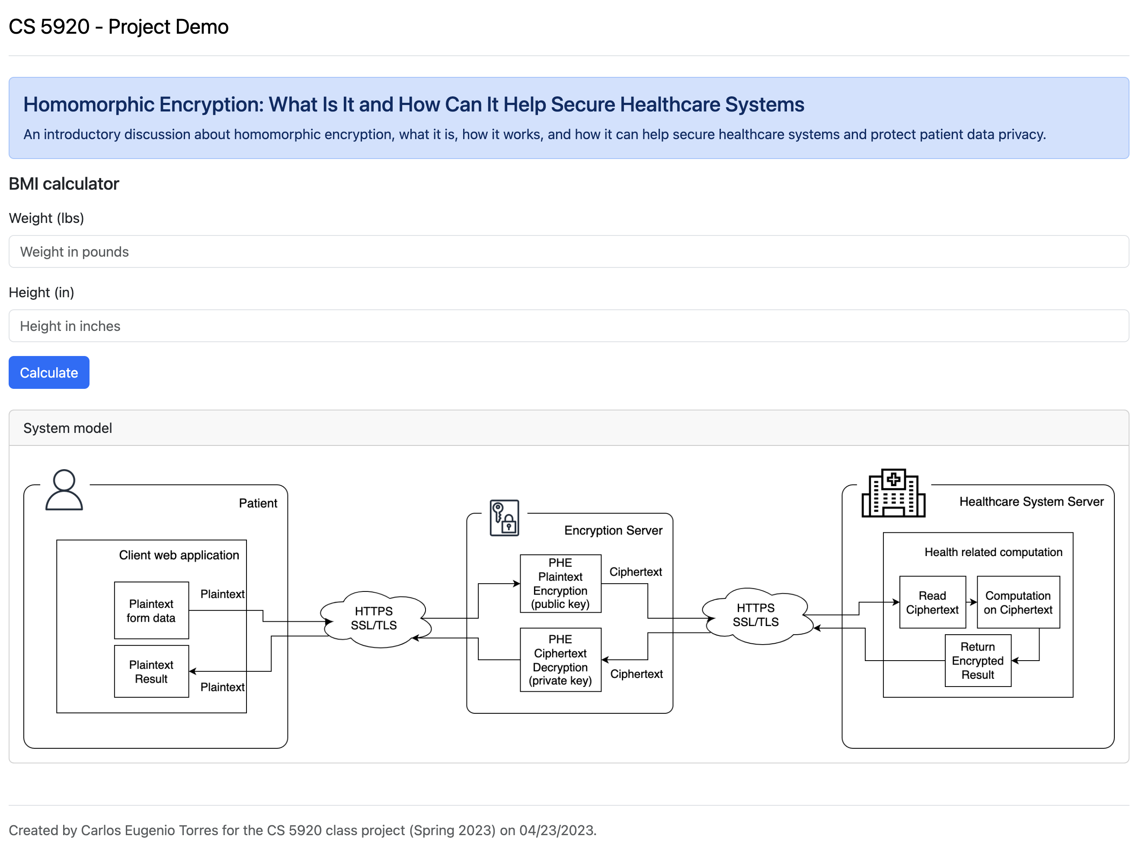
Healthcare System Demo
BMI calculation
weight (lbs)
BMI = 703 ×
height² (in)
(imperial)

