Slide 1

Product Recommendation in Online Advertising with Reinforcement Learning
UCCS
CS 5080
Final Presentation
Carlos E. Torres
12/08/2021

Slide 2

Introduction
Online advertising started in 1994, when Wired.com, then known as HotWired, invented the web banner ad.
It uses websites, or any internet connected medium, to display visual advertising peaces like text, banners, links, videos.
Exploded in growth creating a huge market where advertisers want to maximize their marketing budget by showing ads to more targeted audience.

Slide 3
Introduction (cont)
Advertising agencies are always trying to maximize the click-through rate (CTR) on their advertisers' ads.
The recommendation problem appears in online advertising and gain more attention from computer scientists, machine learning specialists, to try to make advertising more intelligent, learning from user behavior on how to recommend the best ad, product, book, video or song to a specific audience.

Slide 4

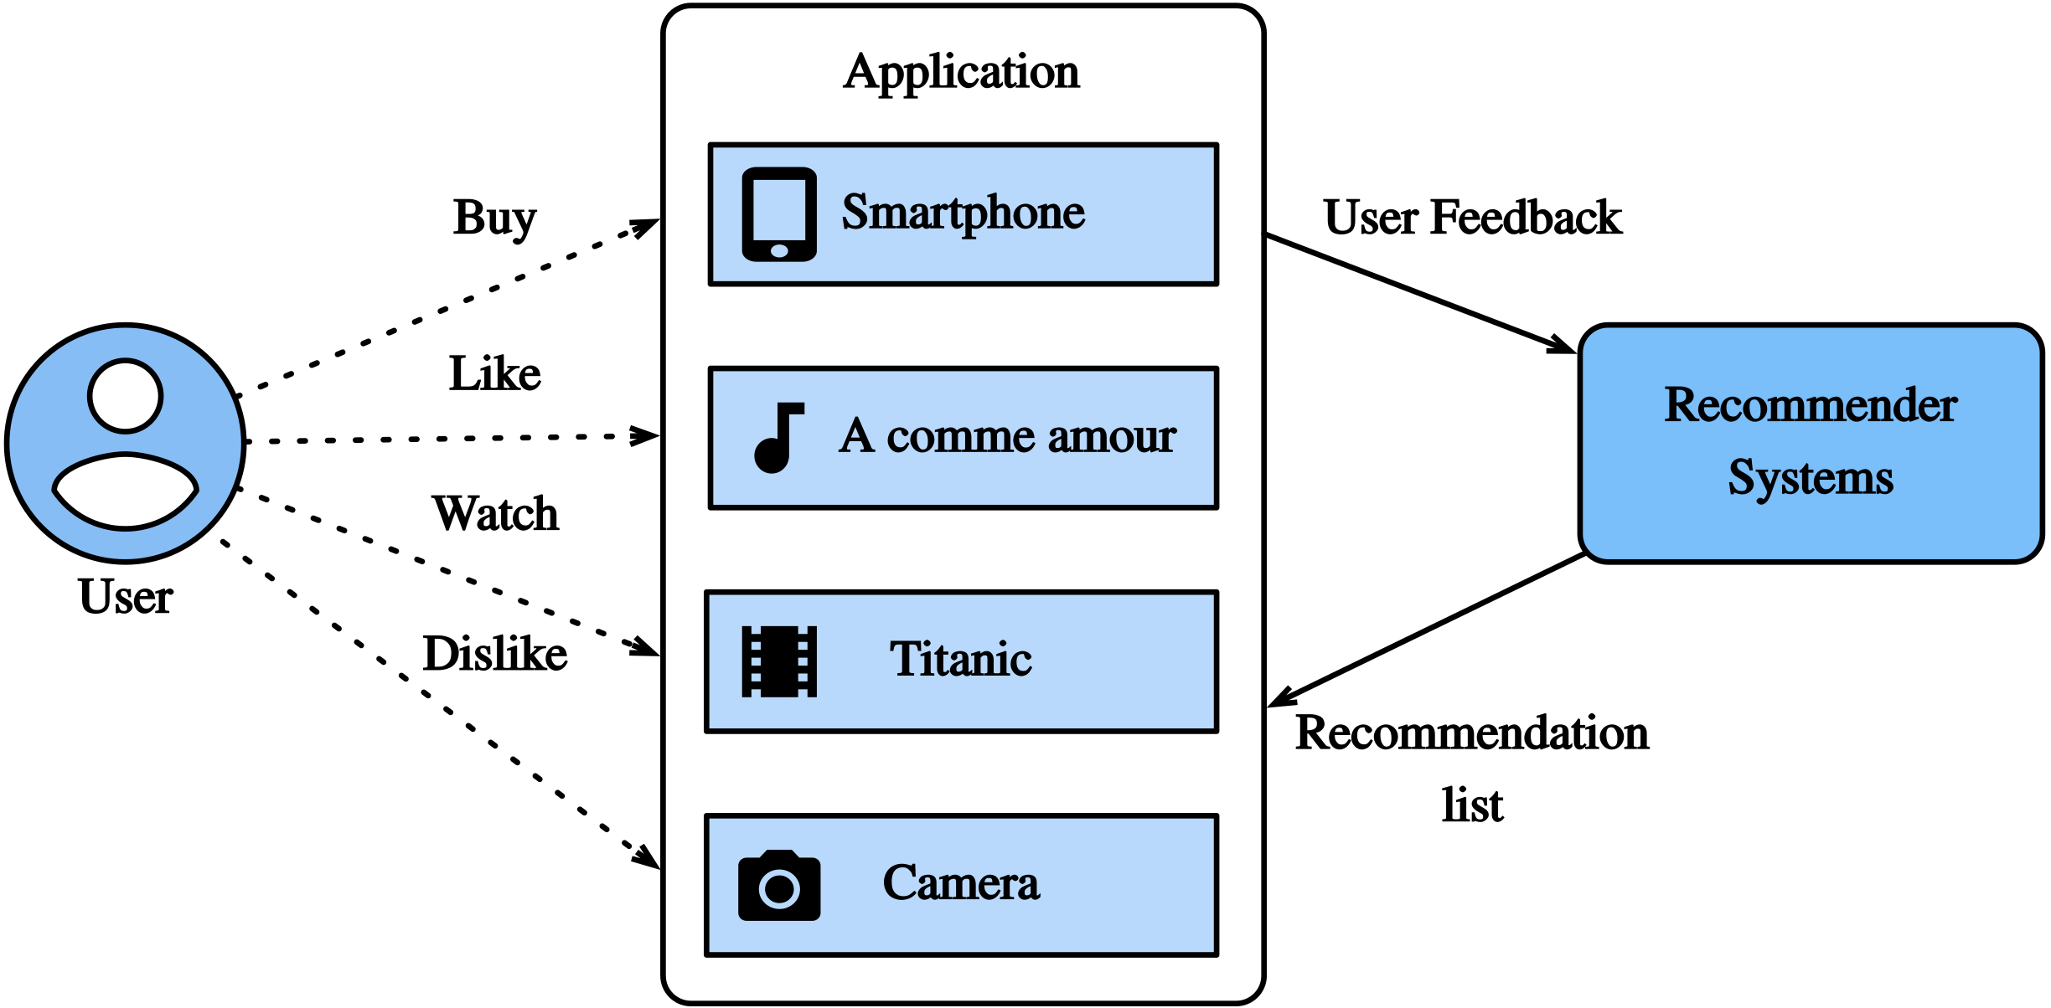
RECOMMENDER SYSTEM
The problem of Product Recommendation in Online Advertising is part of a broader problem of optimal recommendation policies.
The Recommender Systems appeared as an automated software solution to optimize recommendations of items to users.

Slide 5
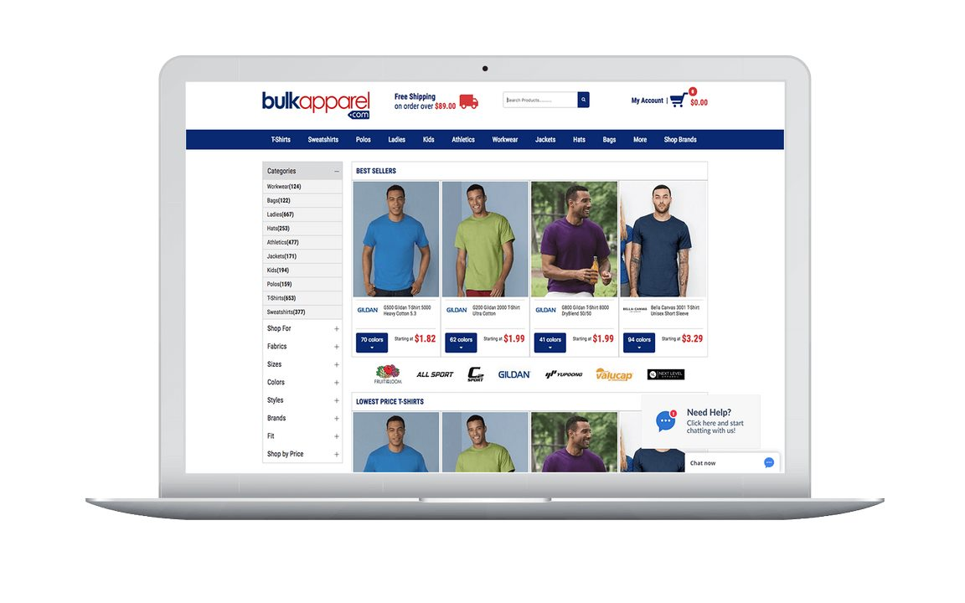


Product recommendation problem
Scenario
E-commerce website
Publisher website
Users view products on an e-commerce website and then visit a publisher website where ads are shown with objective to predict good products recommendations to maximize the CTR of the ad, leading the user back to the product page on the e-commerce website.
User
ad clicks
Organic session
(product views)
Bandit session
(page views)
User
Notes:
The organic session occurs on the e-commerce website during which a user sees various items.
The bandit session occurs on the publisher website, where the agent has the opportunity to recommend some items to users and observe their reactions.

Slide 6
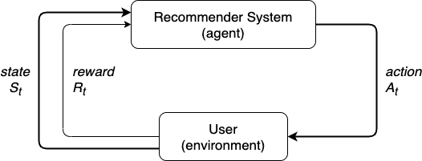
Problem Statement
The Recommender System formulated in terms of a Markov Decision Process (MDP).
S: state space – A finite set of users’ profiles that are part
of the environment. The agent observes the users’ behavior over a time period to learn from it.
A: action space – Set of recommendations (products) by the agent to the user on the publisher website. Based on the views of the user of such item on the e-commerce website.
R: reward – A reward signal for the users’ response to a recommendation from the agent:
1 – user clicked ad
0 – user did not click ad
P: transition probability
𝛾: discount factor
Notes:
The transition probability function is the probability that the state changes from st to st+1, given a certain action. It must satisfy the Markov property, that states to ignore the past and predict the future based on the present.
The discount factor or rate, can assume values0≤γ≤1. It is a measure of the relative importance of future rewards compared to an instant reward. If γ= 0, the agent focuses only on the immediate reward, conversely, if γ= 1, the agent considers more the future rewards for the current action taken.

Slide 7
THE AGENT GOAL
The goal of a reinforcement learning agent is to find an optimal policy, a policy that maximizes the cumulative rewards at each state.
In this context of online advertising, where we have a Recommender System as the agent, the goal is to maximize the cumulative reward for a given user, which means finding the optimal policy that maximizes the click-through rate (CTR).

Slide 8
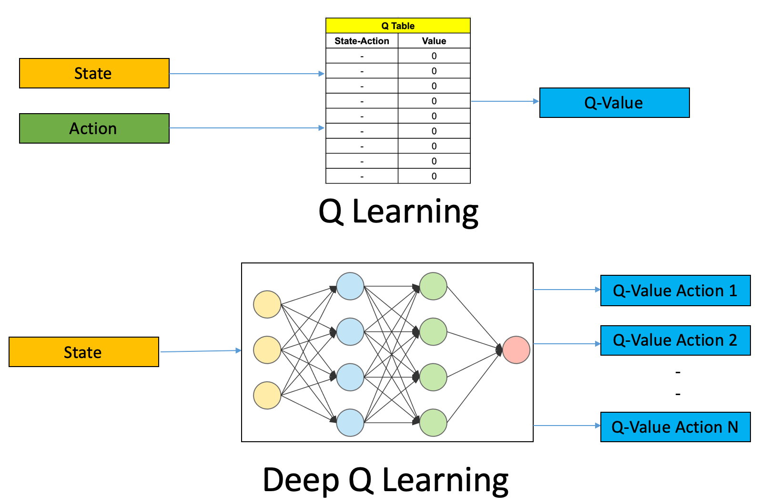
METHODOLOGY
Deep Q-learning
Q-learning
Deep Q-Network (DQN)
Q-learning
In order to teach the agent on how to recommend products to users, we intend to use Q-learning. But, as our Recommender System agent will have to deal with variable and possible high volume data sets for the states and actions, instead of use a table to store and update the value function, we propose the use of a Deep Q-learning approach, using a Deep Q-Network to approximate the state-action value function.
Deep Q-learning
Notes:
The idea behind DeepMind

Slide 9
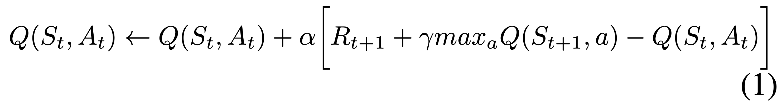

METHODOLOGY
(cont)
The optimal state-action value function $Q^{∗}(s,a)$ is the expected value of $R_{t+1}+γ\max_{a}{Q(S_{t+1}, a)}$, also known as the target Q-value for the network. The predicted Q-value is $Q(S_{t}, A_{t})$.
Experience replay is used to avoid computing the full expectation in the DQN loss by collecting the agent’s experience $e_{t}=(S_{t}, A_{t}, R_{t}, S_{t+1})$, after every step t the agent performs and storing it in a replay memory $D_{t}=\{e_{1}, …, e_{t}\}$. The replay memory $D$ is used to train the DQN, by getting a random sample of experiences and using them as the input to the DQN.
Notes:
The idea behind DeepMind

Slide 10
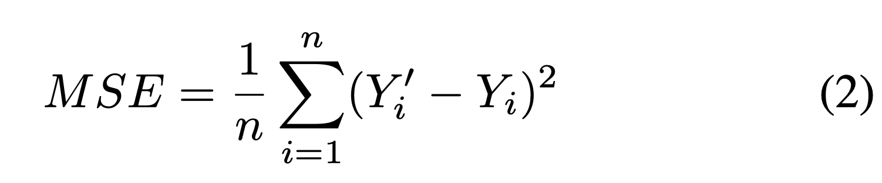
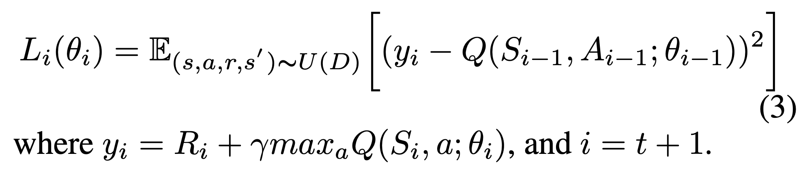
METHODOLOGY
(cont)
Loss function
Notes:
The idea behind DeepMind

Slide 11
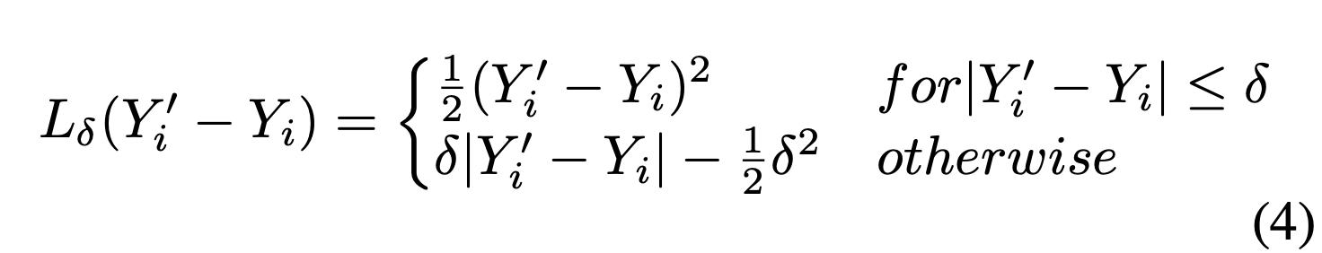
METHODOLOGY
(cont)
Loss function (updated) - Huber loss
where δ (delta) is a hyperparameter that can be set to adjust the interval in which the function will be quadratic or linear.
For loss values less than δ (delta), it uses the MSE; for loss values greater than δ (delta), it uses the Mean Absolute Error (MAE). Thus, Huber loss provides the best of both MAE and MSE.
Notes:
The idea behind DeepMind

Slide 12
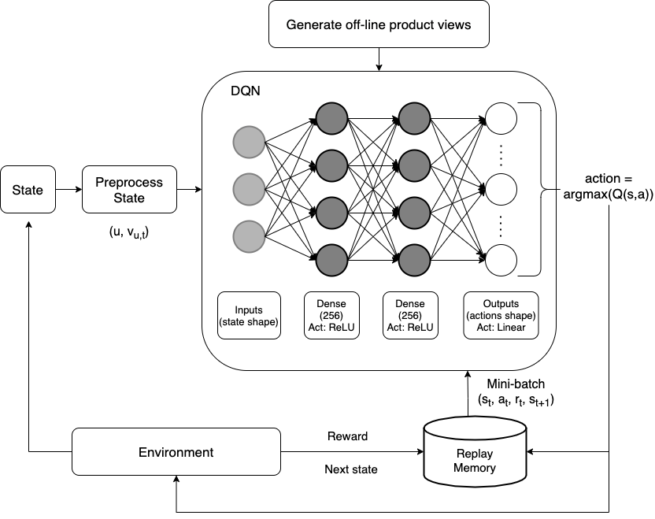
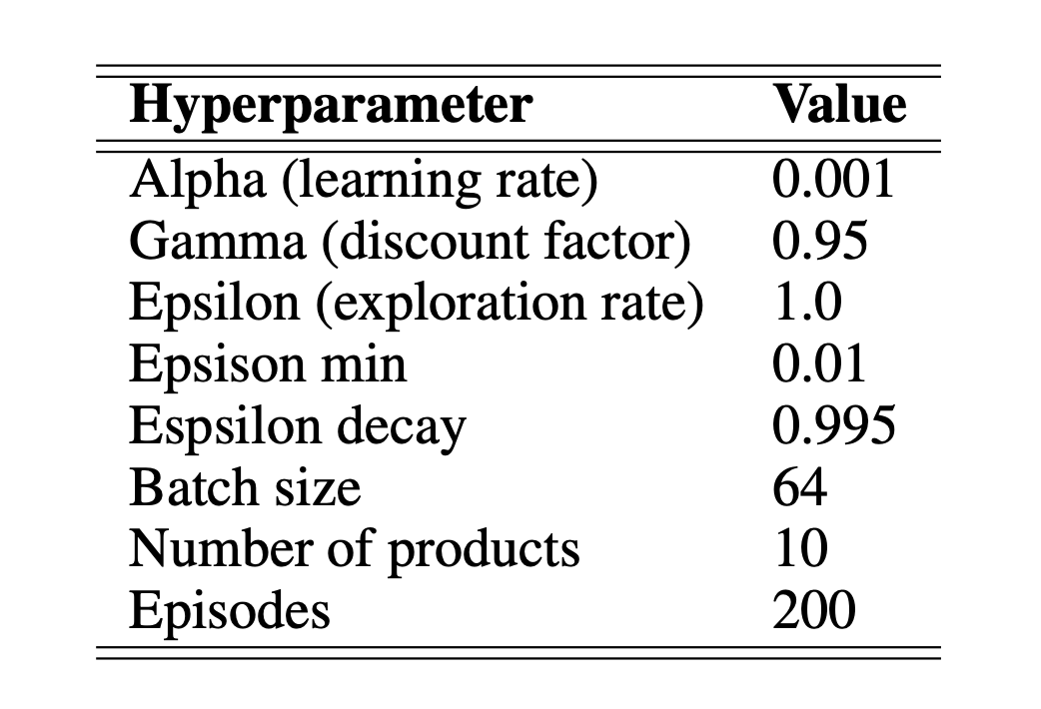
METHODOLOGY
(cont)
System Architecture
Hyperparameters
Notes:
The idea behind DeepMind

Slide 13
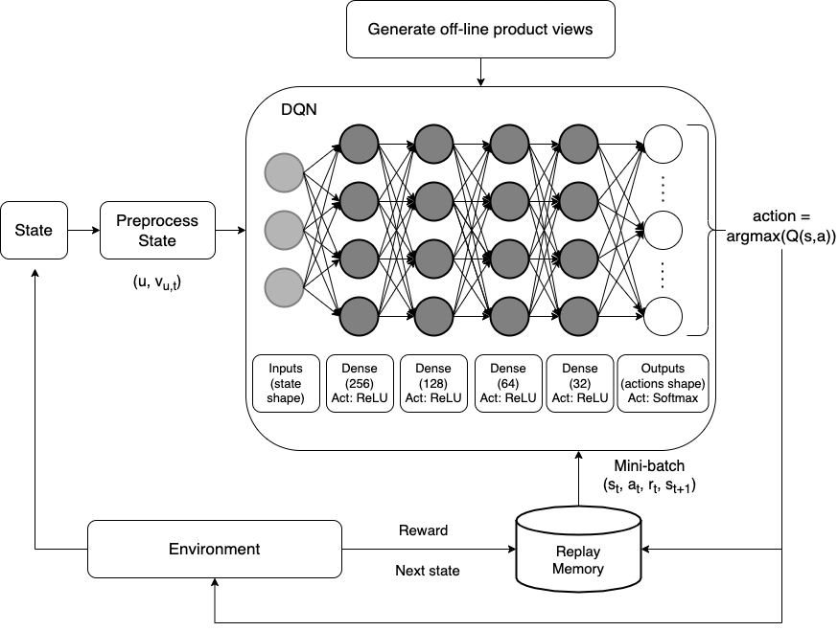
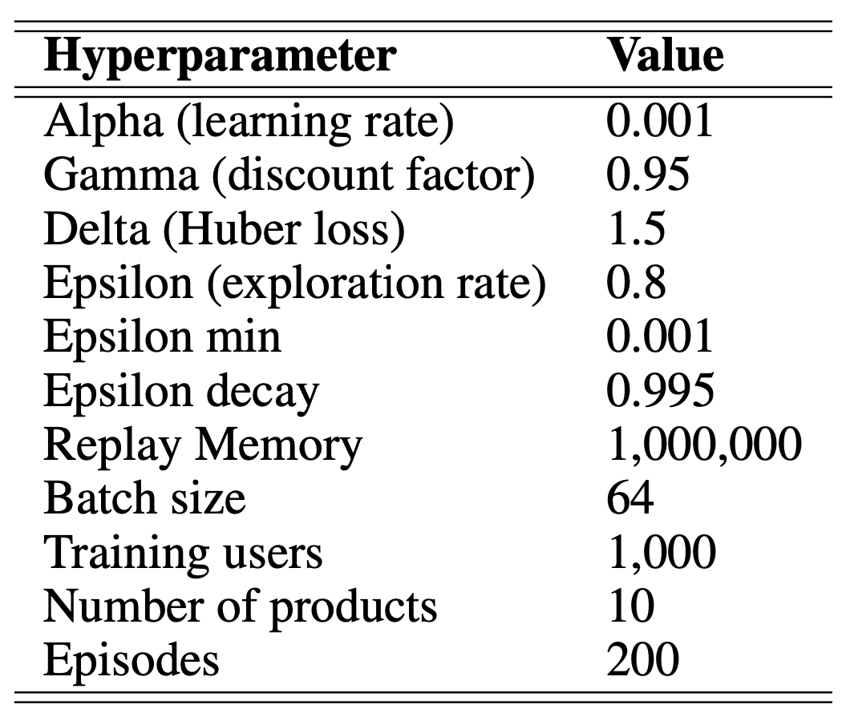
METHODOLOGY
(cont)
System Architecture (updated)
Hyperparameters (updated)
Notes:
The idea behind DeepMind

Slide 14
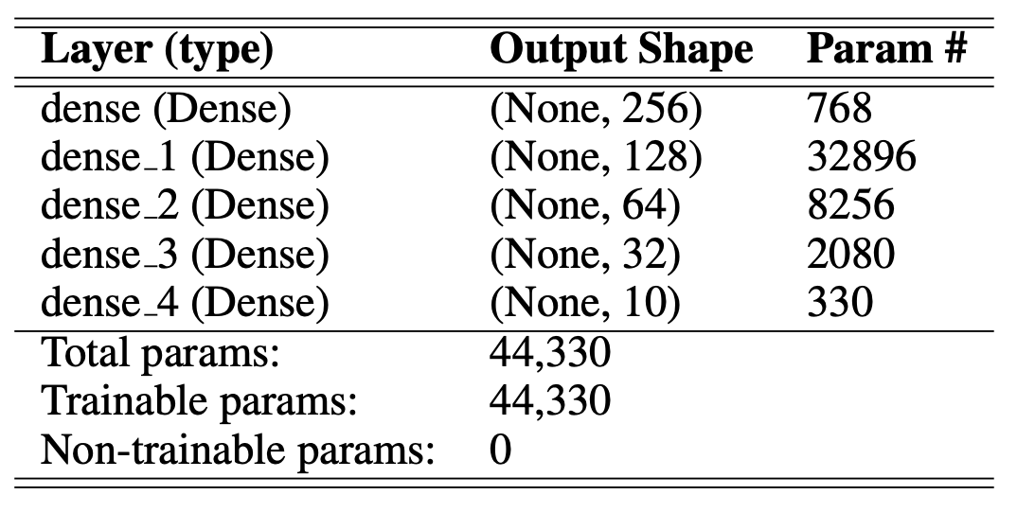
METHODOLOGY
(cont)
DQN model summary
The DQN is a Sequential model.
Input layer with the shape of the state (2).
4 Dense layers with 256, 128, 64, and 32 nodes with ReLU activation function.
Output layer with the shape of the action space (number of products) with a Softmax activation function.
Notes:
The idea behind DeepMind

Slide 15
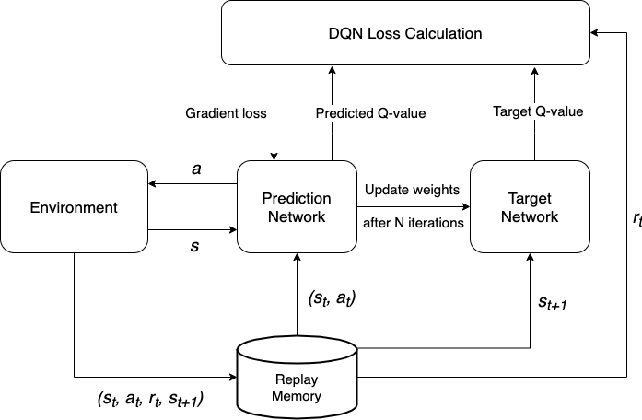
METHODOLOGY
(cont)
DQN internal architecture
Internally, the DQN uses a Prediction network, that updates the weights after N steps, and a Target network that outputs the actual Q-value.
With the outputs of both, the Target Q-value and Predicted Q-value, the loss is calculated and the DQN can learn.
Adapted from Nair et al. (2015)
Notes:
The idea behind DeepMind

Slide 16
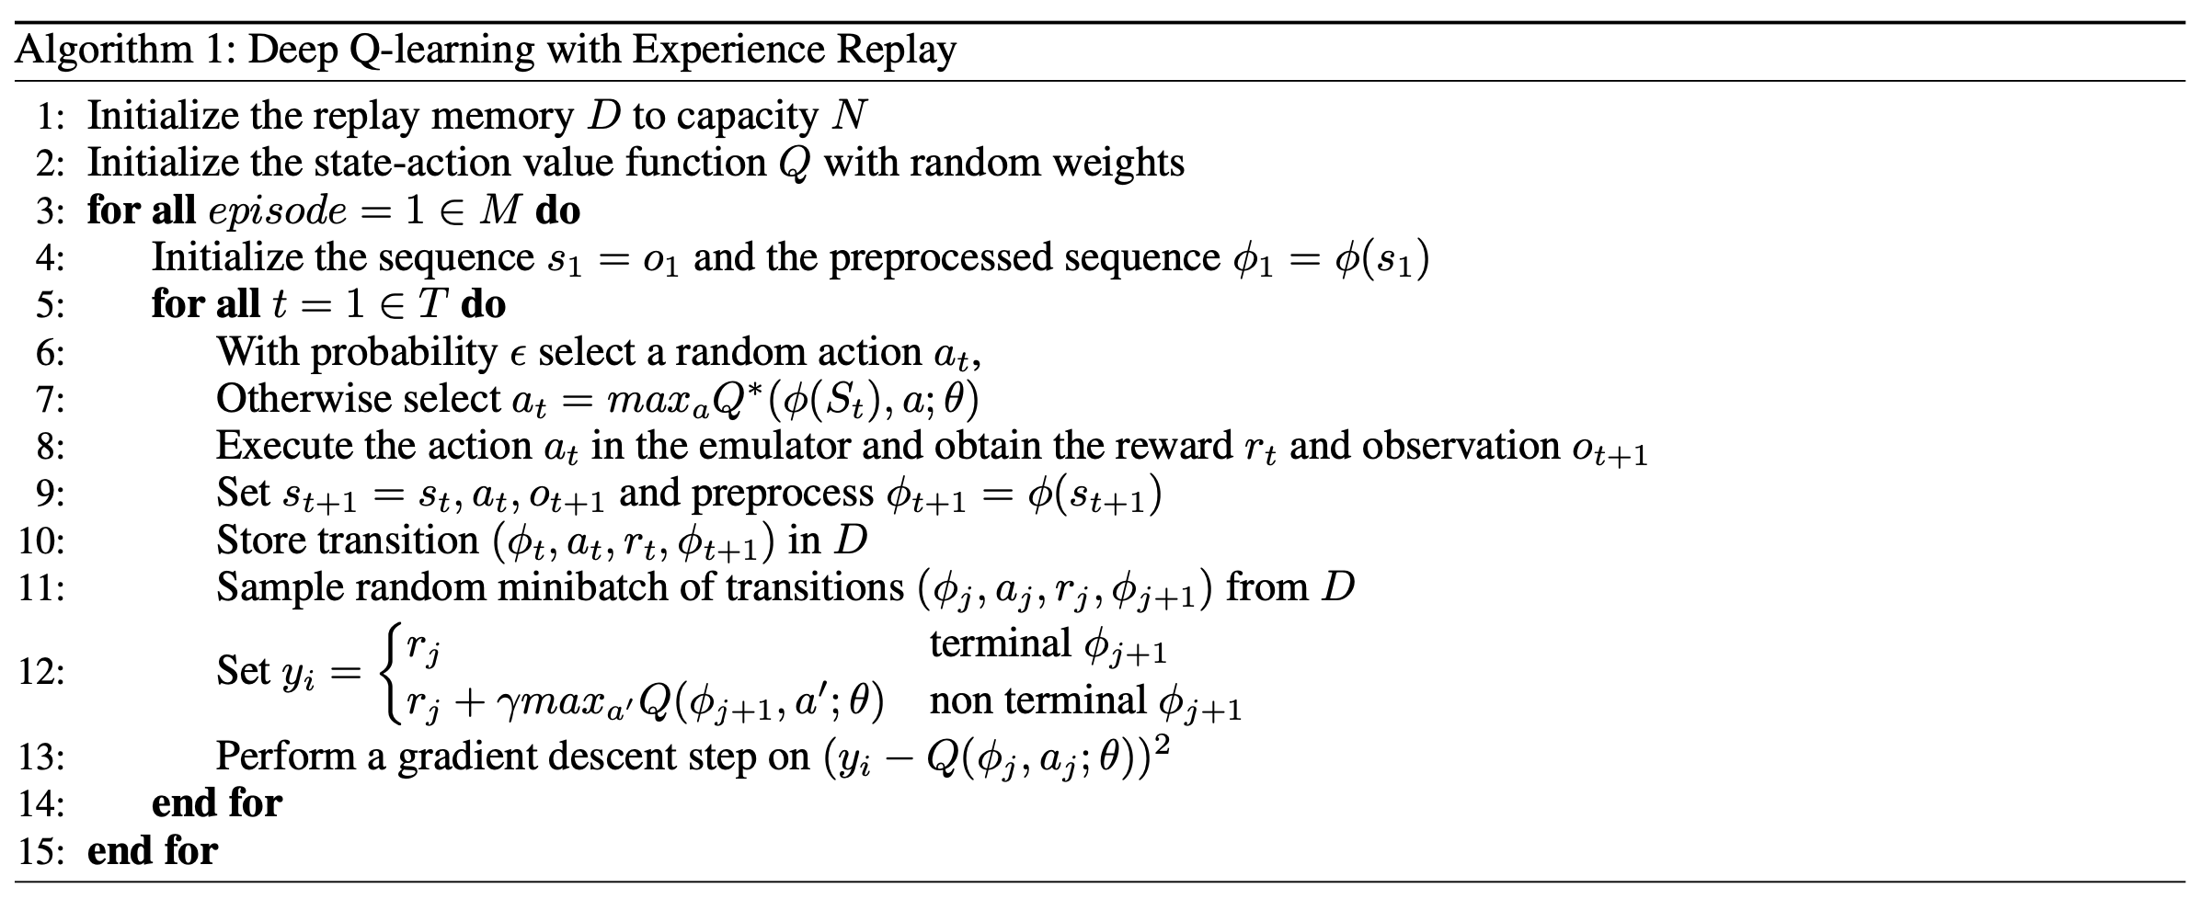
ALGORITHM
Mnih et al. 2013
Notes:
The idea behind DeepMind

Slide 17
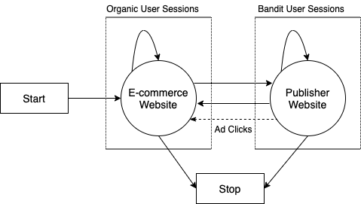
SIMULATION
The project uses a simulated environment for product recommendation called RecoGym, based on the Open AI Gym framework. The environment is defined as follows:
Reset - When called, the simulator initializes a random synthetic user.
Step - At each step call, the simulator ingests the predicted product recommendation from the agent and returns four objects:
Observation - This returns the users complete last organic session if available. When bandit events are occurring, this will return None.
Reward - The reward given by the environment for the previous recommendation. If result in a click = 1, otherwise = 0.
Done - A Boolean value denoting if the user’s shopping sequence has finished. If true, the Reset function will be called, and a new user will be generated for the next step.
Info - Potential logging information from the simulation.
Markov chain of the organic and bandit sessions in the RecoGym environment. Adapted from RecoGym.

Slide 18
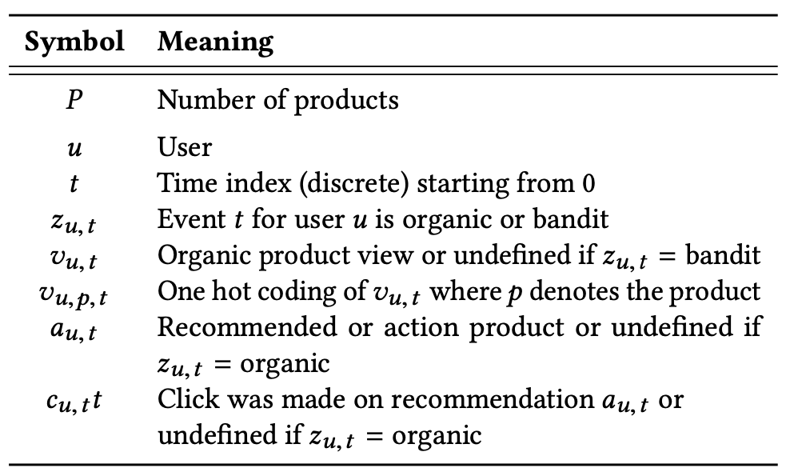
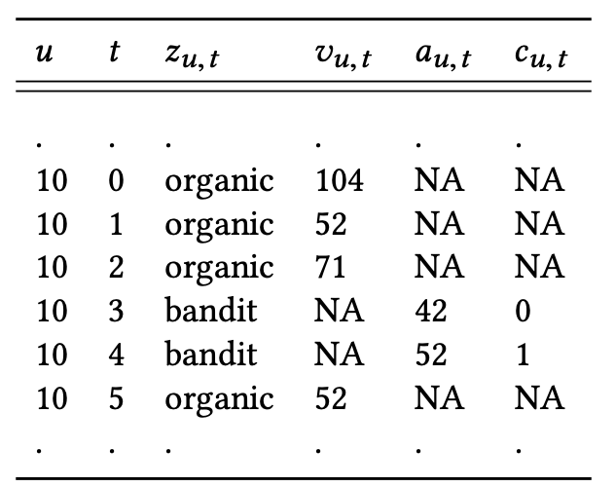
SIMULATION
(cont)
The notation and a sample of the data generated by the simulated environment.
Notation
Example Data

Slide 19
DATA
No labeled or clustered training data sets.
Data generated by the environment (observations), that represent the user interactions with the websites, either organic product views on the e-commerce website or clicks on the publisher website. This data is generated by the RecoGym gym during the state observations.
In real-world applications, this data is acquired by harvesting users’ navigation through websites, using cookies and track scripts. This data is not easy to obtain, because companies that produce and process it charge a lot for a good data set with users’ profiles and behaviors.

Slide 20
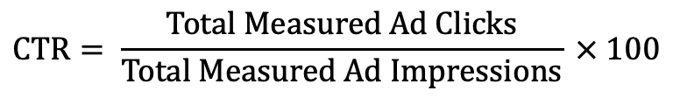
EVALUATION
In order to evaluate how the agent performed in learning how to recommend products to the user, we will track the click-through rate during the policy learning, until it stops improving, then we know we have the best policy at the end of the training.
This is how the CTR is calculated:
According to Google Ads (2021), a good CTR is generally considered to be 1% or higher.
Source: https://support.google.com/google-ads/answer/1722035
$$\text{CTR}= \frac{\text{Total} \text{Measured} \text{Ad} \text{Clicks}}{\text{Total} \text{Measured} \text{Ad} \text{Impressions}} × 100$$

Slide 21
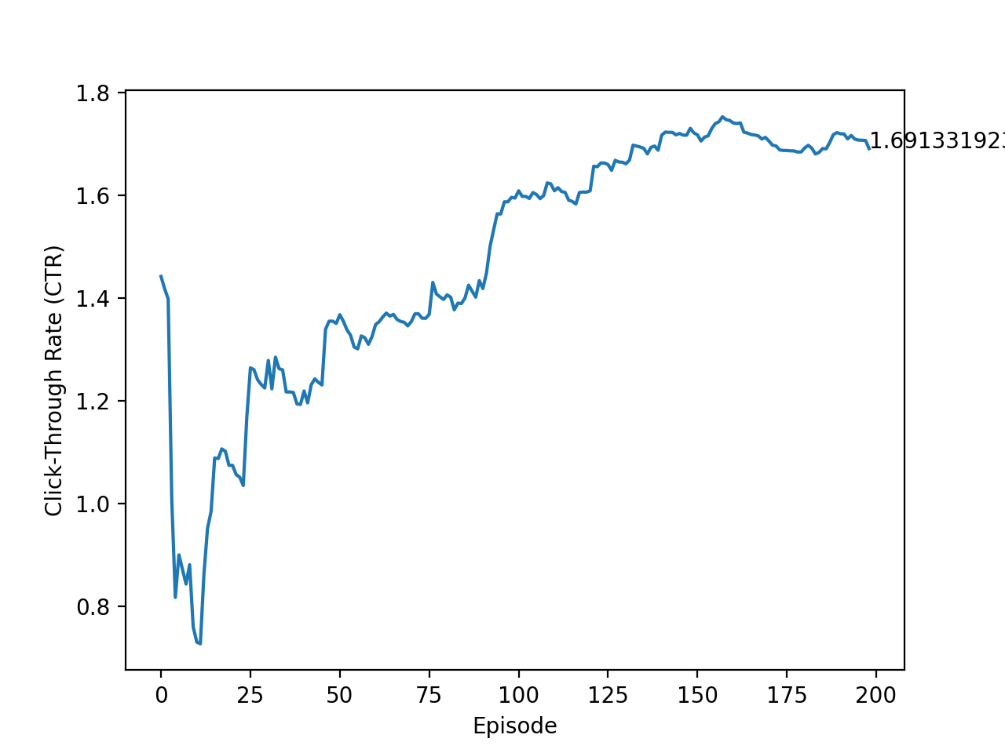
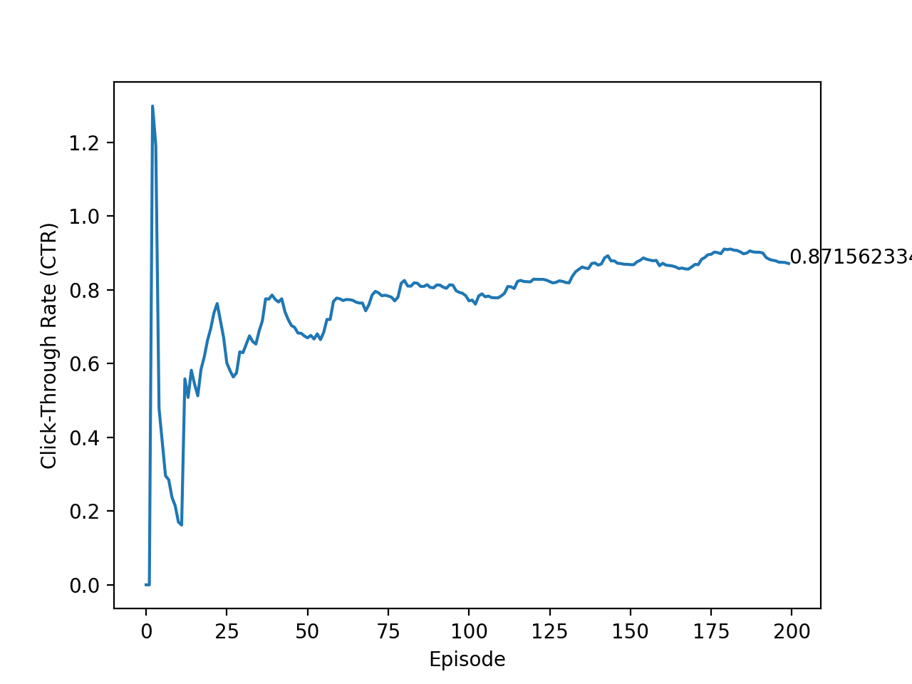
PRELIMINARY Results
CTR = 1.691%
CTR = 0.871%
Recommender agent results
(average CTR)
Random agent results
(average CTR)

Slide 22
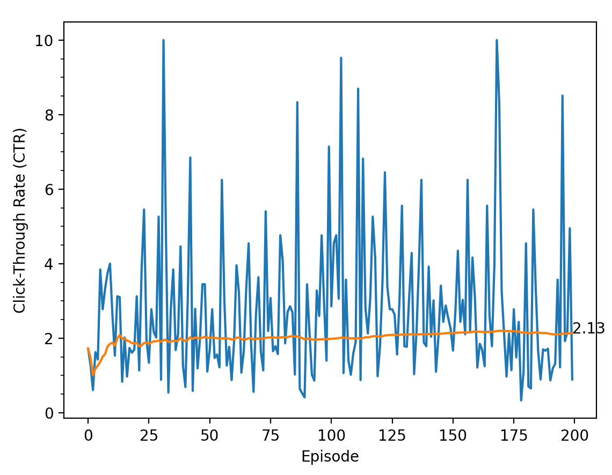
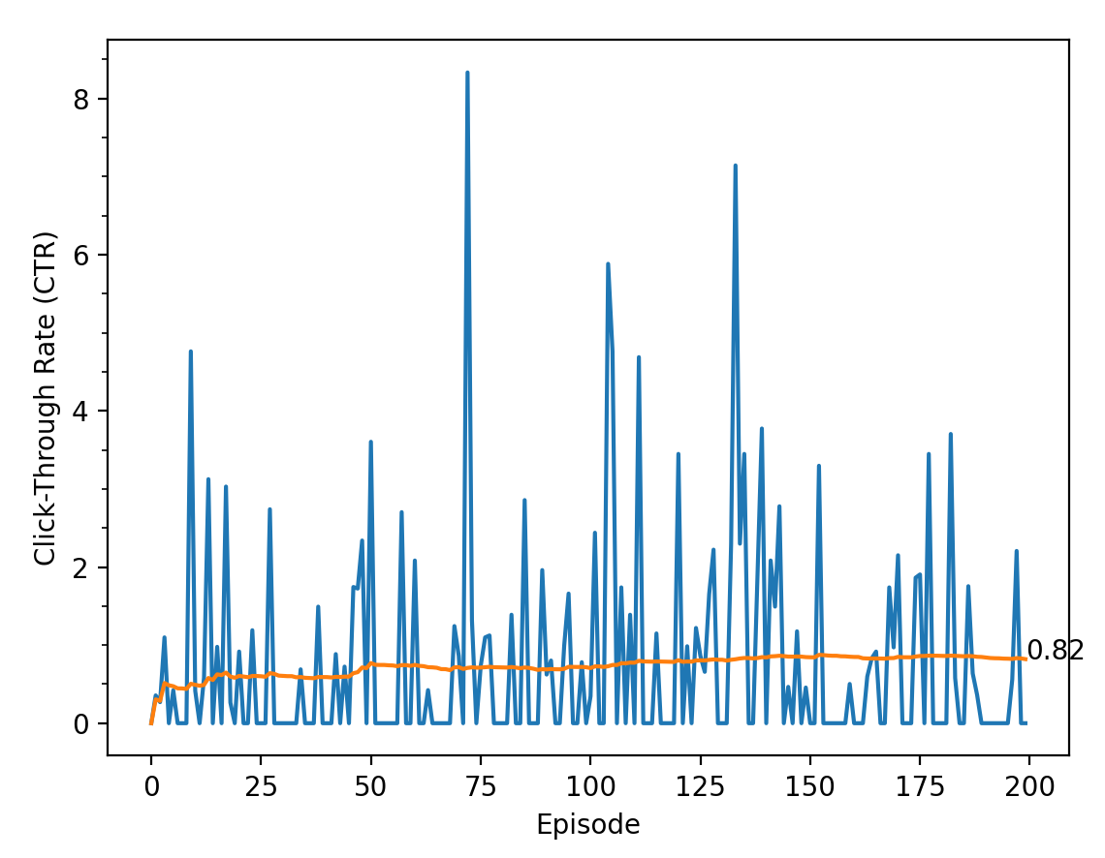
FINAL Results
CTR = 2.13%
CTR = 0.82%
Recommender agent results
(average CTR)
Random agent results
(average CTR)

Slide 23
RELATED Work
Afsar, Crump, and Far in 2021 observed that the recommendation problem can be formulated as a MDP and RL methods can be used to solve it.
Zhao et al. in 2021 and Zou et al. in 2019 used Deep RL to create frameworks to optimize long-term engagement by continuously updating its advertising strategies. Both used DQN to help find the optimal policy.
Choi et al. 2018 took a different approach proposing a recommender system as a gridworld game, using a biclustering technique, to address the large number of discrete actions, reducing the action space significantly.
Zheng et al. in 2018 also used Deep RL with DQN, but in the context of news recommendation, addressing the problem of boring/repetitive recommendations, taking in consideration user feedback (different from click-though rate).
Notes:
Biclustering, also known as co-clustering, two-way clustering, and simultaneous clustering, aims to find subsets of rows and columns of a given data matrix. Remapping states to a n x n grid. The big difference between clustering and biclustering is that clustering derives a global model, whereas biclustering produces a local model.

Slide 24
CONCLUSION
It is proposed the creation of a reinforcement learning agent as a Recommender System to learn by interacting with user inputs in an e-commerce website to recommend items in another publisher website through online advertising with the objective to maximize the click-through rate (CTR).
A Deep Q-learning algorithm, with value learning, and Deep Q-Network, is used to teach the agent the best policy.
A simulated environment is used to illustrate the results, RecoGym, based on the Open AI gym framework.
The results achieved in the end by the agent show an average CTR of 2.13%, which is 159.75% better than the baseline random agent that has an average CTR of 0.82%.

Slide 25
REFERENCES
Afsar, M. M.; Crump, T.; and Far, B. H. 2021. Reinforcement learning based recommender systems: A survey. CoRR, abs/2101.06286.
Brockman, G.; Cheung, V.; Pettersson, L.; Schneider, J.; Schulman, J.; Tang, J.; and Zaremba, W. 2016. OpenAI Gym. CoRR, abs/1606.01540.
Choi, S.; Ha, H.; Hwang, U.; Kim, C.; Ha, J.; and Yoon, S. 2018. Reinforcement Learning based Recommender System using Biclustering Technique. CoRR, abs/1801.05532.
GoogleAds. 2021. Measure traffic to your website. https: //support.google.com/google-ads/answer/1722035. Accessed: 2021-10-20.
He, Z.; Tran, K.-p.; Thomassey, S.; Zeng, X.; and Yi, C. 2020. A reinforcement learning based decision support system in textile manufacturing process. In Developments of Artificial Intelligence Technologies in Computation and Robotics: Proceedings of the 14th International FLINS Conference (FLINS 2020), 550–557. World Scientific.
Liu, F.; Tang, R.; Li, X.; Zhang, W.; Ye, Y.; Chen, H.; Guo, H.; Zhang, Y.; and He, X. 2020. State representation modeling for deep reinforcement learning based recommendation. Knowledge-Based Systems, 205: 106170.
Mnih, V.; Kavukcuoglu, K.; Silver, D.; Graves, A.; Antonoglou, I.; Wierstra, D.; and Riedmiller, M. A. 2013. Playing Atari with Deep Reinforcement Learning. CoRR, abs/1312.5602.
Nair, A.; Srinivasan, P.; Blackwell, S.; Alcicek, C.; Fearon, R.; Maria, A. D.; Panneershelvam, V.; Suleyman, M.; Beat- tie, C.; Petersen, S.; Legg, S.; Mnih, V.; Kavukcuoglu, K.; and Silver, D. 2015. Massively Parallel Methods for Deep Reinforcement Learning. CoRR, abs/1507.04296.

Slide 26
REFERENCES
(cont)
Ricci, F.; Rokach, L.; and Shapira, B. 2011. Introduction to recommender systems handbook. In Recommender systems handbook, 1–35. Springer.
Rohde, D.; Bonner, S.; Dunlop, T.; Vasile, F.; and Karatzoglou, A. 2018. RecoGym: A Reinforcement Learning Environment for the problem of Product Recommendation in Online Advertising. CoRR, abs/1808.00720.
Singel, R. 2010. OCT. 27, 1994: Web gives birth to banner ads. Wired. Com.
Sutton, R. S.; and Barto, A. G. 2018.Reinforcement learning: An introduction. MIT press.
Szepesvári, C. 2010. Algorithms for Reinforcement Learning. Synthesis Lectures on Artificial Intelligence and Machine Learning. Morgan & Claypool Publishers.
Watkins, C. J.; and Dayan, P. 1992. Q-learning. Machine learning, 8(3-4): 279–292.
Zhao, X.; Gu, C.; Zhang, H.; Yang, X.; Liu, X.; Liu, H.; and Tang, J. 2021. DEAR: Deep Reinforcement Learning for Online Advertising Impression in Recommender Systems. In Proceedings of the AAAI Conference on Artificial Intelligence, volume 35, 750–758.
Zheng, G.; Zhang, F.; Zheng, Z.; Xiang, Y.; Yuan, N. J.; Xie, X.; and Li, Z. 2018. DRN: A deep reinforcement learning framework for news recommendation. In Proceedings of the 2018 World Wide Web Conference, 167–176.
Zou, L.; Xia, L.; Ding, Z.; Song, J.; Liu, W.; and Yin, D. 2019. Reinforcement learning to optimize long-term user engagement in recommender systems. In Proceedings of the 25th ACM SIGKDD International Conference on Knowledge Discovery & Data Mining, 2810–2818.

Slide 27



Special thanks
Dr. Kalita
My family, and my colleagues
Let’s stay connected
@cetorres
@cetorres
cetorres@cetorres.com

Slide 28
QUESTIONS ?

