Slide 1

NBA Breakout
By: Conor Eunson

Slide 2
Agenda
Introduction and Background Research
Data Information and Exploration
Model Methodologies
Results and Statistical Analysis
Overall Project Takeaways
Library Citations and Reproducibility Details

Slide 3
Problem Statement/Hypothesis

Slide 4

Problem Information/Importance
NBA player’s ability to breakout into great players is almost impossible to consistently predict
Giving up on a player to soon can have decade long impacts on the NBA
Beneficial to NBA Brand
30 teams across the league
Sports betting
TV Analysts, ESPN
Fans watching

Slide 5
Research Question(s) and Hypothesis
How do I want quantify or classify a “Breakout” player?
Using NBA player statistics are we able to find accurately predict whether they will breakout the following season?
Hypothesis is that NBA players that see an increase of 20% or more to their Points Per Game (PTS) and an increase of 2 plus to Win Shares (WS) from season to season will breakout.

Slide 6
Data Engineering

Slide 7
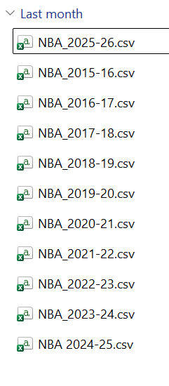
Dataset Details
Basketball reference publicly available NBA data
Downloaded player statistics from 11 NBA seasons
Downloaded each season’s excel file and merged them together
5,968 observations/records, 53 features

Slide 8
Exploratory Analysis
Majority numerical features dataset
2 trends from observing features histogram distributions
Left leaning with sharp decreases
Normal distributions
Verified understanding of features through scatterplots

Slide 9
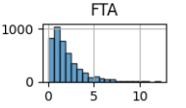
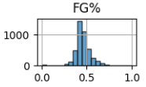
Feature Histogram Distributions Examples

Slide 10
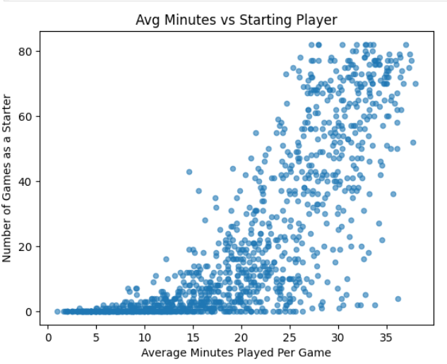
Feature Scatterplot

Slide 11
Preprocessing
Filled missing values for most columns with 0
Dropped Awards column for above 90% null values
Train (2015 – 2023), Seasonal Validation, Test (2024)
Class weight and Scale to handle imbalance (93/7)

Slide 12
Feature Engineering
Transformed SEASON column into numeric values
Categorical encoding of player Position (Pos)
Creation of target variable breakout by creating the following features:
Using shift() to create columns next_PTS and next_WS
Calculated difference between current and future
Created binary target variable using criteria from the hypothesis

Slide 13



Part 1 Target, .Shift(-1)
Player | Age | Season | PTS | next_PTS
AJ Green | 23 | 2022 | 3.3 | 4.5
AJ Green | 24 | 2023 | 4.5 | 7.4
AJ Green | 25 | 2024 | 7.4 | 10.4

Slide 14
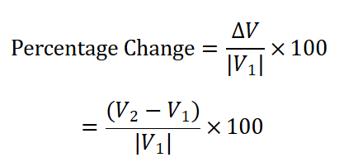
Part 2 Target, Difference Values
Points Per Game (PTS)
Win Shares (WS)
Actual/Numerical Change:
New – Old = Difference
AJ Green Example:
(7.4 – 4.5) – 1 = ~0.644
AJ Green Example:
2.8 – 1.1 = 1.7

Slide 15
Part 3 Target Variable Creation
In order for the player to be labeled a breakout or 1
PTS_difference >= 0.20
WS_difference >= 2
Otherwise, player is labeled as 0
Breakout Label 0 Example
AJ Green
Breakout Label 1 Example
Lebron James
PTS_diff | WS_diff | Breakout
0.644 | 1.7 | 0
PTS_diff | WS_diff | Breakout
0.279 | 3.2 | 1

Slide 16
Experiment Setup and Evaluation Metrics

Slide 17






Explanation of Train/Val/Test
Seasonal training and validation
Ensure order of seasons that cannot be achieved with cross_validate
Test on the final most recent season that was held out

Slide 18
Naïve Majority - DummyClassifier
Finds the majority class and will always predict it
Not learning anything from features
Designed as benchmark for future model performance

Slide 19


LogisticRegression
Calculates weight or impact of features
Use the sigmoid function to covert score to probability
Combined probability used to predict breakout player label
Sigmoid function and Log loss function

Slide 20
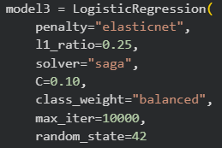
Parameters Tunned
Penalty specifies the regularization impact on the loss function
L1_ratio is the elastic net mixing parameter
Solver used for optimization problem
C is the inverse of regularization strength
Class_weight adjusts the weights of classes from the default 1

Slide 21
XGBoost
Utilizes decision trees to learn sequentially
Each tree that follows goal is to correct prediction errors
Combines output from gradient boosting into a probability value
Makes it class prediction based of this probability

Slide 22
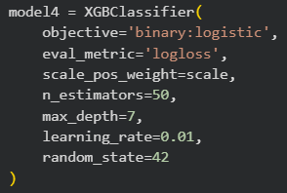
Parameters Tunned
N_estimators sets of number of rounds or trees for boosting
Max_depth increases the depth of layers for each individual tree
Learning_rate impact of each tree individually on the final prediction made

Slide 23
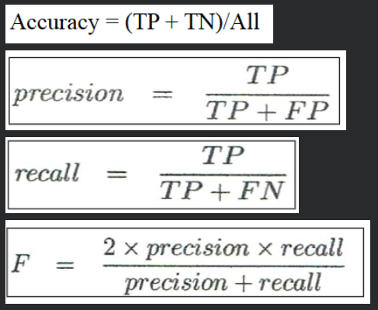
Evaluation Metrics
Confusion matrix shows the number of correct and incorrect predictions
Accuracy represents all predictions correctness
Precision measures how many prediction target were actually target
Recall total identification rate
F1-score balance of P/R

Slide 24
Model Results and Analysis

Slide 25
Model Comparison
Comparison | Accuracy | Precision | Recall | F1-score | Training Time | Testing Time
Naïve Majority | 0.927 | 0.000 | 0.000 | 0.000 | 0.0010 | 0.0002
Baseline Logistic | 0.593 | 0.122 | 0.735 | 0.209 | 0.7835 | 0.0016
Tunned Logistic | 0.601 | 0.132 | 0.794 | 0.226 | 10.0607 | 0.0020
Tunned XGBoost | 0.711 | 0.148 | 0.618 | 0.239 | 0.2910 | 0.0049

Slide 26
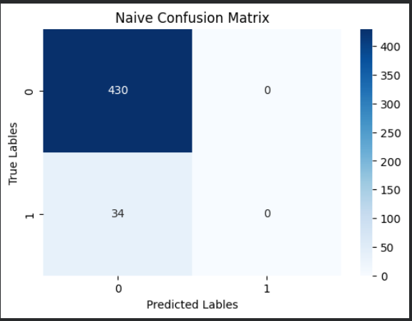
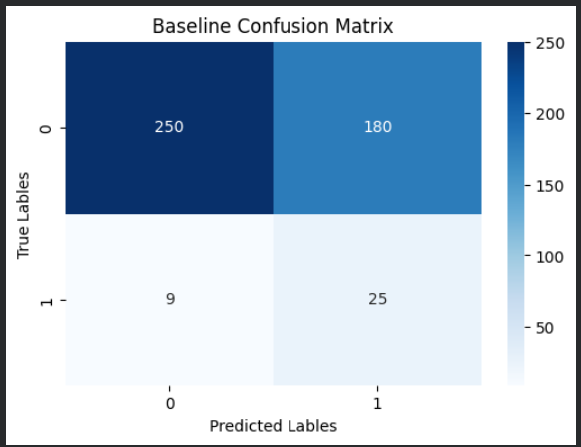
Confusion Matrix

Slide 27

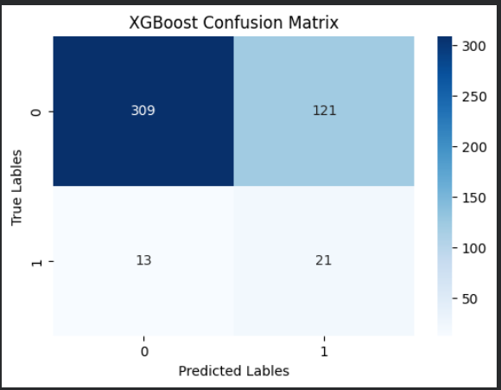
Confusion Matrix Continued

Slide 28
Statistical Analysis
 | Baseline vs XGBoost | Logistic vs XGBoost
Paired t-statistic | -1.7391 | -1.6546
Paired p-value | 0.1569 | 0.1733
Paired significance | Fail to Reject H0 | Fail to Reject H0
McNemar Chi-squared | 21.9248 | 19.3798
McNemar p-value | 0.000003 | 0.000011
McNemar significance | Reject H0 | Reject H0

Slide 29
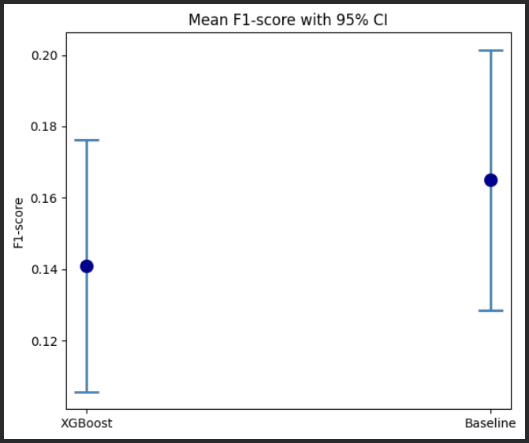
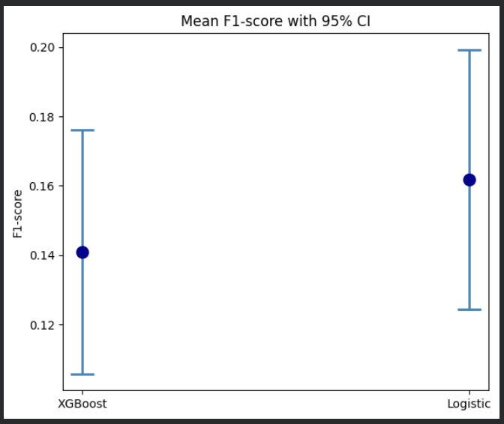
Confidence Intervals

Slide 30
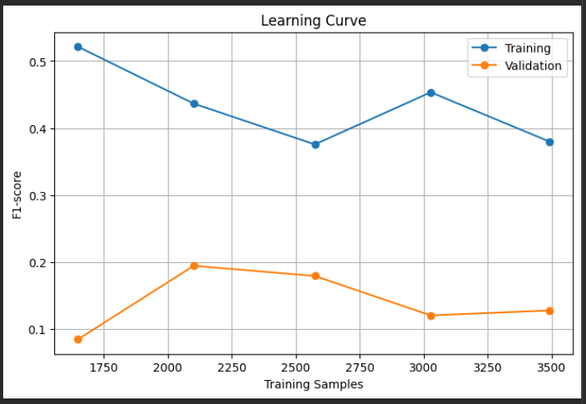
Overall Interpretation
Lack of significance indicates that my best model does not support my hypothesis
Lack of predictive power towards target
Model overfitting towards training data
Additional seasons won’t improve performance

Slide 31
Results
Benefitted seasonality well
Better at classifying target than previous attempts
Limited data and class imbalance impact
Model deployed would cause more harm than good
Sports data is difficult to work with
Amount of time spent researching
Importance of spending time exploring the dataset

Slide 32
Sources/Citations
Dummy Classifier Scikit Documentation
DummyClassifier — scikit-learn 1.9.0 documentation
Shift() Python Documentation
pandas.DataFrame.shift — pandas 3.0.5 documentation
Logistic Regression Scikit Documentation
LogisticRegression — scikit-learn 1.9.0 documentation
XGBoost Documentation (1)
XGBoost Parameters — xgboost 3.3.0 documentation
XGBoost Parameter Information Documentation
XGBClassifier - GeeksforGeeks

Slide 33

Thanks! Any Questions?

