Slide 1
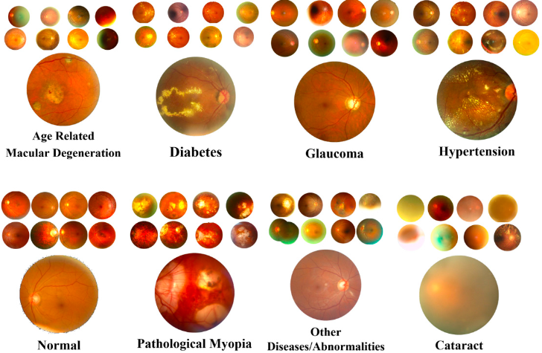
Ocular Disease Diagnoses with Neural Nets
DS 6050: Deep Learning Final Project
Ana Daley, Evan Mitchell, Cecily Wolfe
May 2, 2022
Notes:
Image source: An Effective and Robust Approach Based on R-CNN+LSTM Model and NCAR Feature Selection for Ophthalmological Disease Detection from Fundus Images (Demir and Tasci, 2021)

Slide 2
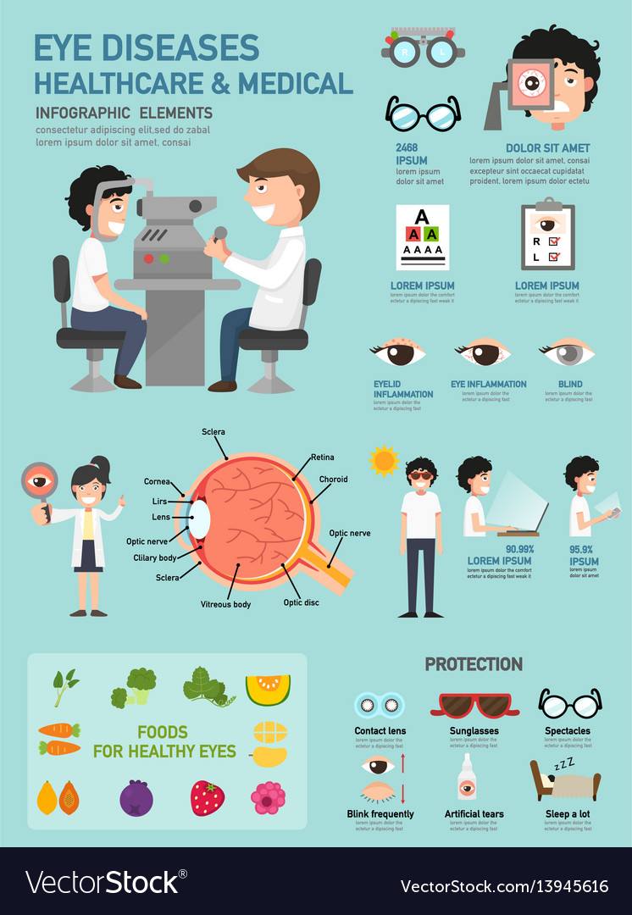
Introduction
2 Billion people living with visual impairments (1)
Half are preventable with early treatment and are currently untreated
Traditional Diagnosis Techniques
Visual Acuity tests, Retinal Exams, and Ocular Tonometry
Time consuming and frustrating
Alternative Diagnosis Technique
Fundus Photography
Difficult for people to interpret
Neural Networks have had success with diagnosis
Notes:
Stat source (WHO): https://www.who.int/news-room/fact-sheets/detail/blindness-and-visual-impairment
Eye disease infographic: https://www.vectorstock.com/royalty-free-vector/eye-diseases-healthcare-amp-medical-infographic-vector-13945616

Slide 3
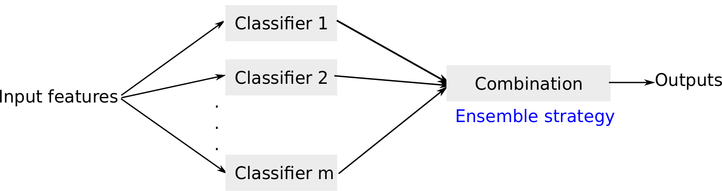
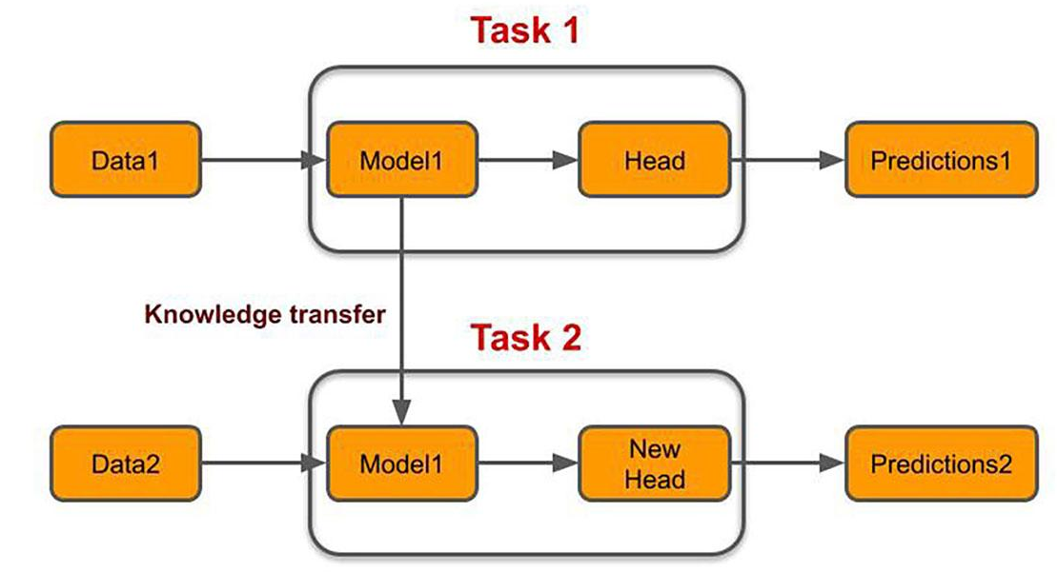
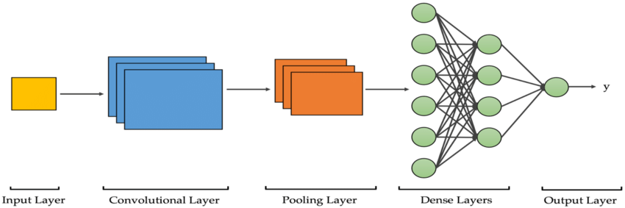
Research Question
Question: Will ensemble models outperform individual models in accurately diagnosing ocular diseases?
Hypothesis
Ensemble models will improve accuracy
Transfer learning models will outperform custom models
VS.
VS.
Notes:
Ensemble models: https://ohdsi.github.io/PatientLevelPrediction/articles/BuildingEnsembleModels.html
Transfer learning: https://www.topbots.com/transfer-learning-in-nlp/
CNN: https://medium.com/swlh/an-overview-on-convolutional-neural-networks-ea48e76fb186

Slide 4
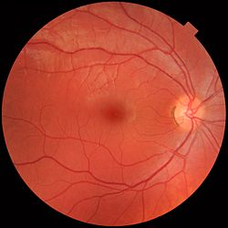
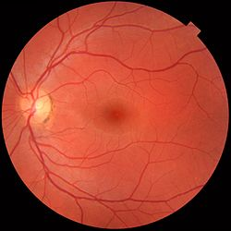
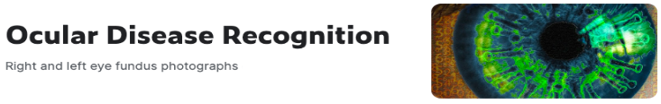
Data Description
Ocular Disease Intelligent Recognition (ODIR) Dataset (2)
Peking University and Shanggong Medical Technology Co. Ltd.
7000 color fundus images labeled with 1+ diagnoses
Diagnoses
Normal (N)
Diabetes (D)
Glaucoma (G)
Cataract (C)
Macular Degeneration (A)
Hypertension (H)
Myopia (M)
Other (O)
Notes:
Ocular disease dataset: https://www.kaggle.com/datasets/andrewmvd/ocular-disease-recognition-odir5k?select=preprocessed_images

Slide 5
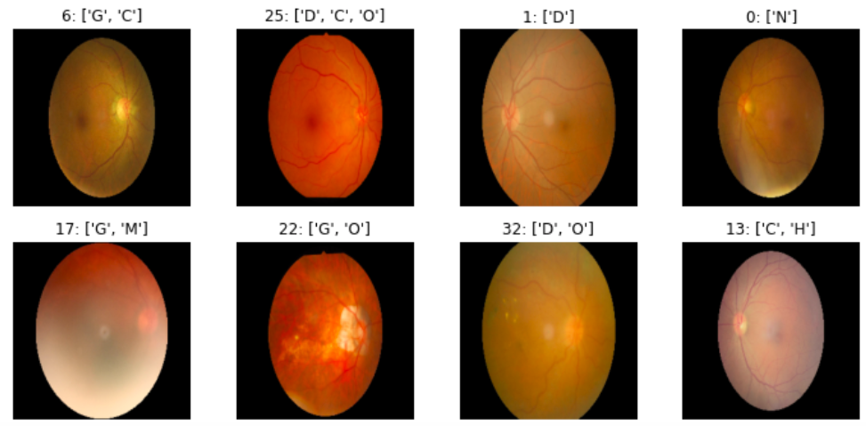
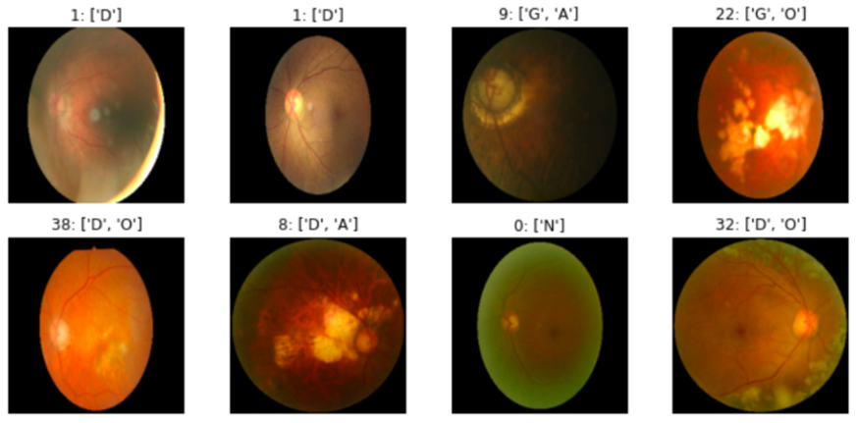
Data Engineering
Handling Multiple Diagnoses
Each unique combination of diagnoses its own class
Balancing Data
Randomly oversampled with replacement classes with < av. num of images per class
Each class with at least mean number of images per class (~180)
Final preprocessed dataset: 12,370 images in 39 classes
Training set: 9896
Validation set: 2474

Slide 6
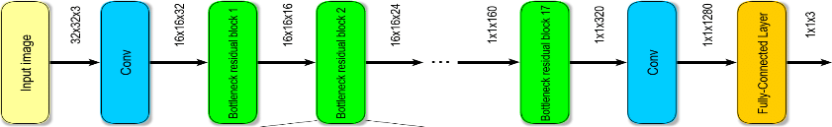
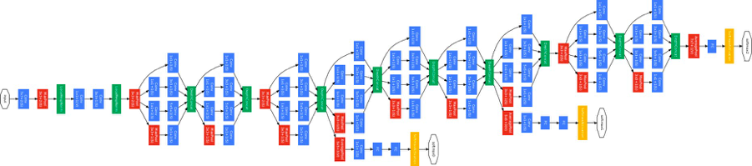
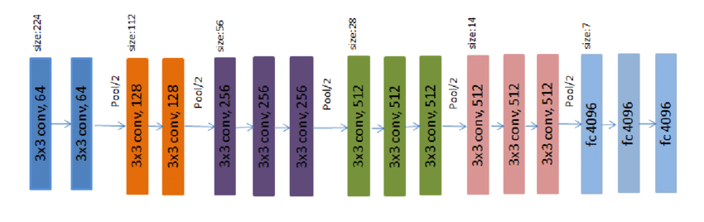
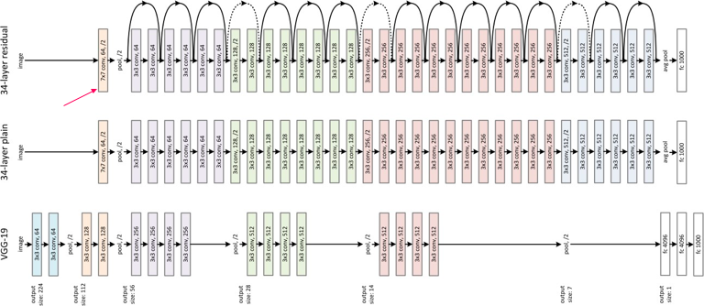
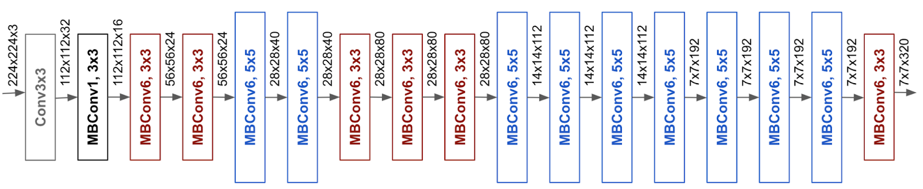
Models and Methods
MobileNetV2
Transfer Learning Models
MobileNetV2
InceptionNetV3
VGG16
ResNet50V2
EfficientNetV2
Custom CNN
Ensembling
Basic averaging
Weighted averages
Class weights
Model optimizer: Adam
Loss function: sparse categorical cross-entropy
InceptionNetV3
VGG16
ResNet50V2
EfficientNetV2
Notes:
MobileNetV2: https://www.researchgate.net/figure/The-architecture-of-the-MobileNetv2-network_fig3_342856036
InceptionNetV3: https://towardsdatascience.com/a-simple-guide-to-the-versions-of-the-inception-network-7fc52b863202
VGG16: https://www.researchgate.net/figure/portrays-the-VGG16-model-for-ImageNet-40-It-has-13-convolutional-layers-and-three_fig2_331562880
ResNet50V2: https://towardsdatascience.com/an-overview-of-resnet-and-its-variants-5281e2f56035
EfficientNetV2: https://ai.googleblog.com/2019/05/efficientnet-improving-accuracy-and.html

Slide 7

Custom CNN Model Architecture
Preprocessing Layers
Convolution and Pooling Layers
Fully Connected and Regularization Layers
Notes:
Looking into our custom CNN model architecture, the first few layers are for preprocessing. We transform the inputs using random rotations, flips, etc. Next, we have a collection of convolution and max pooling layers. Finally, we have a set of fully connected and regularization layers and we used softmax activation to obtain the predicted class.

Slide 8

Custom CNN Model Architecture
Rescaling
Data augmentation
Convolution and max pooling layers
Flattening and dense layers
Regularization (batch normalization, dropout)
Dense softmax layer

Slide 9
Results
Model | Loss | Validation Accuracy | Number of Epochs
MobileNetV2 | 1.4334 | 0.7352 | 120
InceptionNetV3 | 0.9922 | 0.7017 | 90
VGG16 | 1.3468 | 0.5982 | 270
ResNet50V2 | 1.3820 | 0.7061 | 90
EfficientNetV2 | 2.0642 | 0.7676 | 90
Ensemble Model • (1/81) * MobileNetV2 • (39/81) * InceptionNetV3 • (1/81) * VGG16 • (1/81) * ResNet50V2 • (39/81) * EfficientNetV2 | 0.7726 | 0.7773 | 660* *Sum of individual model epochs
Custom CNN | 1.2555 | 0.6968 | 400
Notes:
Moving on to our results, The model with the best loss and validation accuracy is highlighted in red, while the models with the second best loss and accuracy are in blue. Out of the individual transfer learning models, EfficientNetV2 performed the best in terms of accuracy, while InceptionNetV3 performed better in terms of loss. Our custom CNN performed similarly to the ResNet50 architecture. Overall, our best model was the ensemble using weights which favored the InceptionNet and EfficientNet results over the other transfer learning models.

Slide 10
Reflections
Conclusions
Ensemble model outperformed transfer learning and custom models
Not all transfer learning models outperformed custom model
Lowest validation accuracy ≠ lowest loss
Limitations
Preprocessing and balancing the data
Time and computing constraints
Future Work
Explore more weight values for ensemble models
Create additional custom models
Additional evaluation metrics
AUC
F-score
Kappa
Notes:
In conclusion, we found that an ensemble model favoring Inception and EfficientNet was the best predictor of ocular diseases using this dataset. When testing a custom CNN, we found that it was effective when compared to architectures such as VGG16, but not the best overall. We also learned that the model performing best in terms of loss was not the model that performed best when considering accuracy. There were some limitations in our work. Training each model required significant time and computing resources.
We could improve upon our work in the future by testing a wide range of values when choosing how to weigh the results for our ensemble model. Since our custom model performed comparably to other recognized architectures, we could continue to perfect this model or attempt to create additional custom models for this problem. Finally, we could expand our results by taking metrics such as the AUC, F-score, and Kappa into consideration.

Slide 11
Sources
1. “Vision Impairment and Blindness.” World Health Organization. World Health Organization, 2021. https://www.who.int/news-room/fact-sheets/detail/blindness-and-visual-impairment.
2. Larxel. “Ocular Disease Recognition.” Kaggle, September 24, 2020. https://www.kaggle.com/andrewmvd/ocular-disease-recognition-odir5k?select=preprocessed_images.
3. JordiCorbilla. “Jordicorbilla/Ocular-Disease-Intelligent-Recognition-Deep-Learning: Odir-2019. Ocular Disease Intelligent Recognition through Deep Learning Architectures.” GitHub. Accessed March 6, 2022. https://github.com/JordiCorbilla/ocular-disease-intelligent-recognition-deep-learning.
4. Gour, Neha, and Pritee Khanna. “Multi-Class Multi-Label Ophthalmological Disease Detection Using Transfer Learning Based Convolutional Neural Network.” Biomedical Signal Processing and Control 66 (2021): 102329. https://doi.org/10.1016/j.bspc.2020.102329.
5. Li, Cheng, Jin Ye, Junjun He, Shanshan Wang, Yu Qiao, and Lixu Gu. “Dense Correlation Network for Automated Multi-Label Ocular Disease Detection with Paired Color Fundus Photographs.” 2020 IEEE 17th International Symposium on Biomedical Imaging (ISBI), 2020. https://doi.org/10.1109/isbi45749.2020.9098340.
6. Wang, Jing, Liu Yang, Zhanqiang Huo, Weifeng He, and Junwei Luo. “Multi-Label Classification of Fundus Images with EfficientNet.” IEEE Access 8 (2020): 212499–508. https://doi.org/10.1109/access.2020.3040275.
7. He, Junjun, Cheng Li, Jin Ye, Yu Qiao, and Lixu Gu. “Self-Speculation of Clinical Features Based on Knowledge Distillation for Accurate Ocular Disease Classification.” Biomedical Signal Processing and Control 67 (2021): 102491. https://doi.org/10.1016/j.bspc.2021.102491.
8. Demir, Fatih, and Burak Taşcı. “An Effective and Robust Approach Based on R-CNN+LSTM Model and NCAR Feature Selection for Ophthalmological Disease Detection from Fundus Images.” Journal of Personalized Medicine 11, no. 12 (2021): 1276. https://doi.org/10.3390/jpm11121276.

