Slide 1
Characterization of Keto-Reductases for the synthesis of pharmacological relevant secondary alcohols Progress so far
23/02/2021
Bachelor thesis project 2021
Kevin Yar

Slide 2
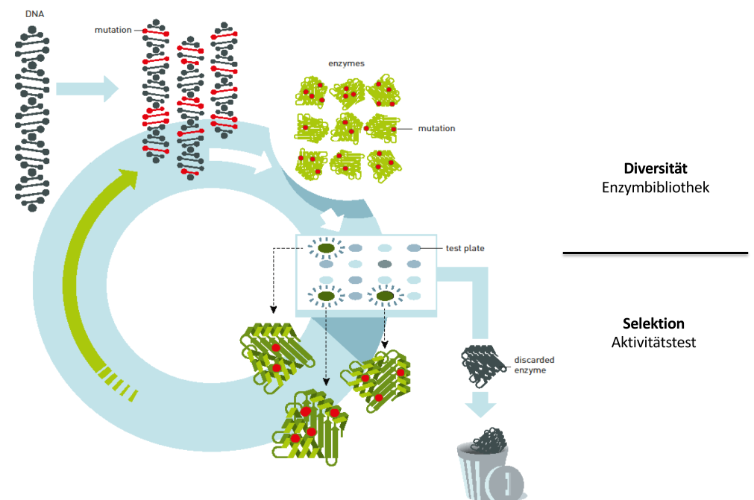
Background
Starting problem:
Enzyme for the reduction of ketones into specific secondary alcohols
Screening for an interesting candidate
via literature search or/and Orthogroup Analysis: Specificity, efficiency, solubility
Best hit (eg. KRED11) shows desired properties
Orthogroup Analysis to find similar Enzymes?
Enzyme Engineering via Rational Protein Design or Directed Evolution?
Can we find a better starting Enzyme through more screening and therefore reduce the cycles of Enzyme Engineering until we reach the desired properties?
n x Cycles < n x Cycles ?
n x Cycles
n x Cycles
www.nobelprize.org
2
Notes:
As for the starting problem:
The goal is to find an enzyme which biocatalsyses a reaction for industrial interests
The first step was to make a literature search followed by an orthogroup analysis the find potential candidates for the reaction.
If a screening is conducted and a best hit was found, the question emerges how to conitune.
We could either go directly to the enzyme engineering part via rational Protein design or directed evolution. Or we repeat the screening procedure to find an even better starting enzyme for the enzyme engineering. In the end the question, which will also partially be answered in my bachelor thesis, is:

Slide 3
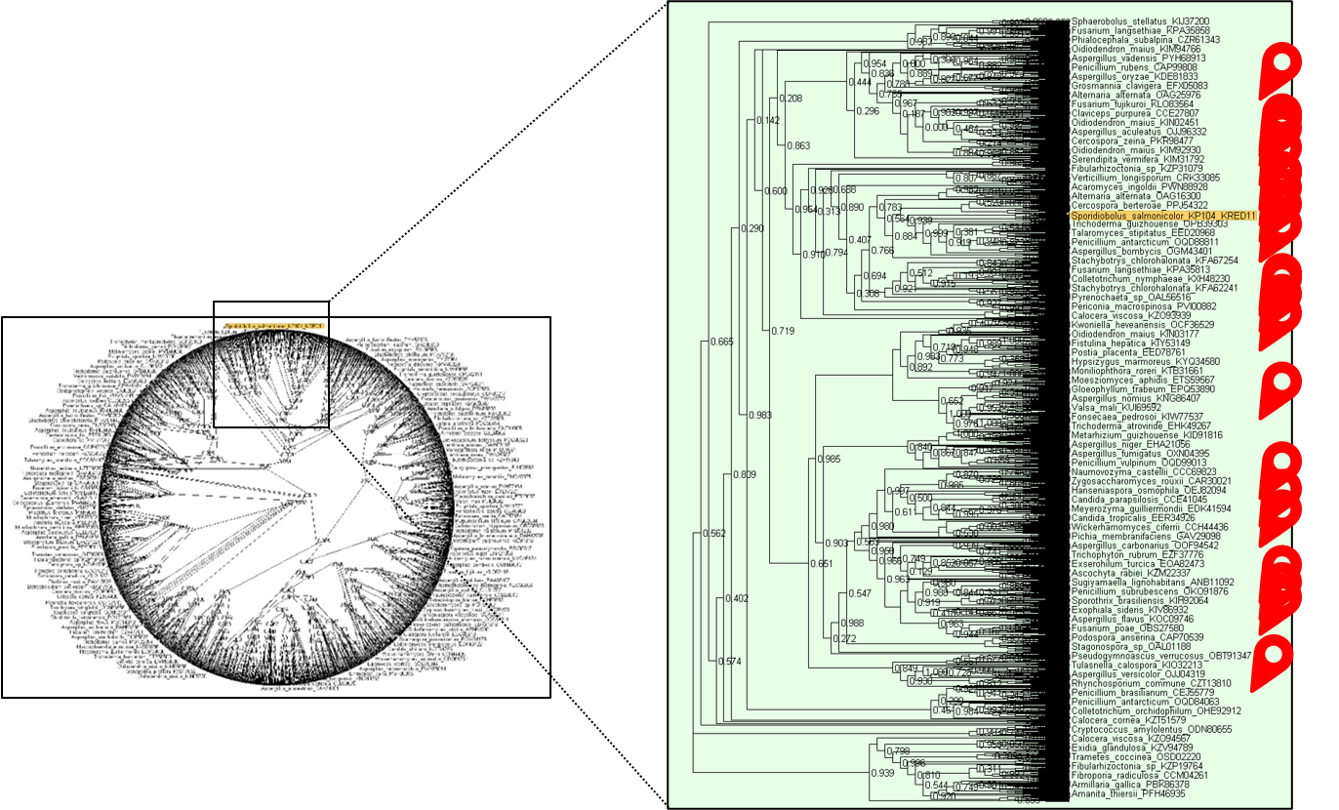
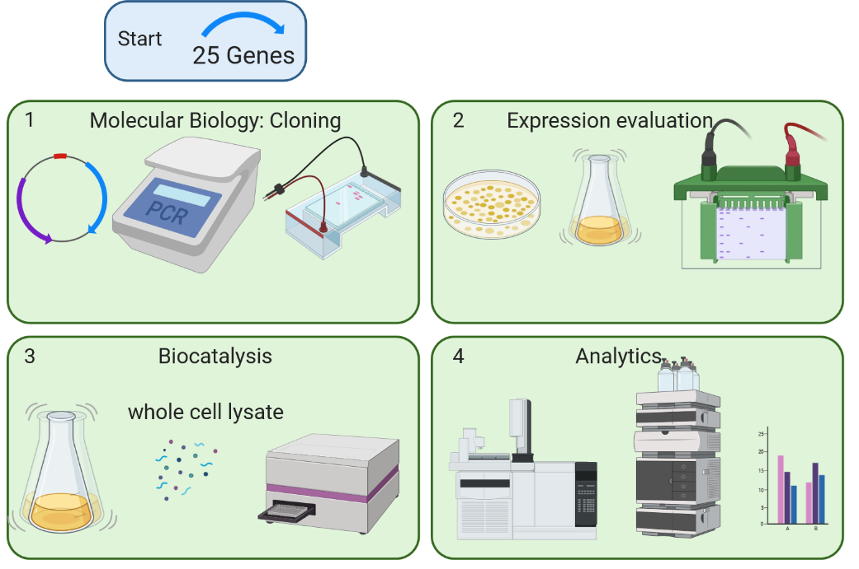
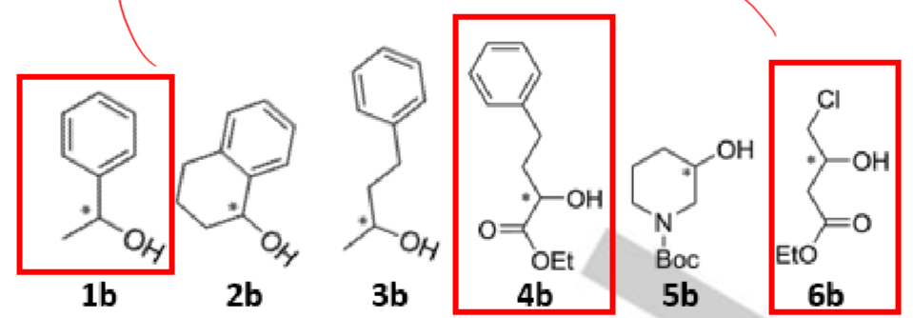
Experimental Overview
Selection of 25 (putative) KREDs for experimental evaluation
Molecular cloning, expression and characterisation towards a set of substrates
24
Sequence Synthesis
-1 Sequence due to production failure
Specificity (Prelog, Anti-prelog), efficiency, stability
Created with BioRender.com Voss et. al
Notes:
For the eperimental overview:
Out of 25 proteins from the KRED11 orthogroup were selected for experimental evaluation.
25 genes ordered, 24 arrived
We then started with Molecular cloning, expression and characterisation towards a set of substrates. With the question in mind Do we see similar functionality? And Are any of these scaffolds better than KRED11 (solubility, thermostability)?
If a promising candidate is identified we will narrow down the search space and perform a second screening round.
If no activity is identified in the first experimental evaluation a different bioinformatics approach will be used to find alternative scaffolds (EnzymeMiner).

Slide 4
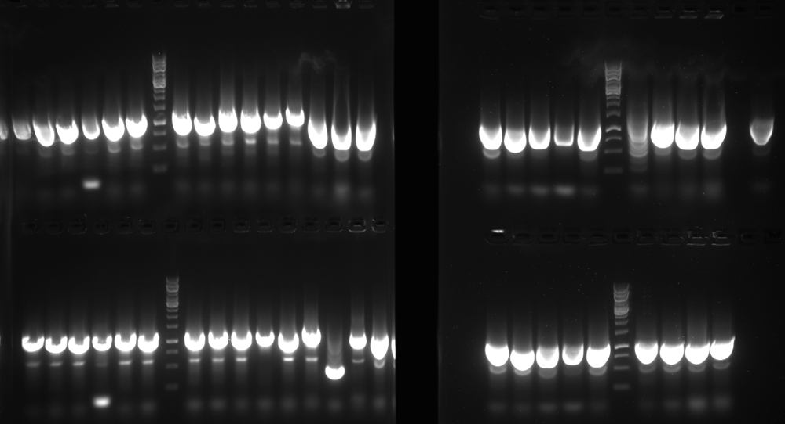
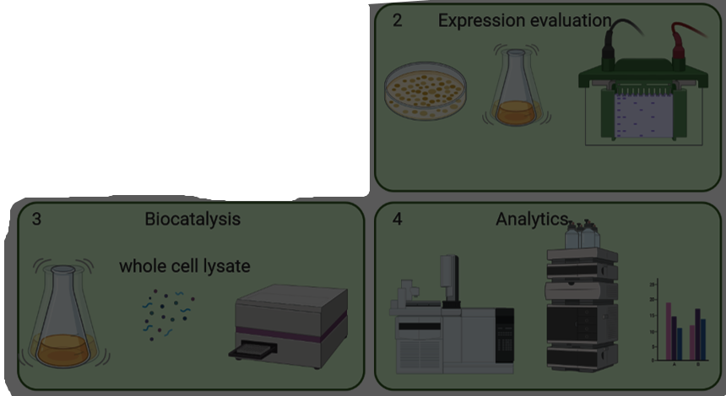

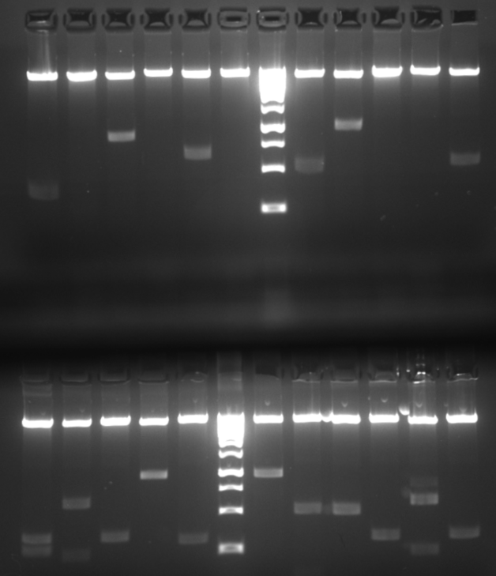
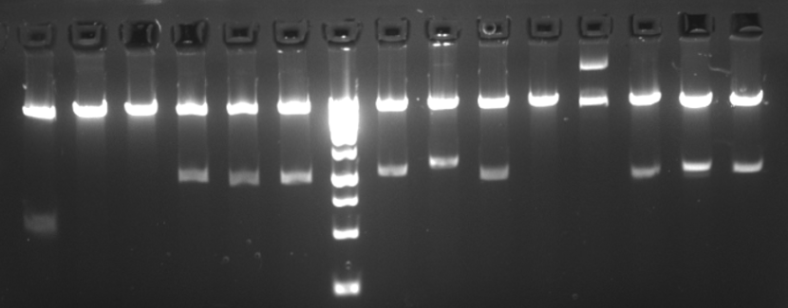
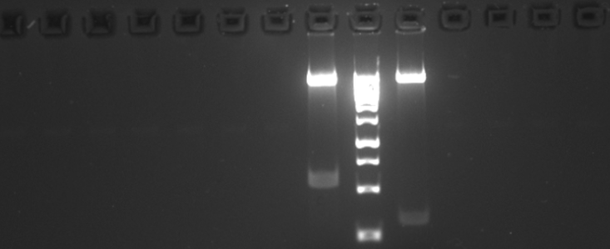
Current Situation
Colony PCR
24
Step
Digestion (Nde1 & Xho1) of KRED-sequence and backbone + ligation
Transformation of pET22b(+)-KREDX in E. Coli BL21 (DE3)
Streaking on Ampicilin LB agar plates
Colony PCR and digestion controle to ensure uptake of Insert
Extern sequencing of Plasmids
Digestion control
( )
Created with BioRender.com
Notes:
Right now we’re still at the Cloning step.
We digested and ligated the KRED sequences and backbone with NDe1 & Xho1
We Transformed the Plasmid into e. coli bl21
Streaked the on ampicilin lb agar plates
And roughly checked the correct uptake of the plasmid via colony pcr followed by a digestio control.
Of all the clones only 2 have to be re-analysed .
After this we can proceed to the expression part

Slide 5
Outline and aim of the thesis
Out of 25 proteins from the KRED11 orthogroup were selected for experimental evaluation.
25 genes ordered
Molecular cloning, expression and characterisation towards a set of substrates.
Do we see similar functionality?
Are any of these scaffolds better than KRED11 (solubility, thermostability)?
If a promising candidate is identified we will narrow down the search space and perform a second screening round.
If no activity is identified in the first experimental evaluation a different bioinformatics approach will be used to find alternative scaffolds (EnzymeMiner).

