Slide 1
Timeline Requirements
Benjimin Aaron
Eric Berryhill
Daniel Caudle
Brian Pecot
Colt Wrobel

Slide 2
Topics
Project Description
Requirements
Functional
Non-Functional
Competitors Table
Diagrams / Images
Priorities

Slide 3
Problem
Current calendar and messaging apps lack the ability to quickly, easily compare schedules in order to plan for future events involving numerous participants.
E.g. project group meeting times

Slide 4
Solution
A personal schedule application that contains conventional methods for creating and manipulating schedules, with the added functionalities of sharing and comparing schedules.
Schedules will be generated as a “Timeline”, which emphasizes a linear time progression.

Slide 5
Project Description
Time visualization
See time linearly, instead of as a grid.
Time management
Create events like any other scheduling app
Share timeline
Combine timelines
Automatically analyze combined timelines to see conflicts or shared free-time

Slide 6
Functional Requirements
Create a Timeline
Create/Add Events
Simple Queries of Timeline
Share Timeline
Combine and Compare Timelines

Slide 7
Non-Functional Requirements
Display a schedule linearly – a timeline
Compare shared Timelines and provide visual feedback
Communicate with Database structure to pull/push user’s Timeline(s) and Event(s).
Import calendar/events from Google Calendar API

Slide 8
Competitor Comparison Table
 | Schedule Creation | Event Creation | Share Schedule | Event Invitation | Schedule Comparison
Google Calendar | + | + | + | + | -
Facebook | - | + | + | + | -
GroupMe / Slack | - | + | - | - | -
Outlook | + | + | + | + | -
TimeTree | + | + | - | + | -

Slide 9
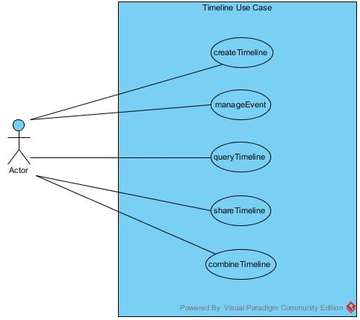

Slide 10
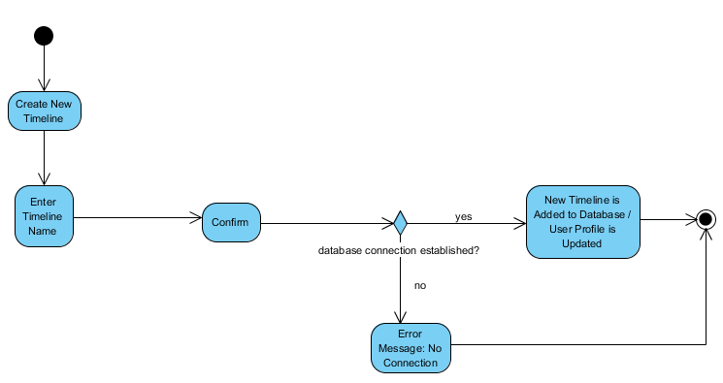
Create Timeline – Activity Diagram

Slide 11
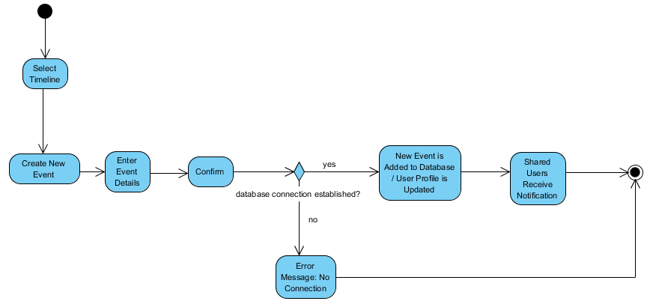
Create Event – Activity Diagram

Slide 12
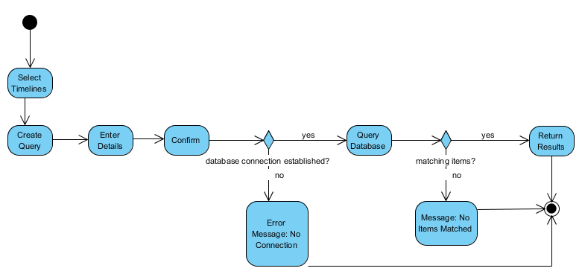
Query Timeline – Activity Diagram

Slide 13
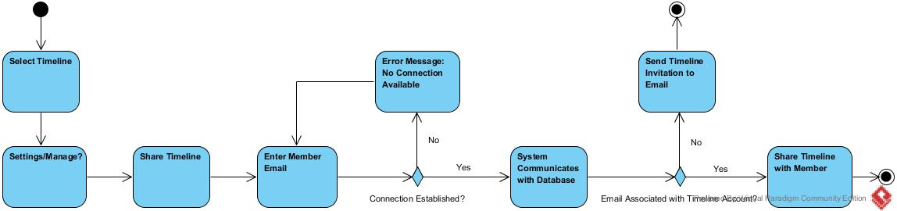
Share Timeline – Activity Diagram

Slide 14
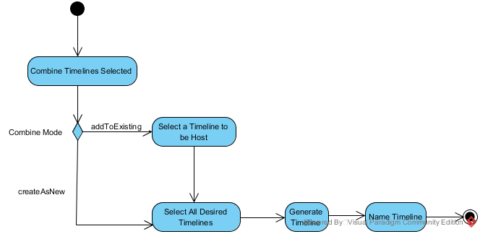
Combine Timelines – Activity Diagram

Slide 15
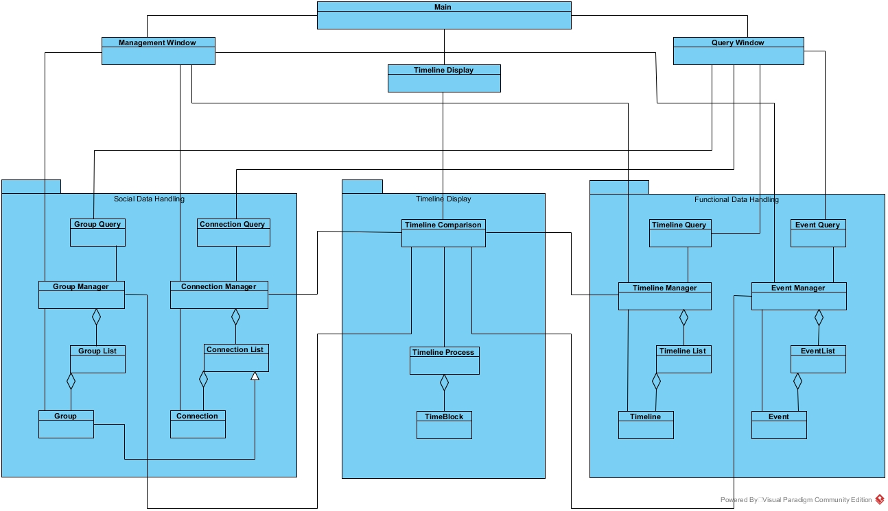
Class Diagram

Slide 16
Priorities
1. Primary: Create, Populate, Share, Combine/Compare Timelines
2. Possible: Google Calendar API integration
3. Future if Time Allows: Automated invitations and Group Management

Slide 17
Potential Risks
Improper database integration: Learning to implement Firebase could delay functionality in the short-term.

