Slide 1
Introduction to ZeroMQ
26 April 2012
Pieter Hintjens, iMatix

Slide 2
Why did we need ØMQ?
Moore's Law means more moving pieces
Cost of connecting pieces was too high
  Custom TCP or UDP
  Broker-based messaging
  Clumsy RPC solutions
We needed cheaper connectivity
It had to be fast and simple

Slide 3
What is ØMQ?
Intelligent “socket” library for messaging
Many kinds of connection patterns
Multiplatform, multi-language (30+)
Fast (8M msg/sec, 30usec latency)
Small (20K lines of C++ code)
Open source LGPL (large community)

Slide 4
ØMQ Hello World
import org.zeromq.ZMQ;
public class hwclient {
public static void main (String[] args){
ZMQ.Context context = ZMQ.context (1);
ZMQ.Socket socket = context.socket (ZMQ.REQ);
socket.connect ("tcp://localhost:5555");
socket.send ("Hello", 0);
System.out.println (socket.recv(0));
}
}
import org.zeromq.ZMQ;
public class hwserver {
public static void main (String[] args) {
ZMQ.Context context = ZMQ.context(1);
ZMQ.Socket socket = context.socket(ZMQ.REP);
socket.bind ("tcp://*:5555");
while (true) {
byte [] request = socket.recv (0);
socket.send("World", 0);
}
}
}

Slide 5
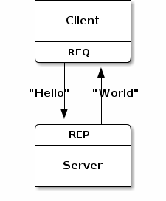
Request-Reply Pattern

Slide 6
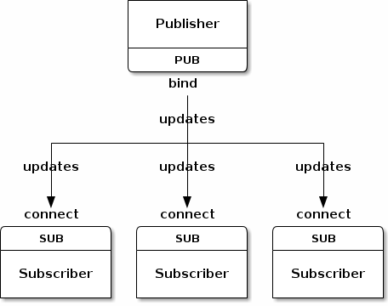
Publish-Subscribe Pattern

Slide 7
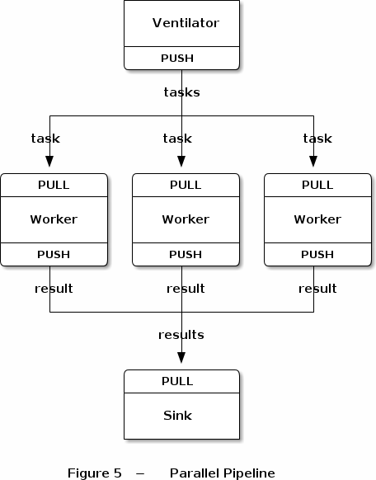
Pipeline Pattern

Slide 8
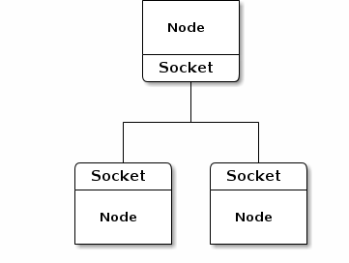
Simple ØMQ Application

Slide 9
ØMQ Transports
Threads in one process (inproc://)
Processes on one box (ipc://)
Processes on one network (tcp://)
Multicast group (pgm://)
Experimental UDP (VTX project)

Slide 10
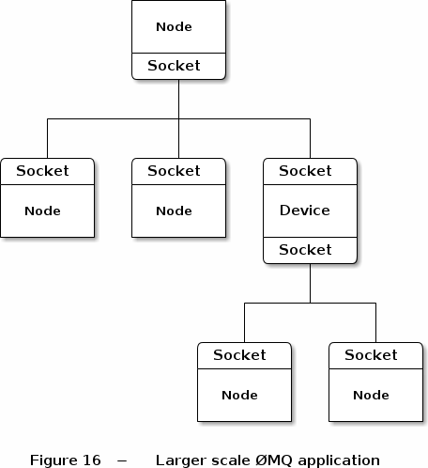
Multihop ØMQ Application

Slide 11
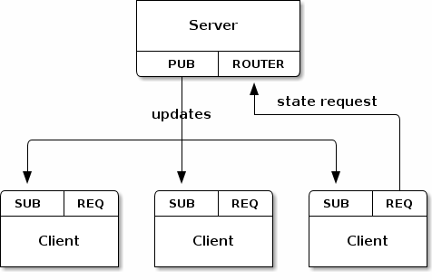
Typical ØMQ Design

Slide 12
ØMQ Low-level Routing
Synchronous request-reply (REQ, REP)
Async round-robin (PUSH, DEALER)
Fair-queuing (PULL, DEALER)
Multicast output (PUB)
Filtered fair-queuing input (SUB)
Unicast (PAIR)
Explicit addressing (ROUTER)

Slide 13
ØMQ High-level Patterns
Least-recently used queue
Majordomo and Titanic
Lazy, Simple, and Paranoid Pirates
Binary Star
Freelance
Clone
Suicidal Snail

Slide 14
ØMQ Features
Mix any languages and platforms
Message blobs of 0 to N bytes
One socket connect to many sockets
Mix transports and connections
Queuing at sender and receiver
Automatic TCP (re)connect
Zero-copy for large messages

Slide 15
ØMQ for Multithreading
Don't use locks, semaphores, mutexes
Design app as message-driven tasks
Each task reads from 1..n sockets
Tasks can talk over inproc://
Tasks can be split into processes over tcp://
No wait states, no locks, full CPU use
Scalable to any number of cores

Slide 16
ØMQ Benefits
Start with simple / fast languages
Move to faster languages where needed
Run on arbitrary platforms (Windows, Android)
Scale to arbitrary sizes (2 cores, 16 cores...)
No per-core or per-seat licensing
Easy to experiment and learn

Slide 17
Working with ØMQ
Rapid prototyping of main components
Small protocols for main flows
ØMQ patterns for main flows
Break components up for performance
Profile and test
Improve incrementally over many cycles
See http://unprotocols.org

Slide 18
ØMQ Origins
iMatix history of enterprise middleware
2004 – AMQP standard for JPMorganChase
2005 – OpenAMQ message broker/client
2008 – ØMQ/0.x for the avant-garde
2009 – ØMQ/1.x for pioneers (finance)
2010 – ØMQ/2.x for early adopters (foss)
2011 – ØMQ/3.x for mass market (cloud)

Slide 19
ØMQ Community
Large, 24/7 community of experts
1,000 people on dev list, 150 on IRC
Responsible for everything:
  Core development & packaging
  Language bindings (35 or more)
  Events and presentations
ØMQ is 100% owned by the community
  Which iMatix is a happy part of

Slide 20
ØMQ Change Process
C4 process: http://rfc.zeromq.org/spec:16
Github fork + pull request taken further
Separate “maintainer” from “contributor”
Minimize friction for contributors
Maximize scale & diversity of community
No demands, no promises, no leaps
Instead, slow incremental improvements

Slide 21
ØMQ Licensing
LGPLv3 with static link exception
  Compatible with all sane use cases
Co-owned by all contributors
  Lower friction for contributors
  Lower risk of hijack
No commercial license option
  Level playing field for all

Slide 22
What does iMatix do?
Tyrant of the ØMQ community
Small focussed investments in ØMQ
Education and evangelism
Document and enforce successful policies
Ensure ØMQ community is sustainable
Help clients use ØMQ in their projects

Slide 23
One Slide on Me
What I do is to identify and solve problems
Technological, social, political, whatever
Observe, Measure, Understand, Express
Try to be accurate, rather than be right
Embrace failure as the only teacher
Help others become happier
Profit is an excuse, money is a tool

Slide 24
ØMQ Resources
www.zeromq.org – main web site
zero.mq – community wiki
#zeromq – IRC channel on Freenode
zeromq-dev – email list on zeromq.org
github.com/zeromq – git repositories
zguide.zeromq.org – user guide
api.zeromq.org – reference manual

