Slide 1

Analysis of Academic Research in Turkey
CS452: Data Science With Python
TERM PROJECT PRESENTATION
Prepared by:
Yiğit KARTAL
Ceyhun TOPAL

Slide 2
Contents
Introduction
Methodology Overview
Data Collection
Data Integration
Gender Classification Problem
Statistical Analyses & Visualization
Discussion
Conclusion

Slide 3
Introduction
Academic research serves as one of the cornerstones of societal and technological advancement. It plays a critical role in shaping economies, driving innovation, and fostering international collaborations.
Turkey's Context:
Rapidly growing higher education sector.
Unique case study to examine academic output and trends over time.
Key Insights:
Gender-based analyses reveal higher participation of women in Turkish academia compared to Western countries.
Comprehensive analysis focuses on temporal trends, gender-based disparities, institutional rankings, and publication preferences.
Challenges Addressed:
Accounting for the absence of gender identifiers in YÖK (Turkish Higher Education Institute) dataset resolved using SQL-based name-gender classification.
Robust data cleaning/merging methodologies, handling diverse formats and missing fields.

Slide 4
Methodology Overview
Data Sources:
Web of Science (WoS): Scholarly publication details (titles, authors, dates, citations, performance scores etc.).
YÖK (Turkish Higher Education Institution): Academic profiles (names, affiliations).
Data Integration Methods:
Cross-matching using Python libraries and data-frame objects.
Standardization and normalization of datasets.
Handling missing/corrupted information by joining datasets, using external models such as gender-classification and name-matching models.

Slide 5
Data Collection
Primary Data Sources:
Web of Science (WoS) database and the YÖK (Turkish Higher Education Institution) website.
Web of Science Dataset:
Extracted detailed information on all academic publications in Turkey.
Included publication titles, author names, publication years and dates, associated institutions, and performance criteria (e.g., citation count, WoS score).
YÖK Dataset:
Comprehensive list of academics in Turkey with their names, surnames, and affiliated universities.
Employed Selenium library to scrape YÖK website for academic profiles, university by university.
Challenges:
Manual extraction from WoS and merging data chunks into one big dataset.
Addressing diverse data formats and integrating information accurately.

Slide 6
Data Integration
Key Steps in Integration
Standardization:
Uniformity in data fields (e.g., names, university names).
Applied string normalization (lowercasing, special character removal).
Conformed names to "Surname, Name" format and handled naming variations.
Matching Algorithms:
Used Python’s rapidfuzz library for name similarity scores.
Matched names with similarity above a certain threshold.
Validation:
Accuracy checks through manual spot-checking.
Consistency checks for high-confidence matches.

Slide 7
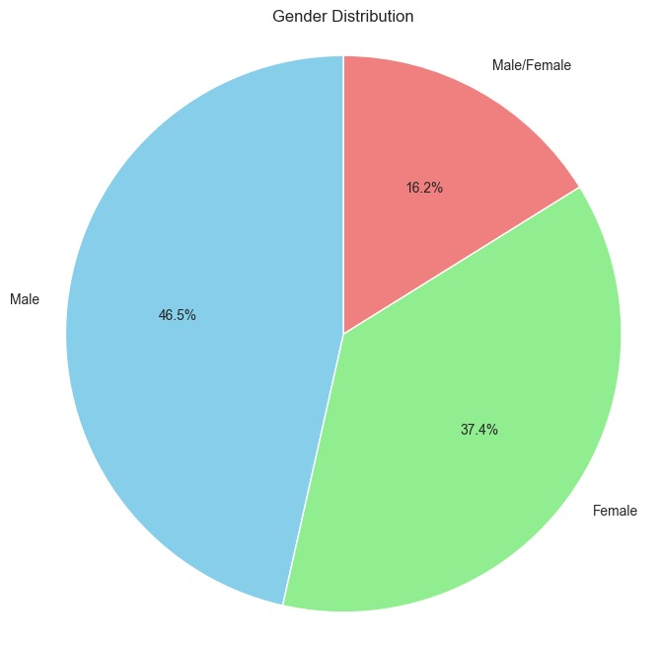
Gender Classification Problem
Problem: Gender not explicitly available in the YÖK dataset.
Solution:
Implemented a name-based gender classification model.
Utilized an SQL database containing name-gender mappings derived from historical and cultural records.
Focused on minimizing classification errors for ambiguous or gender-neutral names through calibration.

Slide 8
Statistical Analyses and Visualization
Statistical Analyses
Temporal Trends: Annual performance scores aggregated over time.
Gender-Based Distributions: Analyzed publication counts and scores by gender.
Institutional Rankings: Top 20 universities ranked by performance scores and academic staff.
Faculty Ranking: Highlighted top 20 faculties by publications and female participation ratios.
Nature of Publications: Examined distribution of publication languages and document types.
Visualization
Created bar charts, line graphs, scatter plots, and pie charts using Python's Matplotlib library.
Emphasized clarity and interpretability for diverse stakeholders.

Slide 9
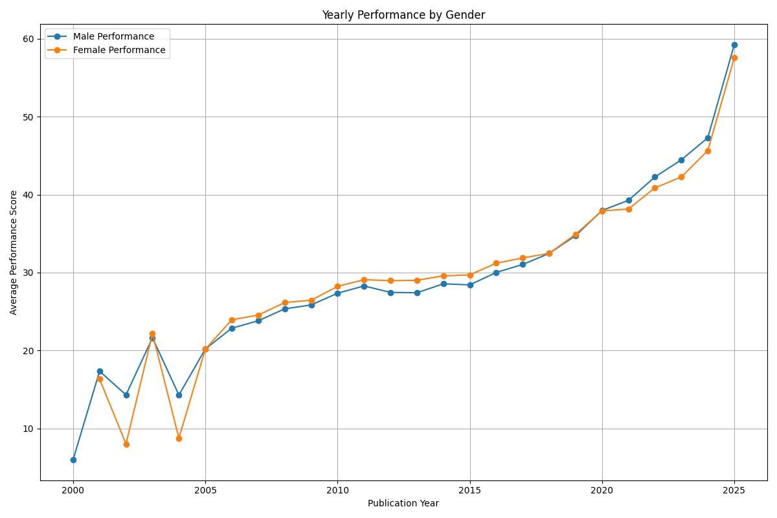
Gender-Based Publication Trends
Figure: Yearly average performance scores classified by gender.

Slide 10
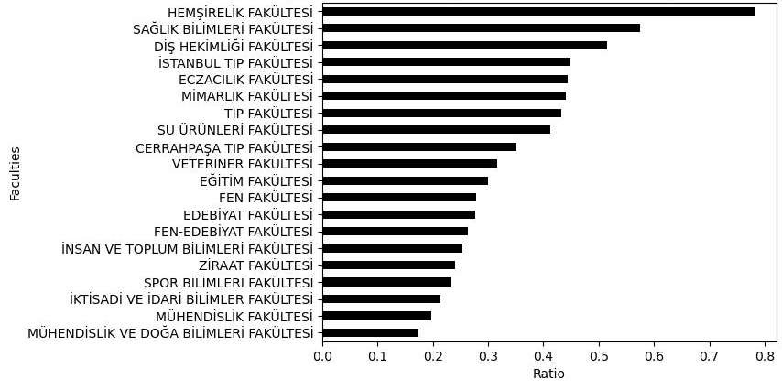
Gender-Based Publication Trends
Figure: Top 20 faculties in Turkey with highest ratio of publications by female academics.

Slide 11
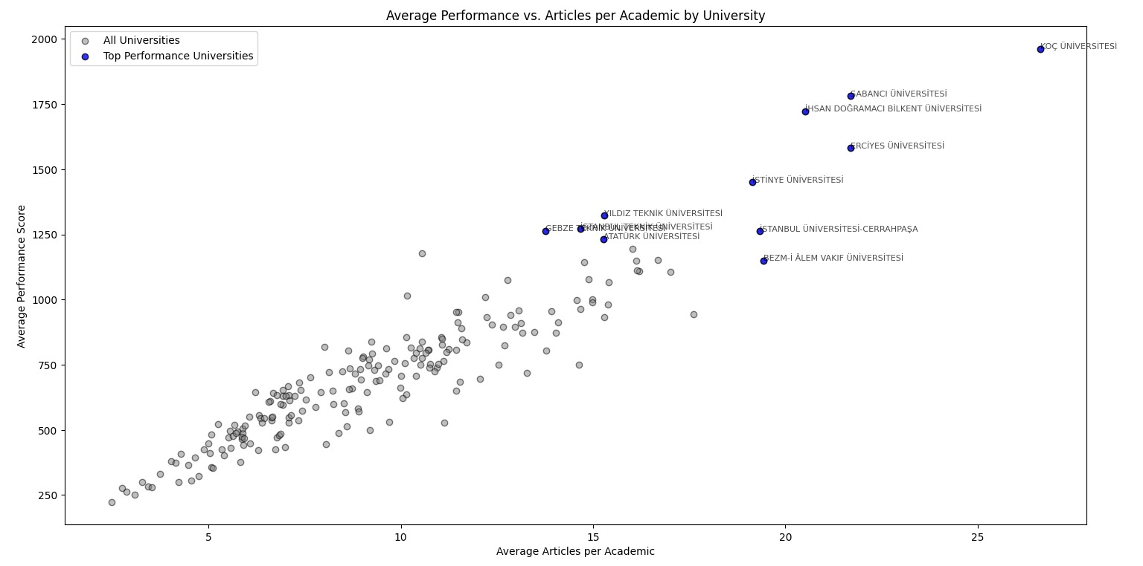
Institutional Performance
Key Insights:
Koç University, Sabancı University, and Bilkent University are notable outliers.
These universities demonstrate high productivity and performance scores.
Strong emphasis on research quality and output.

Slide 12
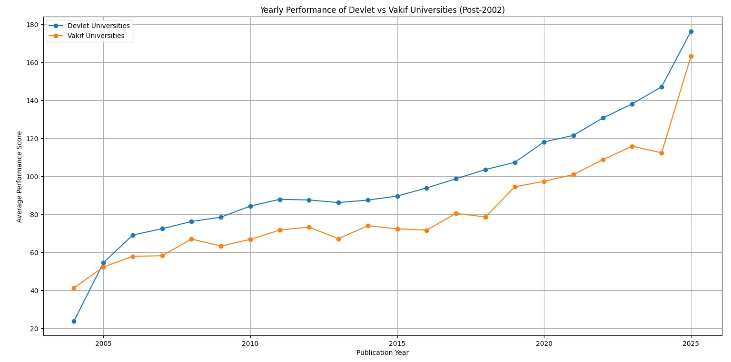
Yearly Performance Trends of State vs. Foundation Universities
Key Findings:
State universities consistently outperform foundation universities.
The gap in performance has narrowed in recent years.
Reflects increased competitiveness and investment in foundation universities.

Slide 13
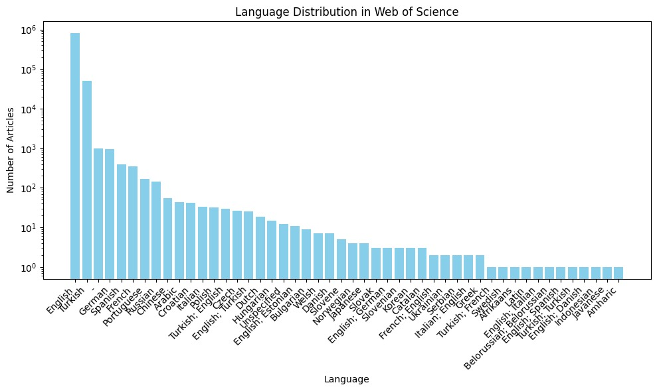
Publication Characteristics

Slide 14
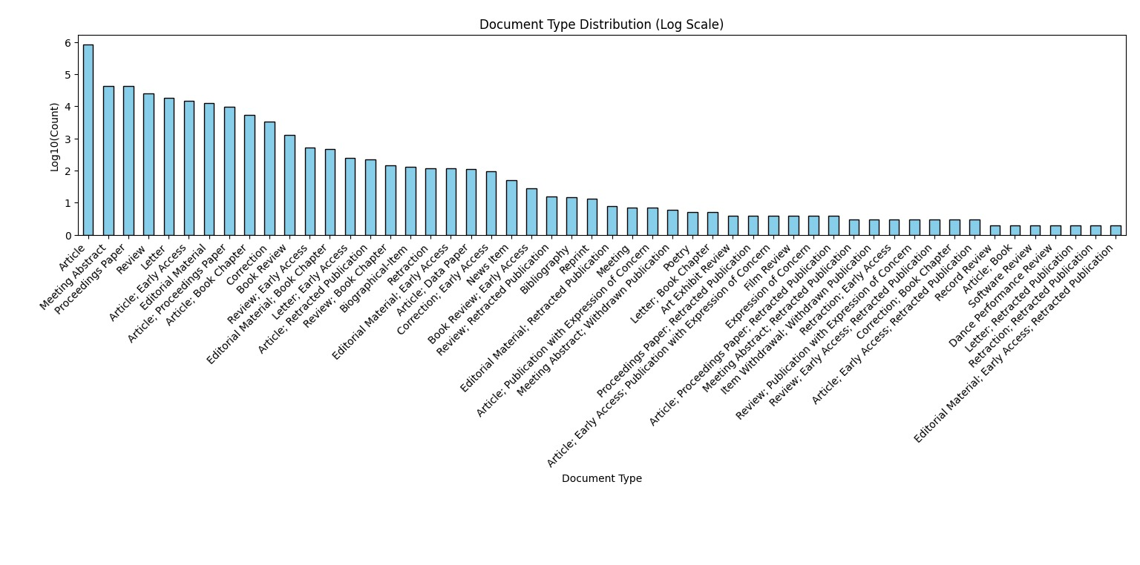
Publication Characteristics

Slide 15
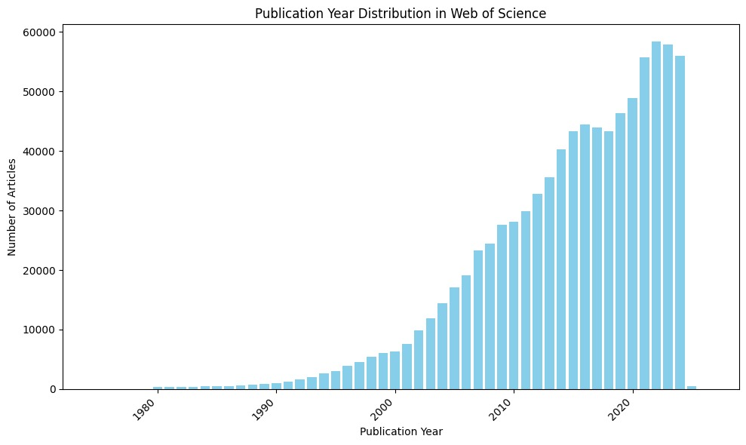
Publication Volume Over Time
Key Findings:
The yearly distribution of publications shows a significant increase from 1980 to the present.
This growth correlates with the expansion of the Turkish higher education system and increased research funding.

Slide 16
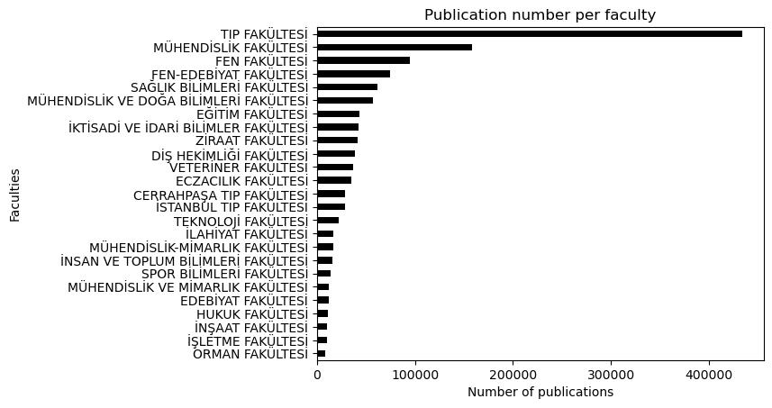
Publication Volume based on Faculties
Figure: Top 20 faculties in Turkey with highest number of publications.

Slide 17
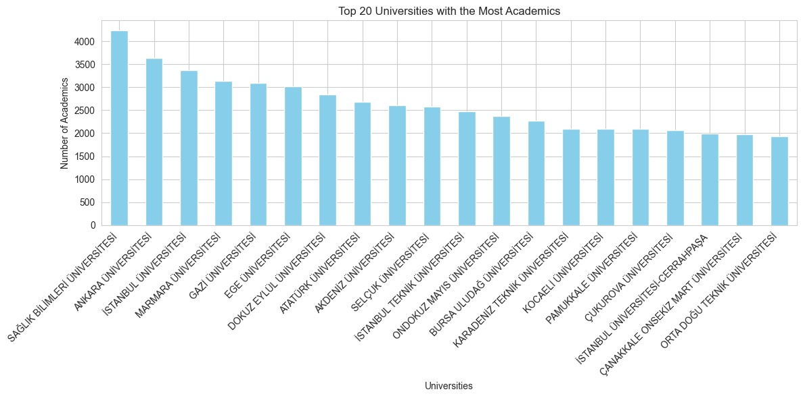
Complementary Statistics – Top 20 Universities with Most Academics

Slide 18
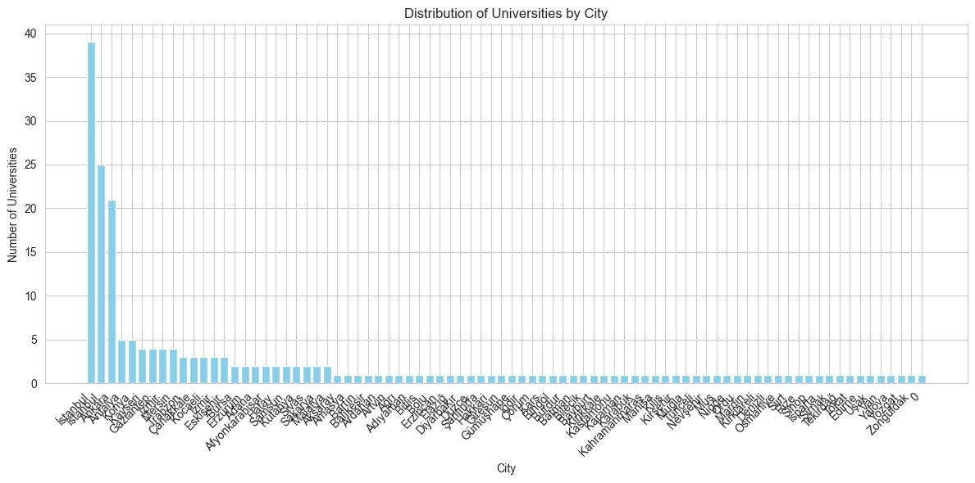
Complementary Statistics – Number of Universities in Turkish Cities

Slide 19
Discussion
Key Observations
Gender Trends:
Female academics lead contributions in Nursing and Health Sciences.
Narrowing performance gaps indicate progress, but engineering still lags.
Institutional Performance:
State universities dominate output; foundation universities are growing but need support.
Publication Characteristics:
English dominates for global collaboration.
Focus on journal articles; more diverse formats like conference papers needed.
Regional Distribution:
Publications concentrated in Istanbul and Ankara.
Need to support less-represented regions for balanced development.
Performance Outliers:
Institutions like Koç, Sabancı, and Bilkent excel due to strong funding and policies.

Slide 20
Conclusion
Comprehensive Analysis:
Integrated data from Web of Science (WoS) and YÖK databases.
Explored trends in publication output, gender representation, and institutional performance.
Key Findings:
Highlighted the growing contributions of female academics.
Emphasized the pivotal role of state universities.
Identified English as the dominant publication language.

