Slide 1
CookBook
Cezar Buna
Agoston Eduard Alexandru

Slide 2
Why have we choosen this project?
We wanted a challenge to imitate the social media
It’s a interactive subject
We wanted to make something user friendly
It requires implementing all the CRUD functionalities

Slide 3
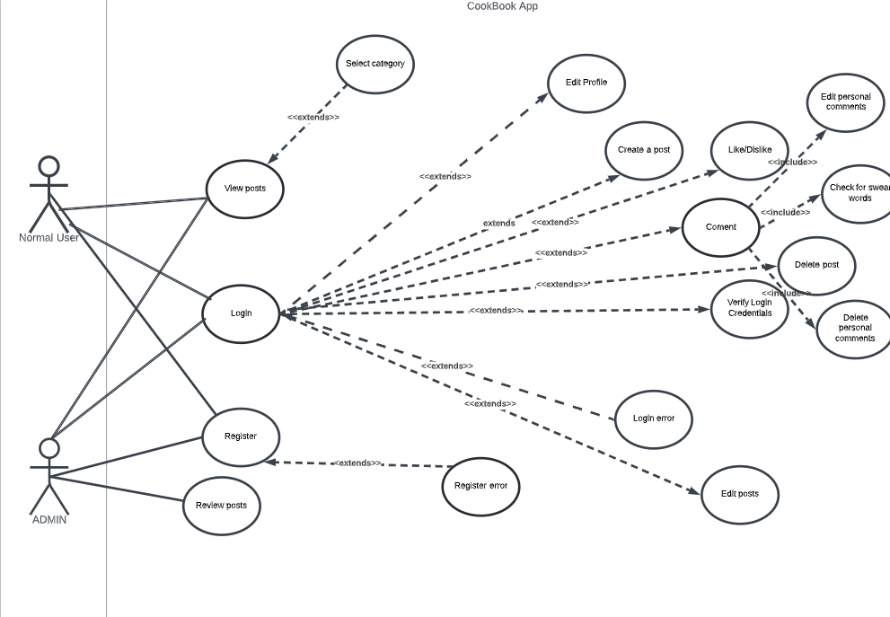
Use case diagram

Slide 4
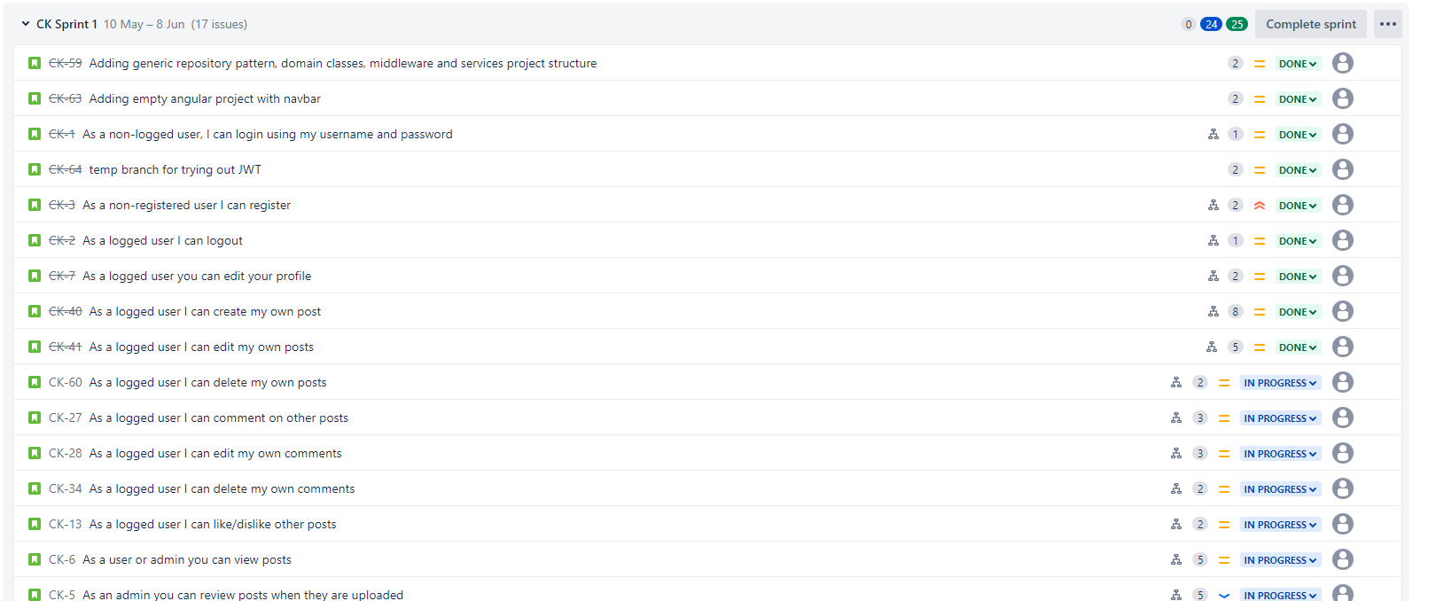
Story overview from Jira

Slide 5
Work split
We made a project diagram
We made the tasks and subtasks
We both worked on the back-end(Cezar worked more on the functionalities and Alex more on the tests)
We collaborated on the front-end(almost equally)

Slide 6
GitHub
Number of commits made by each member:
-Alexandru: 50
-Cezar: 86
!! Note 1: There are multiple github accounts on the repository(2 for each one I believe) because of several issues
!!Note 2: There are about 20 bad commits(some of which are on the main branch), because Cezar messed up and pushed to the main branch(by accident), which caused a lot of issues that were finally solved

Slide 7
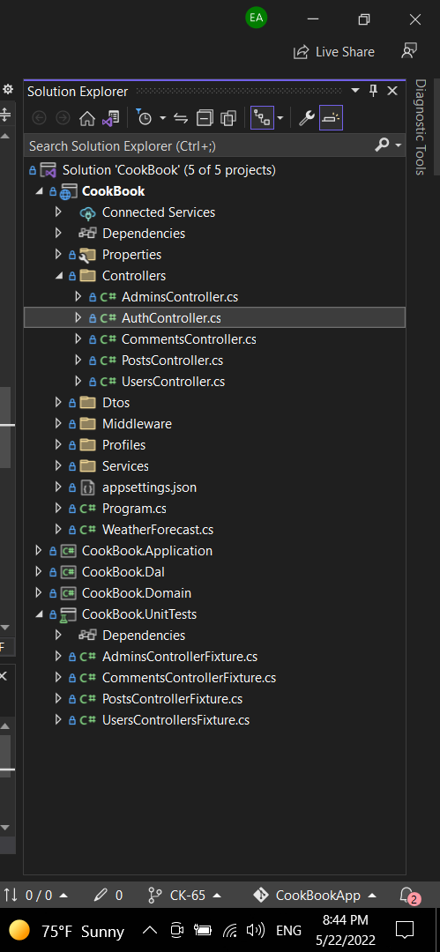
Test
We tested all the back-end methods that perform read or write operations

Slide 8
Project Structures
We used C# in Visual studio2022 for the back-end
SQL for the database
Angular for the front-end

Slide 9
Back-end
Our solution is made out of 4 projects:
The Domain project contains all the models(base entities)
The Dal contains the connection to the database , the entity type configurations and the generic repository pattern
The Application is based on the CQRS pattern, meaning it contains commands , queries and their respective handlers
The Web API contains the entity controllers , data transfer objects , middleware , profiles and services
The web API
The Application
The DAL(data acces layer)
The Domain

Slide 10
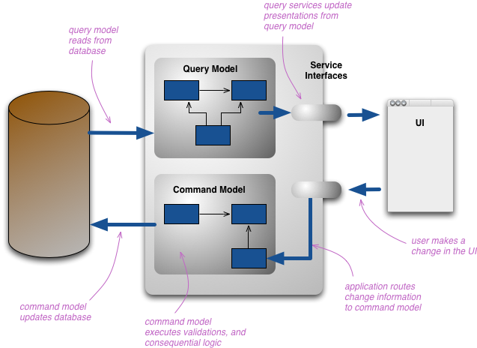
CQRS pattern

Slide 11
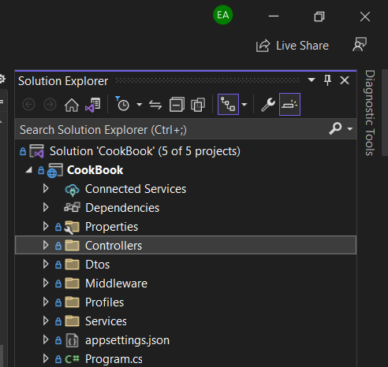
Web API

Slide 12
Thank you for your time !!!

