Slide 1
Real Time Analytics Project

Slide 2
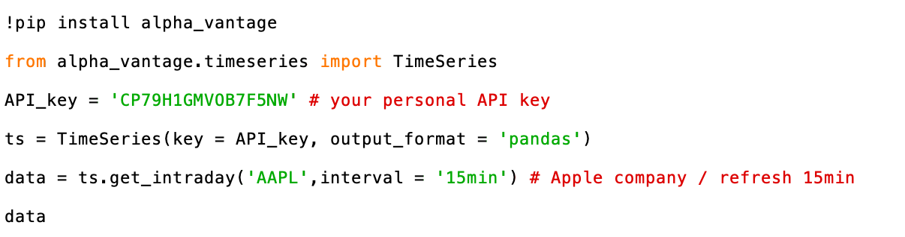
Get Data with API
𝐒𝐭𝐞𝐩𝐬 𝐭𝐨 𝐅𝐨𝐥𝐥𝐨𝐰：
First of all, Claim your free API. (Customer Support | Alpha Vantage)
Secondly, do "pip install alpha_vantage"
Finally, using API key, get the financial data.

Slide 3
How do APIs work?
An application programming interface is a set of rules that define how computers, applications, or machines can talk to each other.
Most web APIs sit between the application and the web server. The user initiates an API call that tells the application to do something, then the application will use an API to ask the web server to do something. The API is the middleman between the application and the web server, and the API call is the request. And every time you use software to communicate with other software or online web servers, you’re using APIs to request the information you need.
The Alpha Vantage API is a method to obtain historical and realtime data for several markets. You can access the data directly in Python or any other programming language of your choosing. From there, you can manipulate the data or store it for later use. Alpha Vantage proudly offers its service for free. They provide a generous rate limit of 5 requests per minute and 500 requests per day.

Slide 4
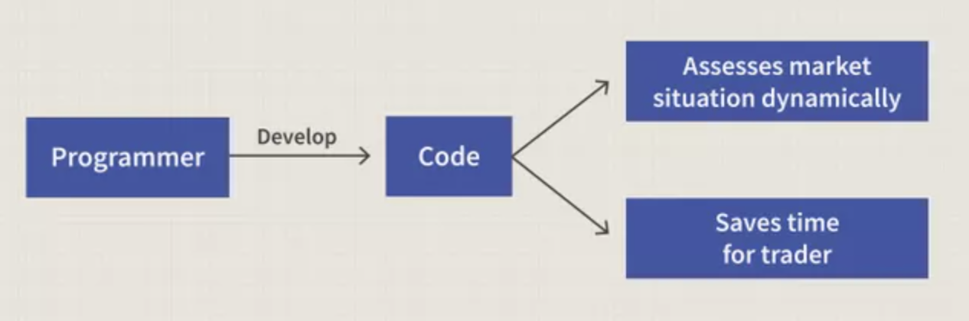
Algorithmic trading
Algorithmic trading is a process for executing orders utilizing automated and pre-programmed trading instructions to account for variables such as price, timing and volume. An algorithm is a set of directions for solving a problem. Computer algorithms send small portions of the full order to the market over time.
Algorithmic trading makes use of complex formulas, combined with mathematical models and human oversight, to make decisions to buy or sell financial securities on an exchange. Algorithmic traders often make use of high-frequency trading technology, which can enable a firm to make tens of thousands of trades per second. Algorithmic trading can be used in a wide variety of situations including order execution, arbitrage, and trend trading strategies.

Slide 5
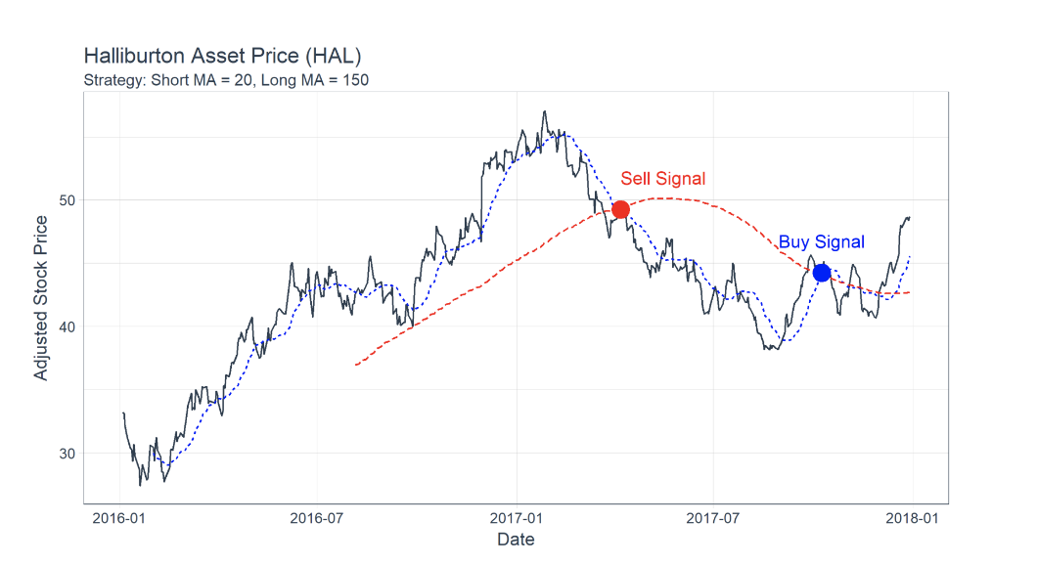
Real time stock data analysis
Real time analytics refers to the process of preparing and measuring data as soon as it enters the database. In other words, users get insights or can draw conclusions immediately (or very rapidly after) the data enters their system.
Real-time analytics allows businesses to react without delay. They can seize opportunities or prevent problems before they happen.
Real time analytics provides signal alerts based on historical price action.

Slide 6
Manipulation packages
Pandas
NumPy
Matplotlib

Slide 7
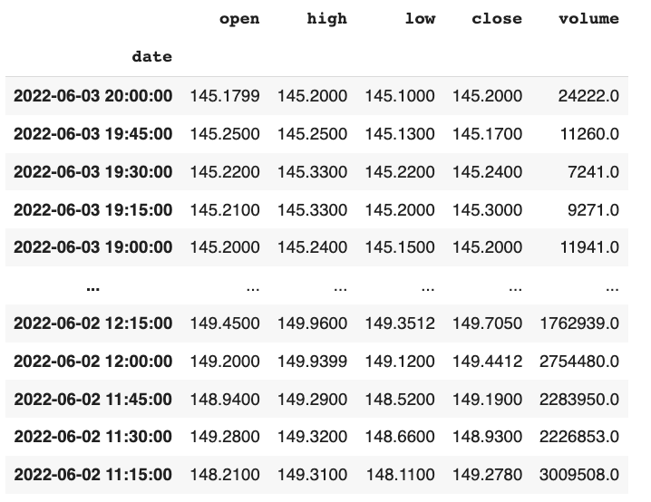
Times Series

Slide 8
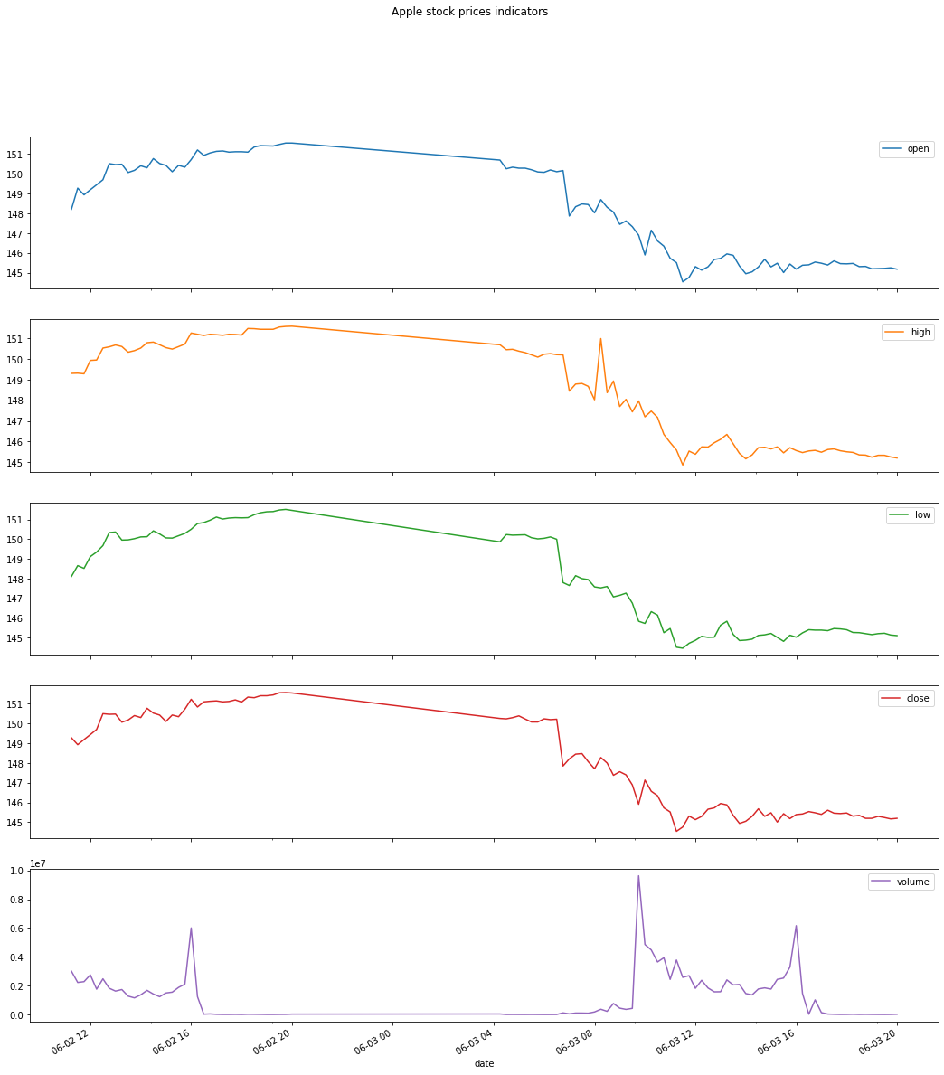
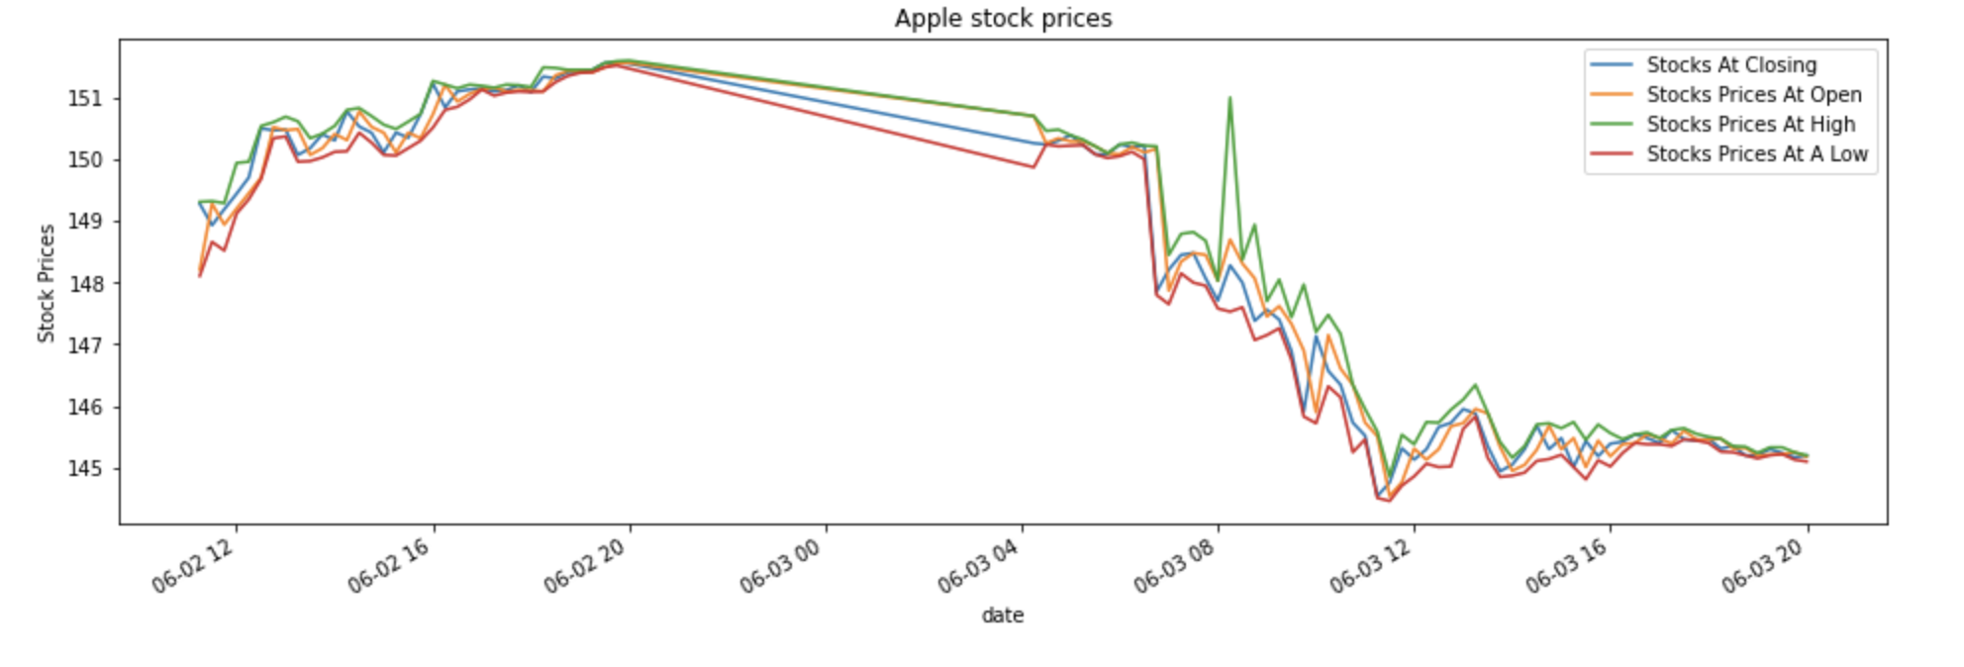
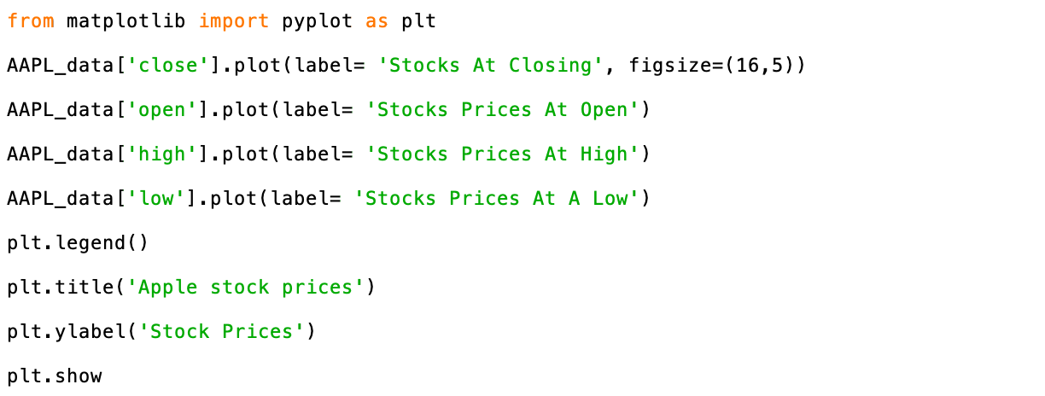
Explanatory Data Analysis (1)

Slide 9
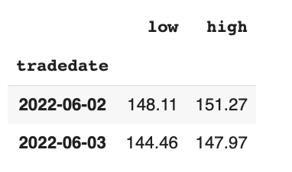
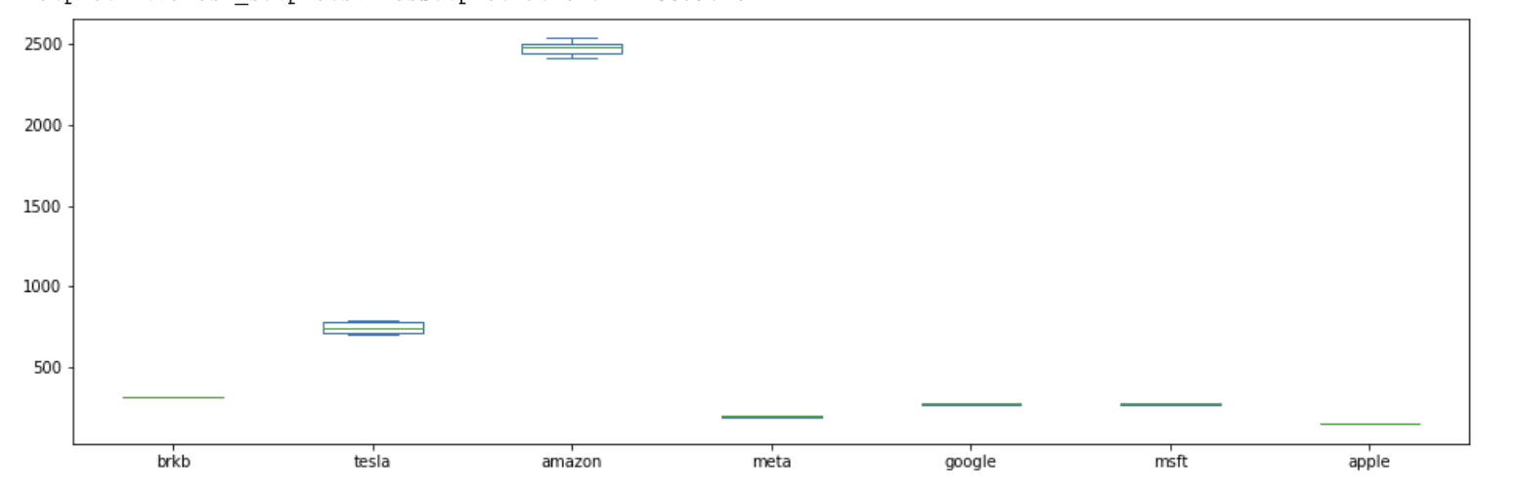
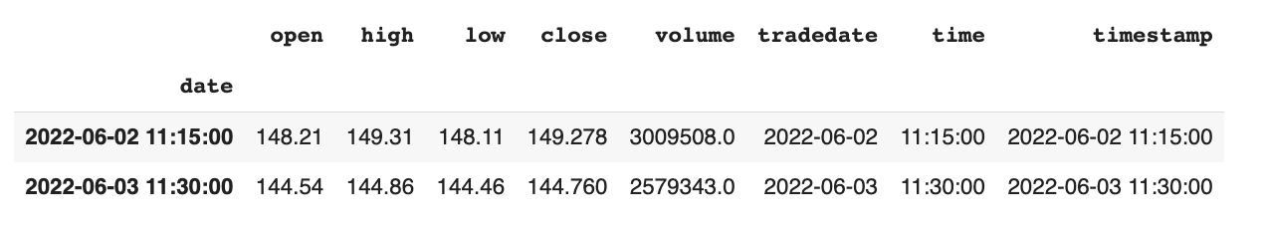
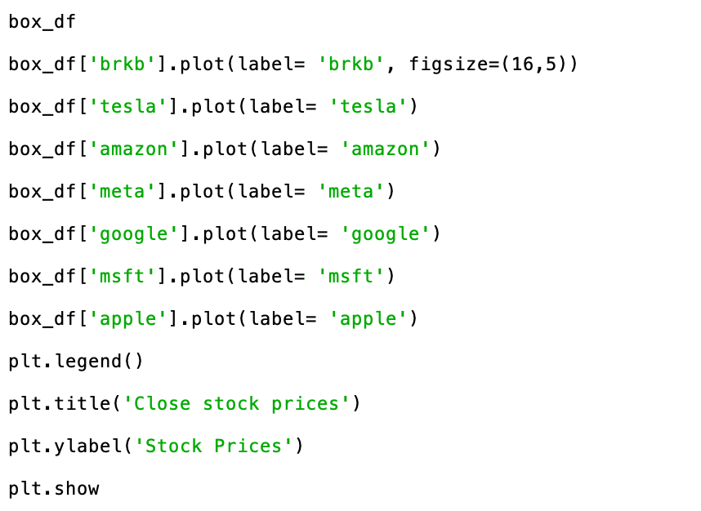
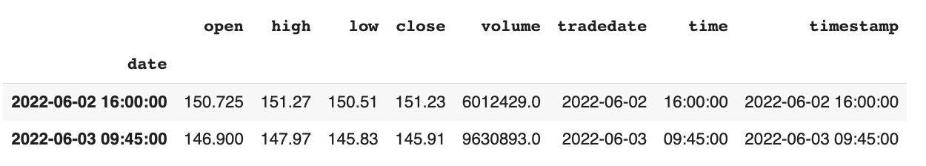
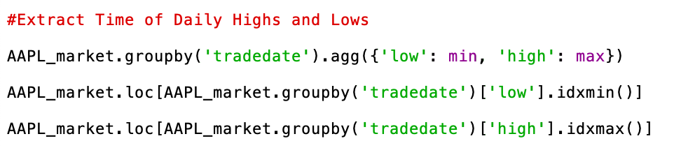
Explanatory Data Analysis (2)

Slide 10
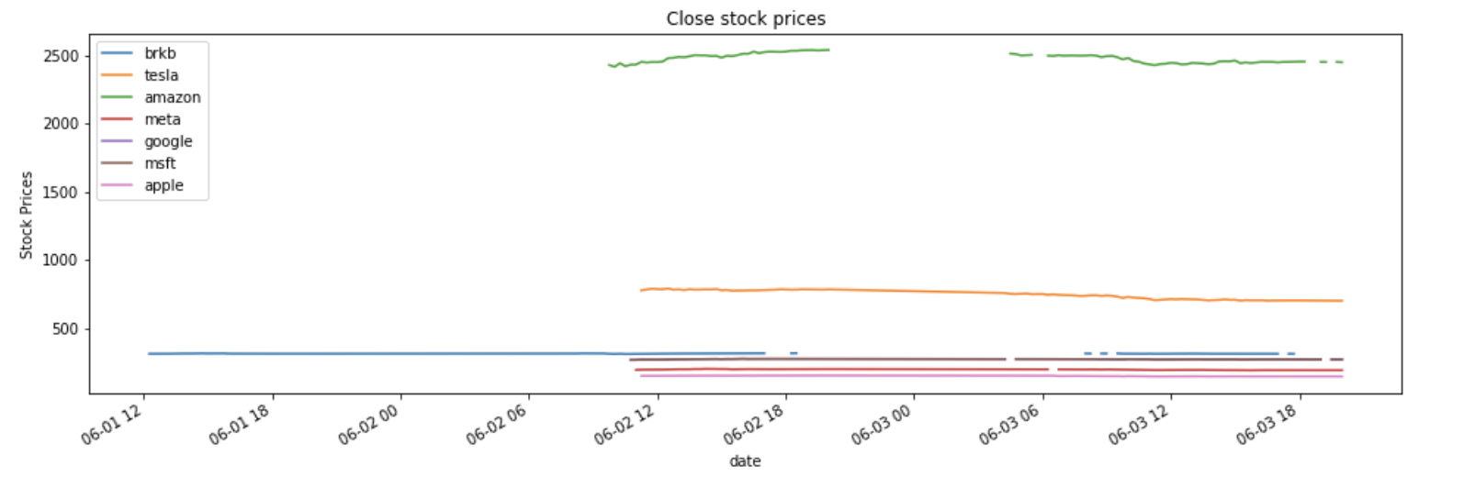
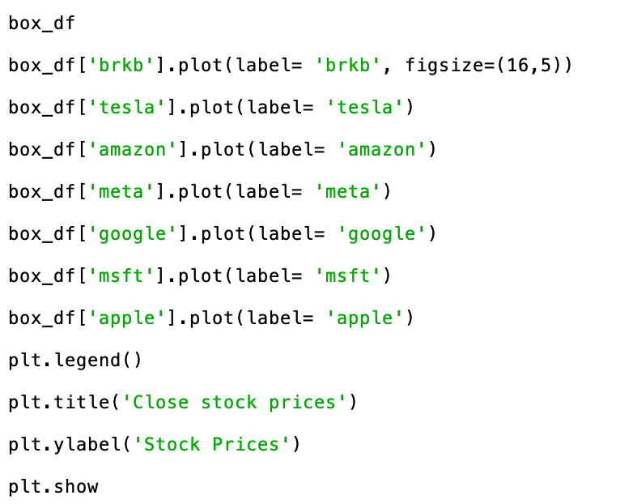
Explanatory Data Analysis (3)

Slide 11
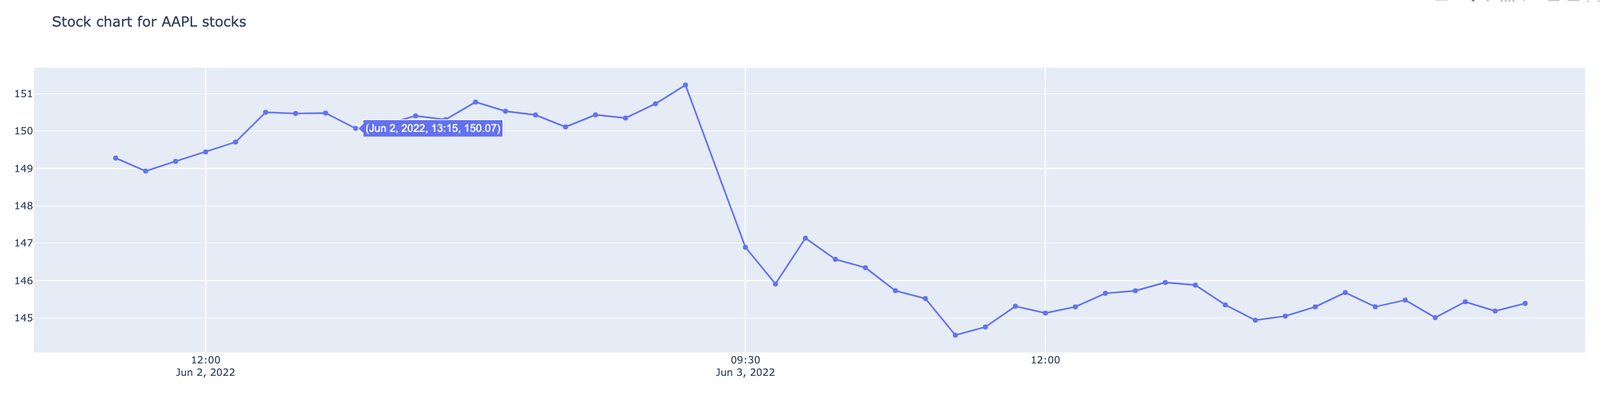
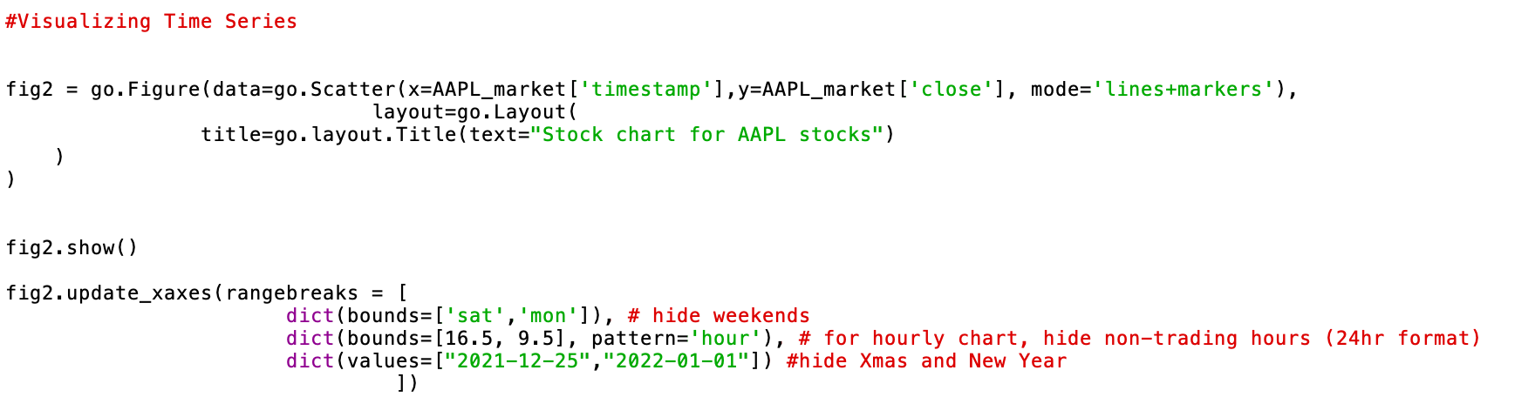
Simple stock chart

Slide 12
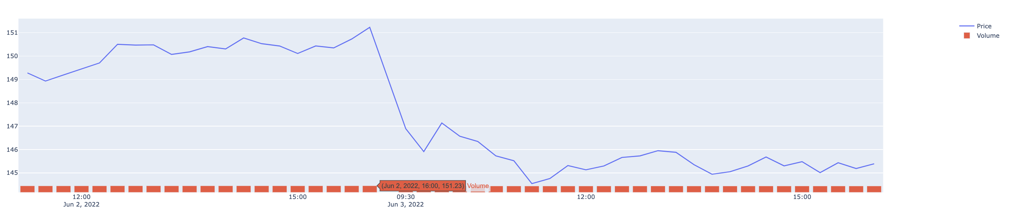
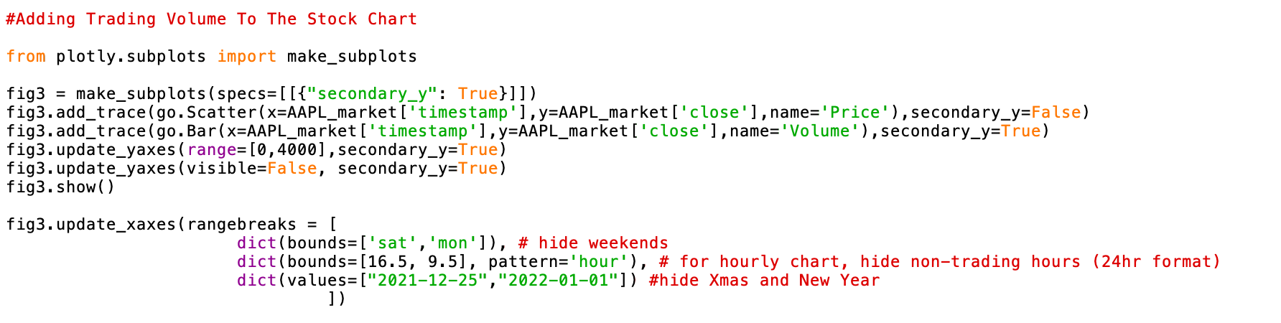
Adding trading volume to the Stock Chart

Slide 13
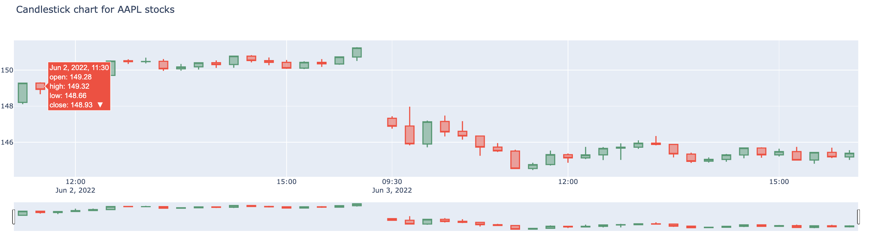
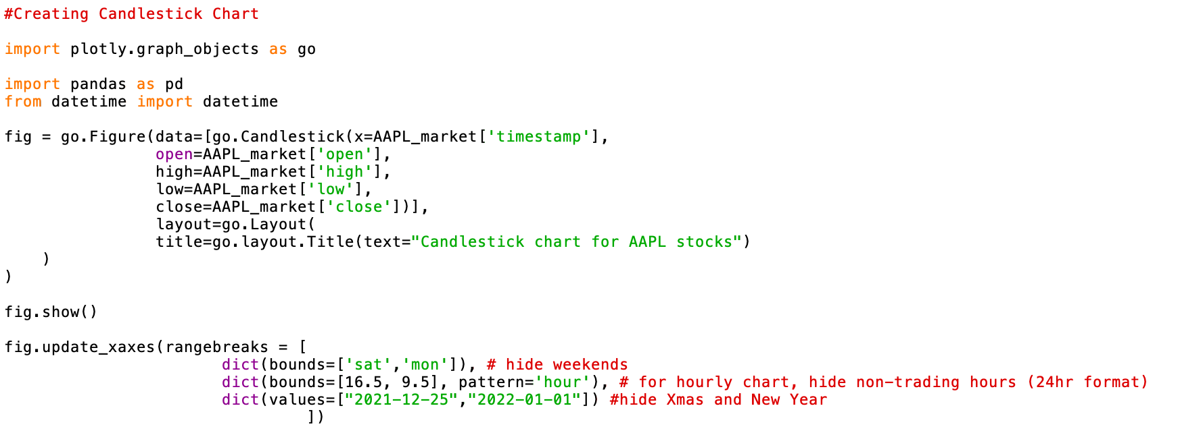
Candlestick Chart
The candlestick chart is a style of financial chart describing open, high, low and close for a given x coordinate (most likely time). The boxes represent the spread between the open and close values and the lines represent the spread between the low and high values. Sample points where the close value is higher (lower) then the open value are called increasing (decreasing). By default, increasing candles are drawn in green whereas decreasing are drawn in red.

Slide 14
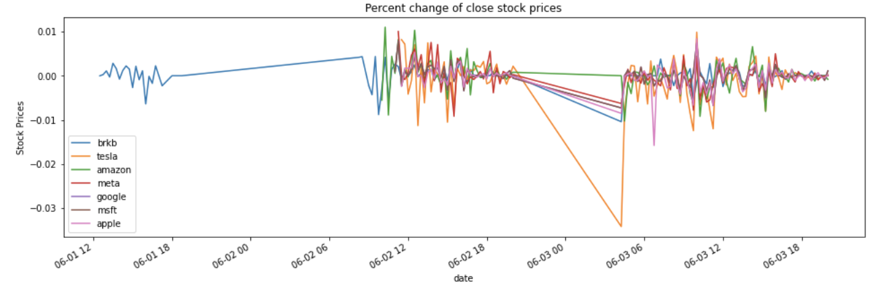
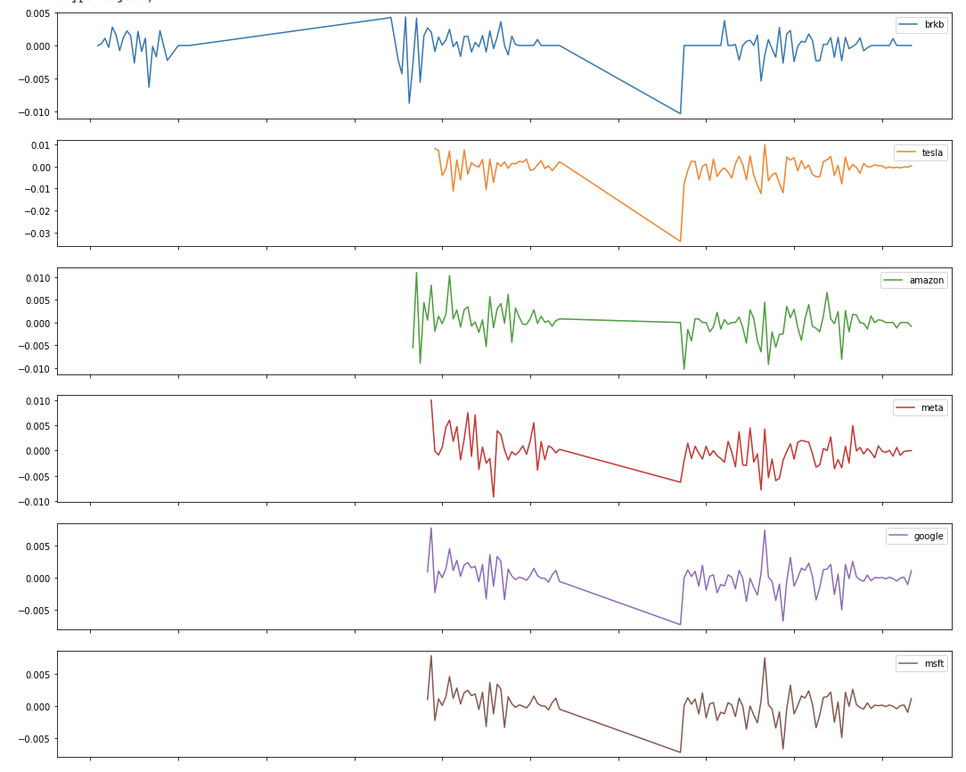
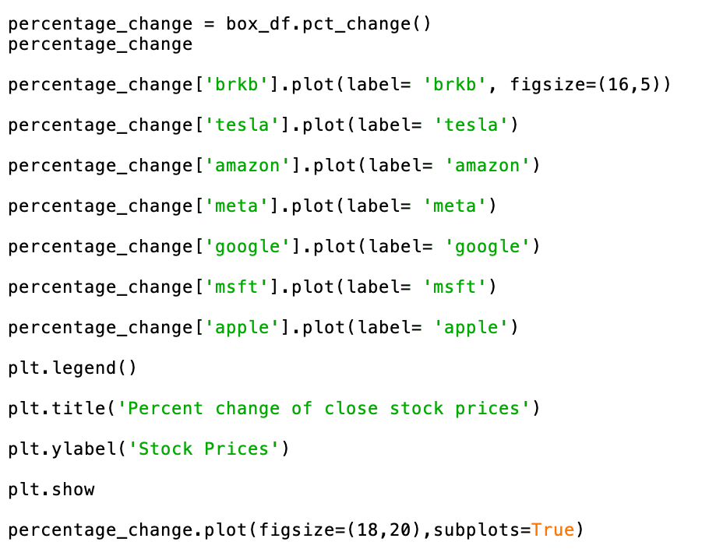
Returns – percentage change

Slide 15
Simple Trading Strategy
Momentum strategy
Moving average crossover

Slide 16
Building a Trading Strategy (1)
creating two separate Simple Moving Averages (SMA) of a time series with differing lookback periods (eg. 1 hour – 4 times 15min intervals and 3 hours – 12 times 15 min interval)
if the short moving average exceeds the long moving average then you go long, if the long moving average exceeds the short moving average then you exit
when you go long, you think that the stock price will go up and will sell at a higher price in the future (= buy signal); When you go short, you sell your stock, expecting that you can buy it back at a lower price and realize a profit (= sell signal)

Slide 17
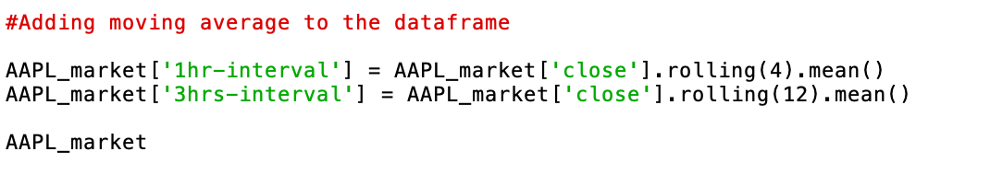
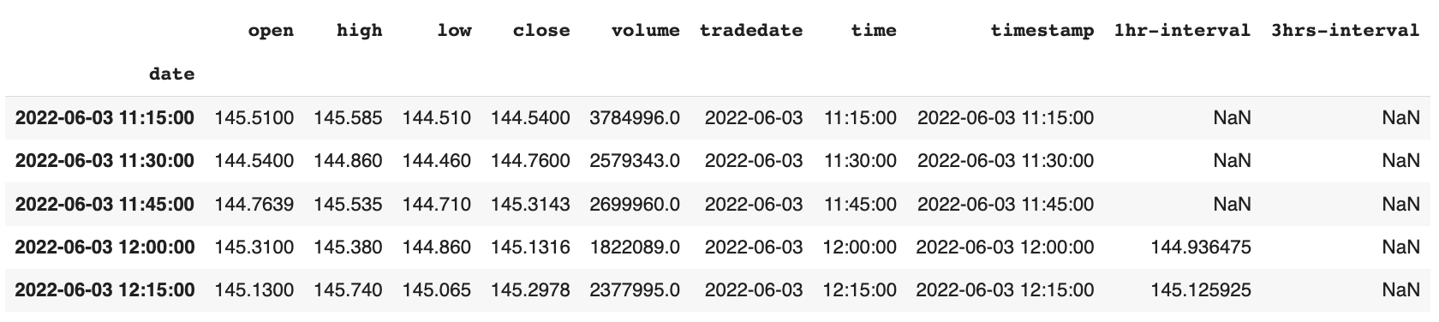
Building a Trading Strategy (2)

Slide 18
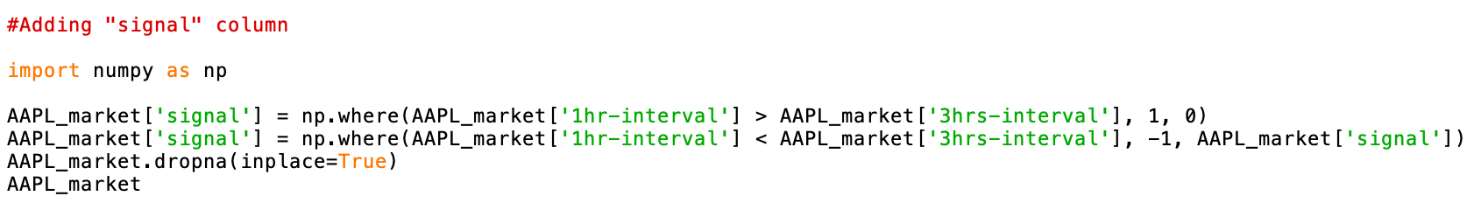
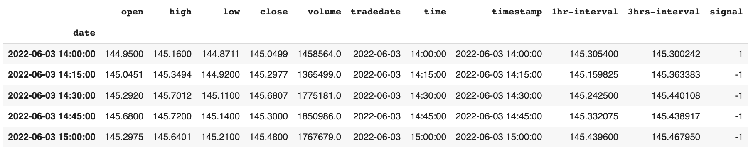
Building a Trading Strategy (3)

Slide 19
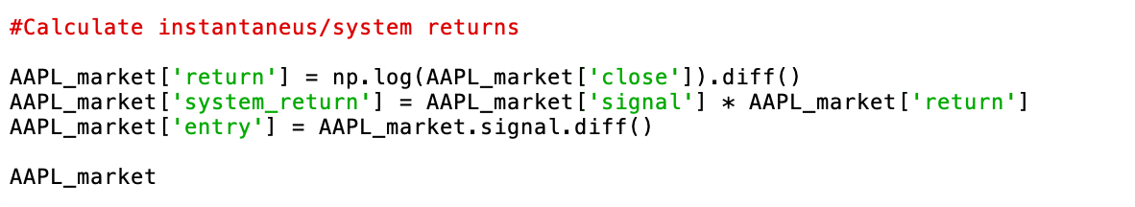
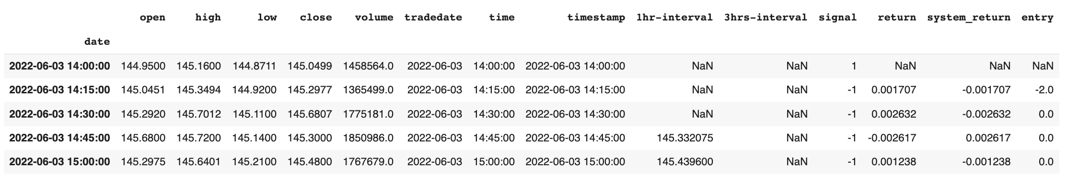
Building a Trading Strategy (4)

Slide 20
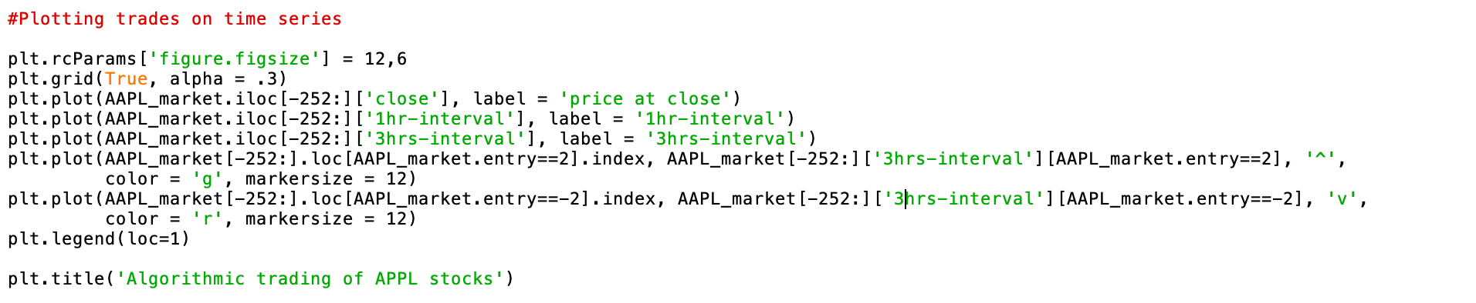
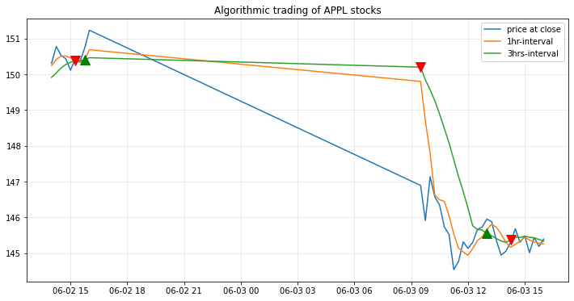
Building a Trading Strategy (5)

Slide 21
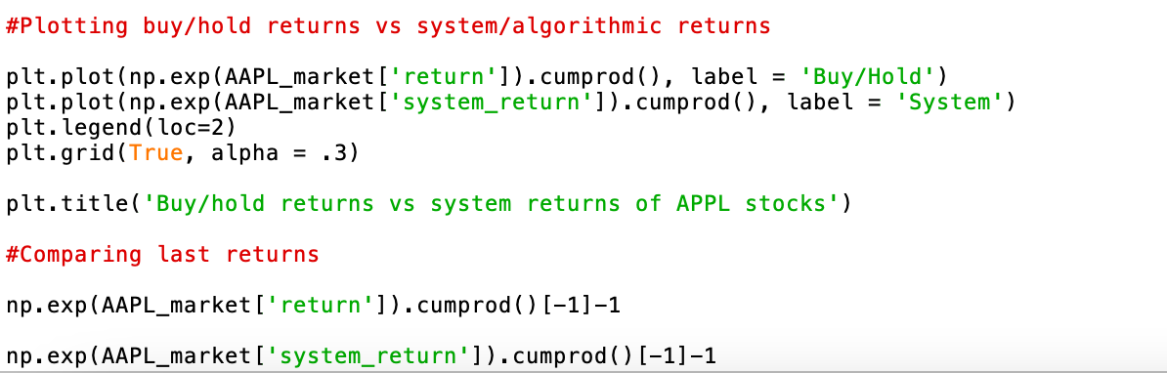
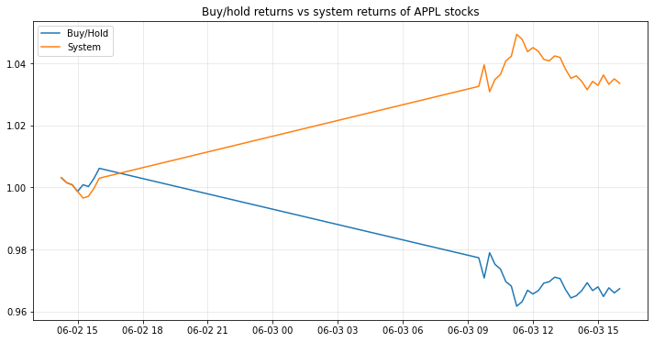
Building a Trading Strategy (6)

