Slide 1
Poland 2040: Technology Sovereignty
• Autonomous systems, AI and dual-use industrial capacity
• Independent expert draft v0.1 · 21 July 2026
Independent public-source analytical draft — no classified material — not a government document. 1

Slide 2
The strategic proposition
• Build a repeatable delivery system, not a single drone programme
• Connect demand, data, testing, procurement, production and talent
• Learn through limited commitments before scaling
• Close weak projects transparently
Independent public-source analytical draft — no classified material — not a government document. 2

Slide 3
Sovereignty means resilience
• Control critical data, interfaces, configuration and lifecycle rights
• Maintain, repair and update despite disruption
• Qualify alternatives and trusted allied suppliers
• Avoid economically unrealistic autarky
Independent public-source analytical draft — no classified material — not a government document. 3

Slide 4
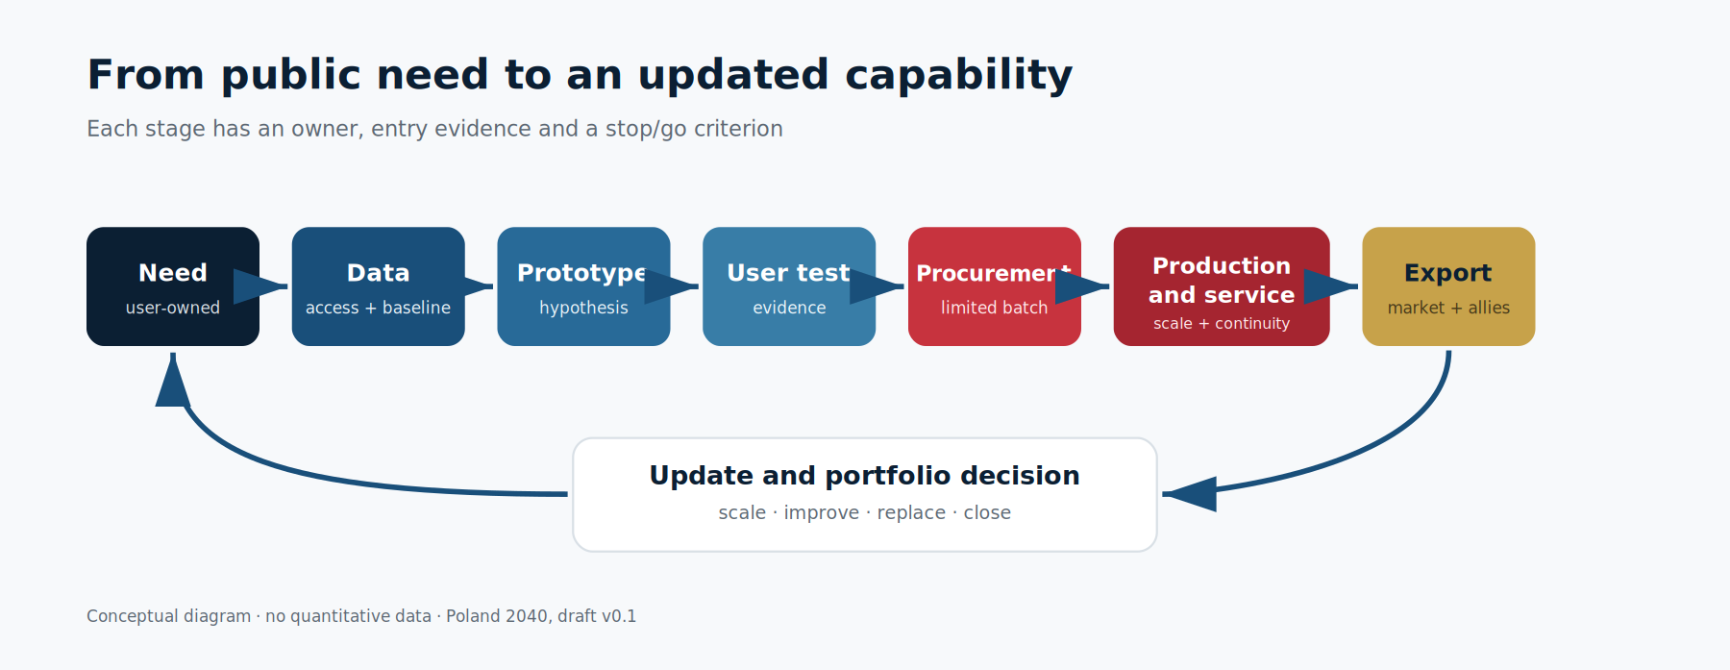
The delivery cycle
• Need → data → prototype → user test → limited batch
• Scale, iterate, retain as research or close
• Production, service, export and continuous update
Independent public-source analytical draft — no classified material — not a government document. 4

Slide 5
Governance and accountability
• A formal strategy owner plus a cross-government delivery integrator
• Exactly one accountable owner per result
• Separate demand, funding, testing and acceptance
• Independent evidence review and conflict-of-interest register
Independent public-source analytical draft — no classified material — not a government document. 5

Slide 6
Responsible AI and secure data
• Federated data ownership and controlled analytical environments
• Versioned data, code, models and configuration
• Independent test sets, monitoring and safe withdrawal
• NATO's six Responsible Use principles as a minimum — CLM-1220
Independent public-source analytical draft — no classified material — not a government document. 6

Slide 7
Industrial model
• Distributed integration, components, software, service and logistics
• Control / co-control / diversify / consciously accept dependency
• Modular capacity and tested substitution
• Lifecycle value in Poland, not final assembly alone
Independent public-source analytical draft — no classified material — not a government document. 7

Slide 8
Poland–Ukraine portfolio
• The bilateral framework covers supply chains, location, joint production and IP — CLM-1212
• Use R&D, testing, licensing, production and JV selectively
• Ownership, cyber, export control, IP and continuity due diligence
• No preferred company without comparison and evidence
Independent public-source analytical draft — no classified material — not a government document. 8

Slide 9
European and allied value
• Poland already participates in BraveTech EU — CLM-1214
• The initiative's stated total budget is EUR 100 million — CLM-1213
• Measure tests, follow-on contracts, investment, IP and production
• Keep national, EU and NATO planning coherent
Independent public-source analytical draft — no classified material — not a government document. 9

Slide 10
Talent network
• Existing universities, technical schools and industrial teams
• Test rapid reskilling as a candidate early-capacity pathway
• Practical projects and long placements
• Compare competence, cost, employment and 12/24-month retention with a baseline
Independent public-source analytical draft — no classified material — not a government document. 10

Slide 11
Civil productivity
• Energy and infrastructure inspection
• Logistics, rail, agriculture, maritime and environmental applications
• Demand-led pilots with a baseline and post-pilot buyer
• Shared modules where they create real value
Independent public-source analytical draft — no classified material — not a government document. 11

Slide 12
Candidate partnership proposition
• Not an official offer; subject to Polish government approval and legal review
• Security due diligence is required before any testing, data access or cooperation
• Candidate inputs: measurable needs, modular products, benchmarks and shared risk
• Potential allied inputs: security-assessed testing, supply chains, scale and compliant exports
Independent public-source analytical draft — no classified material — not a government document. 12

