Slide 1
LABLAB.AI x ASSEMBLYAI VOICE AGENT HACKATHON 2026
Second Listen
Talk through what changed.
Leave with evidence and the next action.
Voice agent for post-investment review
Built on AssemblyAI Voice Agent API and Universal-2
01
Notes:
Project title and positioning. Source: project README and submission copy.

Slide 2
THE MISSED SIGNAL
The sentence no dashboard captures
“The CFO left last week.”
A KPI report can show runway. It cannot preserve the moment an investor hears who left, what changed, or what still needs an answer.
By quarter-end, the quote and the promised follow-up have usually disappeared into memory.
Second Listen captures conversation signals while they are still fresh.
02
Notes:
Illustrative fictional scenario used throughout the product demo.

Slide 3
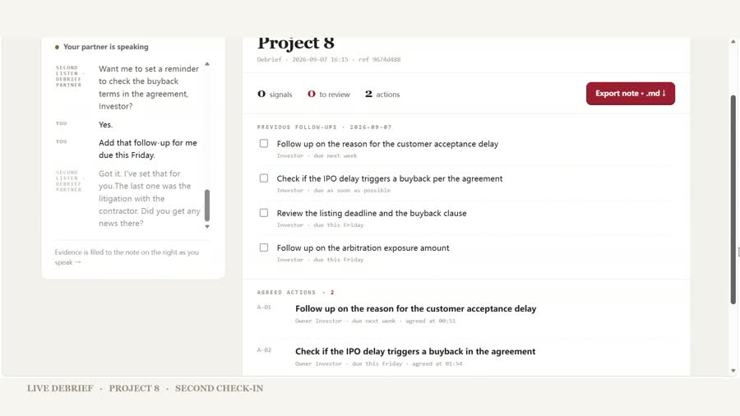
THE PRODUCT
A short debrief becomes an operating record
1 Speak naturally after the call
2 Answer one focused question at a time
3 Leave with quote-backed evidence and agreed actions
Each action keeps its owner, deadline, and the moment it was agreed.
Recorded live-mode run using fictional Project 8
03
Notes:
Screenshot from the recorded live-mode product run. Project 8 is fictional.

Slide 4
PLAYBOOK-GUIDED FOLLOW-UP
The follow-up a summary would miss
INVESTOR
“The CFO left last week.”
WHAT GETS FILED
Source quote kept
SECOND LISTEN
Review flag raised
“Who covers finance now?”
Follow-up gets an owner and due date
The AI surfaces evidence. An authorized person makes the final risk decision.
04
Notes:
The CFO scenario and response are illustrative. The behavior follows the published evidence-led playbook.

Slide 5
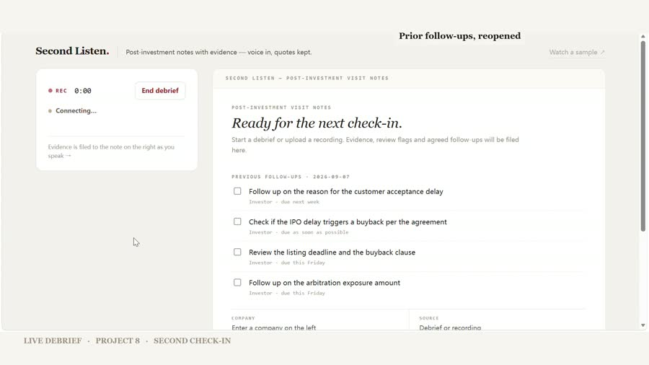
CROSS-DEBRIEF MEMORY
Last week’s actions reopen first
The next check-in starts with unfinished work
The agent asks about each open action before moving to new topics. The investor does not need to reconstruct the last call from memory.
Fictional Project 8
05
Notes:
Screenshot from the recorded live-mode product run. Project 8 is fictional.

Slide 6
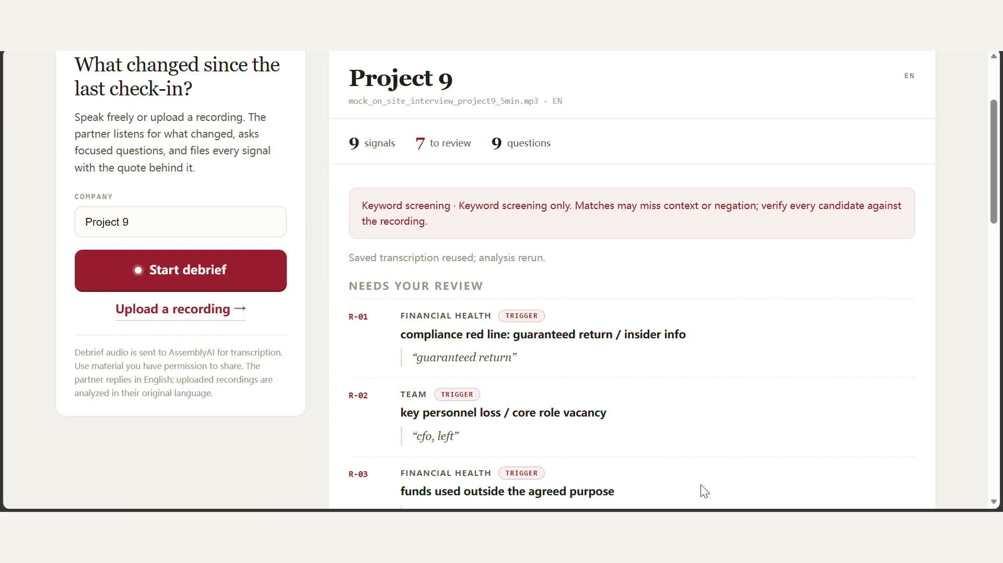
RECORDING MODE
Already have a call recording?
Upload it. Universal-2 transcribes multilingual audio, including Chinese. The same playbook returns candidate signals, review flags, and open questions.
The built-in fallback still surfaces candidates for human review when no compatible LLM is configured.
Fictional Project 9 recording
06
Notes:
Upload path uses AssemblyAI Universal-2. Screenshot uses a fictional Project 9 recording.

Slide 7
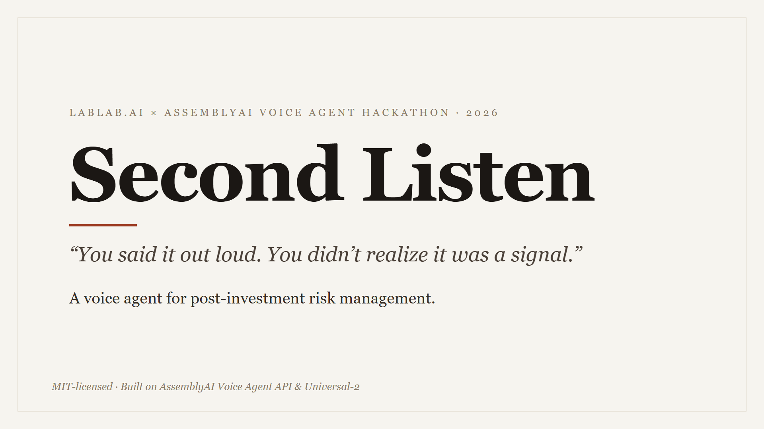
DEMO PROOF
Watch the 3:44 product run
A recorded live-mode run
Project 8 and Project 9 are fictional. One quiet section was removed for length. The live segments otherwise run at their recorded pace.
PLAY
youtu.be/51TKhR5Vg48
No scripted sample playback. The live path runs on AssemblyAI Voice Agent API.
07
Notes:
Video link: https://youtu.be/51TKhR5Vg48. Product execution is real. All company data and scenarios are fictional.

Slide 8
TECHNOLOGY
Two AssemblyAI paths, one evidence method
LIVE DEBRIEF
RECORDING ANALYSIS
AssemblyAI Voice Agent API
Universal-2 plus a pluggable LLM
One WebSocket handles speech recognition, agent reasoning, voice output, turn detection, interruption handling, and JSON-schema tool calls.
Universal-2 provides broad multilingual transcription. A configured OpenAI-compatible LLM applies the same evidence framework to the transcript.
Python standard-library backend. Browser audio connects directly to the Voice Agent WebSocket.
08
Notes:
Sources: project app/deployment/browser/app.js, app/transcribe.py, and README.

Slide 9
BUSINESS VALUE AND ORIGINALITY
Built for the team that owns post-investment risk
BUYER
DIFFERENTIATOR
Fund post-investment and risk teams
A domain playbook that knows what to ask
They already have a risk process on paper. Conversations still have no direct path into it.
Every surfaced signal keeps the quote behind it. The final judgment stays with an authorized human.
Post-investment is the first domain. The same method can carry another review checklist.
09
Notes:
Business positioning and product boundary from the project README and evidence-led playbook.

Slide 10
TRY IT
Your first fictional check-in
1
Open the live demo and enter Project 10
2
Say: “The CFO left last week. I do not know who covers finance.”
3
Watch what the agent asks next
second-listen-wcap.onrender.com
Video youtu.be/51TKhR5Vg48
Code github.com/cezum/second-listen
10
Notes:
Live demo: https://second-listen-wcap.onrender.com/. Video: https://youtu.be/51TKhR5Vg48. Repository: https://github.com/cezum/second-listen.

