Slide 1

Adjusting to the Digital Transition: Rockbuster Stealth's Online Rental Approach
Analyzing and leveraging data to aid with the launch strategy
Mohammed Molla

Slide 2
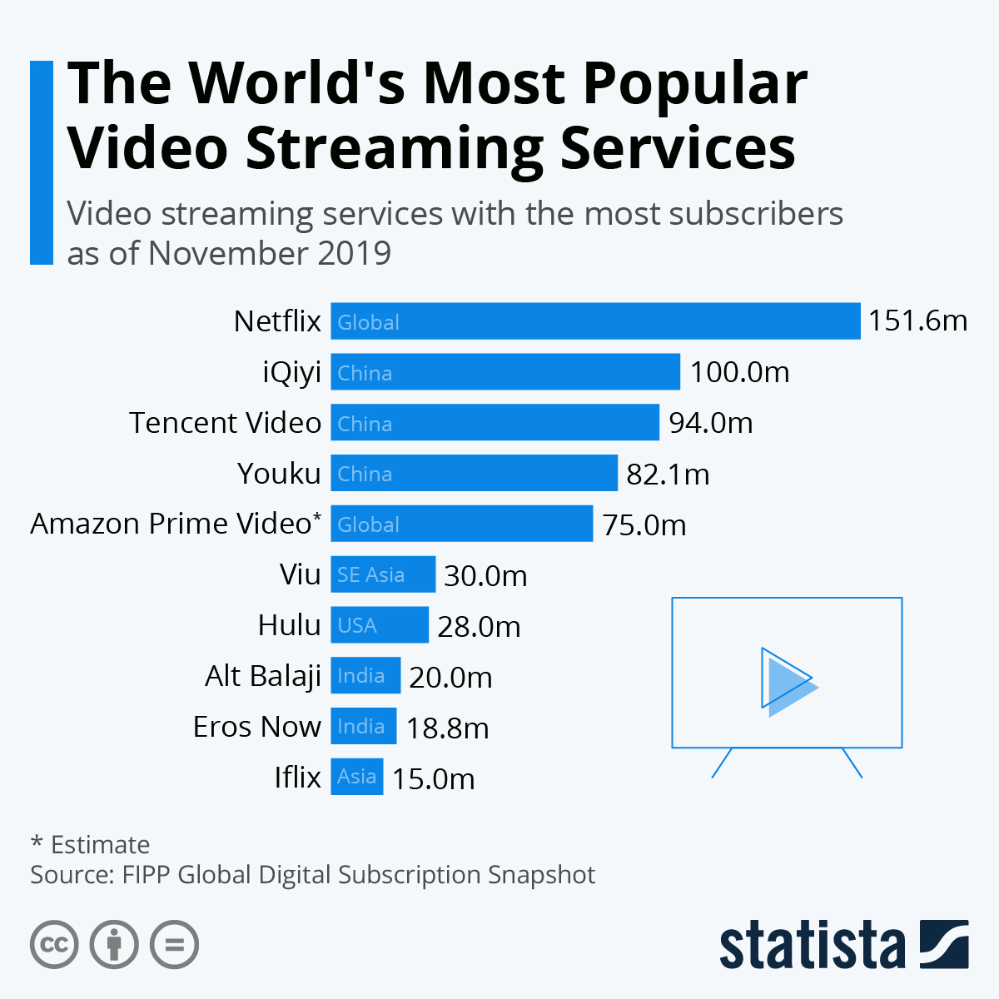
Problem Statement In this digital age people prefer to stream content rather than having to rent physical discs. To stay competitive, Rockbuster Stealth management team is planning to use its existing movie licenses to launch an online video rental service
Challenges:
- The market currently features a plethora of established streaming services, creating a saturated environment.
- Rockbuster needs to build a compelling value proposition for customers, including exclusives, personalized recommendations, or flexible rental periods.
- Determining the right pricing structure is challenging in a market dominated by subscription-based models. The pricing must be competitive but also sustainable for the business.

Slide 3
Objective This analysis aims to employ a data-driven methodology to address the critical questions and leverage the findings to formulate a strategy for the launch of the online streaming service.
Key questions
Which movies contributed the most/least to revenue gain?
What was the average rental duration for all videos?
Which countries are Rockbuster customers based in?
Where are customers with a high lifetime value based?
Do sales figures vary between geographic regions?
Steps to accomplish the objective:
Begin by pinpointing the countries that yield the highest sales figures, allowing us to prioritize our efforts.
Identify our customer base and gain insights into what fosters their loyalty to Rockbuster.
Determine which films—based on genre, actor popularity, and other factors—produce the most revenue.
Enhance revenue by examining existing pricing trends to refine our strategies and maintain competitiveness.

Slide 4
Data-driven approach
Metrics and tools utilized for analysis
Geographic data: Countries that have the most customers and the amount of revenue they generate.
Customer information: Data on revenue produced by customers along with their geographical locations. This information can inform the prioritization of sales strategies.
Inventory information: Insights regarding films, including their categories and languages, to identify which movies are the top revenue generators.
Payment and rental statistics: Minimum, maximum, and average duration of rentals and payments will provide insights into how to develop strategies for the online streaming service.
Tools and methodologies:
SQL for data extraction
Tableau for visualization and analysis
Descriptive Statics
Metrics | Minimum | Maximum | Average
Rental duration | 3 days | 7 days | 5 days
Rental rate | $0.99 | $4.99 | $2.98
Movie duration | 46 min | 185 min | 115 min
 | Customers | Film Category | Language
Count | 584 Active | 20 | 6
Mode | N/A | Sports | English

Slide 5
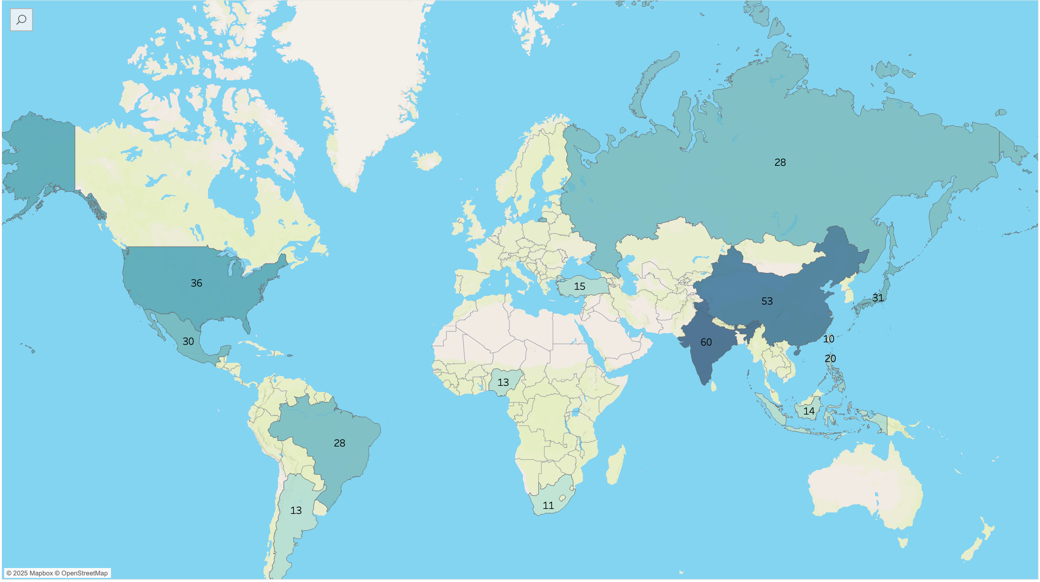
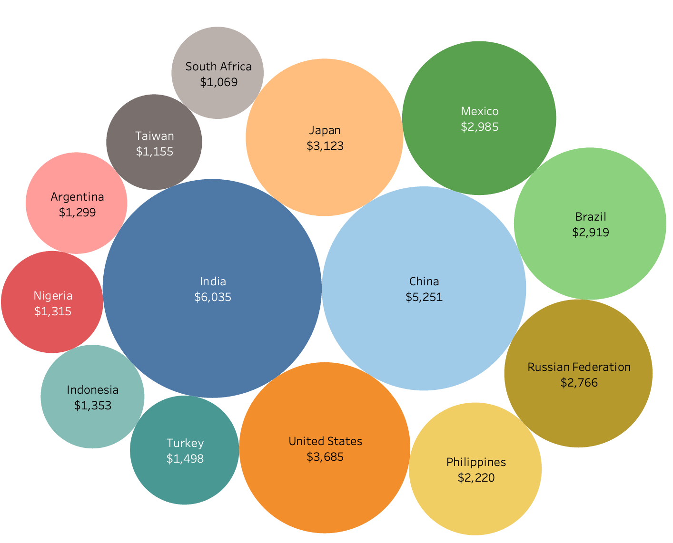
Sales and Customer Data by Country
This is an overview of the leading countries with most customer and generating the highest revenue. It provides insight into our primary markets and indicates areas where we may want to concentrate our efforts.
India, China, and the United States are the leading three countries in terms of both customer base and revenue generation.
To date, total sales have reached $61,312.04, with the top 10 countries accounting for over 50% of this figure, amounting to $31,834.

Slide 6
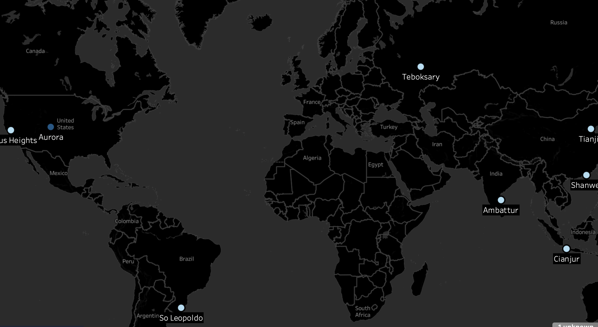
Analyzing Customer Distribution in Key Regions
Understanding where our customers are located allows us to develop focused campaigns and make informed choices regarding the optimal allocation of resources to enhance effectiveness.
The map displays the leading cities ranked by customer count. Notably, only Aurora Colorado, in the USA, has 2 customers, while all other cities have 1 customer each. This information implies the need to focus on retaining customers in areas with a high concentration and to seek out and cultivate growth opportunities in regions with fewer customers.
City | Country | Customer Count
Aurora | United States | 2
India | Ambattur | 1
China | Shanwei | 1
Brazil | So Leopoldo | 1
Teboksary | Russian Federation | 1

Slide 7
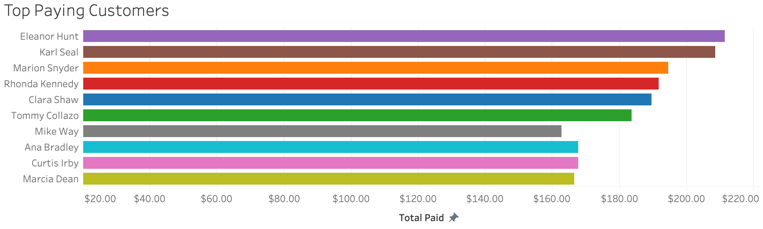
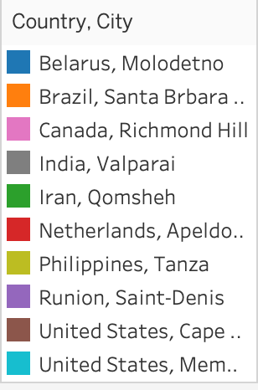
Identifying High-Value Customers Recognizing Rockbusters' most valuable customers can aid in developing loyalty-focused promotions and formulating effective marketing strategies. This approach can encourage existing customers to remain with the company while also attracting new clientele.
Analyzing customer locations reveals that approximately 50% are situated outside the countries with the largest customer bases. This indicates that revenue generation is not constrained by geographic boundaries.

Slide 8
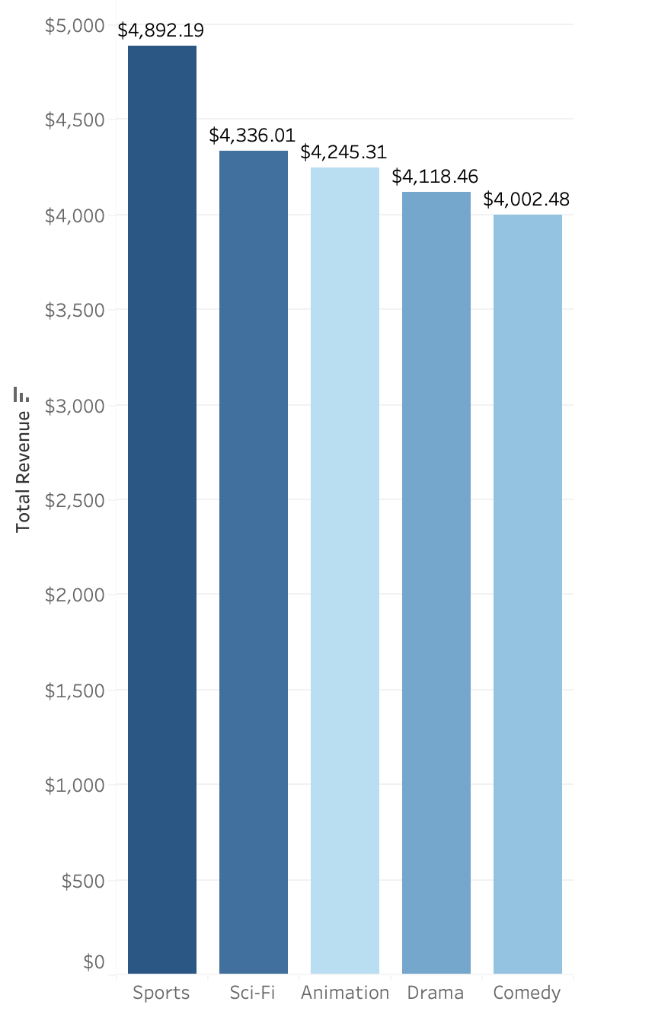
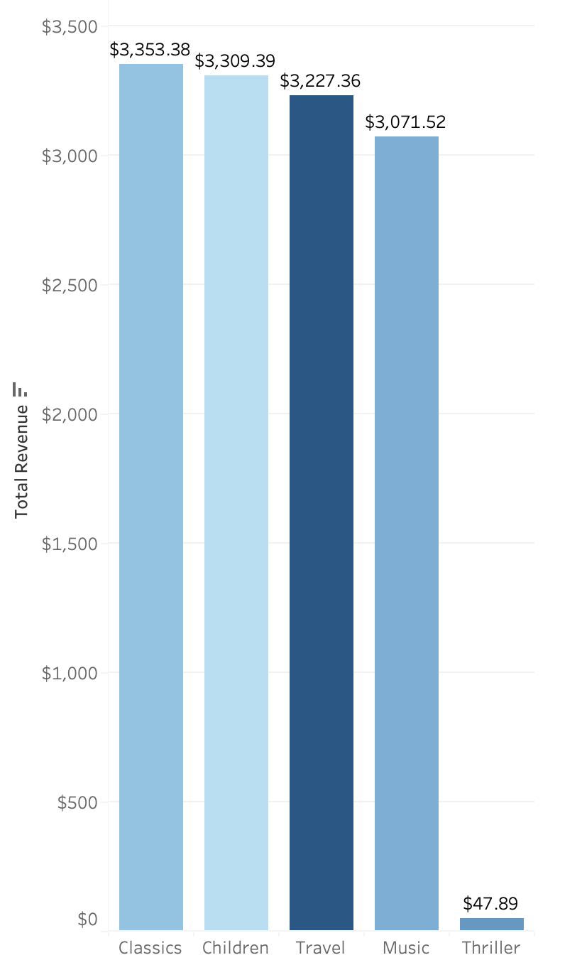
Earnings categorized by film genre
The charts above illustrate the top five and bottom five movie genres based on revenue generated. Most genres show similar levels of revenue, with the Thriller genre being the notable exception. This indicates a potential opportunity to expand the inventory of thriller titles or implement other strategies to boost rental demand.

Slide 9
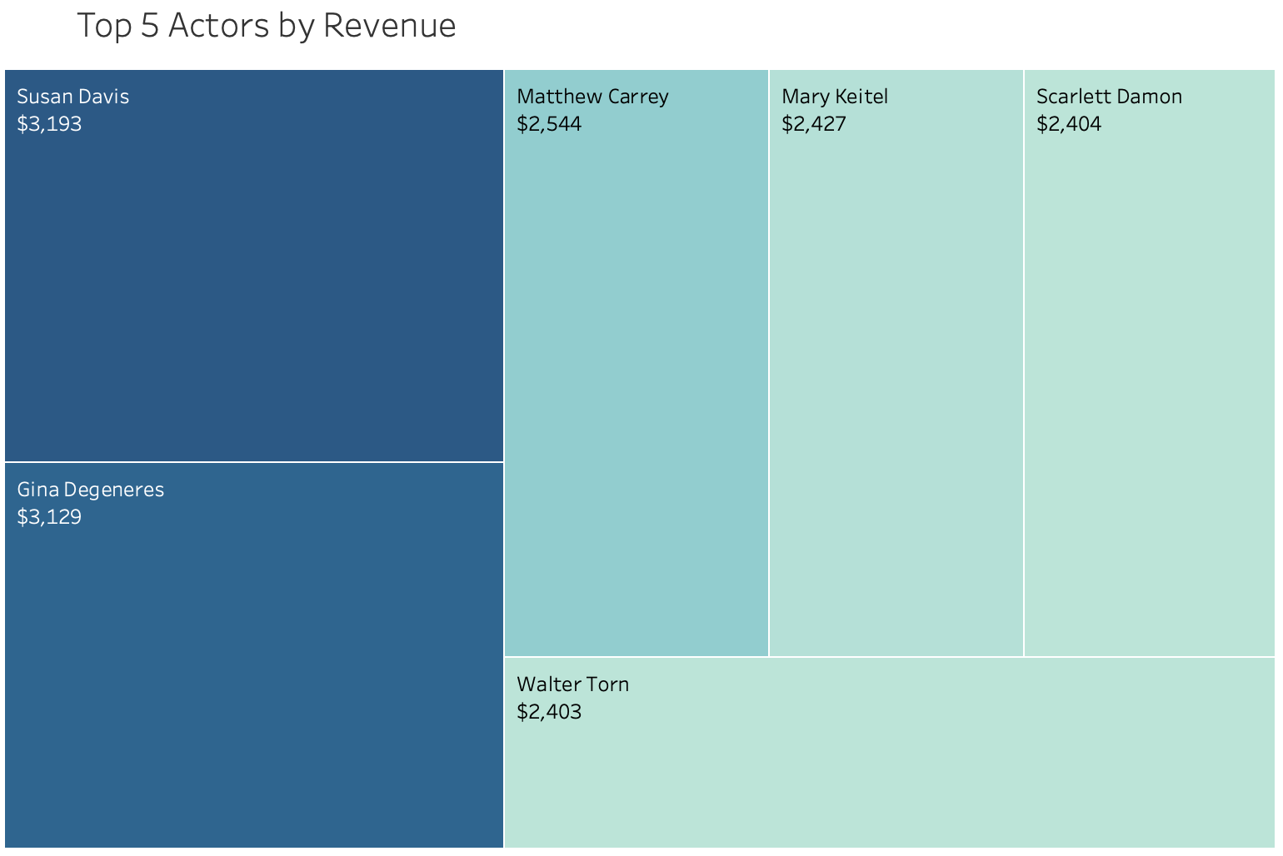
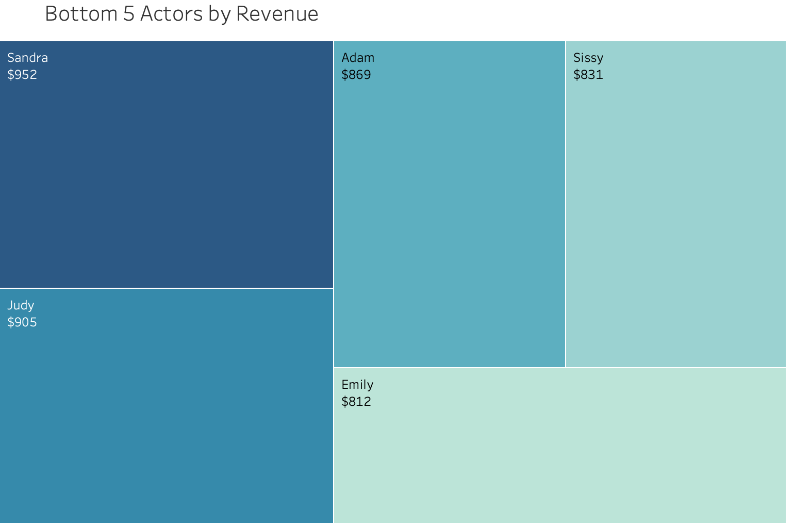
Actors generating highest and lowest revenues
Within the sphere of revenue generation, some individuals stand out prominently. This assessment highlights the top performers whose films achieve the highest earnings. These actors likely possess a substantial fan following, indicating that prominently featuring their movies could successfully attract more viewers and boost rentals.

Slide 10
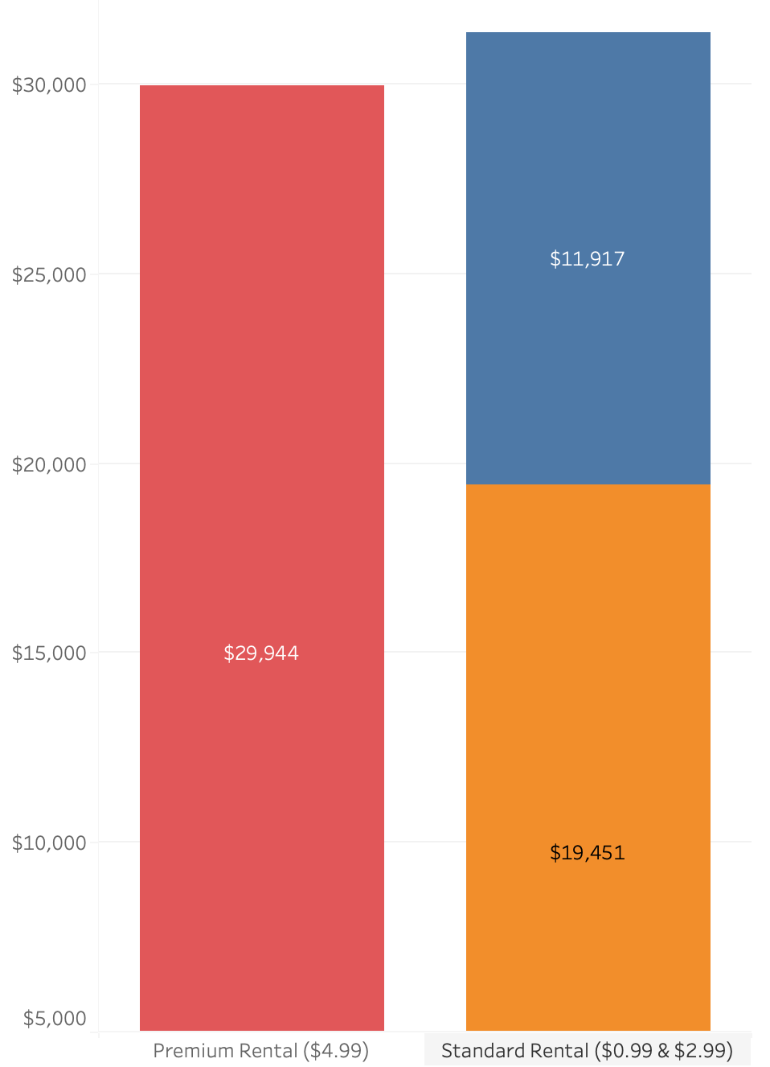
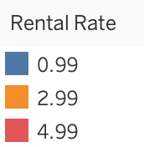
Rental type revenue trend
Total Sales
$ 61,312
Analyzing the differences between budget and luxury rentals reveals the interplay between cost-effectiveness and high-end features in driving overall revenue. Both rental type contribute equally to the over sales figures.
standard rental sales:
51.1%
$31,368
Premium rental sales:
48.8%
$29,944

Slide 11
Conclusion and Recommendations
Geographic Strategy
India, China, and the USA together represent 25% of all active customers across 108 countries. These nations also play a crucial role in generating substantial revenue. Given their large populations, it is essential to focus on growth opportunities in these markets.
Revenue Distribution Across Films and Genres
The analysis reveals a diverse audience, with no single genre significantly dominating revenue generation except for Thrillers. This implies the need to sustain the existing inventory of titles across different genres while also formulating strategies to boost sales in the Thriller category.
Customer Loyalty
Rockbuster's key customers plays a crucial role in generating revenue, highlighting the need for loyalty programs and tailored offers.
Rental Rate Overview
Rockbuster's rental approach demonstrates a strong equilibrium between affordable rentals and premium offerings, with both significantly contributing to nearly equal revenue. The focus is on catering to a variety of customer preferences.

Slide 12

Next Steps
Online Streaming Platform Development
Commence the creation and deployment of the digital streaming platform, ensuring it is scalable and capable of evolving with technological advancements and changing consumer preferences.
Data Collection
Implement method to monitor and collect data on how movies are performing. Which genre is is most watched, which actor is the most popular and collect feedback of customer experience of the service
Streaming Service Strategy
Craft and implement distinctive marketing strategies to facilitate the shift to online streaming. Establish competitive pricing along with exclusive content to engage viewers and introduce promotional offers to draw in new customers.
Obtain and Enhance
Obtain additional licenses to broaden the inventory range, allowing access to a wider customer audience.

Slide 13


Thank You for your cooperation!
Interactive Tableau visualization can be found using the link below.
https://public.tableau.com/app/profile/mohammed.molla/viz/SQL_Visuals/Sheet1 - 1
If you have any questions or inquires, I can be reached at mohammed.molla@rockbuster.com

