Slide 1
actionlib
actionlib提供了一套应对优先级任务的标准接口，集合了topic和service两种通信方式的优点来解决一些时间较长，同时又需要不间断状态返回的任务。它提供了取消任务、定时反馈状态、优先级抢占等方便有效的功能。类似于service，也分为服务器端和客户端两部分。

Slide 2
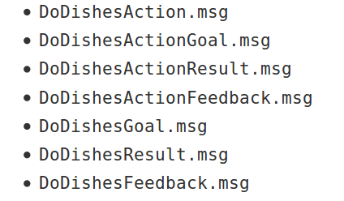
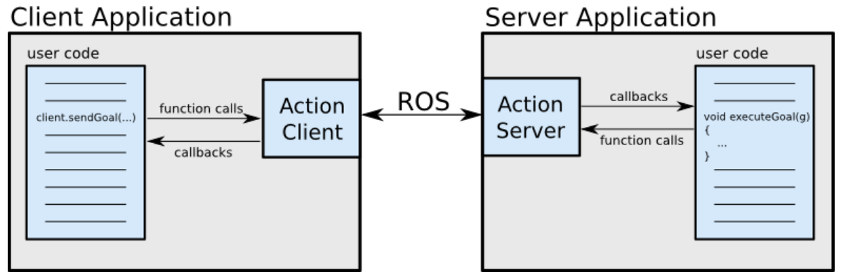
.action File
#goal
uint32 dishwasher_id
---
#result
uint32 total_dishes_cleaned
---
#feedback message
float32 percent_complete

Slide 3
SimpleActionServer Goal Policies
同一时间只有一个goal有效
已经在执行的goal会被新来的终止并替代
An explicit preempt goal preempts all goals with timestamps that are less than or equal to the stamp associated with the preempt
Accepting a new goal implies successful preemption of any old goal and the status of the old goal will be changed automatically to reflect this

Slide 4
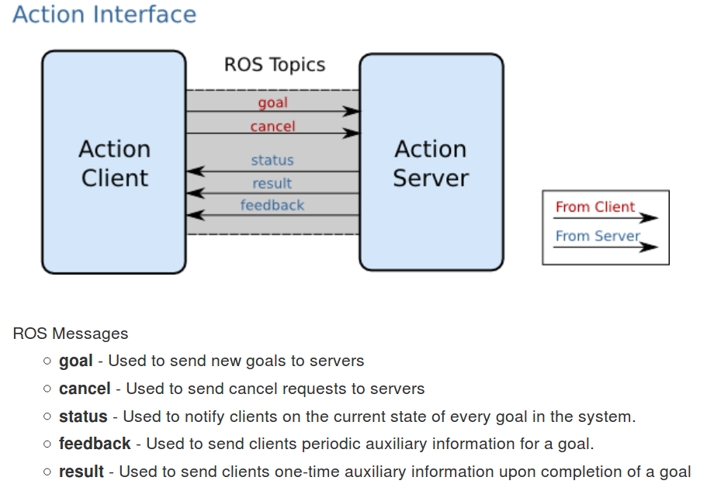
Action Interface & Transport Layer

