Slide 1
ROS
(The Robot Operating System)
Framework
                ROS naming convention
Platforms
Libraries
Tools
Development approach

Slide 2
Installing && Configuring Environment
Linux cmd
Environment variables
Filesystem
Workspace
rosbash bin
$ mkdir -p ~/catkin_ws/src
$ cd ~/catkin_ws/
$ catkin_make

Slide 3
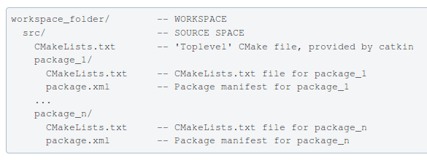
Package
catkin_create_pkg
catkin_make

Slide 4
Nodes
Library
      rospy roscpp
roscore
rosrun
      rosrun turtlesim turtlesim_node
rosnode

Slide 5
roscore
ROS Master
ROS Parameter Server
rosout logging node

Slide 6
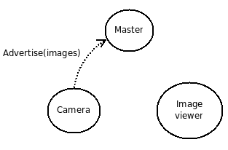
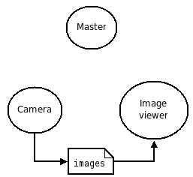
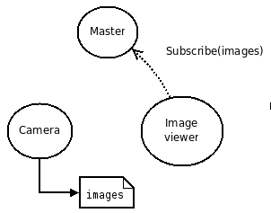
Master

Slide 7
Topics
rosrun rqt_graph rqt_graph
rostopic

Slide 8
Messages
int8, int16, int32, int64 (plus uint*)
float32, float64
string
time, duration
other msg files
variable-length array[] and fixed-length array[C]

Slide 9
Services
Parameters
rosservice
rosservice

Slide 10
roslaunch

Slide 11
Bags

Slide 12
Example
Topic
Service +-×/
Launch
.srv、.msg
Cmakelist
test
Debug log、 log level
Gdb coredump

