Slide 1
/
fs
users
ess
scratch
PAS2880
PAS2880
PAS2880
$USER
cd ../../scratch/PAS2880
cd ../..
users
cd ..
$USER

Slide 2
/
fs
users
ess
scratch
PAS2880
PAS2880
PAS2880
$USER
users
$USER

Slide 3
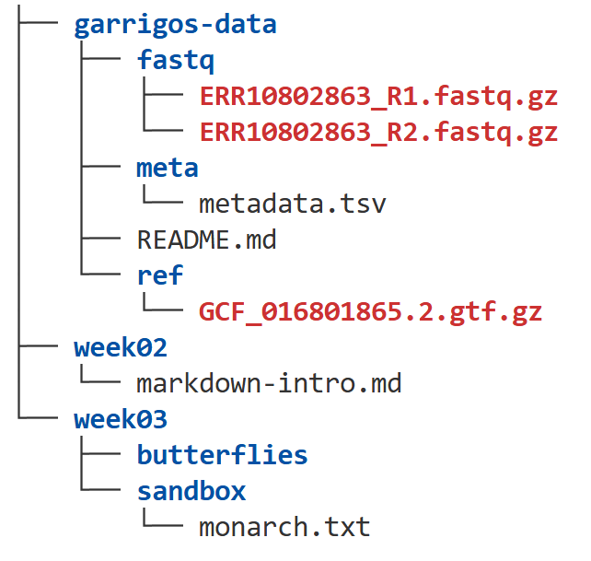

$USER
cd ../../
cd ../

