Slide 1
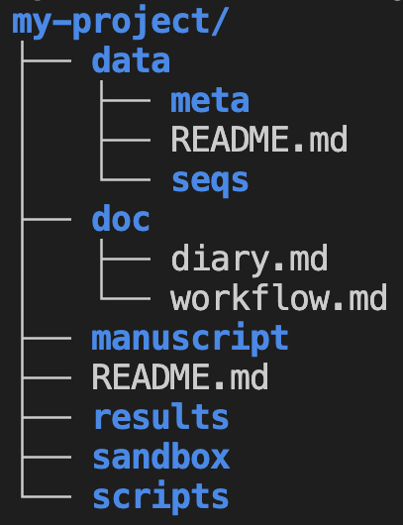
The project’s root folder
Metadata (sample data)
Sequence data (e.g. FASTQ)
Project documentation notebooks
Playground

