Slide 1
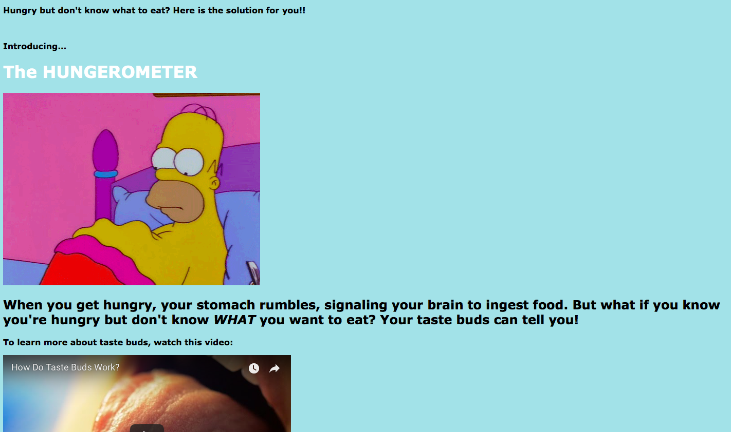
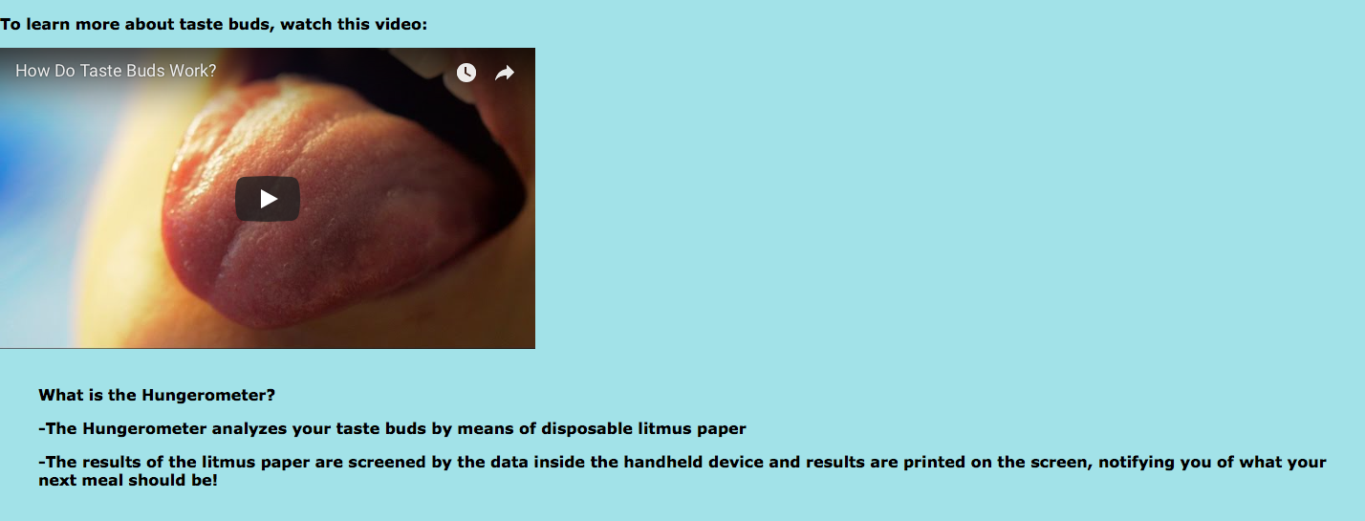
Hungerometer
Chrissy Falino
Device that analyzes your taste buds to determine what your body is actually craving
Computer inside the device retains your taste bud information and can generate a health profile for you
USB can connect to a computer to map your monthly cravings
Can also connect to Hungerometer’s global database
Database reports to World Health Org for annual outline of national health

