Slide 1
Anomaly detection in graphs - past, present and future.
Leman Akoglu CMU
Mary McGlohon Google
Christos Faloutsos CMU

Slide 2
Thank you!
Prof. R.K Agrawal (Jawharlal Nehru University)
P. Krishna Reddy (IIIT Hyderabad)
Jaideep Srivastava (University of Minnesota)

Slide 3

Roadmap
Introduction – Motivation
Why study anomalies?
Past
Present
Future

Slide 4
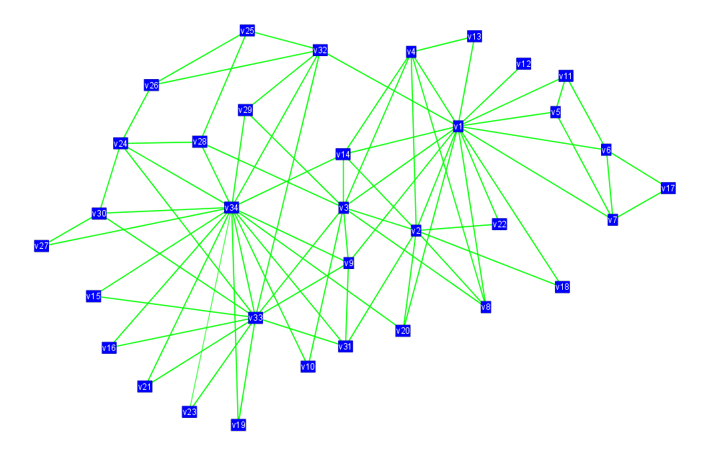
OddBall (2010): Motivation
Given a weighted graph, which nodes are strange/abnormal/extreme?
Computer networks: spammers, port scanners
Phone-call network: telemarketers, misbehaving costumers, faulty equipment
Social network: ‘popularity contests’

Slide 5
OddBall: Premise
Pattern and law discovery, then application
Unless the majority of our nodes closely obey a pattern, only then can we confidently consider as outliers the few nodes that deviate.

Slide 6
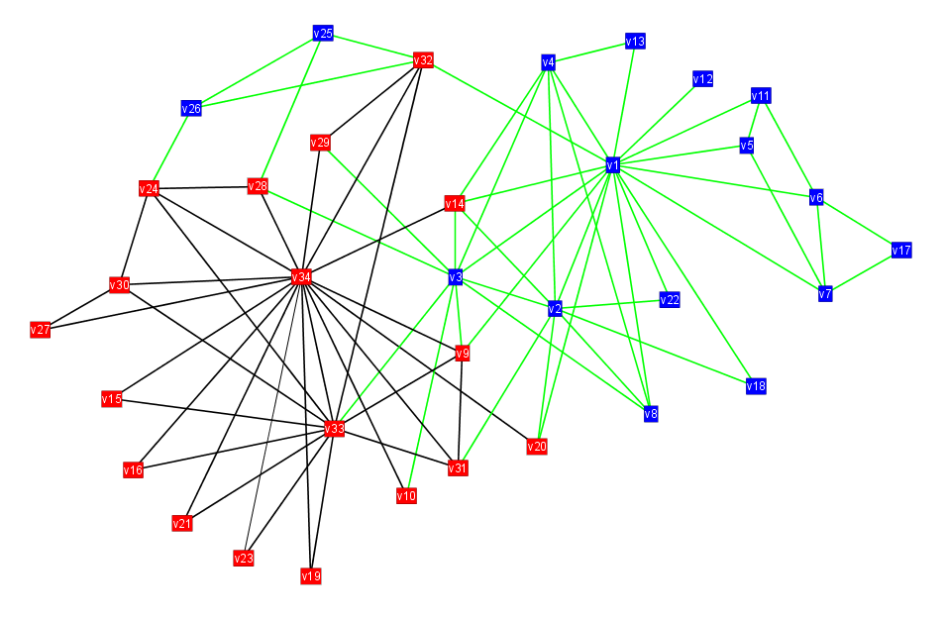
OddBall: Egonets
We extract patterns in egonets-- for any given node, its ego-net is the network formed by its neighbors and edges between them.
Ego

Slide 7
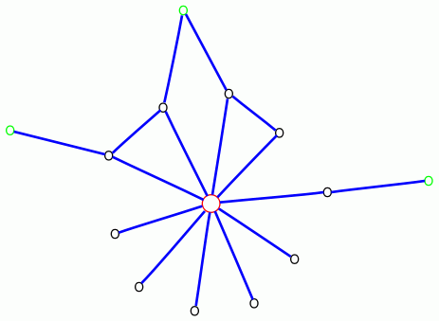
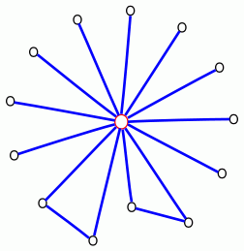
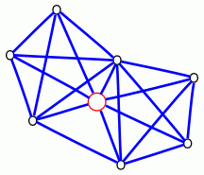
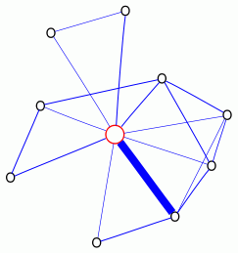
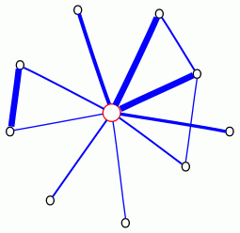
OddBall: Anomalous egonets
Near-star
Near-clique
Near-isolated star
Heavy vicinity
Dominant heavy link

Slide 8
OddBall: Patterns
Analyzed networks from various domains: citation graphs, campaign donations, blog links, emails, packet traffic
Discovered power-law relationships in egonets

Slide 9
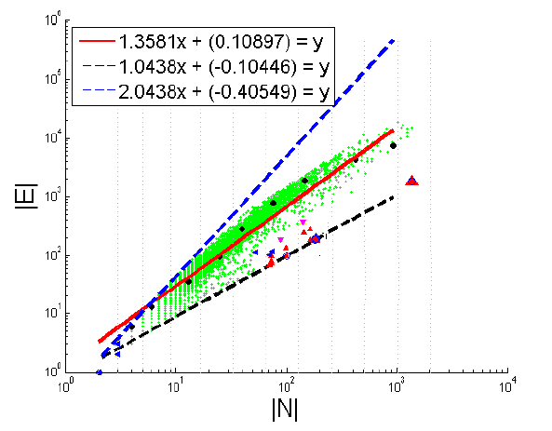
OddBall: Egonet Density Power Law
E_{i} ∝ N_{i}^{α}
1 ≤ α ≤ 2
Near clique/star

Slide 10
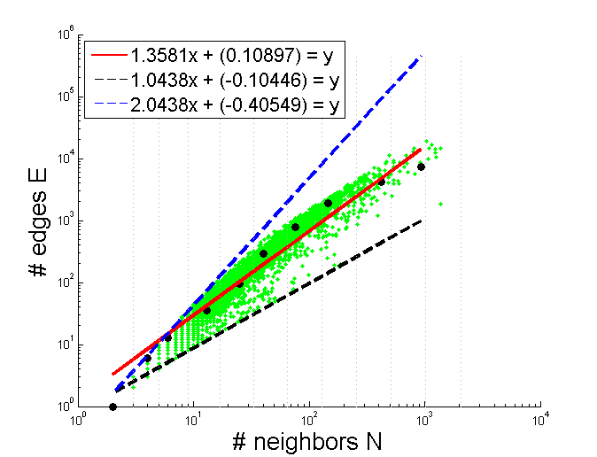
OddBall: Detecting outliers from pattern
Based on distance from fitting line
Enron CEO

Slide 11
OddBall: More applicable patterns
Egonet Weight Power Law
Detects “heavy vicinity”
Egonet λ_{w} Power Law
Detects “dominant heavy link”

Slide 12
OddBall: Summary
Oddball is a node-level, feature-based approach to graph anomaly detection
Method:
extract features
(node embedding, representation learning)
study patterns
define rules
identify outliers

Slide 13



Thank you!

