Slide 1
Anomaly detection in graphs - past, present and future.
Leman Akoglu CMU
Mary McGlohon Google
Christos Faloutsos CMU

Slide 2
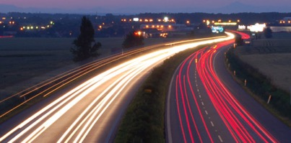
Roadmap
Introduction – Motivation
OddBall
Last 10 years
Future
Q1) definition?
Q2) automation?
Q3) next steps?

Slide 3
Future – parting thoughts
Q1) Definition of anomaly?
A) “… strange/remote/unlikely, wrt our models”
Q2) can we automate it?
A) no, but: look for better models/models
Q3) next steps?
A) cross-disciplinarity -> new models

Slide 4

Future – parting thoughts
Q1) Definition of anomaly?
A) “… strange/remote/unlikely, wrt our models”
Q2) can we automate it?
A) no, but: look for better models
Q3) next steps?
A) cross-disciplinarity -> new models

Slide 5
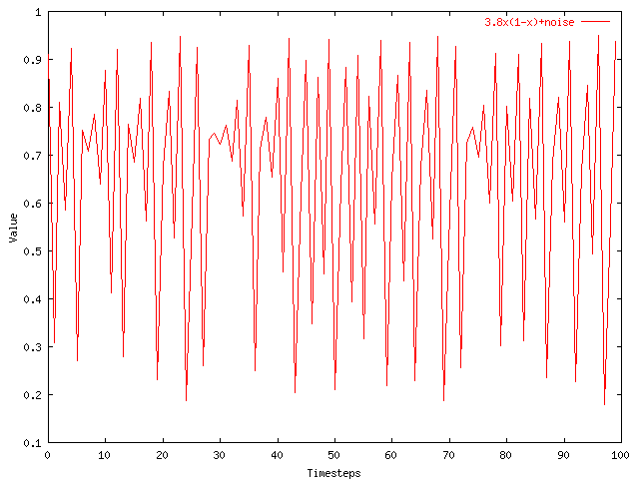
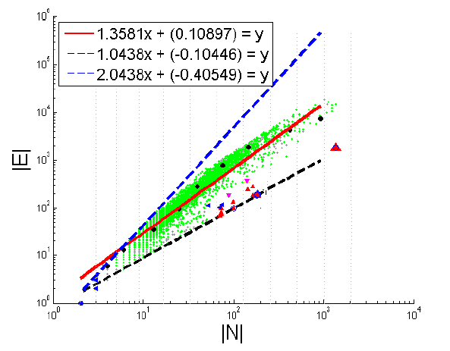
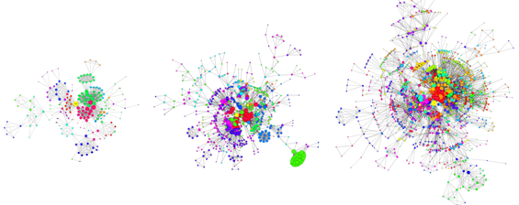
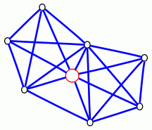

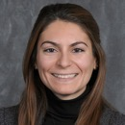
Graphs <-> points <-> time-series
time

Slide 6
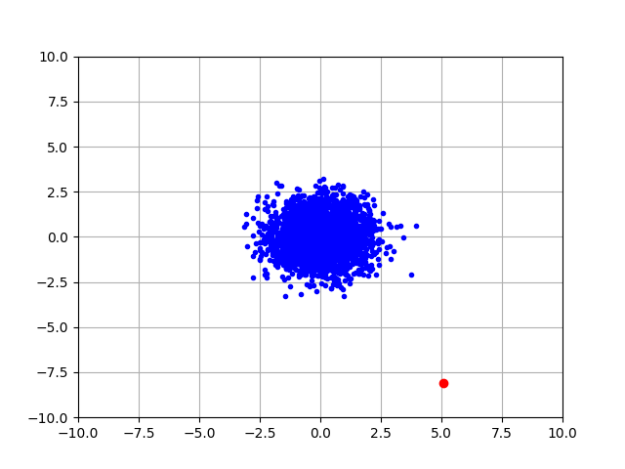
Q1) definition
“an observation which deviates so much from the other observations as to arouse suspicions that it was generated by a different mechanism”
D. M. Hawkins. Identification of outliers, volume 11. Springer, 1980.

Slide 7
Q1) definition
‘deviation from the common rule’
https://www.merriam-webster.com/dictionary/anomaly

Slide 8
Q1) definition
‘deviation from the common rule’
https://www.merriam-webster.com/dictionary/anomaly
But: How to spot rules?

Slide 9
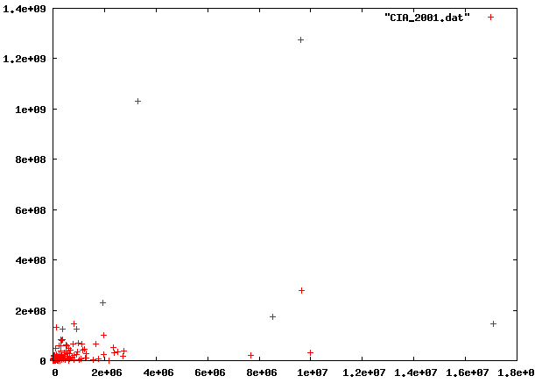
Q1: rules?

Slide 10
Q1: rules?

Slide 11
Q1: rules?

Slide 12
Q1: rules?
population
World countries
area

Slide 13
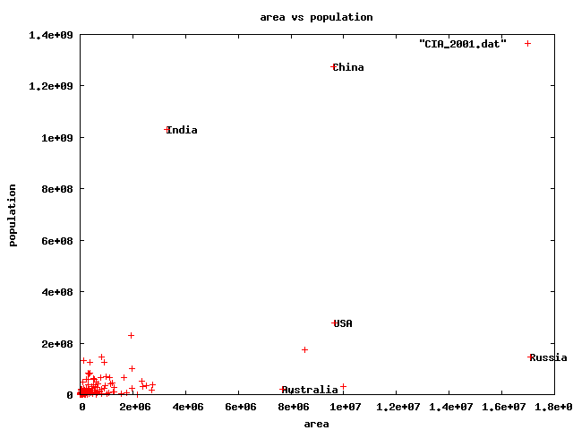
Q1) rules?
🇨🇳
🇮🇳
🇱🇷
🇷🇺
🇦🇺

Slide 14
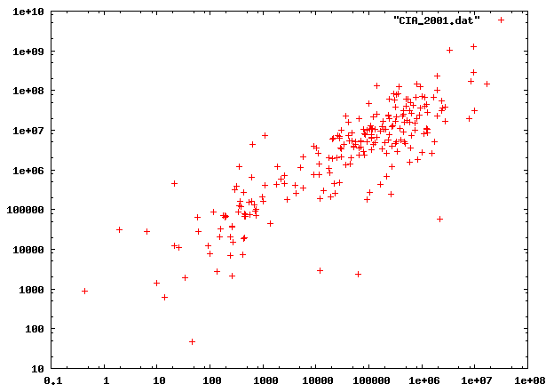
Q1) rules?

Slide 15
Q1) rules?

Slide 16
Q1) rules?

Slide 17
Q1) rules?
population
World countries
area

Slide 18
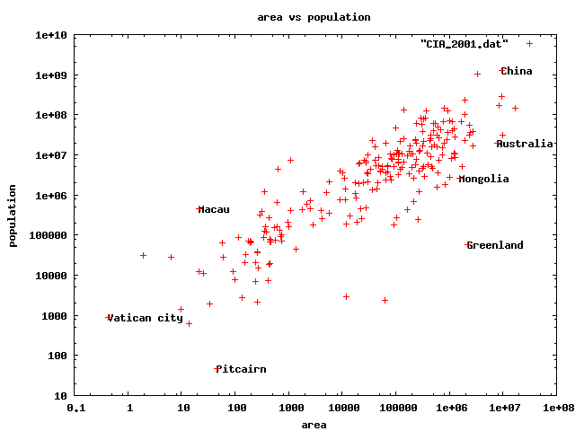
Q1) rules
🇨🇳
🇮🇳
🇻🇦
0.5km²
3x Taj Mahal
🇬🇸
47 residents(!)

Slide 19
Q1) rules
🇨🇳
🇨🇳
🇮🇳
🇻🇦
🇬🇸
Anomalies:
* Wrt our models (/ axis-scales)

Slide 20
Q1) definition
‘deviation from the common rule’*
https://www.merriam-webster.com/dictionary/anomaly
* Wrt our models (/ axis-scales)
But: How to spot rules?

Slide 21
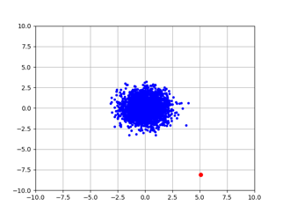
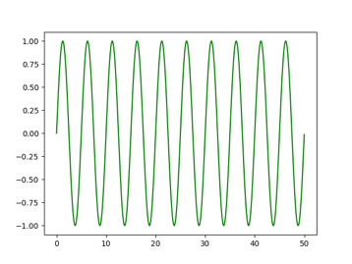

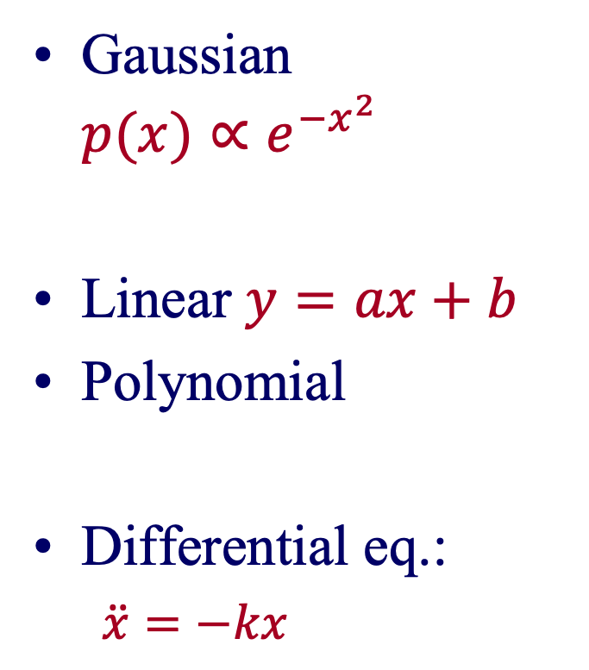
Model (= pattern = rule)
model-instance
Gaussian ${p(x)∝e}^{−x^{2}}$
Linear $y=ax+b$
Polynomial
Differential eq.:
$\ddot{x}=−kx$

Slide 22
Roadmap
Introduction – Motivation
OddBall
Last 10 years
Future
Q1) definition?
Q2) automation?
Q3) next steps?

Slide 23
Future – parting thoughts
Q1) Definition of anomaly?
A) “… strange/remote/unlikely, wrt our models”
Q2) can we automate it?
A) no, but: look for better models
Q3) next steps?
A) cross-disciplinarity -> new models

Slide 24



Q2) automation?
Q2.1
patterns
Q2.2
anomalies
compression

Slide 25
Q2) automation?
Q2.1
patterns
Q2.2
anomalies
compression

Slide 26
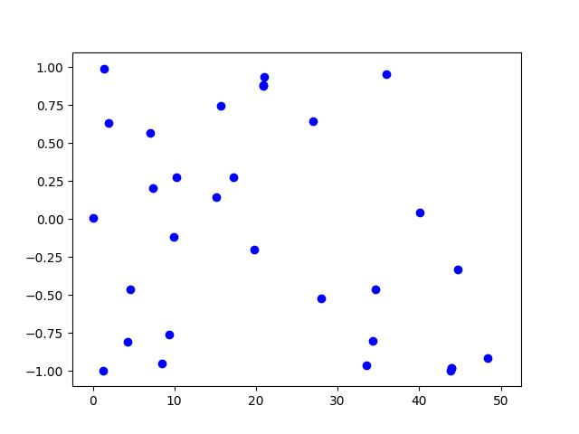
Q2.1) patterns <-> anomalies
Random?

Slide 27
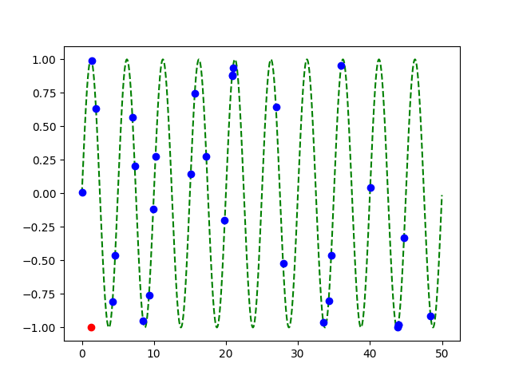
Q2.1) patterns <-> anomalies
Random?
Pattern!
+
Anomaly!

Slide 28
Q2) automation?
✓
Q2.1
patterns
Q2.2
anomalies
compression

Slide 29
Q2.2) patterns <-> compression
2 int per point
1 int per point
(plus 3 parm’s of sinusoid,
plus 2 int for outlier)

Slide 30
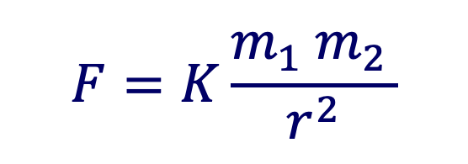
Q2.2) patterns <-> compression
Compression: @heart of science, e.g.:
$$F=K\frac{m_{1} m_{2 }}{r^{2}}$$
⬅️ Kepler ⬅️

Slide 31
compression is great – but …

Slide 32
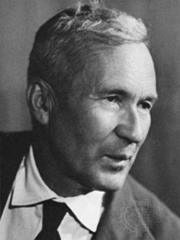
… optimal compression is undecidable!
Theorem*: for an arbitrary string x, computing its Kolmogorov complexity K(x) is undecidable
A.N. Kolmogorov
britannica.com
(*) E.g., [T. M. Cover and J. A. Thomas. Elements of Information Theory. John Wiley and Sons,1991, section 7.7]

Slide 33
… optimal compression is undecidable!
Theorem*: for an arbitrary string x, computing its Kolmogorov complexity K(x) is undecidable
EVEN WORSE
than NP-hard!
A.N. Kolmogorov
(*) E.g., [T. M. Cover and J. A. Thomas. Elements of Information Theory. John Wiley and Sons,1991, section 7.7]

Slide 34


… optimal compression is undecidable!
…which means there will be a chance to discover better models
-> job satisfaction ☺
…

Slide 35
Clarification: compression is possible…
… once we fix the set of models
…

Slide 36
Roadmap
Introduction – Motivation
OddBall
Last 10 years
Future
Q1) definition?
Q2) automation?
Q3) next steps?
Q3.1) examples of new models
Q3.2) how to find them

Slide 37
Future – parting thoughts
Q1) Definition of anomaly?
A) “… strange/remote/unlikely, wrt our models”
Q2) can we automate it?
A) no, but: look for better models
Q3) next steps?
A) cross-disciplinarity -> new models

Slide 38
Q3.1) Examples of (surprising) models
Fractals / self-similarity
Logistic parabola (flies; covid)
Lotka-Volterra
Lorenz attractor (laser / synthetic )
Van der Pol / FitzHugh-Nagumo

Slide 39
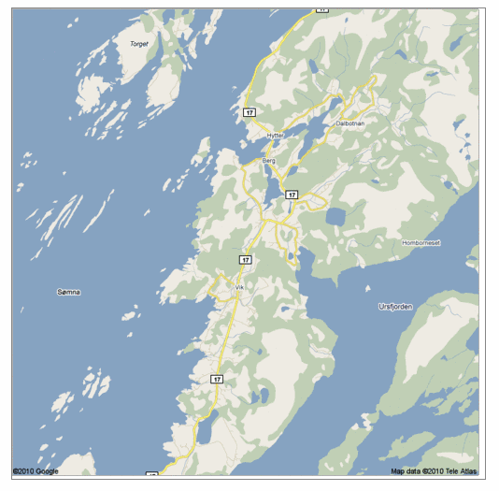
Q: Any pattern?

Slide 40
A: self similar!

Slide 41
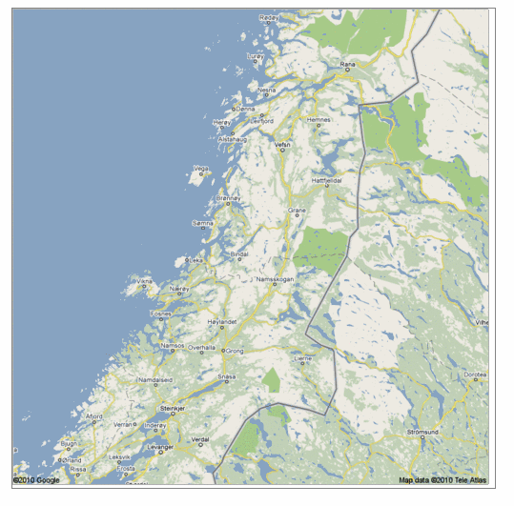
Real, self similar dataset

Slide 42
Real, self similar dataset

Slide 43
Real, self similar dataset

Slide 44
Real, self similar dataset

Slide 45
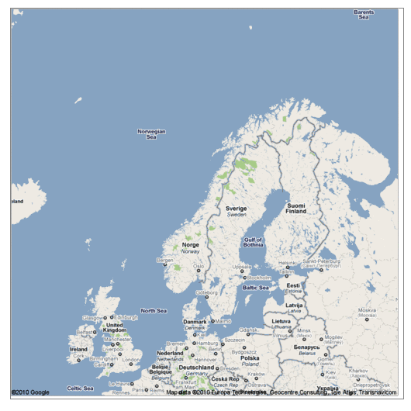
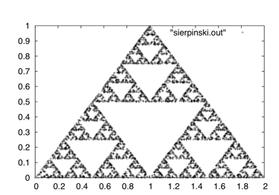
the red is true
origin: Norway
but most other coastlines are ‘self-similar’, too!
Waclaw Sierpinski
en.wikipedia.org

Slide 46
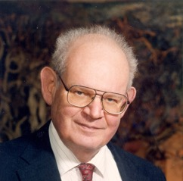
the red is true
origin: Norway
but most other coastlines are ‘self-similar’, too!
B. Mandelbrot
math.yale.edu
en.wikipedia.org

Slide 47
the red is true
origin: Norway
but most other coastlines are ‘self-similar’, too!
B. Mandelbrot
math.yale.edu
en.wikipedia.org

Slide 48
Q: Fractals and Graphs?

Slide 49

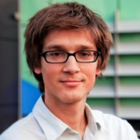
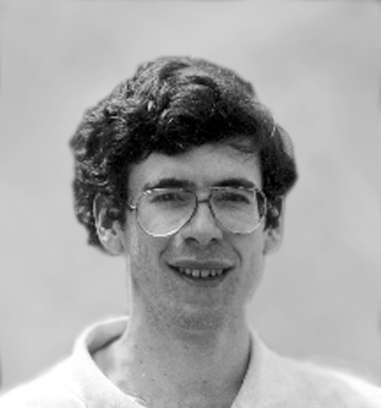
Fractals and Graphs
A: RMAT/Kronecker generators
D. Chakrabarti
J. Leskovec
J. Kleinberg
R-MAT: A Recursive Model for Graph Mining,
by D. Chakrabarti, Y. Zhan and C. Faloutsos,
SDM 2004, Orlando, Florida, USA
Realistic, Mathematically Tractable Graph Generation
and Evolution, Using Kronecker Multiplication,
by J. Leskovec, D. Chakrabarti, J. Kleinberg,
and C. Faloutsos, in PKDD 2005, Porto, Portugal

Slide 50
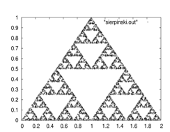
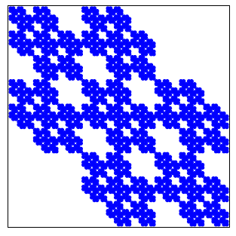
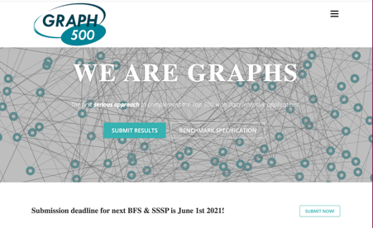
Kronecker Graphs
KDD dissertation award
[J. Leskovec, 2009]
PKDD test of time award, 2015
https://graph500.org/

Slide 51
Q3.1) Examples of models
✓
Fractals / self-similarity (Norway; Kronecker)
Logistic parabola (flies; covid)
Lotka-Volterra
Lorenz attractor (laser / synthetic )
Van der Pol / FitzHugh-Nagumo

Slide 52
Q3.1) models?
Value
Time

Slide 53
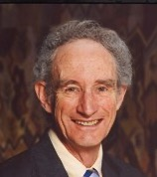

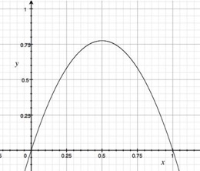
A3.1) Logistic parabola
royalsociety.org
Models population of flies [R. May/1976]
Logistic map
Time-series plot
Time t
Notes:
x_{t+1} = a x_t \cdot \left( 1-x_t \right )

Slide 54
A3.1) Logistic parabola
royalsociety.org
Models population of flies [R. May/1976]
Logistic map
~ SI virus prop. model
~ Bass equation (market penetration)
Special case of Lotka-Volterra
[COVID-19: ~SIR]
Notes:
x_{t+1} = a x_t \cdot \left( 1-x_t \right )

Slide 55

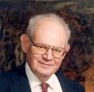
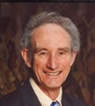
Q3.2) How can we find better models?
A3.2’ Look at the data
A3.2) Domain experts / cross-disciplinarity

Slide 56
Q3.2) How can we find better models?
A3.2) Domain experts / cross-disciplinarity

Slide 57
Future – parting thoughts
✓
Q1) Definition of anomaly?
A) “… strange/remote/unlikely, wrt our models”
Q2) can we automate it?
A) no, but: look for better models
Q3) next steps?
A) cross-disciplinarity -> new models
✓
✓

Slide 58







Thanks
Disclaimer: All opinions are mine; not necessarily reflecting the opinions of the funding agencies
Thanks to: NSF IIS-0705359, IIS-0534205,
CTA-INARC; Yahoo (M45), LLNL, IBM, SPRINT, Google, INTEL, HP, iLab

Slide 59
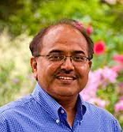
Thanks
Prof. R.K. Agrawal
Prof. P. Krishna Reddy
Prof. Jaideep Srivastava

Slide 60
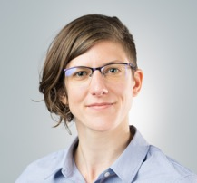
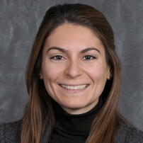
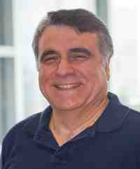
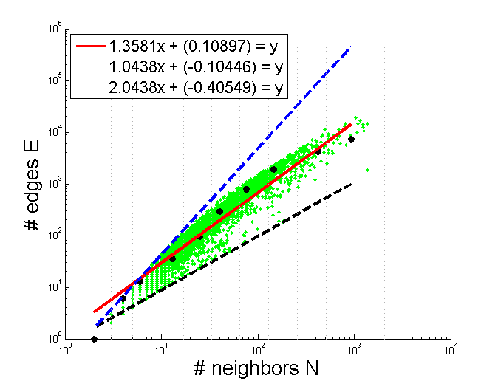

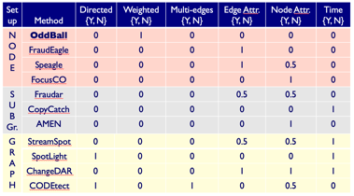
Conclusions
Rep. learning
(= Feature extraction
= Embedding)
Patterns <-> anomalies
Cross-disciplinarity

Slide 61
Conclusions
Thank you!
Rep. learning
(= Feature extraction
= Embedding)
Patterns <-> anomalies
Cross-disciplinarity

