Slide 1
Anomaly detection in graphs - past, present and future.
Leman Akoglu CMU
Mary McGlohon Google
Christos Faloutsos CMU

Slide 2
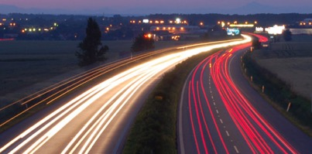
Roadmap
Introduction – Motivation
Past
Present
Future

Slide 3
Roadmap
Introduction – Motivation
Past
Present
Future
Q1) definition?
Q2) automation?
Q3) next steps?

Slide 4
Future – parting thoughts
Q1) Definition of anomaly?
A) “… strange/remote/unlikely, wrt our biases/priors”
Q2) can we automate it?
A) no, but: look for better models/biases/priors
Q3) next steps?
A) cross-disciplinarity -> new+better models

Slide 5
Q1) definition
‘deviation from the common rule’
https://www.merriam-webster.com/dictionary/anomaly

Slide 6
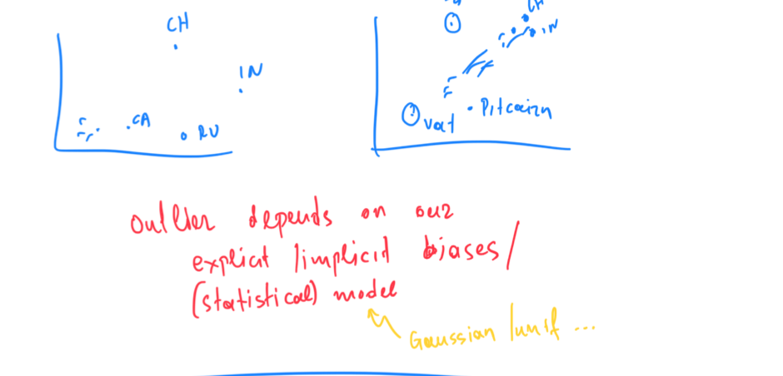
Q1) definition

Slide 7
Roadmap
Introduction – Motivation
Past
Present
Future
Q1) definition?
Q2) automation?
Q3) next steps?

Slide 8
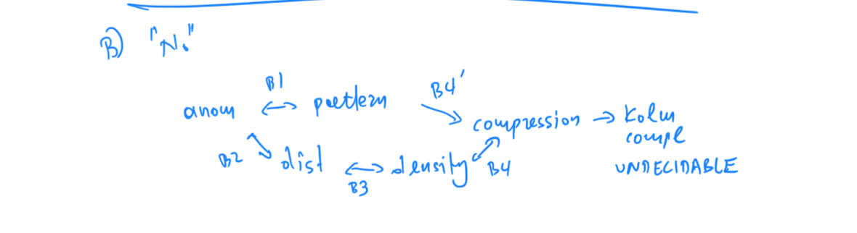
Q2) automation?

Slide 9
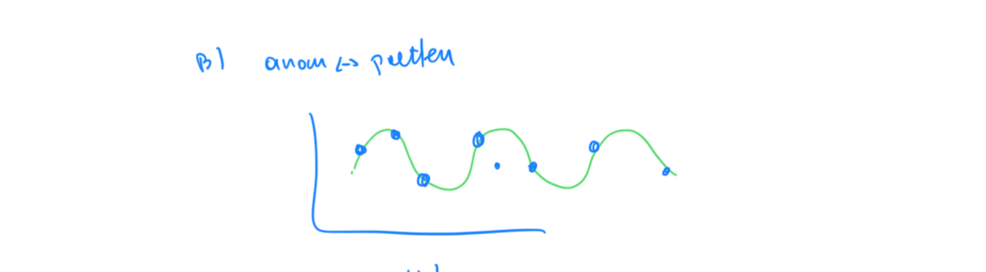

Slide 10
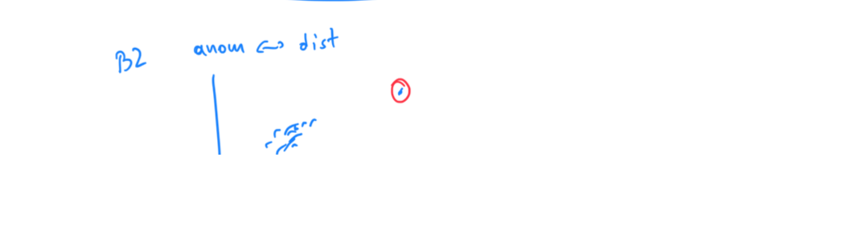

Slide 11
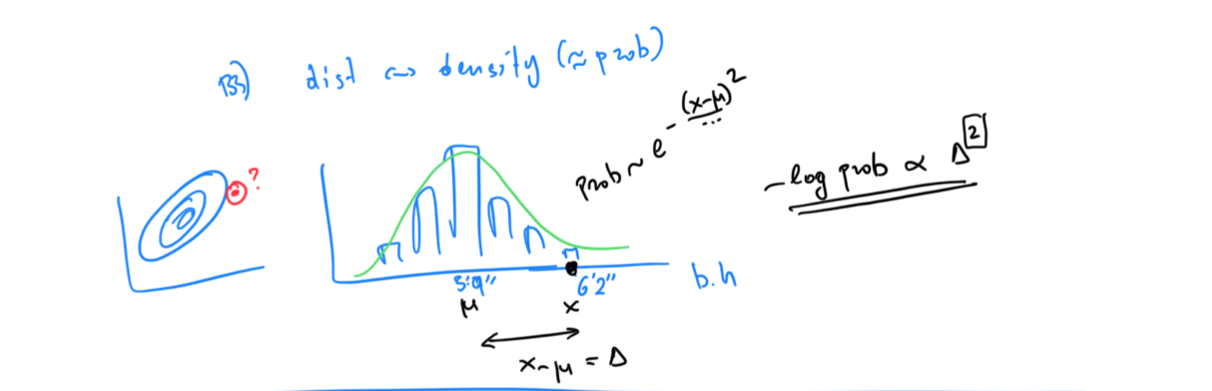

Slide 12
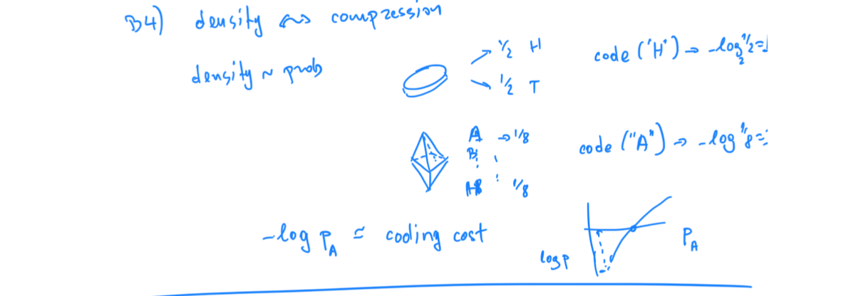

Slide 13
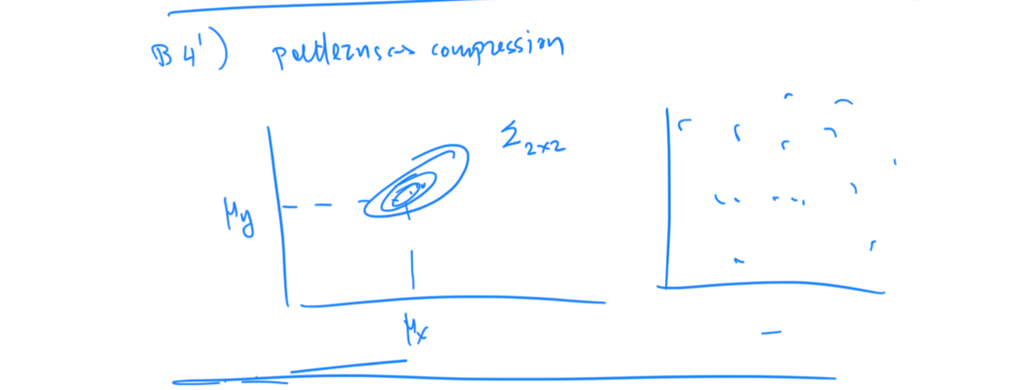

Slide 14
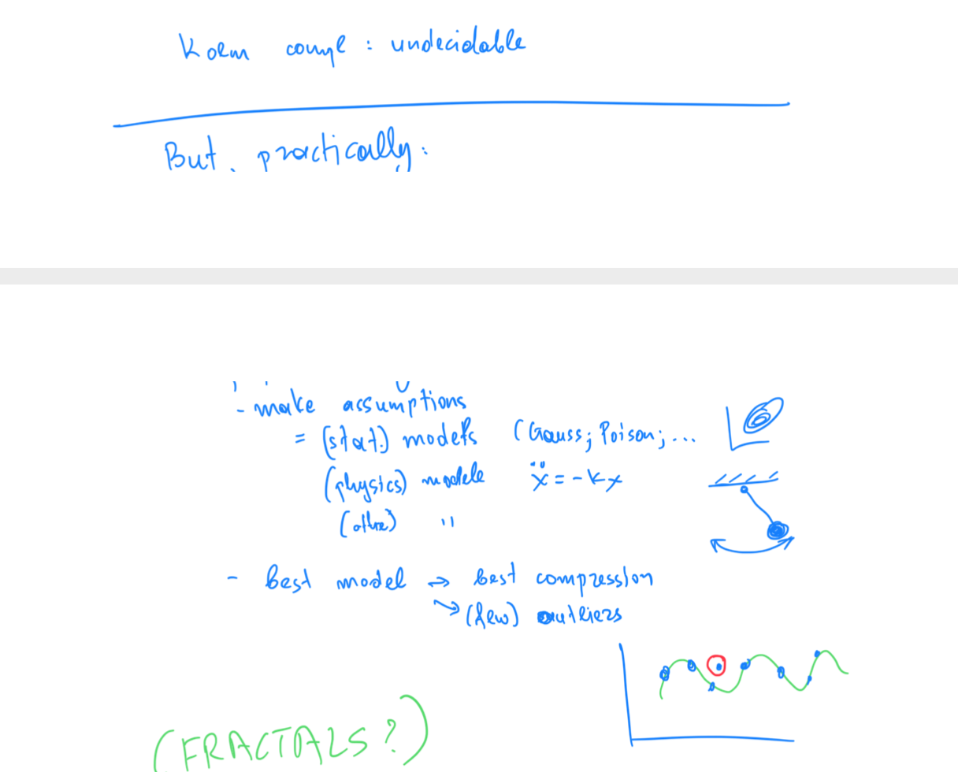

Slide 15
Roadmap
Introduction – Motivation
Past
Present
Future
Q1) definition?
Q2) automation?
Q3) next steps?

Slide 16
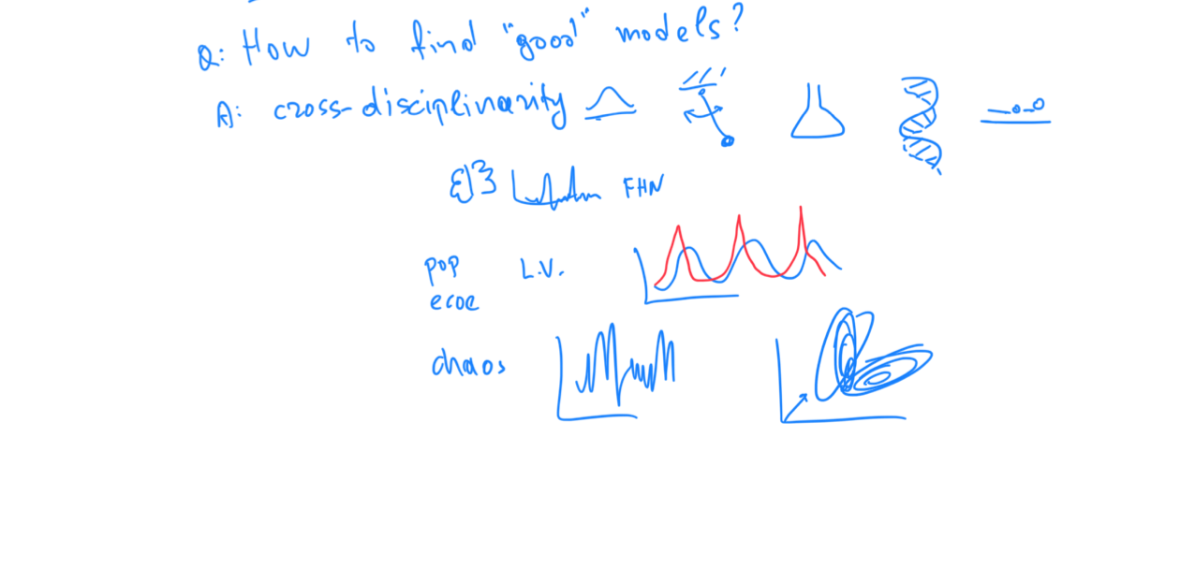

Slide 17
Examples of models
Fractals / self-similarity (Norway)
Logistic parabola (flies; covid)
Lotka-Volterra
Lorenz attractor (laser / synthetic )
Van der Pol / FitzHugh-Nagumo

Slide 18
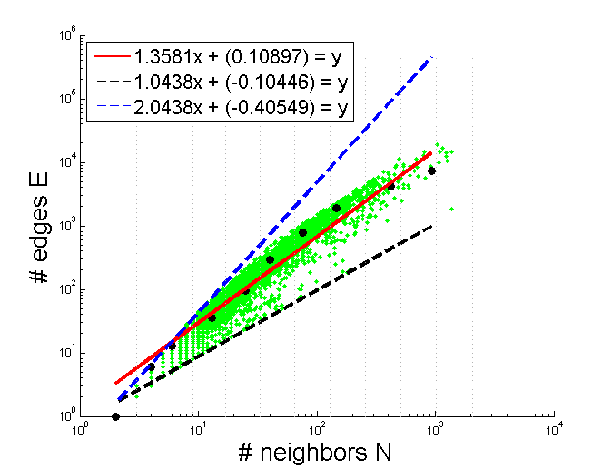

Thank you!

