Slide 1
Anomaly detection in graphs - past, present and future.
Leman Akoglu CMU
Mary McGlohon Google
Christos Faloutsos CMU

Slide 2
Thank you!
Prof. Reddy
Etc
etc

Slide 3
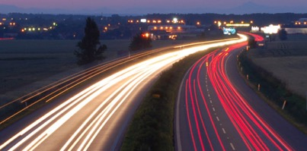
Roadmap
Introduction – Motivation
Why study anomalies?
Past
Present
Future

Slide 4
bla

Slide 5
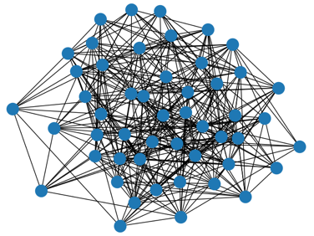
P1.3.1. Outliers
Which node(s) are strange?
Q: How to start?

Slide 6
P1.3.1. Outliers
Which node(s) are strange?
Q: How to start?
A1: egonet; and extract node features

Slide 7
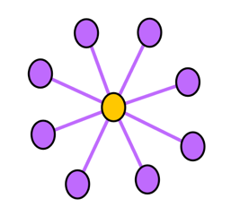
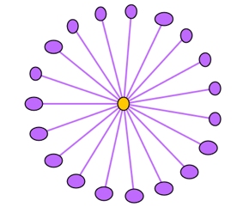
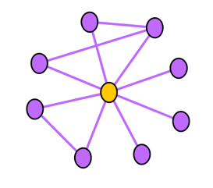
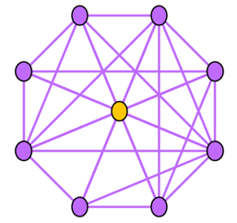
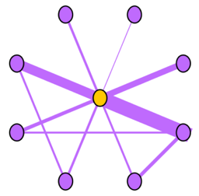
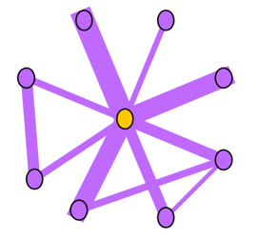
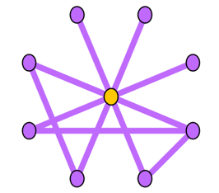
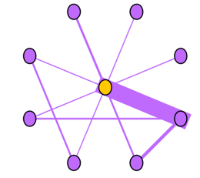
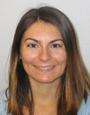
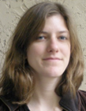
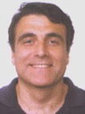
Ego-net Patterns: Which is strange?
Oddball: Spotting anomalies in weighted graphs, Leman Akoglu, Mary McGlohon, Christos Faloutsos, PAKDD 2010

Slide 8

P1.3.1. Outliers
Which node(s) are strange?
Q: How to start?
A: egonet; and extract node features
Q’: which features?
A’: ART! Infinite! Pick a few, e.g.:
KDD2020 ADS Panel: In ML
‘feature engineering is the hardest part’

Slide 9
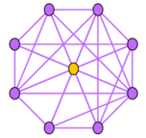
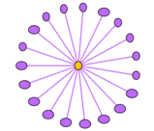



Ego-net Patterns
N_{i}: number of neighbors (degree) of ego i
E_{i}: number of edges in egonet i
W_{i}: total weight of egonet i
λ_{w,i}: principal eigenvalue of the weighted adjacency matrix of egonet i
Oddball: Spotting anomalies in weighted graphs
Leman Akoglu, Mary McGlohon, Christos Faloutsos
PAKDD 2010
Oddball: Spotting anomalies in weighted graphs, Leman Akoglu, Mary McGlohon, Christos Faloutsos, PAKDD 2010

Slide 10
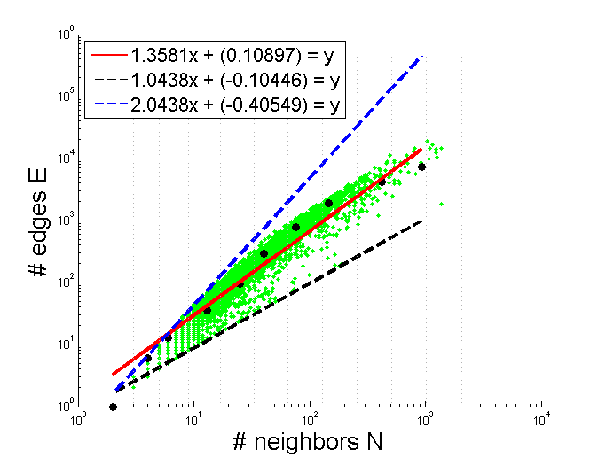
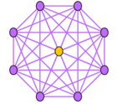
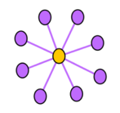
Pattern: Ego-net Power Law Density
E_{i} ∝ N_{i}^{α}
1 ≤ α ≤ 2
Oddball: Spotting anomalies in weighted graphs
Leman Akoglu, Mary McGlohon, Christos Faloutsos
PAKDD 2010
Oddball: Spotting anomalies in weighted graphs, Leman Akoglu, Mary McGlohon, Christos Faloutsos, PAKDD 2010

Slide 11
Pattern: Ego-net Power Law Density
E_{i} ∝ N_{i}^{α}
1 ≤ α ≤ 2
Enron CEO
Oddball: Spotting anomalies in weighted graphs
Leman Akoglu, Mary McGlohon, Christos Faloutsos
PAKDD 2010
Oddball: Spotting anomalies in weighted graphs, Leman Akoglu, Mary McGlohon, Christos Faloutsos, PAKDD 2010

Slide 14
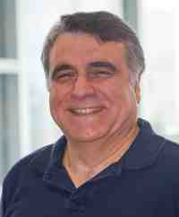
Thank you!

