Slide 1
Anomaly Detection in Graphs Past, Present and Future
Leman Akoglu CMU
Mary McGlohon CMU/Google
Christos Faloutsos CMU

Slide 2
Thank you!
Prof. R.K Agrawal (Jawharlal Nehru University)
P. Krishna Reddy (IIIT Hyderabad)
Jaideep Srivastava (University of Minnesota)

Slide 3

Roadmap
Introduction – Motivation
OddBall : spotting unusual nodes
Last 10 years
Graph Anomalies
Graph Representation
Future

Slide 4
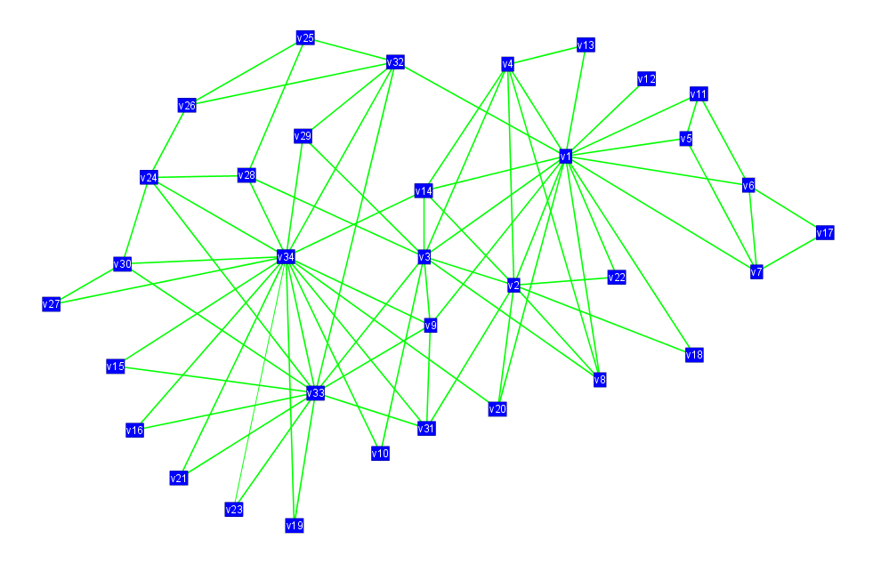
Motivation
Given a weighted graph, which nodes are strange/abnormal/extreme?
Computer networks: spammers, port scanners
Phone-call network: telemarketers, misbehaving customers, faulty equipment
Social network: ‘popularity contests’
Why?
Anomaly suggests behavior that
could have been generated by a different mechanism (bad actors, inorganic behavior)

Slide 5
OddBall: Premise
Pattern and law discovery, then application
Unless the majority of our nodes closely obey a pattern, only then can we confidently consider as outliers the few nodes that deviate.
Idea: Extract features for each node, and find patterns for those features across the graph.

Slide 6
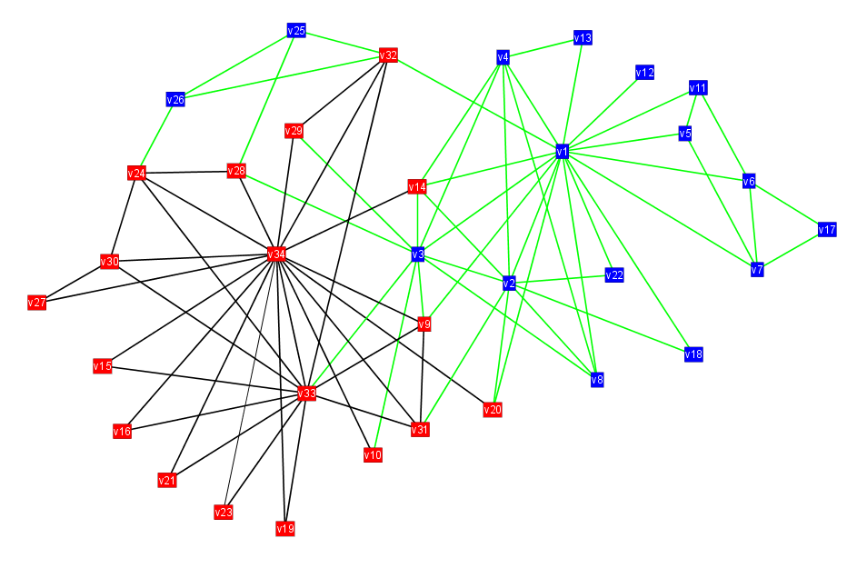
OddBall: Egonets
We extract patterns in egonets-- for any given node, its ego-net is the network formed by its neighbors and edges between them.
Ego

Slide 7
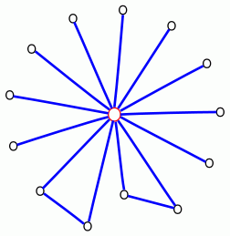
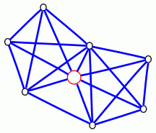
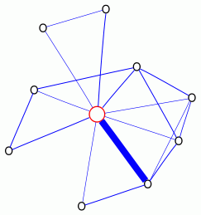
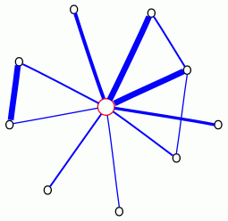
OddBall: Anomalous egonets
Near-star
Near-clique
Heavy vicinity
Dominant heavy link

Slide 8
OddBall: Patterns
Analyzed networks from various domains: citation graphs, campaign donations, blog links, emails, packet traffic
Looked for patterns in ego-nets
Discovered power-law relationships in egonets

Slide 9
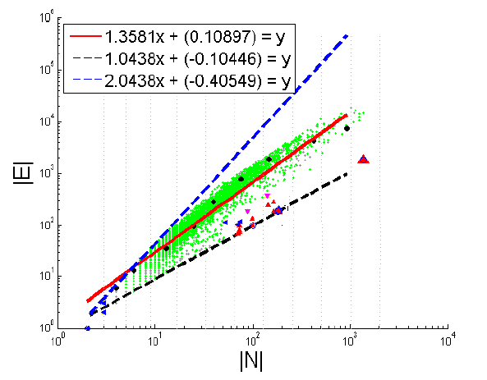
OddBall: Egonet Density Power Law
E_{i} ∝ N_{i}^{α}
1 ≤ α ≤ 2
Near clique/star

Slide 10
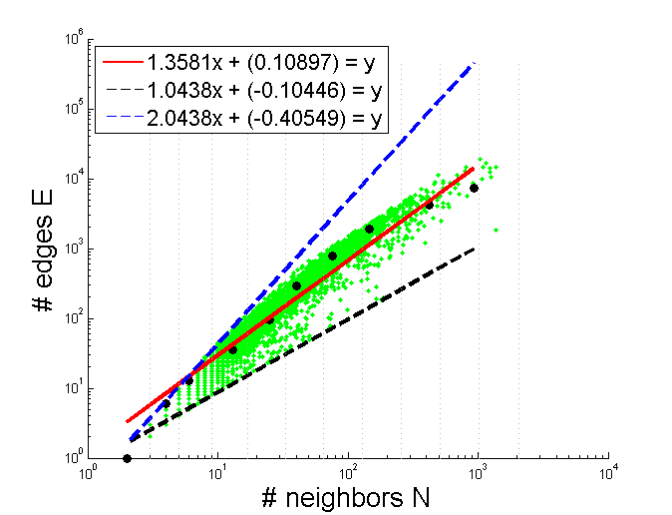
OddBall: Outliers from EDPL
Based on distance from fitting line
Enron CEO
(near-star)

Slide 11
OddBall: More patterns
Egonet Weight Power Law
Detects “heavy vicinity”
Egonet λ_{w} Power Law
Detects “dominant heavy link”
(Oddball: Spotting anomalies in weighted graphs, PAKDD 2010)

Slide 12
OddBall: Summary
Oddball is a node-level, feature-based approach to graph anomaly detection
Method:
extract features
(node embedding, representation learning)
study patterns
define rules
identify outliers

