Slide 1
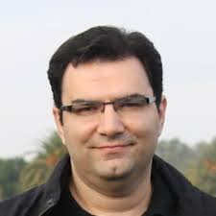

Graph Mining & Multi-Relational Learning Tools and Applications Part I
Shobeir Fakhraei
Amazon
Christos Faloutsos
CMU / Amazon

Slide 2


Bird’s eye view
^{Tool} _{Task} | 1.1 PR/HITS | 1.1 PPR | 1.2 METIS/ SVD | 1.3 OddBall+ | 1.4 BP | 2.1 FM | 2.1 Tensor | 2.2 HIN | 2.3 SRL
1.1 Node Ranking
1.1’ Link Prediction
1.2 Comm. Detection
1.3 Anomaly Detection
1.4 Propagation
Part 1: Plain Graphs
Part 2:
Complex Graphs

Slide 3
Bird’s eye view
Introduction - motivation
Part#1: (plain) Graphs
Part#2: MRL, Tensors etc
Conclusions

Slide 4







Social networks
Who-friends-whom

Slide 5

Social networks
Who-friends-whom
Who-follows-whom
Who-retweets-whom

Slide 6


Biology/medicine
Protein-protein interaction networks
Drugs and side-effects
Symptoms and disease

Slide 7




e-commerce examples
Who-buys-what
…
…

Slide 8
e-commerce examples
Who-buys-what
Who sells what
Who reviews what
…
…

Slide 9

Cyber-security
Who-buys-what
Who-sells-what
Who-reviews-what
Which_machine - connects_to - what
…
<subject> related-to <object> : graph
…
…

Slide 10
Examples on complex graphs?
(all the previous examples, are on ‘plain’ graphs)

Slide 11
Bird’s eye view
^{Tool} _{Task} | 1.1 PR/HITS | 1.1 PPR | 1.2 METIS/ SVD | 1.3 OddBall+ | 1.4 BP | 2.1 FM | 2.1 Tensor | 2.2 HIN | 2.3 SRL
1.1 Node Ranking
1.1’ Link Prediction
1.2 Comm. Detection
1.3 Anomaly Detection
1.4 Propagation
Part 1: Plain Graphs
Part 2:
Complex Graphs

Slide 12
Complex, e.g., time-evolving graphs
What is ‘normal’? suspicious? Groups?
3am, 4/1
…
Bob
3am, 4/1
…
Alice
10pm, 4/3
11pm, 4/3

Slide 13
Complex, e.g., MultiView Graph
What is ‘normal’? suspicious? Groups?
likes
Bob
…
buys
Alice
…
reviews
Chuck
buys

Slide 14


In general, Knowledge Graph
What is ‘normal’? suspicious? Groups?
Works for
parent
…
sibling
Lives-in

Slide 15


Definitions
plain
Complex
Node-attr.
Edge-attr.
…
…
A
F
A
T
…
…
…
Matrix
Coupled Matrices
…
Tensor

Slide 16
Definitions
plain
Complex
Node-attr.
Edge-attr.
…
…
A
F
A
T
…
…
…
Matrix
Coupled Matrices
…
Tensor

Slide 17
Definitions
plain
Complex
Node-attr.
Edge-attr.
…
…
A
F
A
T
…
…
…
Matrix
Coupled Matrices
…
Tensor

Slide 18
Definitions
plain
Complex
Node-attr.
Edge-attr.
…
…
A
F
A
T
…
…
…
Matrix
Coupled Matrices
…
Tensor

Slide 19
Definitions
plain
Complex
Node-attr.
Edge-attr.
…
…
A
F
A
T
…
…
…
Matrix
Coupled Matrices
…
Tensor

Slide 20
Definitions
‘Complex’ include any combination:
Edge AND node attributes
Timestamps
Locations
…
F
T
…
…
Coupled Matrix-Tensor

Slide 21
Definitions
PART 1
Plain graphs
PART 2
Complex graphs
…
A
F
T
…
…

Slide 22
Definitions
PART 1
Plain graphs
PART 2
Complex graphs
…
A
F
T
…
…

Slide 23



‘Recipe’ Structure:
Problem definition
Short answer/solution
LONG answer – details
Conclusion/short-answer

Slide 24

NOT covered here
Deep Learning / GNN
See, eg., www.dgl.ai/
w/ tutorials and s/w
from aws colleagues

Slide 25
Bird’s eye view
^{Tool} _{Task} | 1.1 PR/HITS | 1.1 PPR | 1.2 METIS/ SVD | 1.3 OddBall+ | 1.4 BP | 2.1 FM | 2.1 Tensor | 2.2 HIN | 2.3 SRL
1.1 Node Ranking
1.1’ Link Prediction
1.2 Comm. Detection
1.3 Anomaly Detection
1.4 Propagation
Part 1: Plain Graphs
Part 2:
Complex Graphs

Slide 26
Node importance - Motivation:
Given a graph (eg., web pages containing the desirable query word)
Q1: Which node is the most important?
Q2: How close is node ‘A’ to node ‘B’?
A
B

Slide 27
Node importance - Motivation:
Given a graph (eg., web pages containing the desirable query word)
Q1: Which node is the most important?
PageRank (PR = RWR), HITS (SVD)
Q2: How close is node ‘A’ to node ‘B’?
Personalized P.R. (PPR)
A
B

Slide 28
SVD properties (Singular Value Decomposition)
Hidden/latent variable detection
Compute node importance (HITS)
Block detection
Dimensionality reduction
Embedding (linear)
SVD is a special case of ’deep neural net’
v₀
v₁
u₀
u₁

Slide 29
SVD properties
Hidden/latent variable detection
Compute node importance (HITS)
Block detection
Dimensionality reduction
Embedding (linear)
SVD is a special case of ’deep neural net’
Matrix? SVD!
v₀
v₁
u₀
u₁

Slide 30
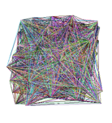
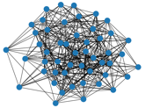
Bird’s eye view
Introduction – Motivation
Part#1: (simple) Graphs
P1.1: node importance
PageRank and Personalized PR
HITS
SVD
?

Slide 31
PageRank
Brin, Sergey and Lawrence Page (1998). Anatomy of a Large-Scale Hypertextual Web Search Engine. 7th Intl World Wide Web Conf.
Page, Brin, Motwani, and Winograd (1999). The PageRank citation ranking: Bringing order to the web. Technical Report

Slide 32
Problem: PageRank
Given a directed graph, find its most interesting/central node
A node is important,
if its parents are important
(recursive, but OK!)

Slide 33


Problem: PageRank - solution
Given a directed graph, find its most interesting/central node
Proposed solution: Random walk; spot most ‘popular’ node (-> steady state prob. (ssp))
A node high ssp,
if its parents have high ssp
(recursive, but OK!)

Slide 34
(Simplified) PageRank algorithm
DETAILS
Let A be the adjacency matrix;
let B be the transition matrix: transpose, column-normalized - then
From
B
To
2
1
3
=
4
5

Slide 35
(Simplified) PageRank algorithm
DETAILS
B p = p
B p = p
2
1
3
=
4
5

Slide 36
Definitions
DETAILS
A Adjacency matrix (from-to)
D Degree matrix = (diag ( d1, d2, …, dn) )
B Transition matrix: to-from, column normalized
B = A^{T} D⁻¹

Slide 37
(Simplified) PageRank algorithm
DETAILS
B p = 1 * p
thus, p is the eigenvector that corresponds to the highest eigenvalue (=1, since the matrix is column-normalized)
Why does such a p exist?
p exists if B is nxn, nonnegative, irreducible [Perron–Frobenius theorem]

Slide 38

(Simplified) PageRank algorithm
In short: imagine a particle randomly moving along the edges
compute its steady-state probabilities (ssp)
Full version of algo: with occasional random jumps
Why? To make the matrix irreducible

Slide 39
(Simplified) PageRank algorithm
In short: imagine a particle randomly moving along the edges
compute its steady-state probabilities (ssp)
Full version of algo: with occasional random jumps
Why? To make the matrix irreducible

Slide 40
(Simplified) PageRank algorithm
In short: imagine a particle randomly moving along the edges
compute its steady-state probabilities (ssp)
Full version of algo: with occasional random jumps
Why? To make the matrix irreducible

Slide 41
(Simplified) PageRank algorithm
In short: imagine a particle randomly moving along the edges
compute its steady-state probabilities (ssp)
Full version of algo: with occasional random jumps
Why? To make the matrix irreducible

Slide 42
(Simplified) PageRank algorithm
In short: imagine a particle randomly moving along the edges
compute its steady-state probabilities (ssp)
Full version of algo: with occasional random jumps
Why? To make the matrix irreducible

Slide 43
(Simplified) PageRank algorithm
In short: imagine a particle randomly moving along the edges
compute its steady-state probabilities (ssp)
PageRank = PR
= Random Walk with Restarts = RWR
= Random surfer

Slide 44
Full Algorithm
DETAILS
With probability 1-c, fly-out to a random node
Then, we have
p = c B p + (1-c)/n 1 =>
p = (1-c)/n [I - c B] ⁻¹ 1

Slide 45
Full Algorithm
DETAILS
With probability 1-c, fly-out to a random node
Then, we have
p = c B p + (1-c)/n 1 =>
p = (1-c)/n [I - c B] ⁻¹ 1
Notes:
{\left[ \begin{array}{c} 1 \\ 1 \\ \ldots \\ 1 \\ \end{array}\right]}

Slide 46
Notice:
pageRank ~ in-degree
(and HITS, also: ~ in-degree)
Notes:
{\left[ \begin{array}{c} 1 \\ 1 \\ \ldots \\ 1 \\ \end{array}\right]}

Slide 47

Bird’s eye view
^{Tool} _{Task} | 1.1 PR/HITS | 1.1 PPR | 1.2 METIS/ SVD | 1.3 OddBall+ | 1.4 BP | 2.1 FM | 2.1 Tensor | 2.2 HIN | 2.3 SRL
1.1 Node Ranking
1.1’ Link Prediction
1.2 Comm. Detection
1.3 Anomaly Detection
1.4 Propagation
Part 1: Plain Graphs
Part 2:
Complex Graphs

Slide 48
Node importance - Motivation:
Given a graph (eg., web pages containing the desirable query word)
Q1: Which node is the most important?
Q2: How close is node ‘A’ to node ‘B’?
A
B

Slide 49
Personalized P.R.
Taher H. Haveliwala. 2002. Topic-sensitive PageRank. (WWW '02). 517-526. http://dx.doi.org/10.1145/511446.511513

Slide 50
Extension: Personalized P.R.
How close is ‘4’ to ‘2’?
(or: if I like page/node ‘2’, what else would you recommend?)
2
1
3
4
5
Notes:
{\left[ \begin{array}{c} 1 \\ 1 \\ \ldots \\ 1 \\ \end{array}\right]}

Slide 51
Extension: Personalized P.R.
How close is ‘4’ to ‘2’?
(or: if I like page/node ‘2’, what else would you recommend?)
2
1
3
4
5
Notes:
{\left[ \begin{array}{c} 1 \\ 1 \\ \ldots \\ 1 \\ \end{array}\right]}

Slide 52
Extension: Personalized P.R.
How close is ‘4’ to ‘2’?
(or: if I like page/node ‘2’, what else would you recommend?)
2
1
3
4
5
Notes:
{\left[ \begin{array}{c} 1 \\ 1 \\ \ldots \\ 1 \\ \end{array}\right]}

Slide 53
Extension: Personalized P.R.
How close is ‘4’ to ‘2’?
(or: if I like page/node ‘2’, what else would you recommend?)
High score (A -> B) if
Many
Short
Heavy
paths A->B
2
1
3
4
5
Notes:
{\left[ \begin{array}{c} 1 \\ 1 \\ \ldots \\ 1 \\ \end{array}\right]}

Slide 54




Extension: Personalized P.R.
your favorite
With probability 1-c, fly-out to a random node(s)
Then, we have
p = c B p + (1-c)/n 1 =>
p = (1-c)/n [I - c B] ⁻¹ 1
$$\vec{e}$$
$$\vec{e}$$
$$\vec{e}$$
Notes:
{\left[ \begin{array}{c} 1 \\ 1 \\ \ldots \\ 1 \\ \end{array}\right]}

Slide 55


Extension: Personalized P.R.
How close is ‘4’ to ‘2’?
A: compute Personalized P.R. of ‘4’, restarting from ‘2’
2
1
3
4
5
Notes:
{\left[ \begin{array}{c} 1 \\ 1 \\ \ldots \\ 1 \\ \end{array}\right]}

Slide 56
Extension: Personalized P.R.
How close is ‘4’ to ‘2’?
A: compute Personalized P.R. of ‘4’, restarting from ‘2’ – Related to
‘escape’ probability
‘round trip’ probability
…
Notes:
{\left[ \begin{array}{c} 1 \\ 1 \\ \ldots \\ 1 \\ \end{array}\right]}

Slide 57
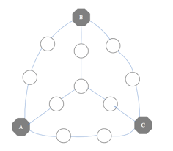
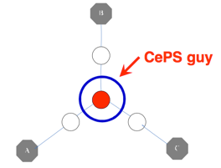

Applications of node proximity
Recommendation
Link prediction
‘Center Piece Subgraphs’
…
Fast Algorithms for Querying and Mining Large Graphs Hanghang Tong, PhD dissertation, CMU, 2009. TR: CMU-ML-09-112.

Slide 58
Bird’s eye view
^{Tool} _{Task} | 1.1 PR/HITS | 1.1 PPR | 1.2 METIS/ SVD | 1.3 OddBall+ | 1.4 BP | 2.1 FM | 2.1 Tensor | 2.2 HIN | 2.3 SRL
1.1 Node Ranking
1.1’ Link Prediction
1.2 Comm. Detection
1.3 Anomaly Detection
1.4 Propagation
Part 1: Plain Graphs
Part 2:
Complex Graphs

Slide 59
Bird’s eye view
^{Tool} _{Task} | 1.1 PR/HITS | 1.1 PPR | 1.2 METIS/ SVD | 1.3 OddBall+ | 1.4 BP | 2.1 FM | 2.1 Tensor | 2.2 HIN | 2.3 SRL
1.1 Node Ranking
1.1’ Link Prediction
1.2 Comm. Detection
1.3 Anomaly Detection
1.4 Propagation
Part 1: Plain Graphs
Part 2:
Complex Graphs

Slide 60
Bird’s eye view
Introduction – Motivation
Part#1: (simple) Graphs
P1.1: node importance
PageRank and Personalized PR
HITS
SVD (Singular Value Decomposition)
?

Slide 61
Kleinberg’s algo (HITS)
Kleinberg, Jon (1998). Authoritative sources in a hyperlinked environment. Proc. 9th ACM-SIAM Symposium on Discrete Algorithms.

Slide 62
Recall: problem dfn
Given a graph (eg., web pages containing the desirable query word)
Q1: Which node is the most important?

Slide 63

Why not just PageRank?
HITS (and its derivative, SALSA), differentiate between “hubs” and “authorities”
HITS can help to find the largest community
(SVD: powerful tool)
idols
fans

Slide 64
Problem: PageRank
From PR
Given a directed graph, find its most interesting/central node
A node is important,
if its parents are important
(recursive, but OK!)

Slide 65
Problem: PageRank
HITS
Given a directed graph, find its most interesting/central node
``wise’’
A node is important,
if its parents are important
(recursive, but OK!)
AND: A node is ``wise’’
if its children are important

Slide 66
Kleinberg’s algorithm
Step 0: find nodes with query word(s)
Step 1: expand by one move forward and backward

Slide 67
Kleinberg’s algorithm
on the resulting graph, give high score (= ‘authorities’) to nodes that many ``wise’’ nodes point to
give high wisdom score (‘hubs’) to nodes that point to good ‘authorities’
hubs
authorities

Slide 68
Kleinberg’s algorithm
Then:
a_{i} = h_{k} + h_{l} + h_{m}
that is
a_{i} = Sum (h_{j}) over all j that (j,i) edge exists
or
a = A^{T} h
k
l
i
m
=

Slide 69
Kleinberg’s algorithm
Then:
a_{i} = h_{k} + h_{l} + h_{m}
that is
a_{i} = Sum (h_{j}) over all j that (j,i) edge exists
or
a = A^{T} h
k
l
i
m
=

Slide 70
Kleinberg’s algorithm
symmetrically, for the ‘hubness’:
h_{i} = a_{n} + a_{p} + a_{q}
that is
h_{i} = Sum (q_{j}) over all j that (i,j) edge exists
or
h = A a
n
i
p
q
=

Slide 71
Kleinberg’s algorithm
symmetrically, for the ‘hubness’:
h_{i} = a_{n} + a_{p} + a_{q}
that is
h_{i} = Sum (q_{j}) over all j that (i,j) edge exists
or
h = A a
n
i
p
q
=

Slide 72
Kleinberg’s algorithm
In conclusion, we want vectors h and a such that:
h = A a
a = A^{T} h
=

Slide 73
Kleinberg’s algorithm
In conclusion, we want vectors h and a such that:
h = A a
a = A^{T} h
=

Slide 74
Kleinberg’s algorithm
In conclusion, we want vectors h and a such that:
h = A a
a = A^{T} h
=

Slide 75
Kleinberg’s algorithm
In conclusion, we want vectors h and a such that:
h = A a
a = A^{T} h
=

Slide 76
Kleinberg’s algorithm
In short, the solutions to
h = A a
a = A^{T} h
are the left- and right- singular-vectors of the adjacency matrix A.
Starting from random a’ and iterating, we’ll eventually converge
… to the vector of strongest singular value.
Dfn: in +4

Slide 77
Kleinberg’s algorithm - results
Eg., for the query ‘java’:
0.328 www.gamelan.com
0.251 java.sun.com
0.190 www.digitalfocus.com (“the java developer”)

Slide 78
Bird’s eye view
Introduction – Motivation
Part#1: (simple) Graphs
P1.1: node importance
PageRank and Personalized PR
HITS
SVD (Singular Value Decomposition)
?

Slide 79
SVD properties
Hidden/latent variable detection
Compute node importance (HITS)
Block detection
Dimensionality reduction
Embedding

Slide 80






Crush intro to SVD
Dfn: in +4
h = A a
a = A^{T} h
(SVD) matrix factorization: finds blocks
‘music lovers’
‘singers’
‘sports lovers’
‘athletes’
‘citizens’
‘politicians’
M
idols
N
fans
+
+
~

Slide 81
Crush intro to SVD
(SVD) matrix factorization: finds blocks
A) Even if shuffled!
‘music lovers’
‘singers’
‘sports lovers’
‘athletes’
‘citizens’
‘politicians’
M
idols
N
fans
+
+
~

Slide 82
Crush intro to SVD
(SVD) matrix factorization: finds blocks
B) Even if ‘salt+pepper’ noise
‘music lovers’
‘singers’
‘sports lovers’
‘athletes’
‘citizens’
‘politicians’
M
idols
N
fans
+
+
~

Slide 83
Crush intro to SVD
Basis for anomaly detection – P1.3
Basis for tensor/PARAFAC – P2.1
‘music lovers’
‘singers’
‘sports lovers’
‘athletes’
‘citizens’
‘politicians’
M
idols
N
fans
+
+
~

Slide 84
SVD properties
Hidden/latent variable detection
Compute node importance (HITS)
Block detection
Dimensionality reduction
Embedding
v₀
v₁
u₀
u₁

Slide 85
Crush intro to SVD
h = A a
a = A^{T} h
Dfn: in +4
(SVD) matrix factorization: finds blocks
HITS: first singular vector, ie, fixates on largest group
‘music lovers’
‘singers’
‘citizens’
‘politicians’
Authority scores
‘sports lovers’
‘athletes’
M
idols
N
fans
+
+
~
Hub scores

Slide 86
SVD properties
Hidden/latent variable detection
Compute node importance (HITS)
Block detection
Dimensionality reduction
Embedding
v₀
v₁
u₀
u₁

Slide 87
Crush intro to SVD
(SVD) matrix factorization: finds blocks
‘music lovers’
‘singers’
‘sports lovers’
‘athletes’
‘citizens’
‘politicians’
M
idols
N
fans
+
+
~

Slide 88
SVD properties
Hidden/latent variable detection
Compute node importance (HITS)
Block detection
Dimensionality reduction
Embedding
v₀
v₁
u₀
u₁

Slide 89
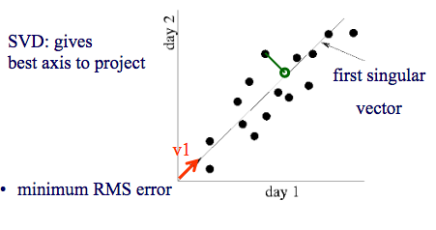
SVD - intuition
#retweets for …
#retweets for Byonce
v₁
v₂
u₁
u₂

Slide 90
SVD properties
Hidden/latent variable detection
Compute node importance (HITS)
Block detection
Dimensionality reduction / projection
Embedding
v₀
v₁
u₀
u₁

Slide 91
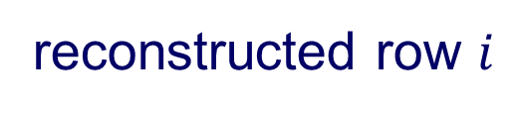

Crush intro to SVD
SVD compression is a linear autoencoder
M idols
reconstructed row $i$
N
fans
…
scores
…
row $i$ (M dim)
Independent Component Analysis,Aapo Hyvarinen, Erkki Oja, and Juha Karhunen (Wiley, 2001) – sec 6.2.4, p. 136.

Slide 92
SVD properties
Hidden/latent variable detection
Compute node importance (HITS)
Block detection
Dimensionality reduction
Embedding (linear)
SVD is a special case of ’deep neural net’
v₀
v₁
u₀
u₁

Slide 93
Node importance - Motivation:
Given a graph (eg., web pages containing the desirable query word)
Q1: Which node is the most important?
PageRank (PR = RWR), HITS
Q2: How close is node ‘A’ to node ‘B’?
Personalized P.R.

Slide 94
SVD properties
Hidden/latent variable detection
Compute node importance (HITS)
Block detection
Dimensionality reduction
Embedding (linear)
SVD is a special case of ’deep neural net’
v₀
v₁
u₀
u₁

Slide 95
SVD properties
Hidden/latent variable detection
Compute node importance (HITS)
Block detection
Dimensionality reduction
Embedding (linear)
SVD is a special case of ’deep neural net’
Matrix? SVD!
v₀
v₁
u₀
u₁

Slide 96
Bird’s eye view
^{Tool} _{Task} | 1.1 PR/HITS | 1.1 PPR | 1.2 METIS/ SVD | 1.3 OddBall+ | 1.4 BP | 2.1 FM | 2.1 Tensor | 2.2 HIN | 2.3 SRL
1.1 Node Ranking
1.1’ Link Prediction
1.2 Comm. Detection
1.3 Anomaly Detection
1.4 Propagation
Part 1: Plain Graphs
Part 2:
Complex Graphs

Slide 97
Problem
Given a graph, and k
Break it into k (disjoint) communities

Slide 98
Short answer
METIS [Karypis, Kumar]

Slide 99
Solution#1: METIS
Arguably, the best algorithm
Open source, at
http://glaros.dtc.umn.edu/gkhome/fetch/sw/metis/metis-5.1.0.tar.gz
and *many* related papers, at same url
Main idea:
coarsen the graph;
partition;
un-coarsen

Slide 100
Solution #1: METIS
G. Karypis and V. Kumar. METIS 4.0: Unstructured graph partitioning and sparse matrix ordering system. TR, Dept. of CS, Univ. of Minnesota, 1998.
<and many extensions>

Slide 101
Solutions #2,3…
Fiedler vector (2nd singular vector of Laplacian).
Modularity: Community structure in social and biological networks M. Girvan and M. E. J. Newman, PNAS June 11, 2002. 99 (12) 7821-7826; https://doi.org/10.1073/pnas.122653799
Co-clustering: [Dhillon+, KDD’03]
Clustering on the A² (square of adjacency matrix) [Zhou, Woodruff, PODS’04]
Minimum cut / maximum flow [Flake+, KDD’00]
….

Slide 102


A word of caution
BUT: often, there are no good cuts:
A,B
A,B

Slide 103

A word of caution
BUT: often, there are no good cuts:
A,B
A,B

Slide 104
A word of caution
Maybe there are no good cuts: ``jellyfish’’ shape [Tauro+’01], [Siganos+,’06], strange behavior of cuts [Chakrabarti+’04], [Leskovec+,’08]

Slide 105
A word of caution
Maybe there are no good cuts: ``jellyfish’’ shape [Tauro+’01], [Siganos+,’06], strange behavior of cuts [Chakrabarti+,’04], [Leskovec+,’08]
?
?
D. Chakrabarti, Y. Zhan, D. Blandford, C. Faloutsos and G. Blelloch: NetMine: New Mining Tools for Large Graphs, in SDM 2004 Workshop

Slide 106

Short answer
METIS [Karypis, Kumar]
(but: maybe NO good cuts exist!)

Slide 107
Bird’s eye view
^{Tool} _{Task} | 1.1 PR/HITS | 1.1 PPR | 1.2 METIS/ SVD | 1.3 OddBall+ | 1.4 BP | 2.1 FM | 2.1 Tensor | 2.2 HIN | 2.3 SRL
1.1 Node Ranking
1.1’ Link Prediction
1.2 Comm. Detection
1.3 Anomaly Detection
1.4 Propagation
Part 1: Plain Graphs
Part 2:
Complex Graphs

Slide 108
Bird’s eye view
^{Tool} _{Task} | 1.1 PR/HITS | 1.1 PPR | 1.2 METIS/ SVD | 1.3 OddBall+ | 1.4 BP | 2.1 FM | 2.1 Tensor | 2.2 HIN | 2.3 SRL
1.1 Node Ranking
1.1’ Link Prediction
1.2 Comm. Detection
1.3 Anomaly Detection
1.4 Propagation
Part 1: Plain Graphs
Part 2:
Complex Graphs

Slide 109
Bird’s eye view
Introduction – Motivation
Part#1: (simple) Graphs
P1.1: node importance
P1.2: community detection
P1.3: fraud/anomaly detection
P1.4: belief propagation
un-supervised
?
semi-supervised
109

Slide 110
Bird’s eye view
Introduction – Motivation
Part#1: (simple) Graphs
P1.1: node importance
P1.2: community detection
P1.3: fraud/anomaly detection
P1.3.1. Outliers
P1.3.2. Lock-step behavior
P1.4: belief propagation
un-supervised
?
110

Slide 111


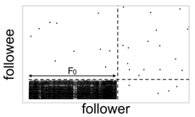

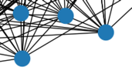
Problem
Given:
Find:
Outliers
Lock-step

Slide 112
Solution
Given:
Find:
Outliers
Lock-step
OddBall
SVD

Slide 113

P1.3.1. Outliers
Which node(s) are strange?
Q: How to start?

Slide 114
P1.3.1. Outliers
Which node(s) are strange?
Q: How to start?
A1: egonet; and extract node features

Slide 115
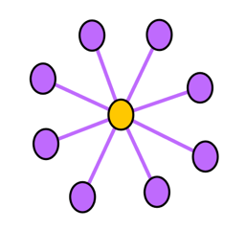
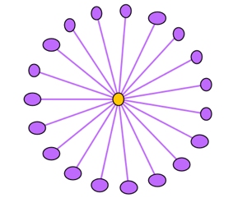
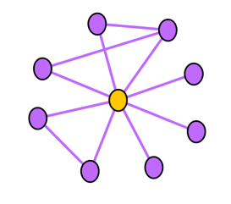
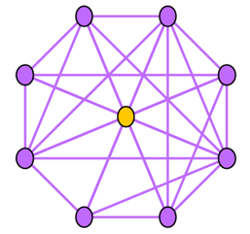
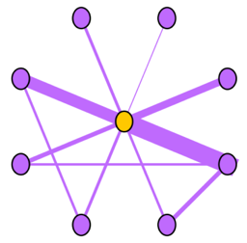
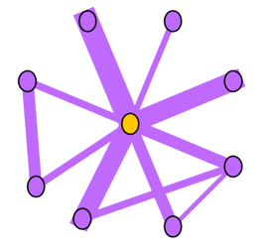
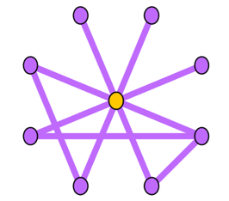
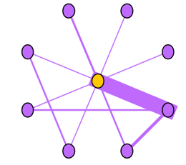


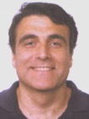
Ego-net Patterns: Which is strange?
Oddball: Spotting anomalies in weighted graphs, Leman Akoglu, Mary McGlohon, Christos Faloutsos, PAKDD 2010

Slide 116

P1.3.1. Outliers
Which node(s) are strange?
Q: How to start?
A: egonet; and extract node features
Q’: which features?
A’: ART! Infinite! Pick a few, e.g.:
KDD2020 ADS Panel: In ML
‘feature engineering is the hardest part’

Slide 117
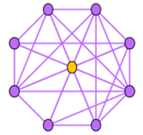
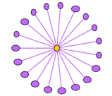



Ego-net Patterns
N_{i}: number of neighbors (degree) of ego i
E_{i}: number of edges in egonet i
W_{i}: total weight of egonet i
λ_{w,i}: principal eigenvalue of the weighted adjacency matrix of egonet i
Oddball: Spotting anomalies in weighted graphs
Leman Akoglu, Mary McGlohon, Christos Faloutsos
PAKDD 2010
Oddball: Spotting anomalies in weighted graphs, Leman Akoglu, Mary McGlohon, Christos Faloutsos, PAKDD 2010

Slide 118
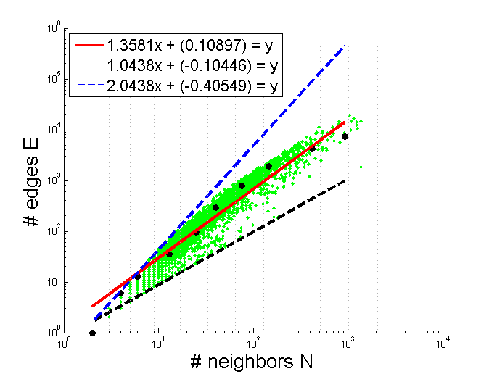
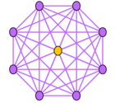
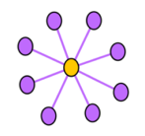
Pattern: Ego-net Power Law Density
E_{i} ∝ N_{i}^{α}
1 ≤ α ≤ 2
Oddball: Spotting anomalies in weighted graphs
Leman Akoglu, Mary McGlohon, Christos Faloutsos
PAKDD 2010
Oddball: Spotting anomalies in weighted graphs, Leman Akoglu, Mary McGlohon, Christos Faloutsos, PAKDD 2010

Slide 119
Pattern: Ego-net Power Law Density
E_{i} ∝ N_{i}^{α}
1 ≤ α ≤ 2
Enron CEO
Oddball: Spotting anomalies in weighted graphs
Leman Akoglu, Mary McGlohon, Christos Faloutsos
PAKDD 2010
Oddball: Spotting anomalies in weighted graphs, Leman Akoglu, Mary McGlohon, Christos Faloutsos, PAKDD 2010

Slide 120
Bird’s eye view
Introduction – Motivation
Part#1: (simple) Graphs
P1.1: node importance
P1.2: community detection
P1.3: fraud/anomaly detection
P1.3.1. Outliers
P1.3.2. Lock-step behavior
P1.4: belief propagation
un-supervised
?
120

Slide 121
Problem
Given:
Find:
Outliers
Lock-step

Slide 122
P1.3.1. How to find ‘suspicious’ groups?
‘blocks’ are normal, right?
idols
fans

Slide 123
P1.3.1. How to find ‘suspicious’ groups?
‘blocks’ are normal, right?
A,B
idols
A,B
fans

Slide 124
Except that:
‘blocks’ are normal, right?
‘hyperbolic’ communities are more realistic [Araujo+, PKDD’14]
idols
fans

Slide 125
Except that:
‘blocks’ are usually suspicious
‘hyperbolic’ communities are more realistic [Araujo+, PKDD’14]
Q: Can we spot blocks, easily?

Slide 126

Except that:
‘blocks’ are usually suspicious
‘hyperbolic’ communities are more realistic [Araujo+, PKDD’14]
Q: Can we spot blocks, easily?
A: Silver bullet: SVD!

Slide 127
Crush intro to SVD
Reminder (from HITS)
Recall: (SVD) matrix factorization: finds blocks
‘music lovers’
‘singers’
‘sports lovers’
‘athletes’
‘citizens’
‘politicians’
M
idols
N
fans
+
+
~

Slide 128




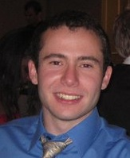
Inferring Strange Behavior from Connectivity Pattern in Social Networks PAKDD’14
Meng Jiang, Peng Cui, Shiqiang Yang (Tsinghua)
Alex Beutel, Christos Faloutsos (CMU)

Slide 129

Dataset
Tencent Weibo
117 million nodes (with profile and UGC data)
3.33 billion directed edges

Slide 130
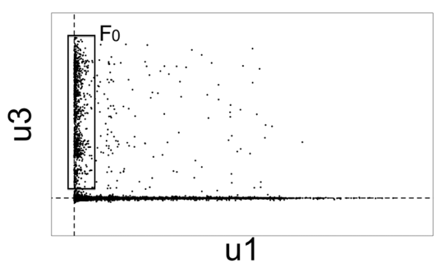

Real Data
“Rays”
“Block”
‘blocks’ create ‘spokes’

Slide 131

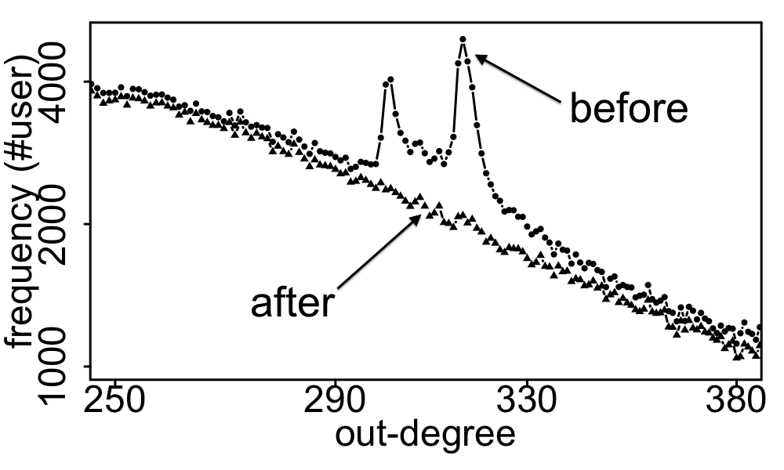
Real Data
Spikes on the out-degree distribution
×

Slide 132
Solution
Given:
Find:
Outliers
Lock-step
OddBall
SVD

Slide 133
Bird’s eye view
^{Tool} _{Task} | 1.1 PR/HITS | 1.1 PPR | 1.2 METIS/ SVD | 1.3 OddBall+ | 1.4 BP | 2.1 FM | 2.1 Tensor | 2.2 HIN | 2.3 SRL
1.1 Node Ranking
1.1’ Link Prediction
1.2 Comm. Detection
1.3 Anomaly Detection
1.4 Propagation
Part 1: Plain Graphs
Part 2:
Complex Graphs

Slide 134
Bird’s eye view
Introduction – Motivation
Part#1: (simple) Graphs
P1.1: node importance
P1.2: community detection
P1.3: fraud/anomaly detection
P1.4: belief propagation
un-supervised
?
semi-supervised
134

Slide 135
Problem
What color, for the rest?
Given homophily (/heterophily etc)?

Slide 136










Short answer:
What color, for the rest?
A: Belief Propagation (‘zooBP’)
www.cs.cmu.edu/~deswaran/code/zoobp.zip
+

Slide 137
Bird’s eye view
Introduction – Motivation
Part#1: (simple) Graphs
…
P1.4: belief propagation
Basics
Fast, linear approximation (FaBP)
Latest: zooBP
Success stories
?
137

Slide 138

Background
Prof. Danai Koutra
U. Michigan

Slide 139

Belief Propagation
“Propagation matrix”:
Homophily
Iterative message-based method
AI
class of receiver
class of
sender
0.9 | 0.1
0.1 | 0.9
...
until stop criterion fulfilled
1st round
2nd round
PL
[Pearl ‘82][Yedidia+ ’02] … [Gonzalez+ ‘09][Chechetka+ ‘10]
Notes:
Class of receiver / class of sender : without bubbles

Slide 140
Background

Slide 141
Bird’s eye view
Introduction – Motivation
Part#1: (simple) Graphs
…
P1.4: belief propagation
Basics
Fast, linear approximation (FaBP)
Latest: zooBP
Success stories
?
141

Slide 142
Unifying Guilt-by-Association Approaches: Theorems and Fast Algorithms
Danai Koutra
U Kang
Hsing-Kuo Kenneth Pao
Tai-You Ke
Duen Horng (Polo) Chau
Christos Faloutsos
ECML PKDD, 5-9 September 2011, Athens, Greece
Notes:
Work in collaboration with National Taiwan University

Slide 143

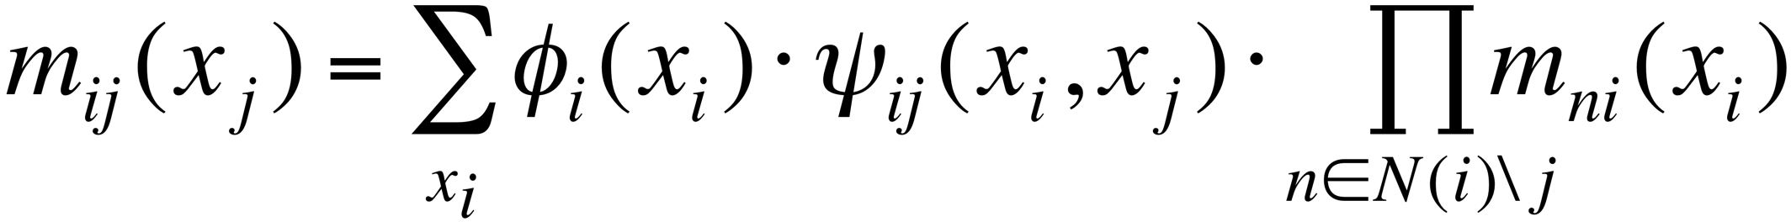
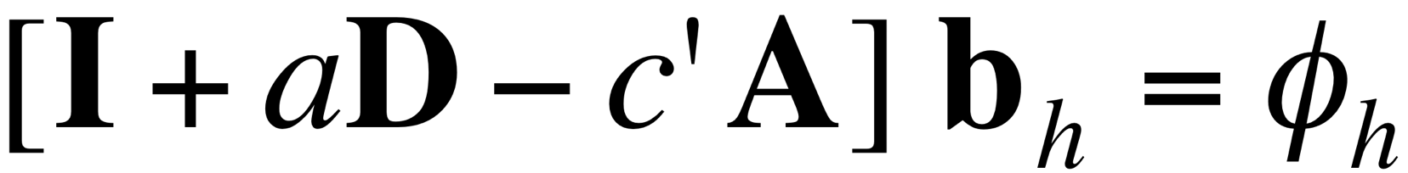
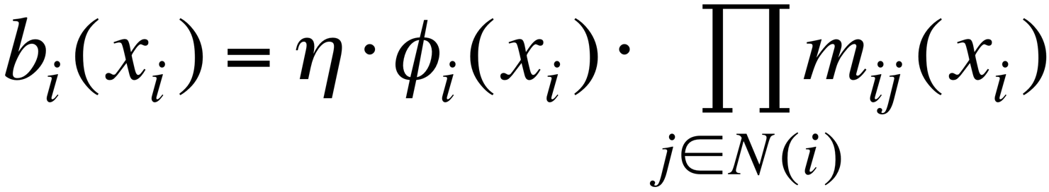
BP vs. Linearized BP
DETAILS
Original [Yedidia+]:
Our proposal:
Belief Propagation
BP is approximated by
Linearized BP
1
1
1
d1
d2
d3
0 1 0
1 0 1
0 1 0
?
0
-10⁻²
10⁻²
non-linear
linear
Closed-form formula?
Convergence?
Notes:
Half: yedidia equations → non-linear equations
Half: theorem -→ linear
Swap!

Slide 144
BP vs. Linearized BP
DETAILS
Original [Yedidia+]:
Our proposal:
Belief Propagation
BP is approximated by
Linearized BP
1
1
1
d1
d2
d3
0 1 0
1 0 1
0 1 0
?
0
-10⁻²
10⁻²
non-linear
linear
Closed-form formula?
Convergence?
Notes:
Half: yedidia equations → non-linear equations
Half: theorem -→ linear
Swap!

Slide 145
Problem: anomalies in ratings
Given a heterogeneous graph on users, products, sellers and positive/negative ratings with “seed labels”
Find the top k most anomalous users, products and sellers
+
Dhivya Eswaran, Stephan Günnemann, Christos Faloutsos, Disha Makhija, Mohit Kumar, “ZooBP: Belief Propagation for Heterogeneous Networks”, VLDB 2017

Slide 146
Problem: anomalies in ratings
Given a heterogeneous graph on users, products, sellers and positive/negative ratings with “seed labels”
Find the top k most anomalous users, products and sellers
+
Dhivya Eswaran, Stephan Günnemann, Christos Faloutsos, Disha Makhija, Mohit Kumar, “ZooBP: Belief Propagation for Heterogeneous Networks”, VLDB 2017

Slide 147
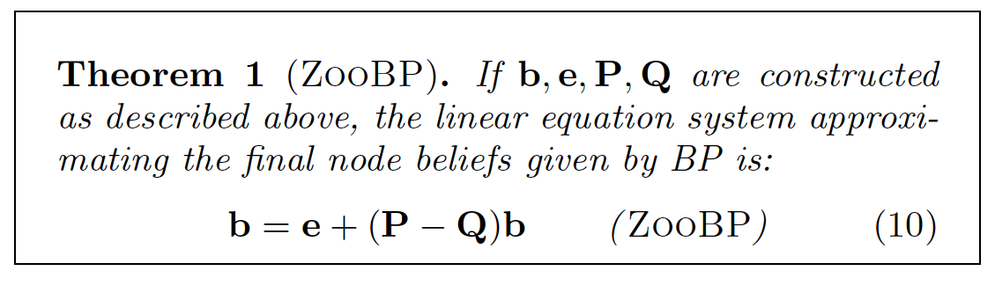
Problem: anomalies in ratings
DETAILS
+
Dhivya Eswaran, Stephan Günnemann, Christos Faloutsos, Disha Makhija, Mohit Kumar, “ZooBP: Belief Propagation for Heterogeneous Networks”, VLDB 2017

Slide 148
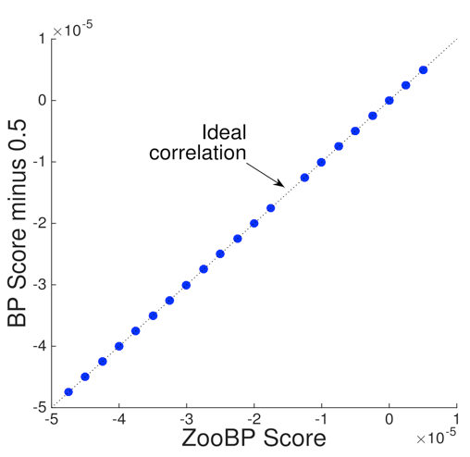
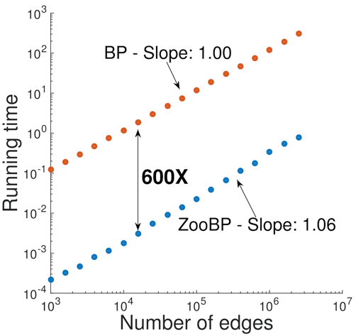
ZooBP: features
Fast; convergence guarantees.
600x (matlab)
3x (C++)
ideal
Near-perfect accuracy
linear in graph size
Dhivya Eswaran, Stephan Günnemann, Christos Faloutsos, Disha Makhija, Mohit Kumar, “ZooBP: Belief Propagation for Heterogeneous Networks”, VLDB 2017

Slide 149
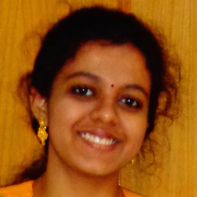
ZooBP: code etc
http://www.cs.cmu.edu/~deswaran/code/zoobp.zip
Dhivya Eswaran, Stephan Günnemann, Christos Faloutsos, Disha Makhija, Mohit Kumar, “ZooBP: Belief Propagation for Heterogeneous Networks”, VLDB 2017

Slide 150
Bird’s eye view
Introduction – Motivation
Part#1: (simple) Graphs
…
P1.4: belief propagation
Basics
Fast, linear approximation (FaBP)
Latest: zooBP
Success stories
?
150

Slide 151


Other ‘success stories’?
Accounting fraud
Malware detection

Slide 152
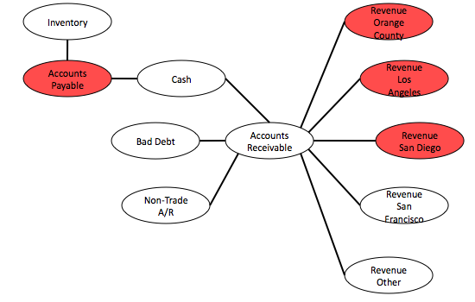
Network Effect Tools: SNARE
Some accounts are sort-of-suspicious – how to combine weak signals?
Before
Mary McGlohon, Stephen Bay, Markus G. Anderle, David M. Steier, Christos Faloutsos: SNARE: a link analytic system for graph labeling and risk detection. KDD 2009: 1265-1274

Slide 153





Polonium: Tera-Scale Graph Mining and Inference for Malware Detection
PATENT PENDING
SDM 2011, Mesa, Arizona
Polo Chau
Machine Learning Dept
Carey Nachenberg
Vice President & Fellow
Jeffrey Wilhelm
Principal Software Engineer
Adam Wright
Software Engineer
Prof. Christos Faloutsos
Computer Science Dept

Slide 154
Short answer:
What color, for the rest?
A: Belief Propagation (‘zooBP’)
www.cs.cmu.edu/~deswaran/code/zoobp.zip
+

Slide 155
Bird’s eye view
^{Tool} _{Task} | 1.1 PR/HITS | 1.1 PPR | 1.2 METIS/ SVD | 1.3 OddBall+ | 1.4 BP | 2.1 FM | 2.1 Tensor | 2.2 HIN | 2.3 SRL
1.1 Node Ranking
1.1’ Link Prediction
1.2 Comm. Detection
1.3 Anomaly Detection
1.4 Propagation
Part 1: Plain Graphs
Part 2:
Complex Graphs

Slide 156
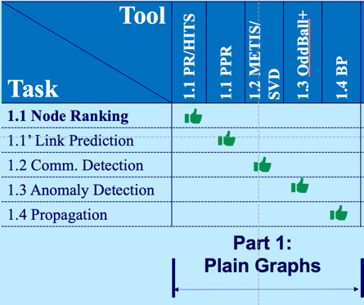
Conclusions for Part P1
Over-arching conclusion:
Many, time-tested tools for plain graphs (PR, SVD, BP)

Slide 157




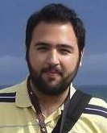
Thanks to
Danai Koutra
U. Michigan
Namyong Park
CMU
Dhivya Eswaran
CMU -> Amazon
Hyun Ah Song
CMU -> Amazon
Vagelis
Papalexakis
UCR

Slide 158

P1 – Graphs - More references
Danai Koutra and Christos Faloutsos, Individual and Collective Graph Mining: Principles, Algorithms, and Applications October 2017, Morgan Claypool

Slide 159


P1 – Graphs - More references
Deepayan Chakrabarti and Christos Faloutsos, Graph Mining: Laws, Tools, and Case Studies Oct. 2012, Morgan Claypool.

Slide 160
P1 – Graphs - More references
Anomaly detection
Leman Akoglu, Hanghang Tong, & Danai Koutra, Graph based anomaly detection and description: a survey Data Mining and Knowledge Discovery (2015) 29: 626.
Arxiv version: https://arxiv.org/abs/1404.4679

Slide 161
Bird’s eye view
^{Tool} _{Task} | 1.1 PR/HITS | 1.1 PPR | 1.2 METIS/ SVD | 1.3 OddBall+ | 1.4 BP | 2.1 FM | 2.1 Tensor | 2.2 HIN | 2.3 SRL
1.1 Node Ranking
1.1’ Link Prediction
1.2 Comm. Detection
1.3 Anomaly Detection
1.4 Propagation
Part 1: Plain Graphs
Part 2:
Complex Graphs

