Slide 1
Anomaly detection in graphs - past, present and future.
Leman Akoglu CMU
Mary McGlohon Google
Christos Faloutsos CMU

Slide 2
Thank you!
Prof. Reddy
Etc
etc

Slide 3
Q1) Definition of anomaly?
A) “… strange/remote/unlikely, wrt our biases/priors”
Q2) can we automate it?
A) no, but better models/biases/priors, help

Slide 4
Q1) definition
‘deviation from the common rule’
https://www.merriam-webster.com/dictionary/anomaly

Slide 5
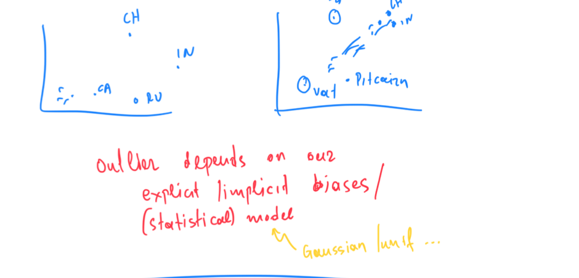
Q1) definition

Slide 6
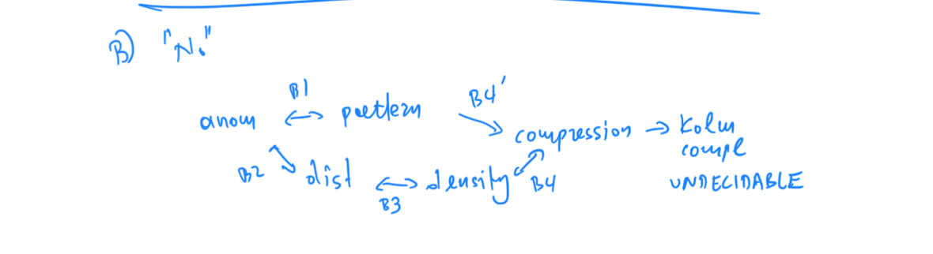

Slide 7
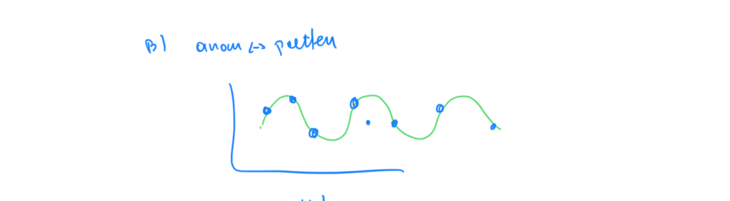

Slide 8
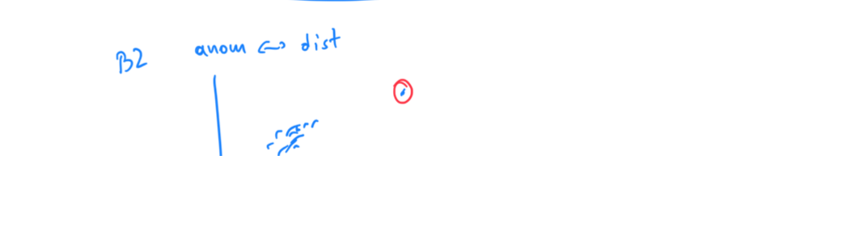

Slide 9
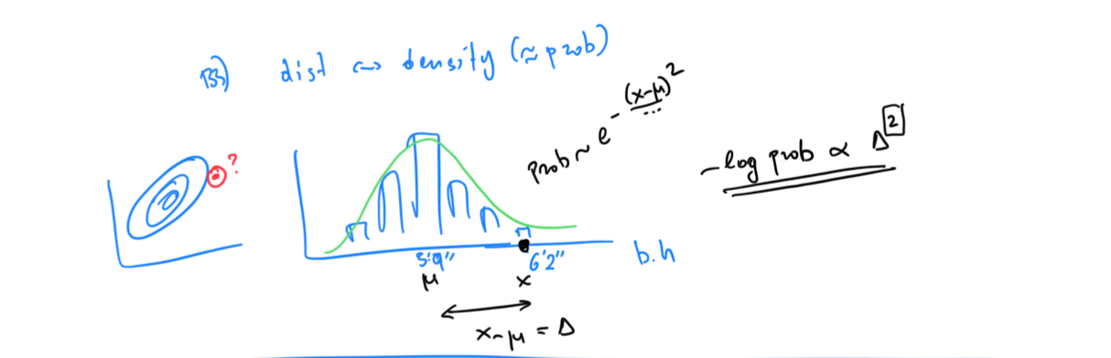

Slide 10
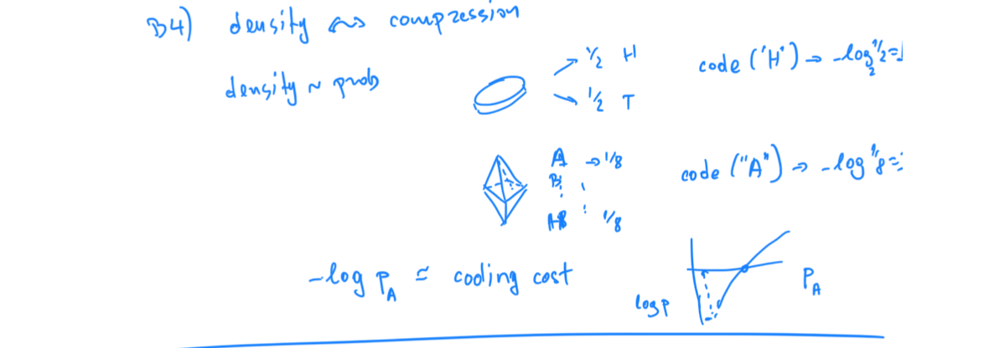

Slide 11
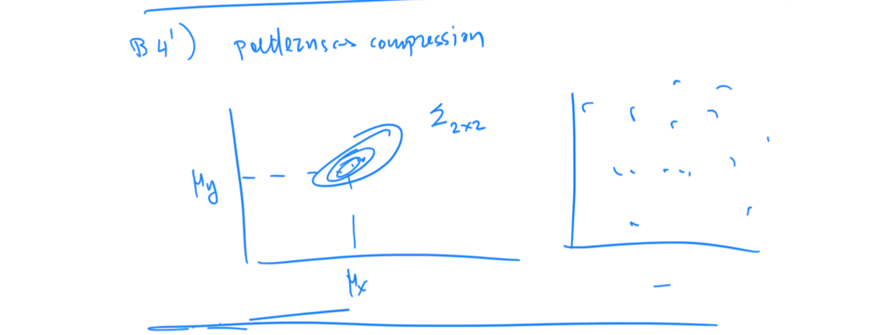

Slide 12
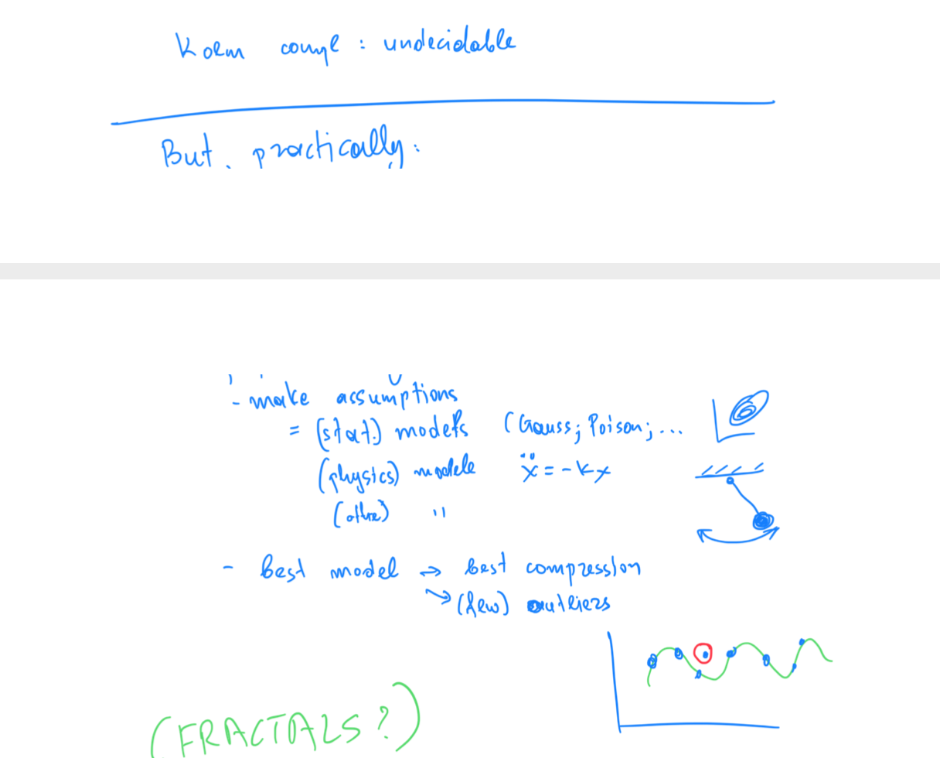

Slide 13
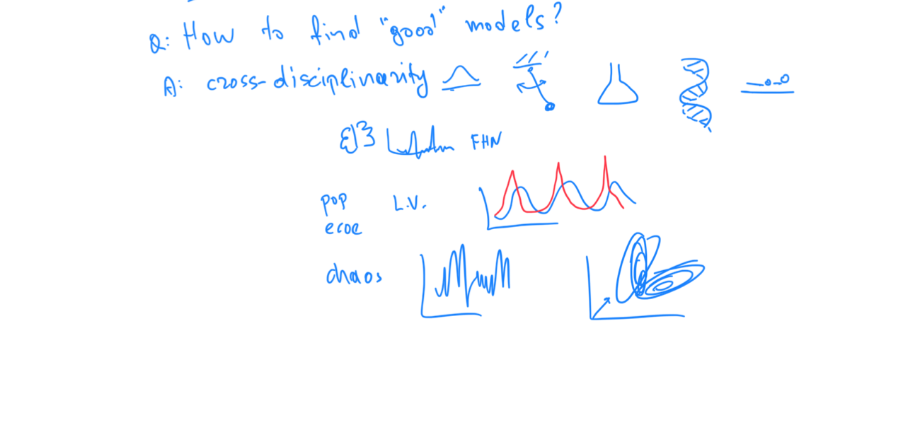

Slide 16
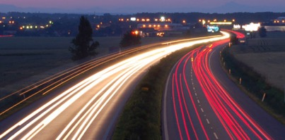
Roadmap
Introduction – Motivation
Why study anomalies?
Past
Present
Future

Slide 17
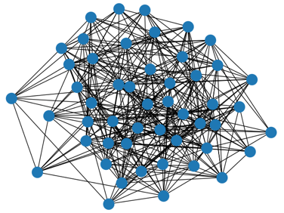
P1.3.1. Outliers
Which node(s) are strange?
Q: How to start?

Slide 18
P1.3.1. Outliers
Which node(s) are strange?
Q: How to start?
A1: egonet; and extract node features

Slide 19
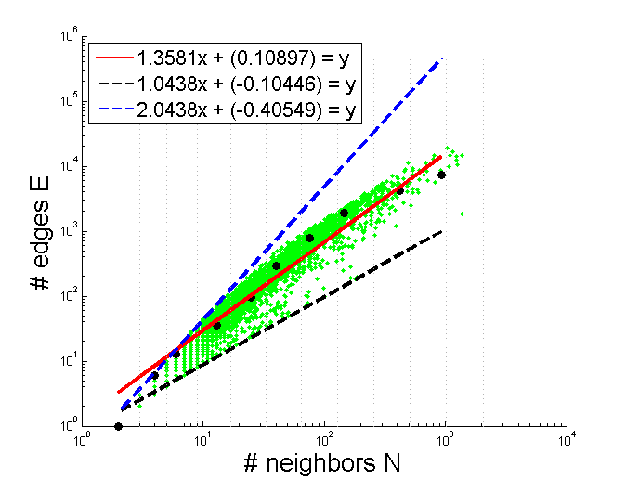

Thank you!

