Slide 1
Spotting anomalies in large graphs: Ten years later.
Leman Akoglu CMU
Mary McGlohon Google
Christos Faloutsos CMU

Slide 2
Thank you!
Prof. Reddy
Etc
etc

Slide 3
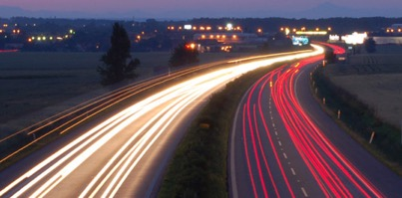
Roadmap
Introduction – Motivation
Why study anomalies?
Past
Present
Future

Slide 4
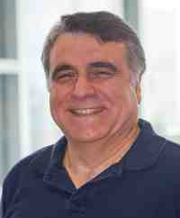
Thank you!

