Slide 1
Anomaly detection in graphs - past, present and future.
Leman Akoglu CMU
Mary McGlohon Google
Christos Faloutsos CMU

Slide 2
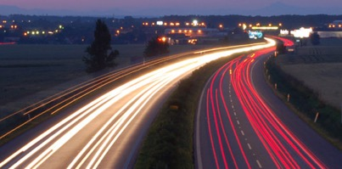
Roadmap
Introduction – Motivation
Past
Present
Future

Slide 3
Roadmap
Introduction – Motivation
Past
Present
Future
Q1) definition?
Q2) automation?

Slide 4
Future – parting thoughts
Q1) Definition of anomaly?
A) “… strange/remote/unlikely, wrt our biases/priors”
Q2) can we automate it?
A) no, but: look for better models/biases/priors

Slide 5
Q1) definition
‘deviation from the common rule’
https://www.merriam-webster.com/dictionary/anomaly

Slide 6
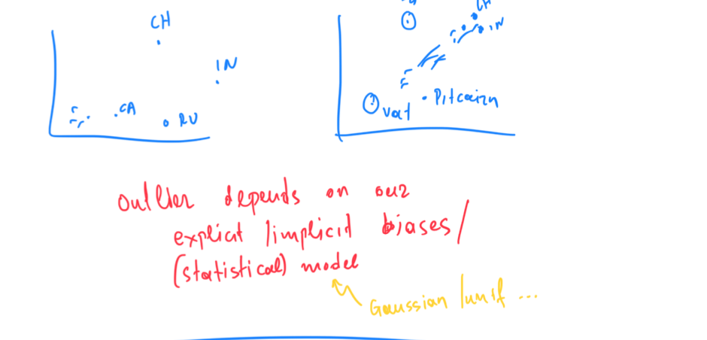
Q1) definition

Slide 7
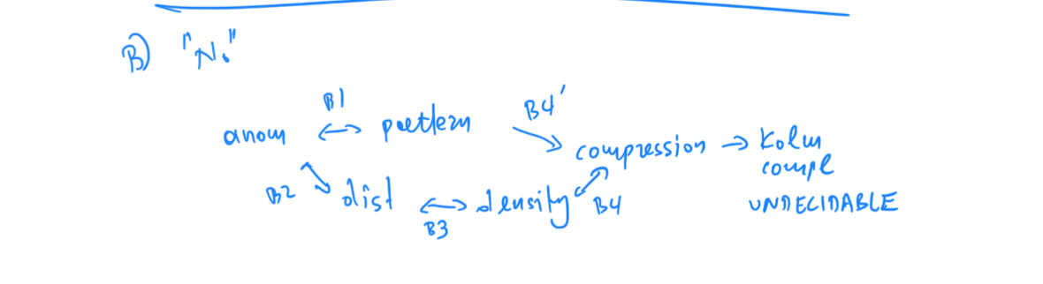

Slide 8
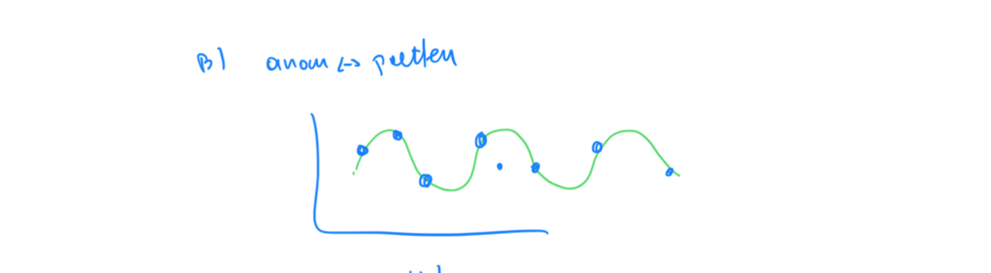

Slide 9
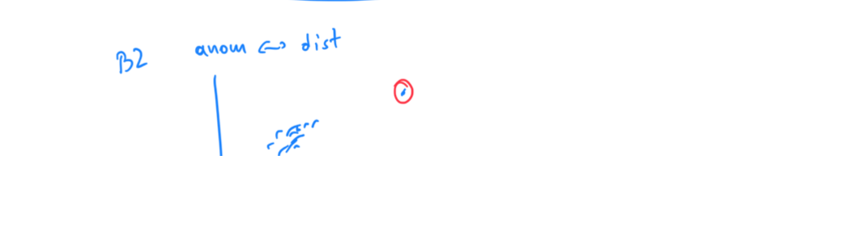

Slide 10
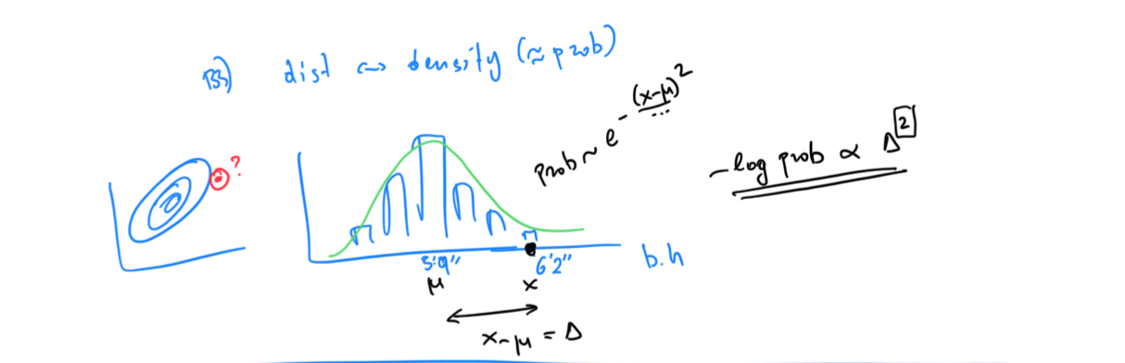

Slide 11
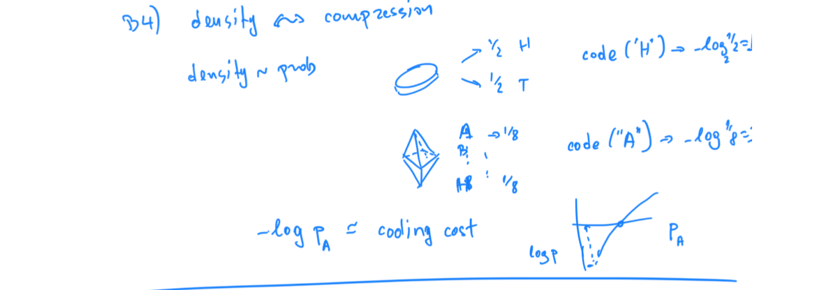

Slide 12
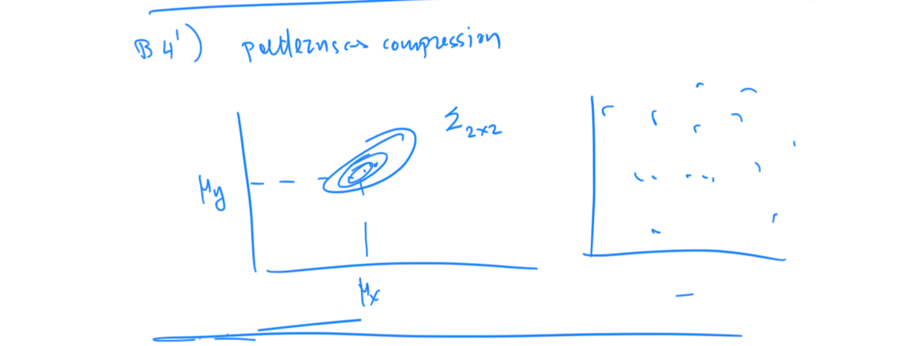

Slide 13
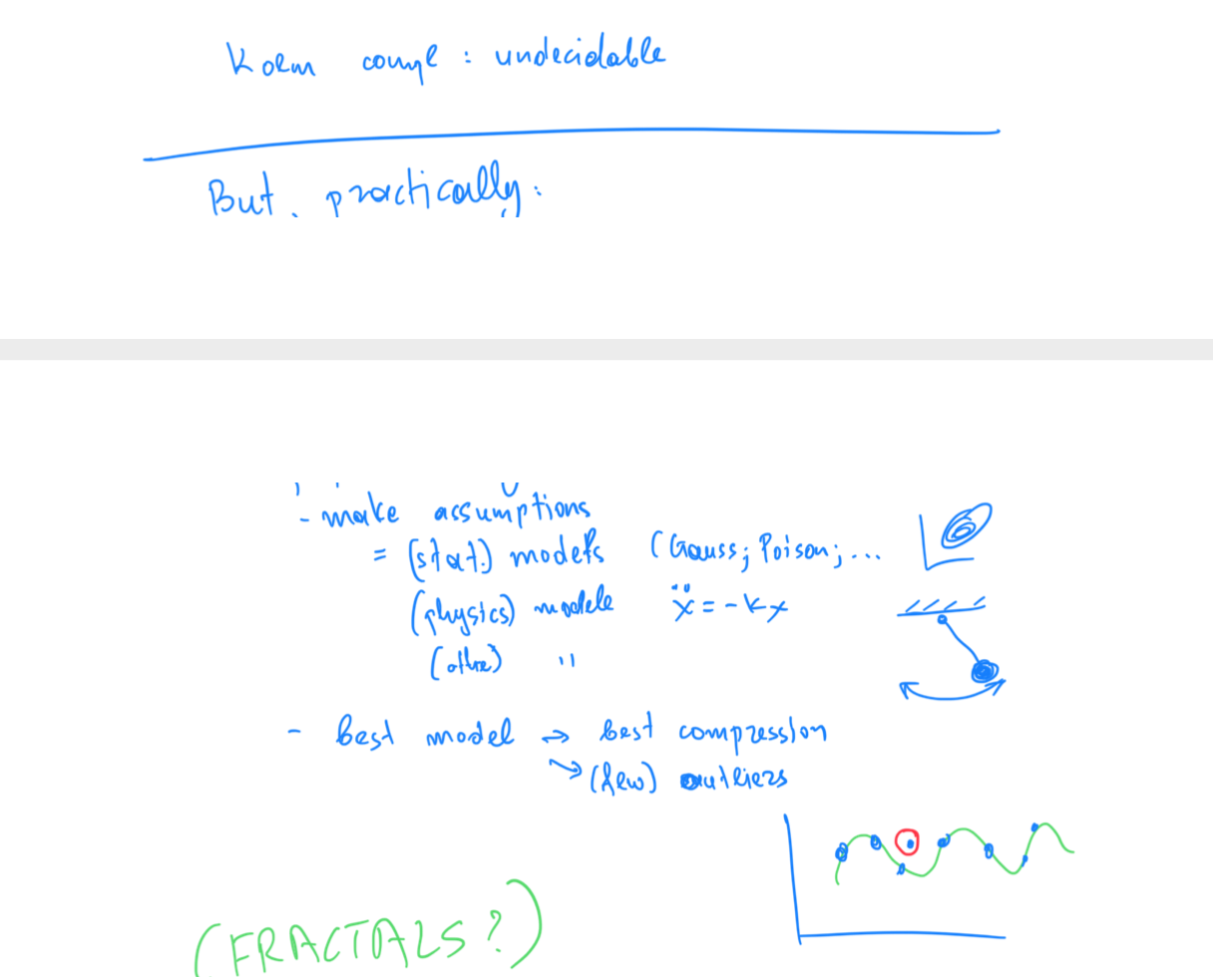

Slide 14
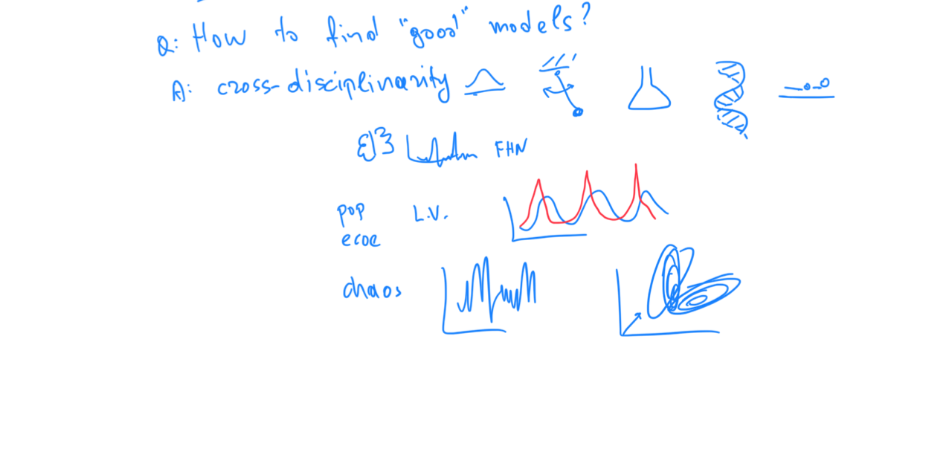

Slide 17
Roadmap
Introduction – Motivation
Why study anomalies?
Past
Present
Future

Slide 18
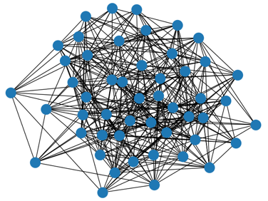
P1.3.1. Outliers
Which node(s) are strange?
Q: How to start?

Slide 19
P1.3.1. Outliers
Which node(s) are strange?
Q: How to start?
A1: egonet; and extract node features

Slide 20
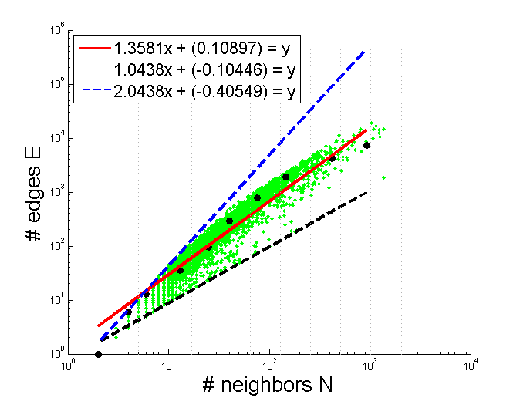

Thank you!

