Slide 1
Anomaly Detection in Graphs Past, Present and Future
Leman Akoglu CMU
Mary McGlohon CMU*
Christos Faloutsos CMU
* Now at Google; work done at CMU
Notes:
Hello, good afternoon everyone. I’m Mary, and you’ll also be hearing from Leman and Christos in a bit. Today we are presenting a high-level view of the state of anomaly detection in graphs, including work that came out of our paper published in this conference in 2010, “Oddball: Spotting Anomalies in Weighted Graphs”.

Slide 2
Thank you!
Prof. R.K Agrawal (Jawharlal Nehru University)
P. Krishna Reddy (IIIT Hyderabad)
Jaideep Srivastava (University of Minnesota)
Notes:
First, we would like to thank you all for having us, and in particular to the conference organizers for their help in getting us set up. Professor Agrawal, Prof Reddy, and Prof Srivastava, thank you very much

Slide 3
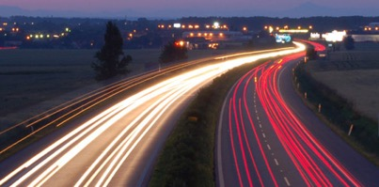
Roadmap
Introduction – Motivation
OddBall : spotting unusual nodes
Last 10 years
Graph Anomalies
Graph Representation
Future
Notes:
So, today, we’ll first give an overview of why we are interested in graph anomalies. Then, we will give a short a case study of anomaly detection in graphs, which is the Oddball work.
Then, Leman will present some of the work that has happened since then, and the different approaches that one can take for anomaly detection and for graph representation.
Finally, Christos will talk about some of the challenges for the future of graph mining and anomaly detection.

Slide 4
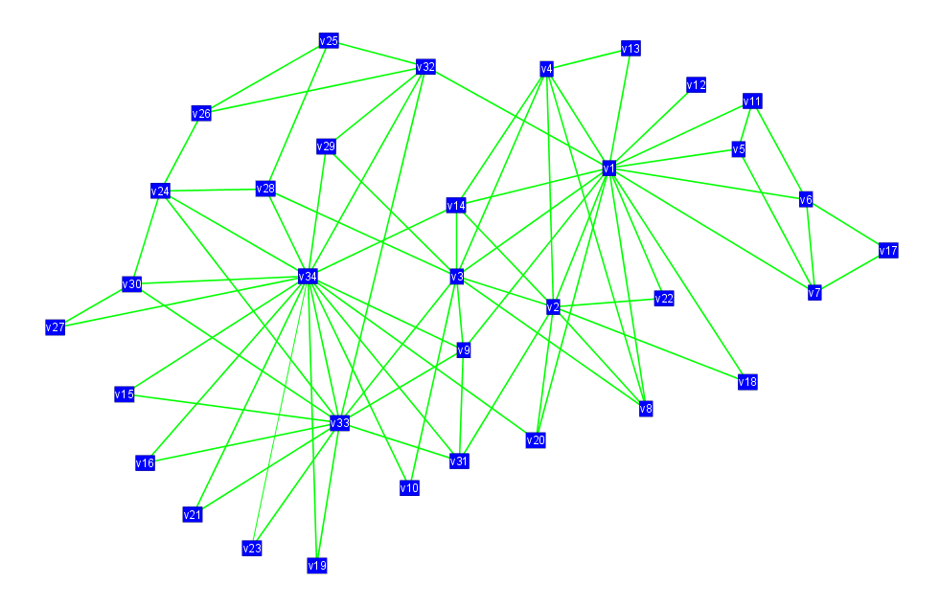
Motivation
Given a weighted graph, which nodes are strange/abnormal/extreme?
Computer networks: spammers, port scanners
Phone-call network: telemarketers, misbehaving customers, faulty equipment
Social network: ‘popularity contests’
Why?
Anomaly suggests behavior that
could have been generated by a different mechanism (bad actors, inorganic behavior)
Notes:
Our goal for Oddball is focused on identifying anomalous nodes within a graph. That is, we have a graph representing entities and weighted relationships between them, and we would like to know which nodes are unusual. In many graphs, this could represent a bad actor-- such as a spammer or port scanner in computer networks or telemarketers. It could also suggest something unintentional is happening, such as faulty equipment in a phone-call network. Or it could suggest intentionally extreme behavior, such as “popularity contests” in social networks.
But the central idea is that a node-level anomaly often suggests that whatever behavior that node is following, is unlike the behavior that other nodes in the graph, and was possibly generated by a different or non-organic mechanism. And that is often a thing that we want to know about when we’re working with graph data.

Slide 5
OddBall: Premise
Pattern and law discovery, then application
Unless the majority of our nodes closely obey a pattern, only then can we confidently consider as outliers the few nodes that deviate.
Idea: Extract features for each node, and find patterns for those features across the graph.
Notes:
So how do we approach this problem of finding these unusually-behaving nodes?
Well, first we need to define what, exactly, we mean when we say “unusual”. And the only way we can know what is unusual is if we know what is typical behavior.
Graphs by nature aren’t uniform and each node is going to have some different properties. However, if we consider those properties as features, then we can look across the graph at how these features tend to be distributed, and identify patterns of these node features. Once we know what the patterns are, then we can identify the exception to the rules.
So, what features can we use that we can apply to all graphs, no matter where they came from?

Slide 6
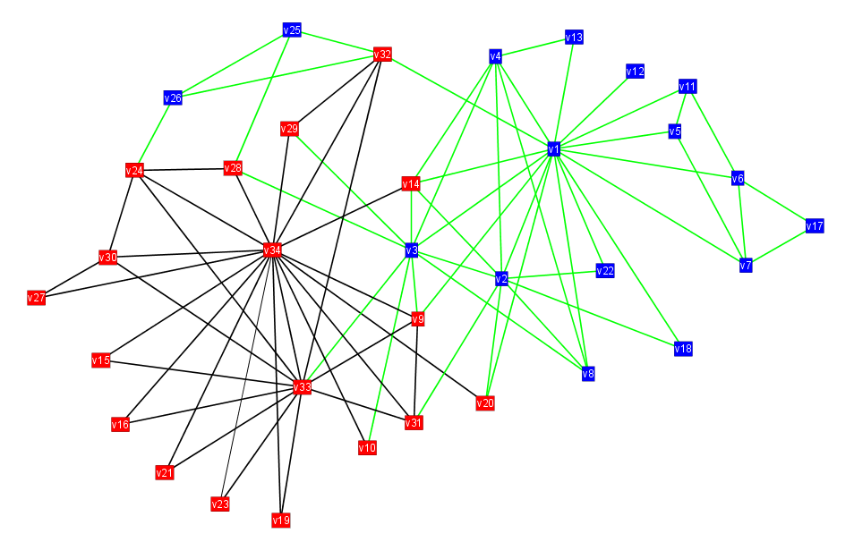
OddBall: Egonets
We extract patterns in egonets-- for any given node, its ego-net is the network formed by its neighbors and edges between them.
Ego
Notes:
The approach that we use for that, is egonets. That is, for each node in the graph, a “ego”, the ego-net is the subgraph that is formed by taking the ego-node, and all of its neighbors, as well as any edges between those neighbors. So, in this case, if we have the one node denoted with the red star, then we extract the ego-net by taking all of its neighbors one-step out-- the other nodes in red, and then take all the edges between that set of nodes. So you then have a subgraph, the ego-net, for the starred node. And that ego-net will have certain properties, that describe how that node is positioned within the larger graph and how it behaves.
You can then repeat the process for each node in your graph. So you have N nodes in your graph, and then N ego-nets, so you have a whole collection of ego-nets, each looking a bit different from each other.

Slide 7
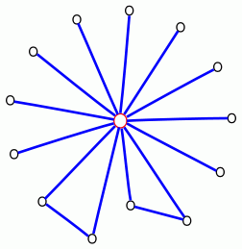
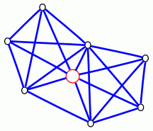
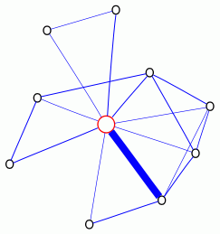
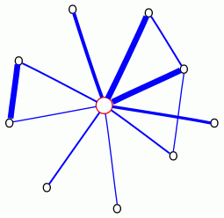
OddBall: Anomalous egonets
Near-star
Near-clique
Heavy vicinity
Dominant heavy link
Notes:
So, to find the anomalous nodes, we are essentially finding anomalous ego-nets. So, what behaviors might be considered unusual? Well, we might have a node that’s a near-star-- that is, the node has a lot of neighbors, but none of them are friends with each other.
Or, on the other extreme, a near-clique-- where all of a nodes neighbors are linked to each other.
Or, you could take edge weights into consideration and identify anomalies there. So you have one ego-net that has a lot of high-weight edges, suggesting a lot of high traffic or active behavior coming from and around that node. Or, it might be considered unusual if an egonet overall has light-weight edges, except for one single edge that has a very high weight.
So these are the kinds of ego-net based anomalies we might be looking for. Of course, we can’t say how anomalous any of these ego-nets are, until we study the patterns across ego-nets. We need to find the rules before the exceptions

Slide 8
OddBall: Patterns
Analyzed networks from various domains: citation graphs, campaign donations, blog links, emails, packet traffic
Looked for patterns in ego-nets
Discovered power-law relationships in egonets
Notes:
So that’s what we did. We took weighted graphs from a number of different domains-- citation graphs, political campaign donations, blogs, emails, and network system traffic.
We extracted ego-nets, and looked for what the typical graph properties were of the ego-nets across the graphs.
It turns out that when you take the properties of ego-nets extracted from the graph, they do in fact tend to follow some patterns, with power-law distributions.

Slide 9
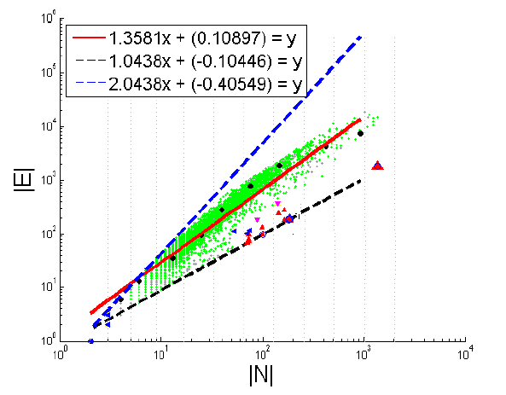
OddBall: Egonet Density Power Law
E_{i} ∝ N_{i}^{α}
1 ≤ α ≤ 2
Near clique/star
Notes:
One of these partnerns is what we call the Egonet Density Power Law. So, if we have this collection of all these ego-nets, how dense do they tend to be? Are they very dense-- with all neighbors connected to each other, or sparse, where a node’s immediate neighbors don’t tend to be connected? Overall it’s somewhere in between, and we don’t have very many ego-nets that follow either extreme.
This plot is for the Enron email dataset graph. Each green point on this graph here represents a single ego-net, and it is plotted based on the number of nodes the egonet on the x axis, and number of edges on the y axis. When you plot it in a log-log scale as shown, you can roughly see a linear trend, and plot a fitting line, which is shown in red. We found that you could do this , and the slope of that line is between 1 and 2, depending on the graph you’re analyzing.
When you plot the number of nodes in the ego net vs the number of neighbors, the outliers are going to be the cliques-- which have a hgh number of edges and are going to be closer to the blue dotted line, or the near-stars with fewer edges-- closer to the black dotted line.

Slide 10
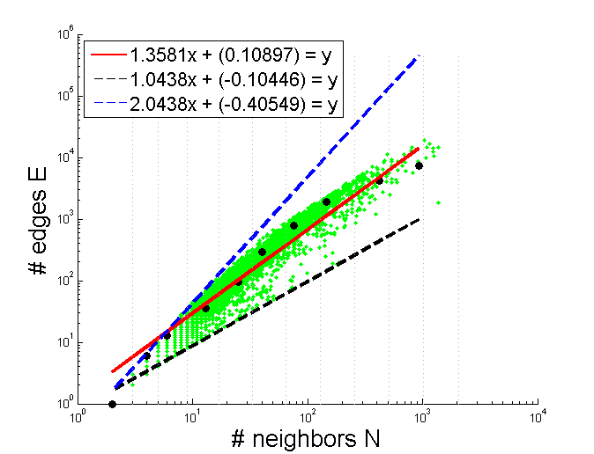
OddBall: Outliers from EDPL
Based on distance from fitting line
Enron CEO
(near-star)
Notes:
So once you have your pattern, and your fitting line, you can then quantify how anomalous a given node is, by how much its egonet deviates from the pattern. In this case, there is a node that has more neighbors than almost any other node in the graph, but an unusually low number of edges between nodes in its ego-net. It turns out that in the Enron email graph, that is the CEO. So, perhaps emailing the entire company was anomalous behavior that could have produced this property.

Slide 11
OddBall: More patterns
Egonet Weight Power Law
Detects “heavy vicinity”
Egonet λ_{w} Power Law
Detects “dominant heavy link”
(Oddball: Spotting anomalies in weighted graphs, PAKDD 2010)
Notes:
We repeated this with other datasets and other graph properties of ego-nets, and identified other patterns that we could use to quantify anomalies. You can read more in the paper.

Slide 12
OddBall: Summary
Oddball is a node-level, feature-based approach to graph anomaly detection
Method:
extract features
(node embedding, representation learning)
study patterns
define rules
identify outliers
Notes:
In summary, the oddball approach is looking for node-level anomalies, by using features of nodes with ego-nets. As Leman will talk about next, there is a lot of other work with different approaches to graph anomaly detection, including those that look for anomalous subgraphs or anomalies in evolving graphs.
The way we identified these anomalies in Oddball was to extract features with ego-nets, study what distribution these features take, and find the rules, then find exceptions to the rules. Christos will discuss later about what the next challenges are when it comes to finding such patterns to use.
So with that, I’ll hand it off to Leman to talk about other work in this area.

Slide 13



Thank you!

