Slide 1
Anomaly detection in graphs - past, present and future.
Leman Akoglu CMU
Mary McGlohon CMU*
Christos Faloutsos CMU
* Now at Google; work done at CMU

Slide 2
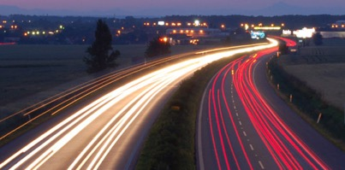
Roadmap
Introduction – Motivation
OddBall
Last 10 years
Future
Q1) definition?
Q2) automation?
Q3) next steps?

Slide 3
Future – parting thoughts
Q1) Definition of anomaly?
A) “… strange/remote/unlikely, wrt our models”
Q2) can we automate it?
A) no, but: look for better models/models
Q3) next steps?
A) cross-disciplinarity -> new models

Slide 4
Future – parting thoughts
Q1) Definition of anomaly?
A) “… strange/remote/unlikely, wrt our models”
Q2) can we automate it?
A) no, but: look for better models
Q3) next steps?
A) cross-disciplinarity -> new models

Slide 5
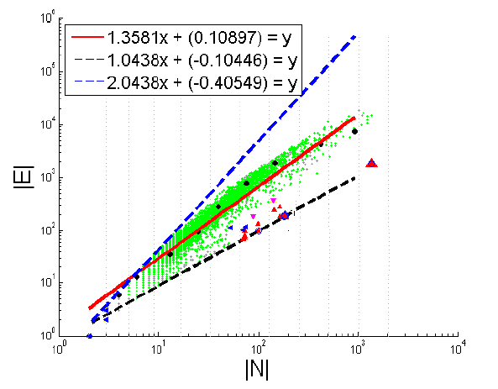
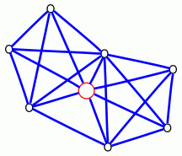

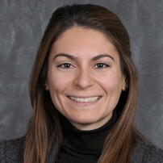
Graphs <-> points

Slide 6
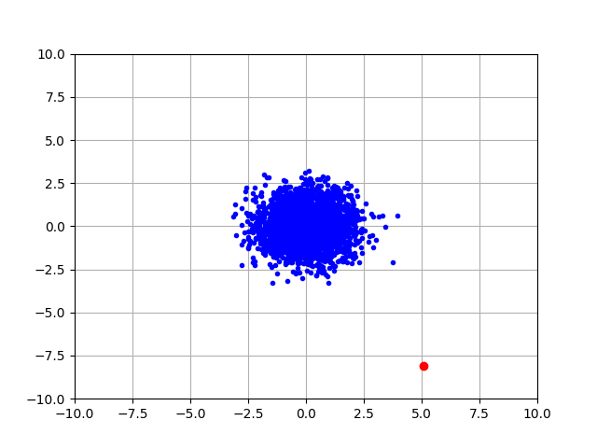
Q1) definition
“an observation which deviates so much from the other observations as to arouse suspicions that it was generated by a different mechanism”
D. M. Hawkins. Identification of outliers, volume 11. Springer, 1980.

Slide 7
Q1) definition
‘deviation from the common rule’
https://www.merriam-webster.com/dictionary/anomaly

Slide 8
Q1) definition
‘deviation from the common rule’
https://www.merriam-webster.com/dictionary/anomaly
But: How to spot rules?

Slide 9
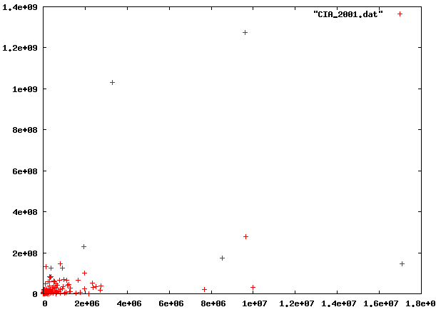
Q1: rules?

Slide 10
Q1: rules?

Slide 11
Q1: rules?

Slide 12
Q1: rules?
population
World countries
cia.gov
factbook
2001
area

Slide 13
Q1: rules?
population
World countries
🇨🇳
🇮🇳
area

Slide 14
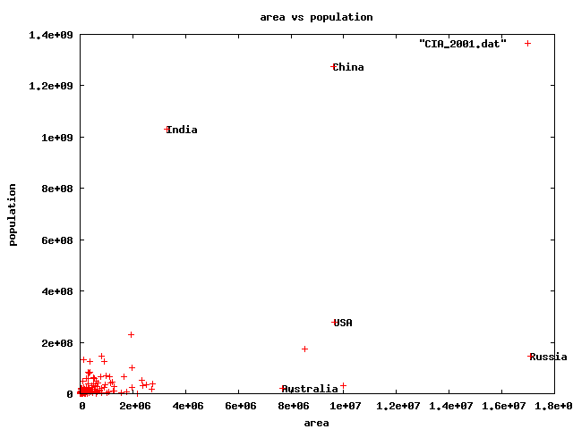
Q1) rules?
🇨🇳
🇮🇳
🇱🇷
🇷🇺
🇦🇺

Slide 15
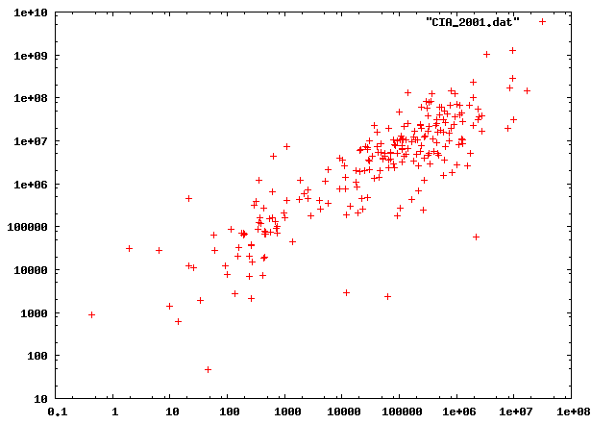
Q1) rules?

Slide 16
Q1) rules?

Slide 17
Q1) rules?
population
World countries
cia.gov
factbook
2001
area

Slide 18
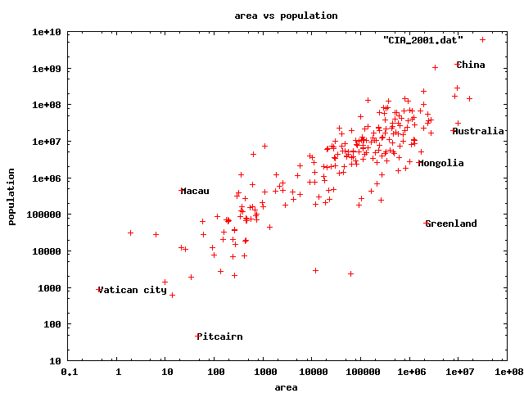
Q1) rules
🇨🇳
🇮🇳
🇻🇦
0.5km²
3x Taj Mahal
🇬🇸
47 residents(!)

Slide 19
Q1) rules
uniform/Gaussian ->
linear scales
Pareto/log-logistic ->
log scales
🇨🇳
🇨🇳
🇮🇳
🇻🇦
🇬🇸
Anomalies:
* Wrt our models (/ axis-scales)

Slide 20
Q1) definition
‘deviation from the common rule’*
https://www.merriam-webster.com/dictionary/anomaly
* Wrt our models (/ axis-scales)
But: How to spot rules?

Slide 21
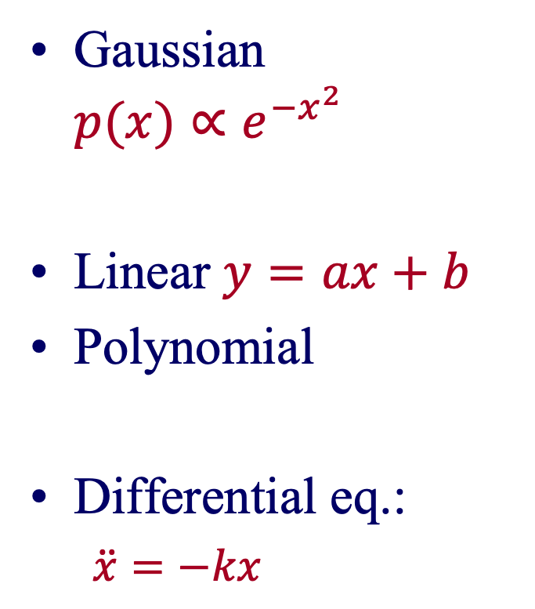
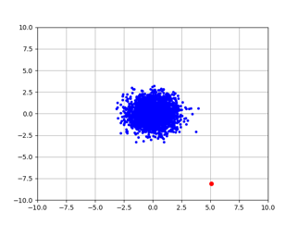
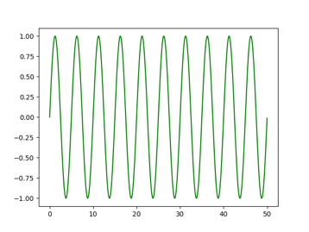

Model (= pattern = rule)
model-instance

Slide 22
Roadmap
Introduction – Motivation
OddBall
Last 10 years
Future
Q1) definition?
Q2) automation?
Q3) next steps?

Slide 23


Future – parting thoughts
Q1) Definition of anomaly?
A) “… strange/remote/unlikely, wrt our models”
Q2) can we automate it?
A) no, but: look for better models
Q3) next steps?
A) cross-disciplinarity -> new models

Slide 24


Q2) automation?
✓
Q2.1
patterns
Q2.2
anomalies
compression

Slide 25
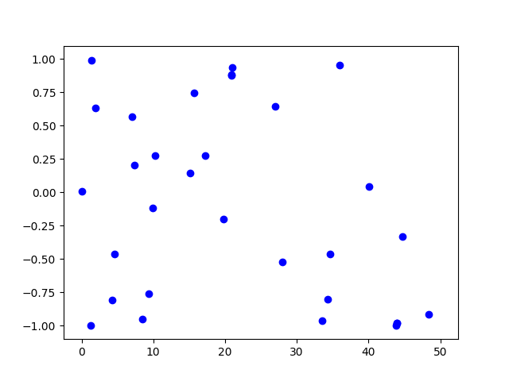
Q2.2) patterns <-> compression
Random ->
2 int / point

Slide 26
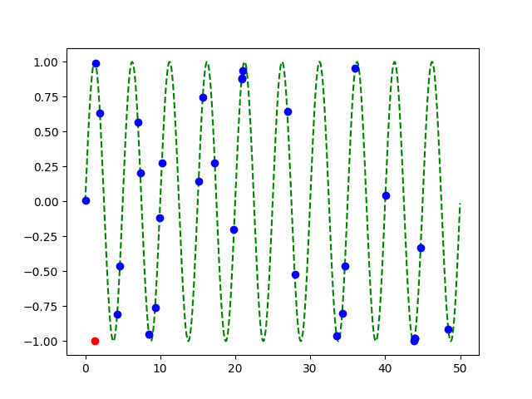
Q2.2) patterns <-> compression
Random ->
2 int / point
sine ->
1 int / point

Slide 27
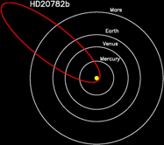
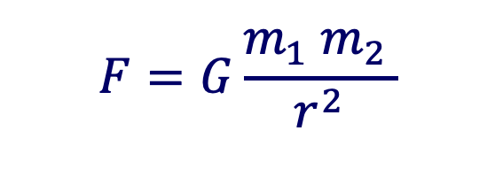
Compression is great!
Occam’s razor
MDL (Minimum Description Length)
(all of science: reductionism = compression)
⬅️
But:

Slide 28
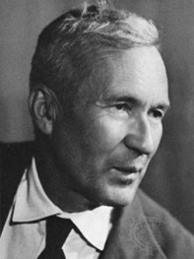
… optimal compression is undecidable!
Theorem*: for an arbitrary string x, computing its Kolmogorov complexity K(x) is undecidable
A.N. Kolmogorov
britannica.com
(*) E.g., [T. M. Cover and J. A. Thomas. Elements of Information Theory. John Wiley and Sons,1991, section 7.7]

Slide 29
… optimal compression is undecidable!
Theorem*: for an arbitrary string x, computing its Kolmogorov complexity K(x) is undecidable
EVEN WORSE
than NP-hard!
A.N. Kolmogorov
(*) E.g., [T. M. Cover and J. A. Thomas. Elements of Information Theory. John Wiley and Sons,1991, section 7.7]

Slide 30


… optimal compression is undecidable!
…which means there will be a chance to discover better models
-> job satisfaction ☺
…

Slide 31
Clarification: compression is possible…
… once we fix the set of models
…
k-means, ++

Slide 32

Future – parting thoughts
Q1) Definition of anomaly?
A) “… strange/remote/unlikely, wrt our models”
Q2) can we automate it?
A) no, but: look for better models
Q3) next steps?
A) cross-disciplinarity -> new models

Slide 33
Roadmap
Introduction – Motivation
OddBall
Last 10 years
Future
Q1) definition?
Q2) automation?
Q3) next steps?
Q3.1) examples of new models
Q3.2) how to find them

Slide 34
Q3.1 Example of (surprising) models
Fractals / self-similarity
Logistic parabola (flies; covid)
Lotka-Volterra
Lorenz attractor (laser / synthetic )
Van der Pol / FitzHugh-Nagumo

Slide 35
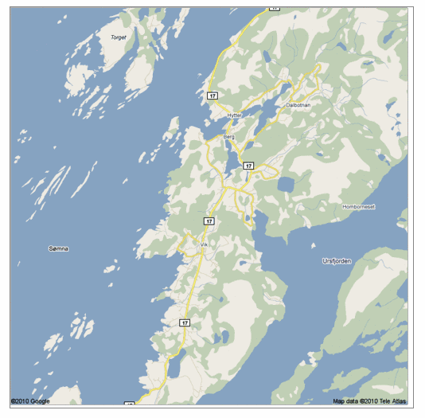
Q: Any pattern?

Slide 36
A: self similar!

Slide 37
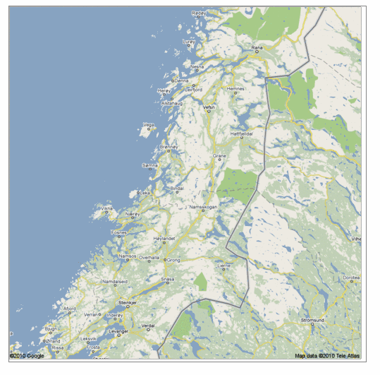
Real, self similar dataset

Slide 38
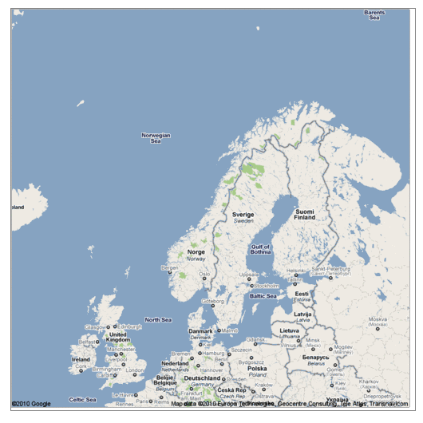
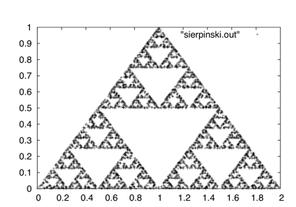
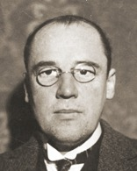
the red is true
origin: Norway
but most other coastlines are ‘self-similar’, too!
Waclaw Sierpinski
en.wikipedia.org

Slide 39
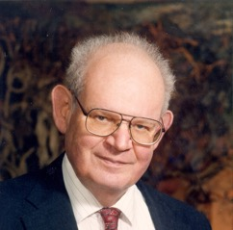

the red is true
origin: Norway
but most other coastlines are ‘self-similar’, too!
B. Mandelbrot
math.yale.edu
en.wikipedia.org

Slide 40
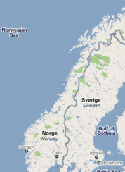

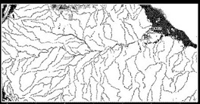
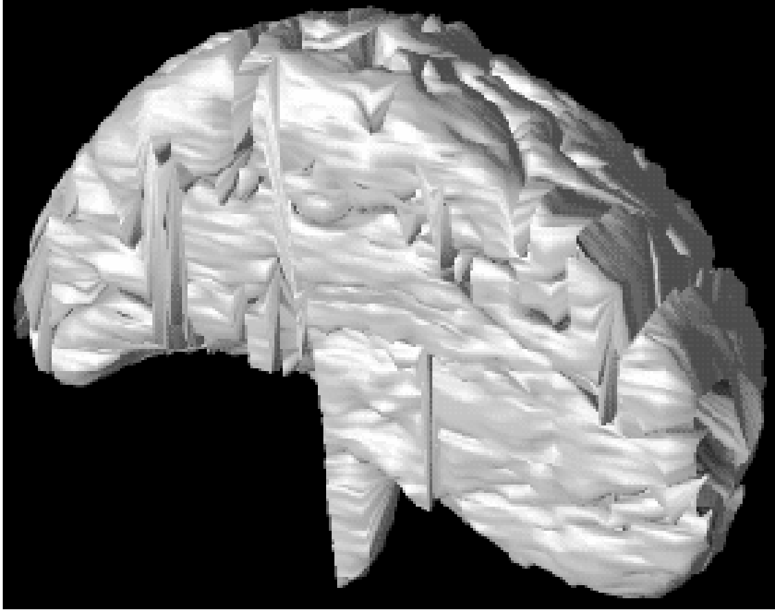
The Fractal Geometry of Nature
1.5
Amazon
delta
1.8
Surface of
mammalian
brain
2.7
B. Mandelbrot
math.yale.edu
en.wikipedia.org

Slide 41
Q: Fractals and Graphs?

Slide 42


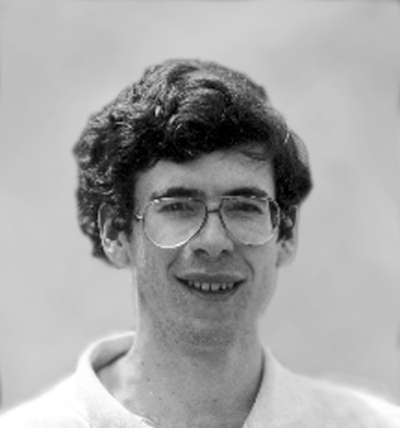
Fractals and Graphs
A: RMAT/Kronecker generators
D. Chakrabarti
J. Leskovec
J. Kleinberg
R-MAT: A Recursive Model for Graph Mining,
by D. Chakrabarti, Y. Zhan and C. Faloutsos,
SDM 2004, Orlando, Florida, USA
Realistic, Mathematically Tractable Graph Generation
and Evolution, Using Kronecker Multiplication,
by J. Leskovec, D. Chakrabarti, J. Kleinberg,
and C. Faloutsos, in PKDD 2005, Porto, Portugal

Slide 43
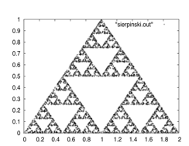
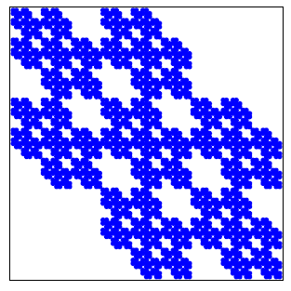
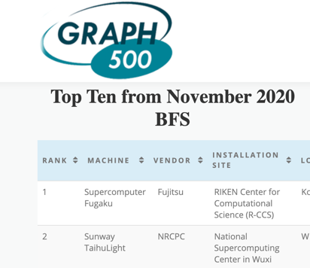
Kronecker Graphs
KDD dissertation award, 2009
PKDD test of time award, 2015
https://graph500.org/
RIKEN

Slide 44
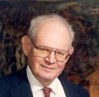
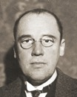

Q3.2) How can we find better models?
A3.2) Domain experts / cross-disciplinarity

Slide 45
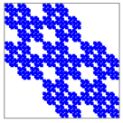
Future – parting thoughts
✓
Q1) Definition of anomaly?
A) “… strange/remote/unlikely, wrt our models”
Q2) can we automate it?
A) no, but: look for better models
Q3) next steps?
A) cross-disciplinarity -> new models
✓
✓

Slide 46







Thanks
Disclaimer: All opinions are mine; not necessarily reflecting the opinions of the funding agencies
Thanks to: NSF IIS-0705359, IIS-0534205,
CTA-INARC; Yahoo (M45), LLNL, IBM, SPRINT, Google, INTEL, HP, iLab

Slide 47



Thanks
Prof. R.K. Agrawal
Prof. P. Krishna Reddy
Prof. Jaideep Srivastava

Slide 48
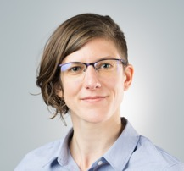
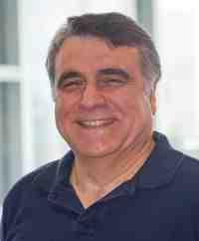
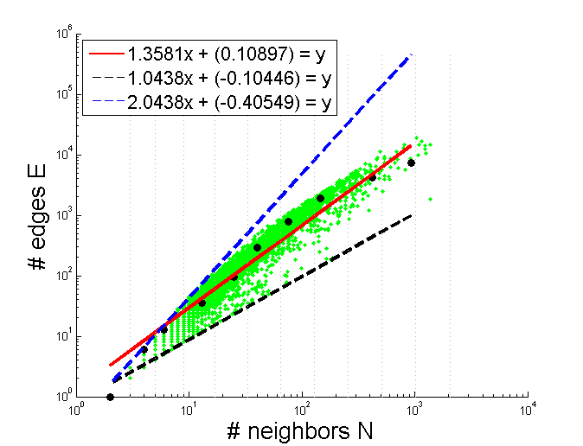

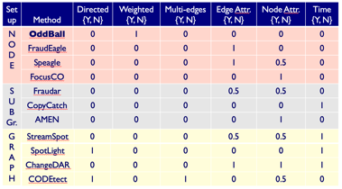
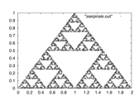
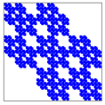
Conclusions
Rep. learning
(= Feature extraction
= Embedding)
Patterns <-> anomalies
Cross-disciplinarity

Slide 49
Conclusions
Thank you!
Rep. learning
(= Feature extraction
= Embedding)
Patterns <-> anomalies
Cross-disciplinarity

