Slide 1
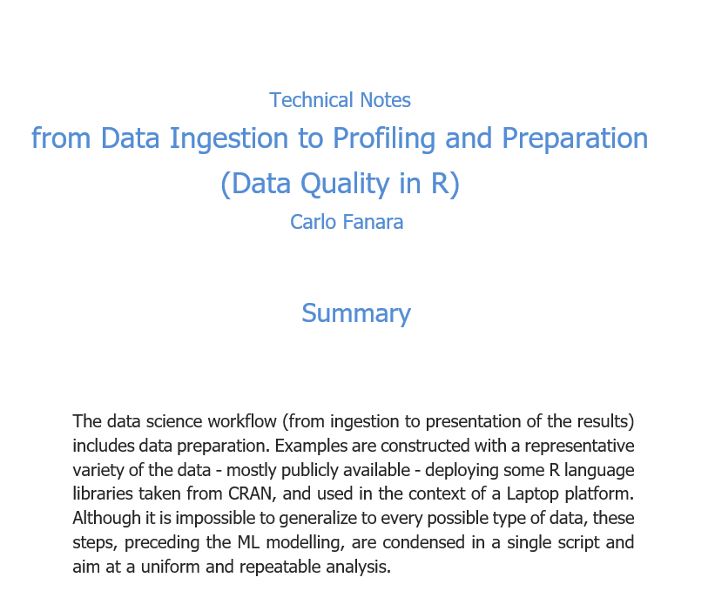

Slide 2
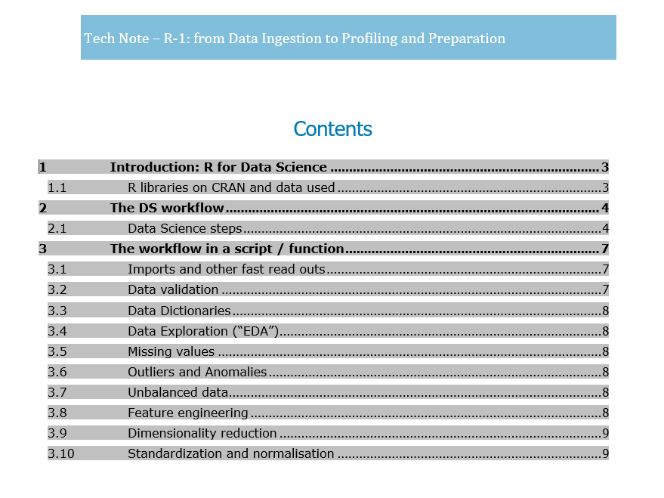

Slide 3
DATA …
DATA …
Raw data ingestion
Correct the data format
Get some Statistics
Analyze
Model
Summarize
Report
Data formats/types(º)
Missing values and imputation
Standardization
Normalisation
Data tidying
Exploration, stats and Viz
Outliers management
Feature engineering
Data “balancing”
“Dummifying”
Choice of model
Evaluation
Sensitivity and lift
INT, SIGNED /UNSIGNED INT, CHAR…
NA, NULL, ‘999’….
Impute via modelling→ML prediction!
Standardisation:
S = (Max-v(k))/(Max-Min)
or
Z = (v(k)-mean)/(std dev)
…
Norm= v(k)/Max
Tidying: one item per line per dataset
Quite non-normalized in the RDBMS sense → “big table” – redundant but apt for modeling
MODELING …

Slide 4
MODELING …
DATA …
Feature Engineering (feature selection, elimination, construction, association…)
Raw data ingestion
Correct the data format
Get some Statistics
Analyze
Model
Summarize
Report
Data formats/types(º)
Missing values and imputation
Standardization
Normalisation
Data tidying
Exploration, stats and Viz
Outliers management
Feature engineering
Data “balancing”
“Dummifying”
Choice of model
Evaluation
Sensitivity and lift
Data balancing (ex. A target variable in training is 90% =‘yes’ means prediction unbalanced) → up/downscaling of unbalances
Dummification: categorical variables/factors
→ encoding, flattening…
Modeling choice: binary? (e.g. overall risk=yes or no) or multi-category
→ logistic, random Forest, SVM, other ensembling…
Model evaluation / assessment (ROC, AUC…)
Sensitivity analysis / lift: influences of params on outcome → recommend to physical IoT implementer
MODELING …

Slide 5
