Slide 1

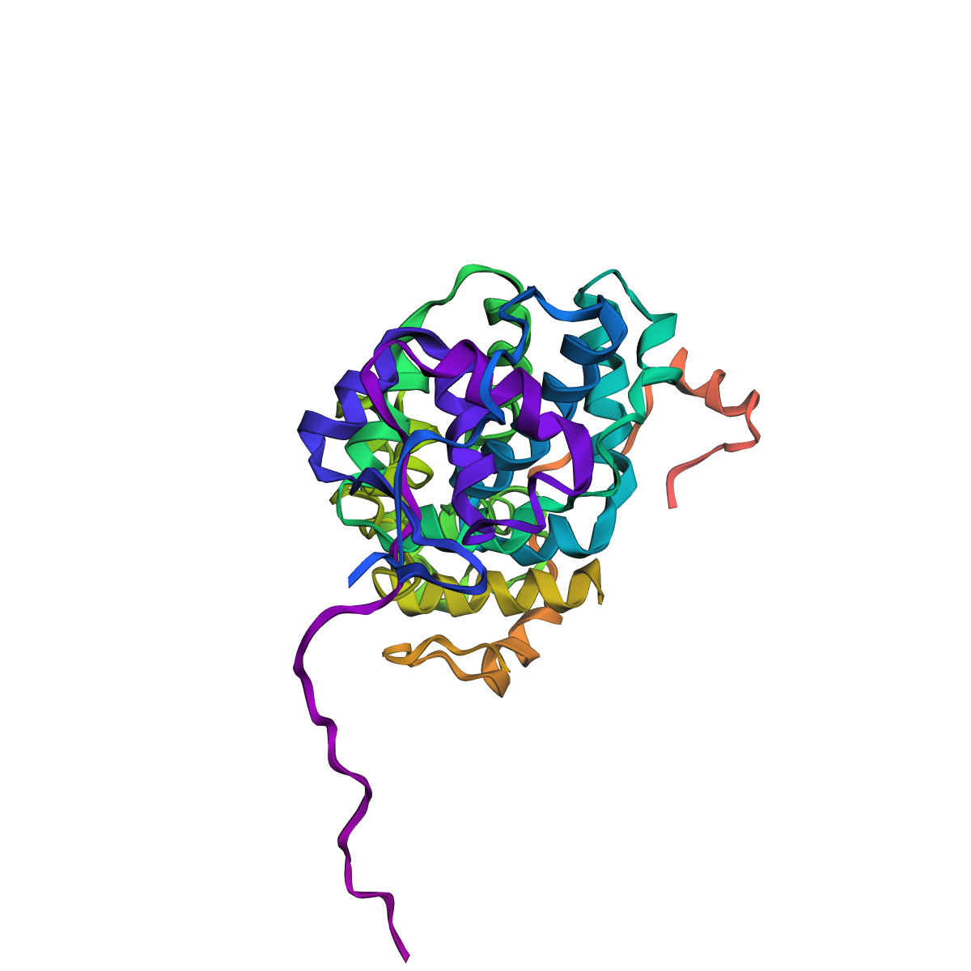
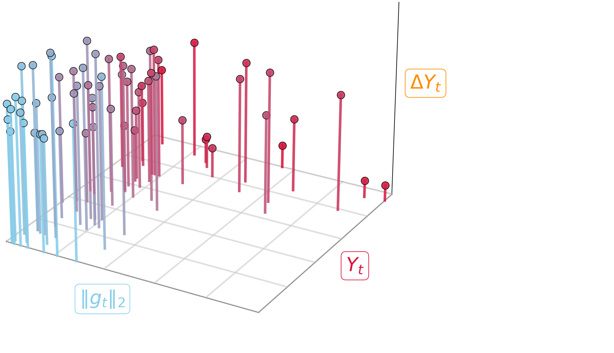
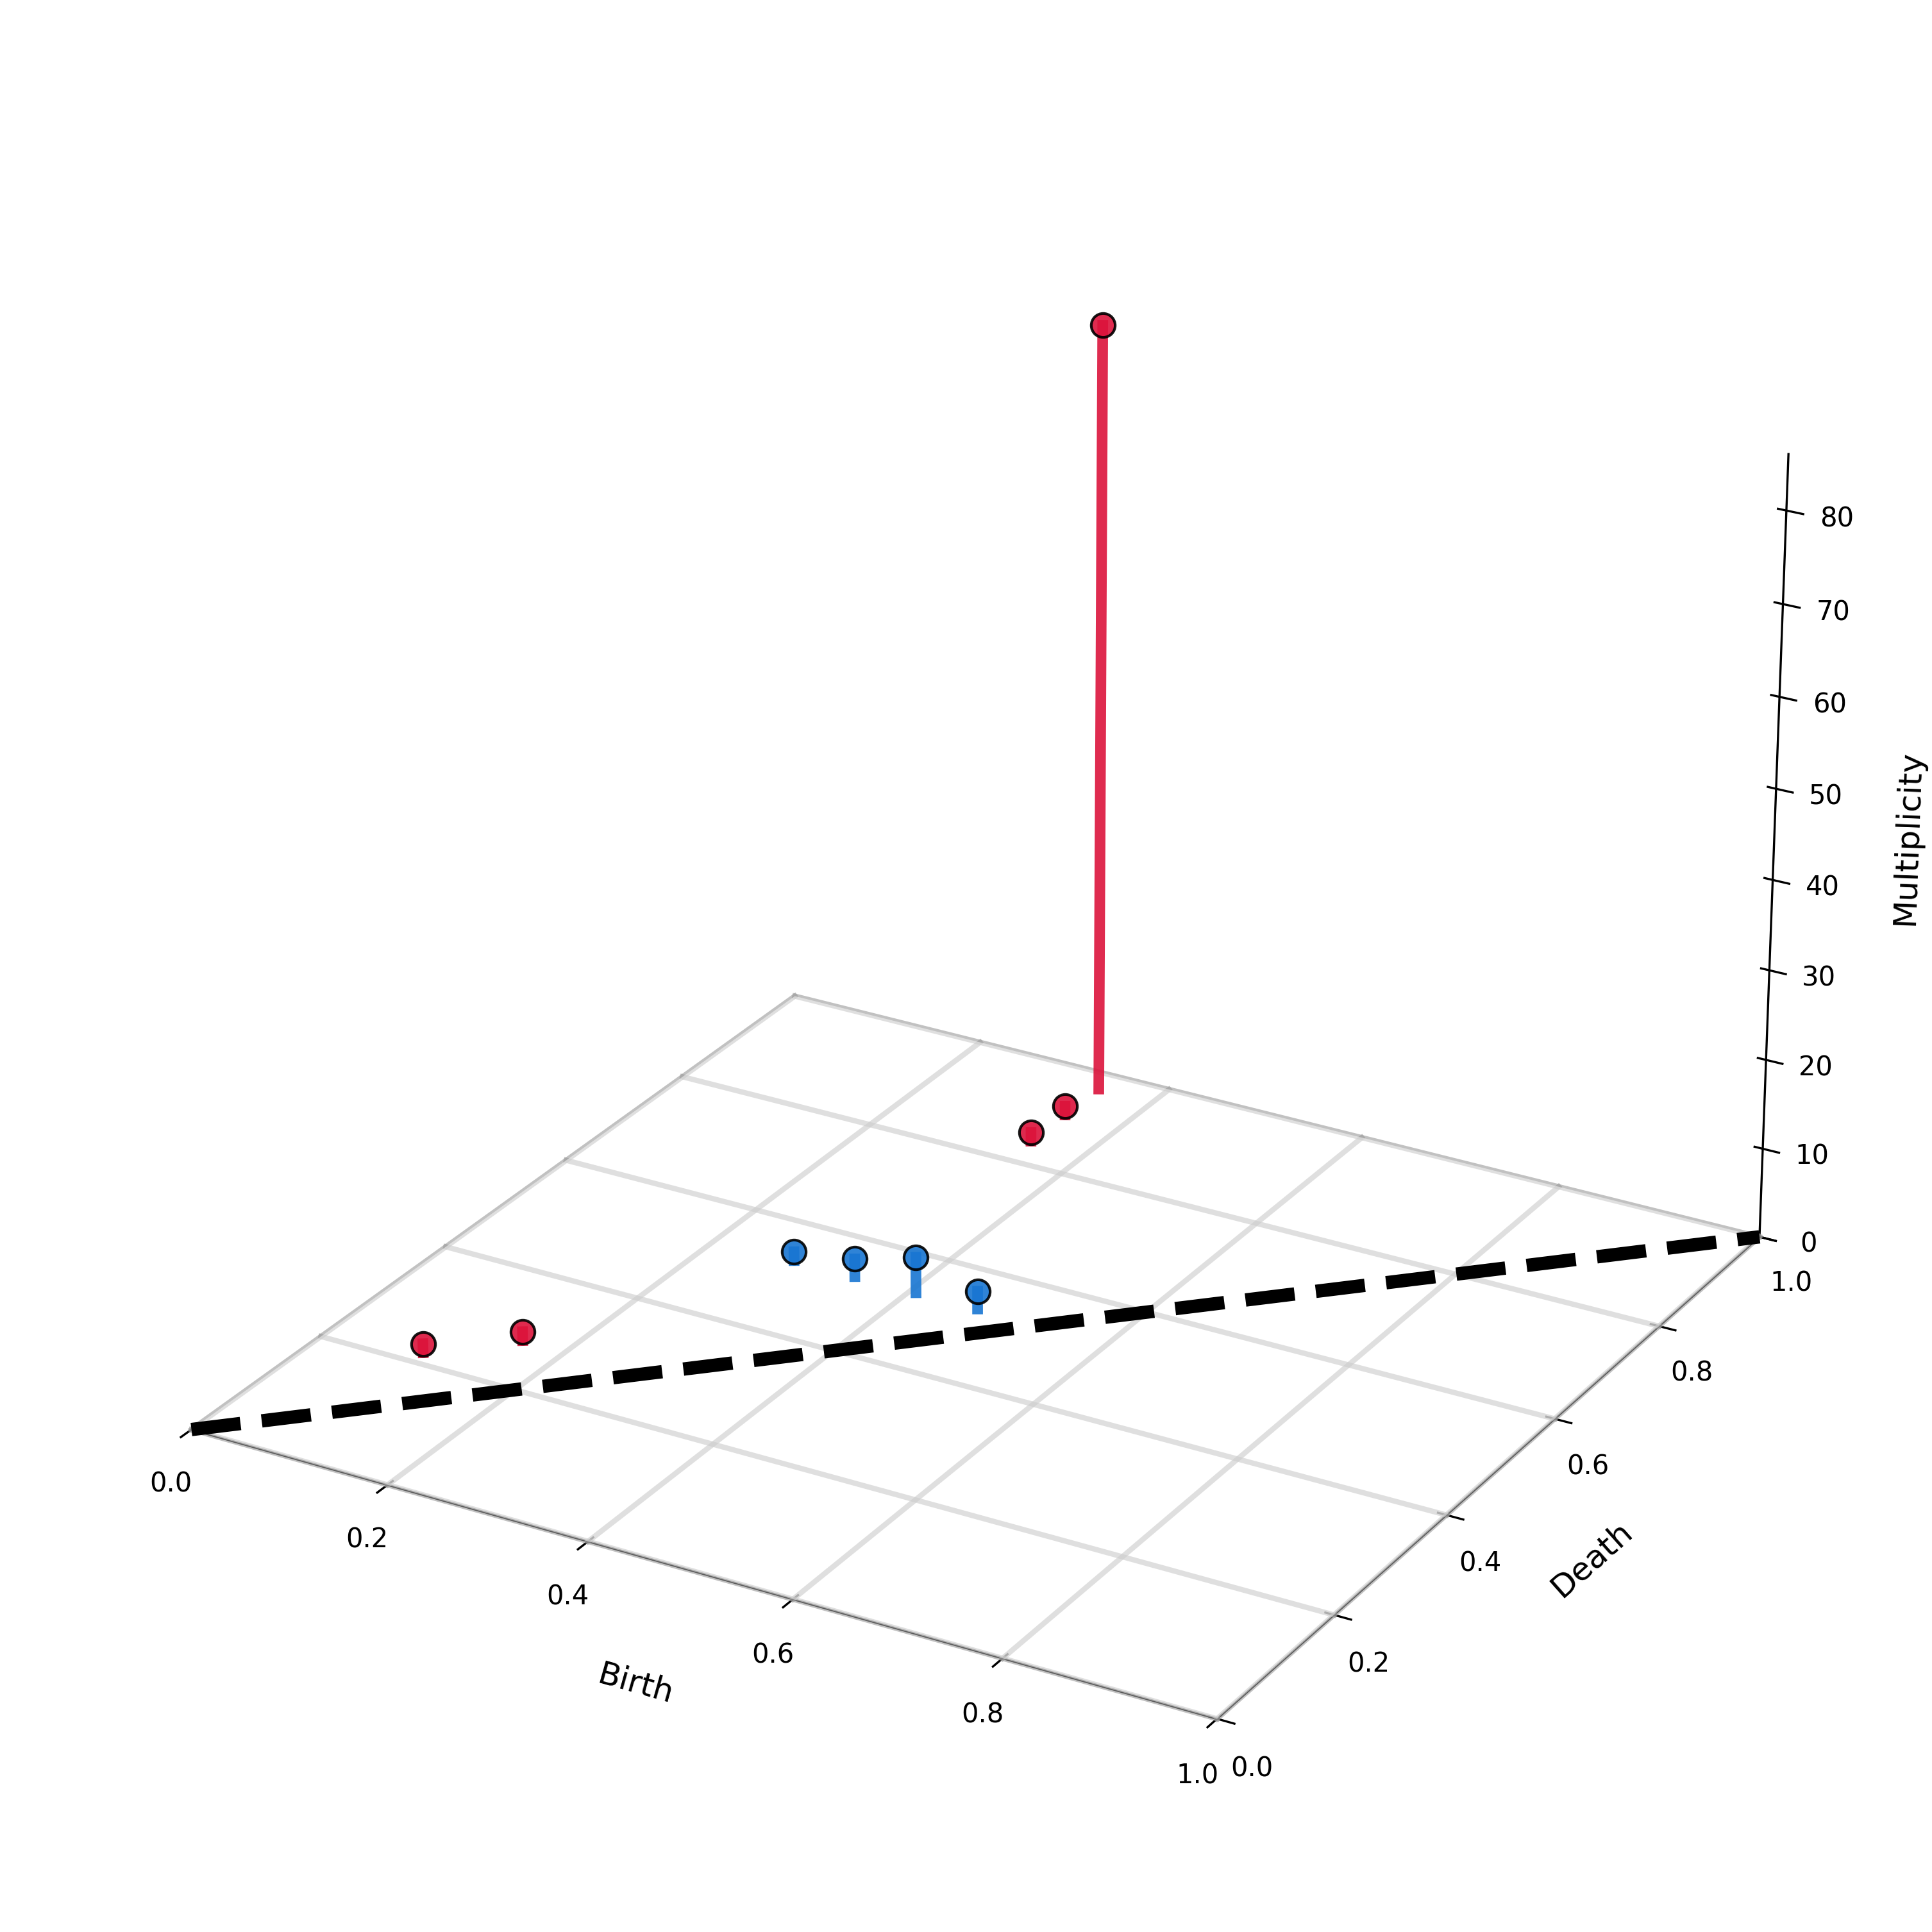
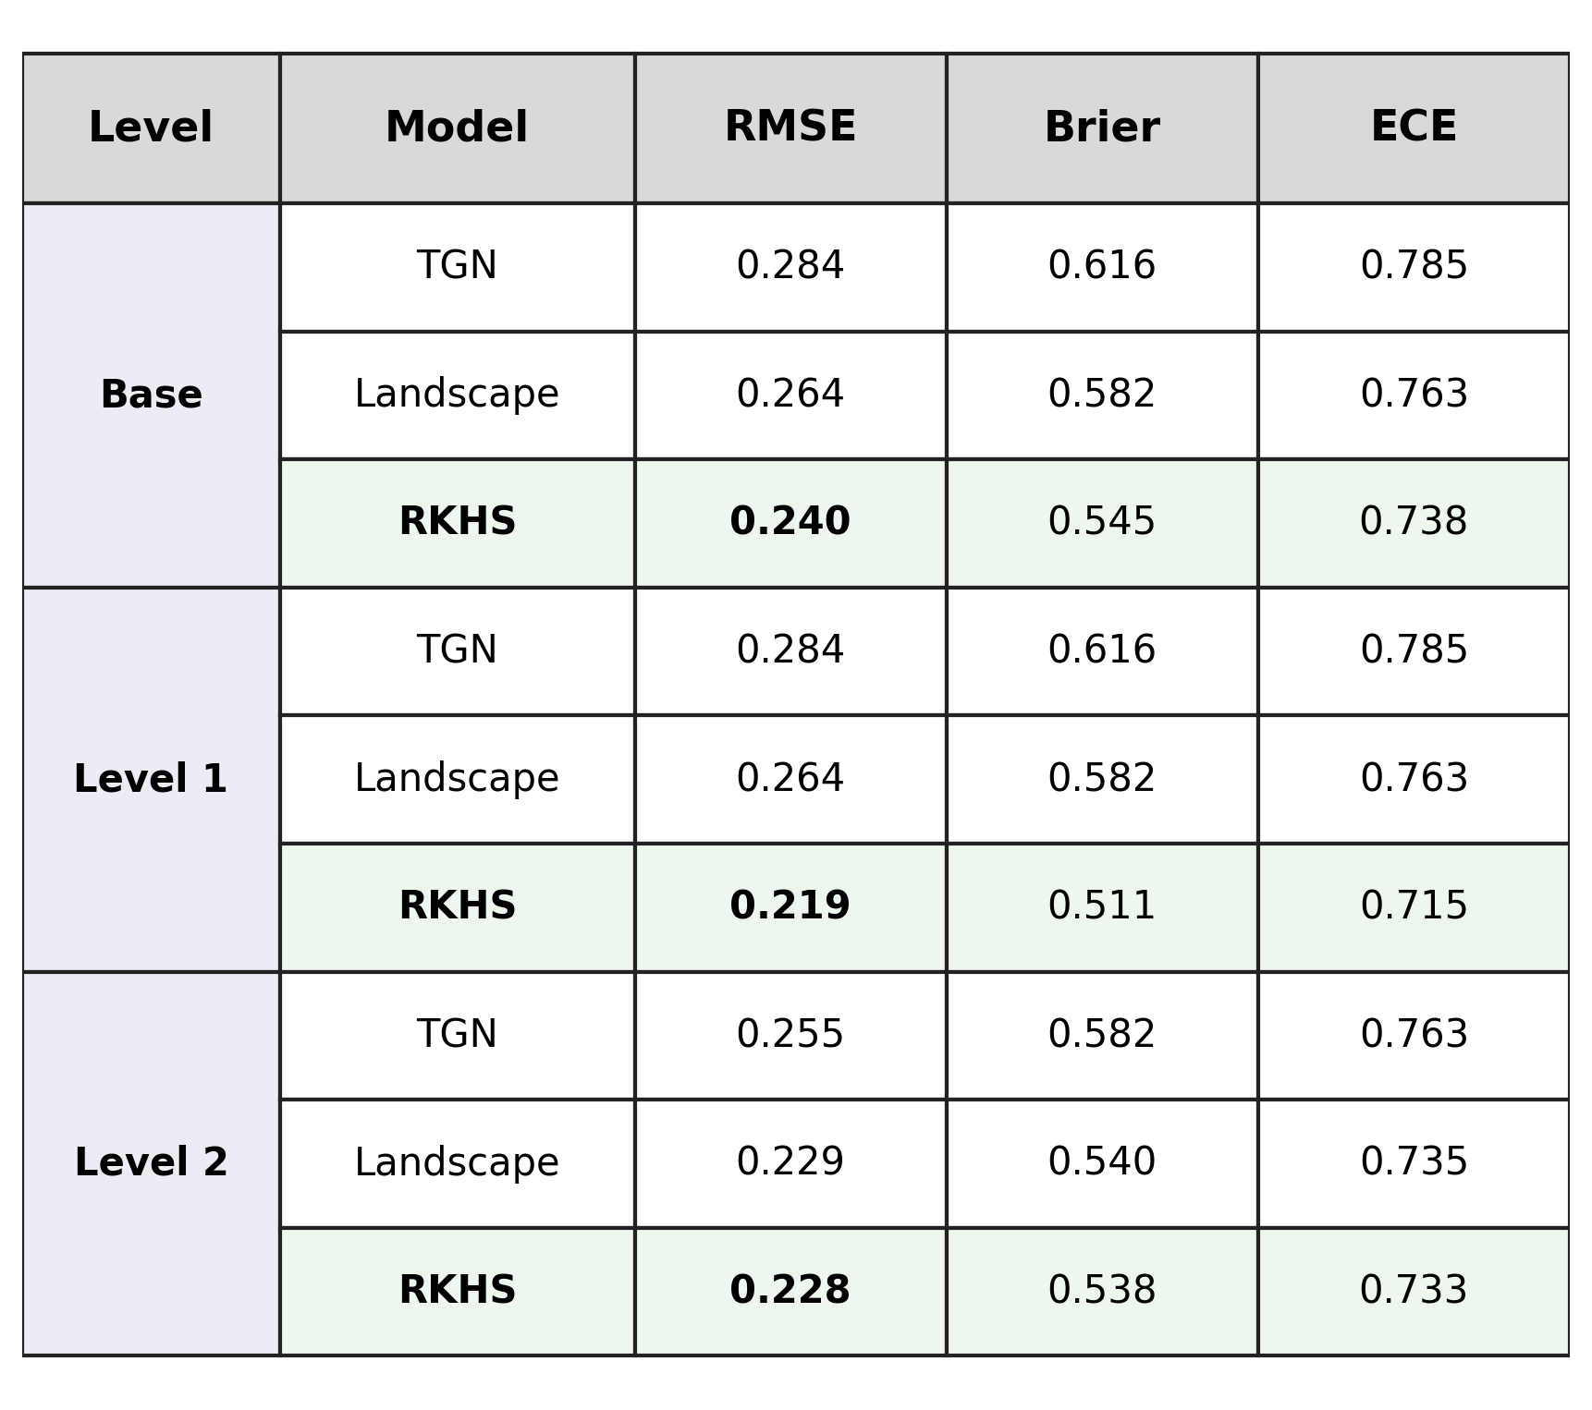
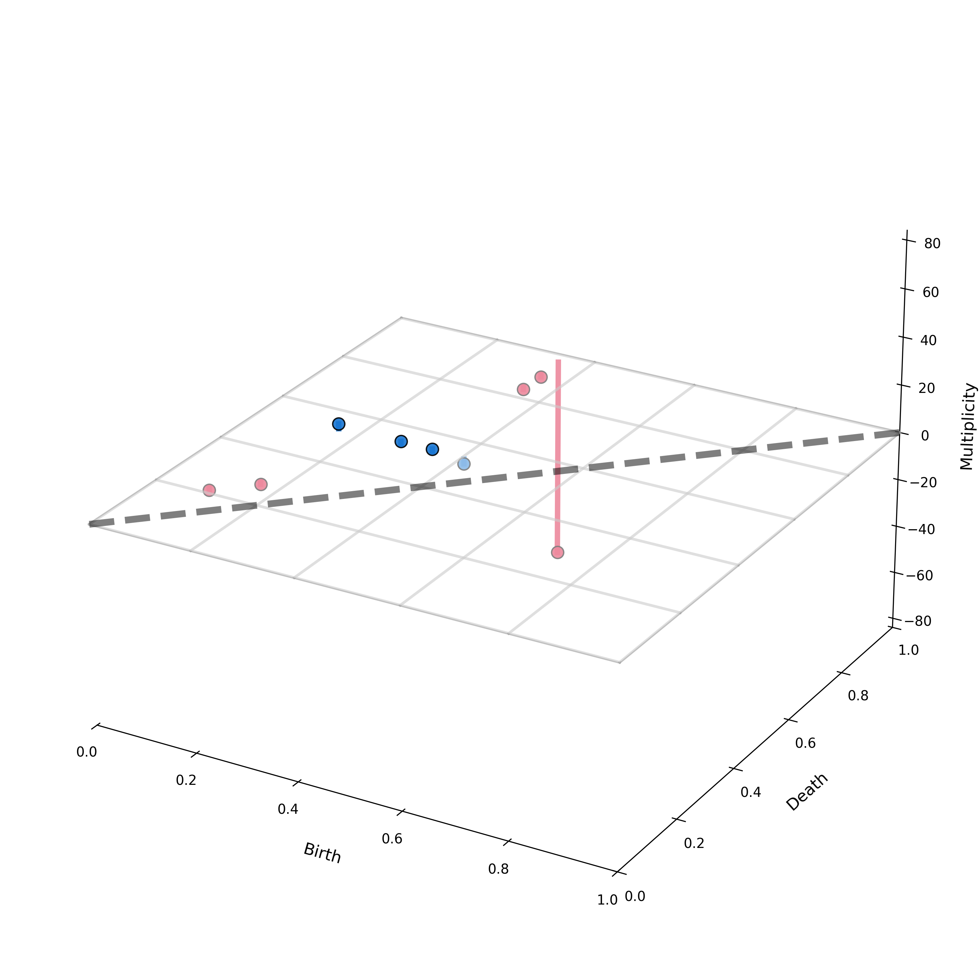

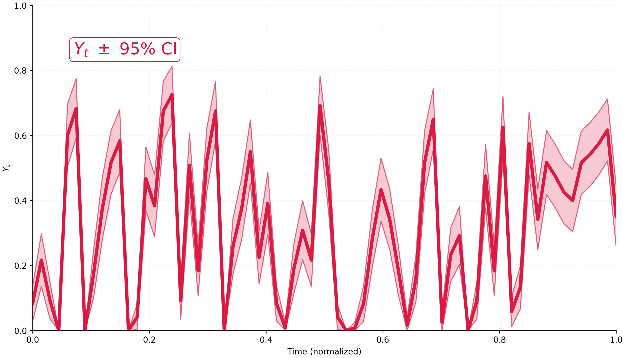
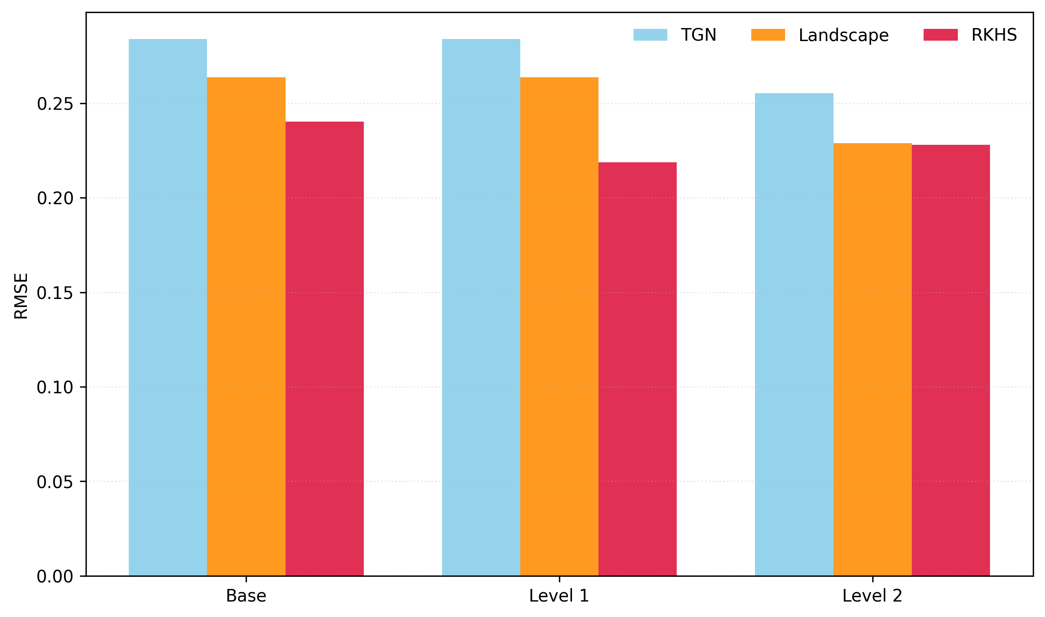

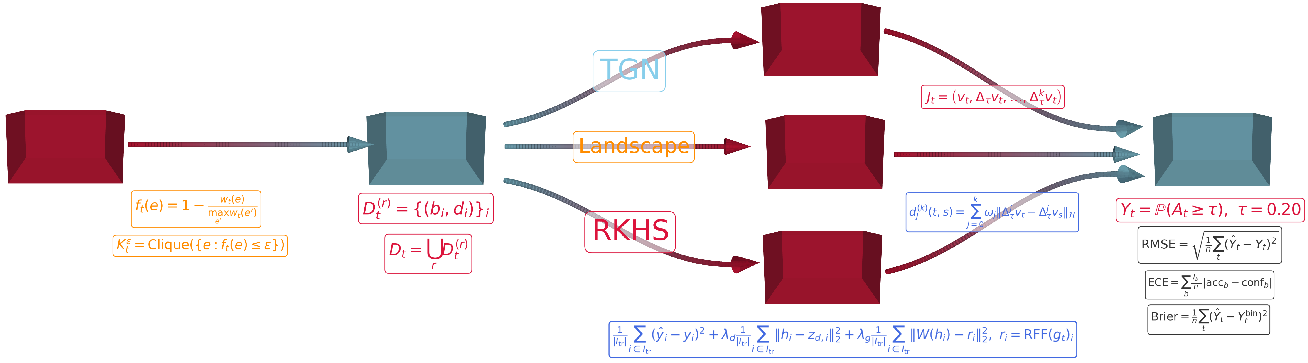

XX-000
Protein Folding Stuff
Charles Fanning Advisor: Dr. Mehmet Aktas
Abstract
We study whether changes in contact-network topology predict transitions into high-risk epidemic periods across several classical empirical proximity network datasets. We use temporal graph learning with persistent homology-based topological signals and evaluate large-outbreak risk using SIR simulations to test whether topological drift serves as an early warning signal for epidemic instability.
Results
Conclusions
In summary, the principal theoretical contribution of this work is the formulation of a hierarchical topological jet framework that rigorously integrates recursive persistence structures, temporal drift operators, and RKHS-based alignment into a unified learning pipeline for dynamic contact networks. Empirically, the results on the \textit{Infectious} dataset show that topology-aware models consistently outperform the graph-only TGN baseline, with the RKHS-constrained approach achieving the strongest overall performance and Level~2 representations substantially improving all model classes. The primary limitation is that evaluation was conducted on a small chronological test set with effectively single-class support, which restricts the strength of calibration and generalization claims despite the consistent directional improvements observed. Future work should therefore focus on larger temporally stratified multi-dataset validation, balanced test splits, and the extension of the framework to deeper structural and temporal jet hierarchies for early epidemic transition forecasting.
Methodology
Dataset
“Infectious” Exhibition: Science Gallery exhibit crowd interaction network, partitioned into 24-hour windows [1].
Framework
Graph-only: Temporal Graph Network (TGN) on temporal graphs with cumulative contact duration as edge weights.
$$m_{i}\left(t\right)={\text{msg}}_{s}\left(s_{i}\left(t^{−}\right),s_{j}\left(t^{−}\right),Δt,e_{ij}(t)\right), m_{j}\left(t\right)={\text{msg}}_{d}\left(s_{j}\left(t^{−}\right),s_{i}\left(t^{−}\right),Δt,e_{ij}(t)\right)$$
$${\overline{m}}_{i}\left(t\right)=\text{agg}\left(\left\{m_{i}\left(t_{k}\right)\right\}:t_{k}≤t\right), s_{i}\left(t\right)=\text{mem}\left({\overline{m}}_{i}\left(t\right),s_{i}\left(t^{−}\right)\right)$$
$$z_{i}\left(t\right)=\text{emb}\left(i,t\right)=\sum_{j∈𝒩_{i}^{k}\left(\left[0,t\right]\right)}{h\left(s_{i}\left(t\right),s_{j}\left(t\right),e_{ij}\left(t\right),v_{i}\left(t\right),v_{j}\left(t\right)\right)}$$
Graph-and-Topology:
Persistence diagrams $D_{t}$ are computed from weighted clique filtrations. $$g_{t}=D_{t+Δ}−D_{t} , ℒ={\left(\hat{Y_{t}}−Y_{t}\right)}^{2}+λ_{D} |z_{t}−φ\left(D_{t}\right)|_{2}^{2}+λ_{g} |z_{t}−φ\left(g_{t}\right)|_{2}^{2}$$
Persistence Landscapes:
$$λ_{i}\left(x\right)=max\left(0,min\left(x−b_{i},d_{i}−x\right)\right)$$
$$Λ_{k}\left(x\right)=\text{k}\text{−}\text{th} \text{largest} \text{value} \text{of} {\left\{λ_{i}(x)\right\}}_{i=1}^{N_{t}}$$
$${\left(L_{t}\right)}_{k,j}=Λ_{k}\left(x_{j}\right)$$
Our Approach (RKHS): The drift term $g_{t}$ is mapped to an RKHS feature representation $φ\left(g_{t}\right)$ for topology-constrained learning.
$$K\left(X,A\right)≅⊕ℤ, \hat{K\left(X,A\right)}=∏𝕋, χ_{θ}\left(α\right)=e^{i\left\langle α,θ\right\rangle }$$
$$λ\left(θ\right)=\frac{1}{2}\sum_{u,v∈V}{w_{u,v}{\left|e^{iφ_{θ}(u)}−e^{iφ_{θ}(v)}\right|}^{2}}, dν_{t}\left(θ\right)=e^{−tλ\left(θ\right)}dμ\left(θ\right)$$
↓ (Fourier-Stieltjes Transform)
$$k_{ν_{t}}\left(α,β\right)=∫_{∏𝕋}χ_{θ}\left(α−β\right)e^{−tλ\left(θ\right)}dμ(θ)$$
↓ (Bochner’s Theorem) ↓ (Reproducing Kernel Hilbert Space)
$$k_{ν_{t}}\left(α,β\right)={\left\langle Φ_{ν_{t}}\left(α\right),Φ_{ν_{t}}(α)\right\rangle }_{L^{2}\left(ν_{t}\right)}, ℋ_{ν_{t}}=\overline{\text{span}}\left\{Φ_{ν_{t}}\left(α\right):α∈K(X,A)\right\}$$
Drift Levels:
$$W_{p}^{\left(n+1\right)}\left(Γ,Λ\right)≔\inf_{σ}\left.|{\left.1\left(d_{1}^{\left(n\right)}\left(u_{i},v_{i}\right)\right.1\right)}_{i}\right.|_{p}$$
$$g_{t}^{\left(n,1\right)}=D_{t+Δ}^{\left(n\right)}−D_{t}^{\left(n\right)}$$
$$g_{t}^{\left(n,k\right)}=\sum_{j=0}^{k}{{\left(−1\right)}^{k−j}\left({k \atop j}\right)}D_{t+jΔ}^{\left(n\right)}$$
$$J_{t}^{\left(n,k\right)}=\left(D_{t}^{\left(n\right)},g_{t}^{\left(n,1\right)},g_{t}^{\left(n,2\right)},…,g_{t}^{\left(n,k\right)}\right)$$
References
L. Isella, J. Stehlé, A. Barrat, C. Cattuto, J.-F. Pinton, and W. Van den Broeck (2011). What's in a crowd? Analysis of face-to-face behavioral networks. Journal of Theoretical Biology, 271(1):166--180.
E. Rossi, B. Chamberlain, F. Frasca, D. Eynard, F. Monti, and M. Bronstein (2020). Temporal graph networks for deep learning on dynamic graphs. arXiv preprint arXiv:2006.10637.
P. Bubenik (2015). Statistical topological data analysis using persistence landscapes. Journal of Machine Learning Research, 16(1):77--102.
Code
Notes:
Copyright Colin Purrington (http://colinpurrington.com/tips/academic/posterdesign).

