Slide 1



Building ColdFusion Workflow with PDF, digital signature, & Directory Watcher
Presented by Shirak Avakian
Adobe ColdFusion Summit 2015

Slide 2
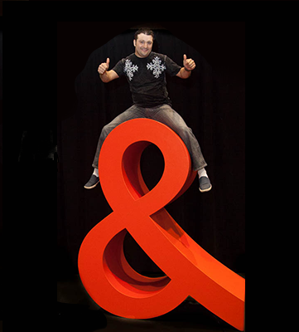



Who am I?
Shirak Avakian
Senior Web Architect
Century-National Insurance
CFFlex Technology, INC.
Connect
@ShirakAvakian
shirakavakian@gmail.com
http://cf-click.blogspot.com/
Adobe ColdFusion Summit 2015

Slide 3
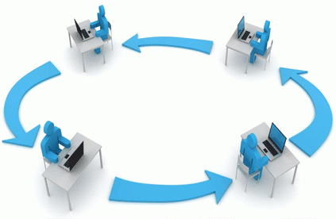

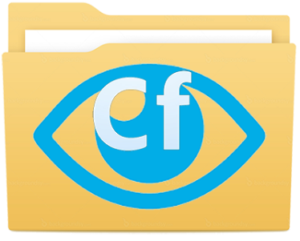
Subjects To Cover
Workflow in ColdFusion
PDF Digital Signatures
Directory Watcher
Adobe ColdFusion Summit 2015

Slide 4


Workflow in ColdFusion
What is a workflow?
A workflow consists of an orchestrated and repeatable pattern of business activity enabled by the systematic organization of resources into processes that transform materials, provide services, or process information. (Wikipedia)
Is there ColdFusion workflow service?
NO
Adobe ColdFusion Summit 2015

Slide 5

Workflow in ColdFusion
What are we trying
to accomplish with a workflow?
Adobe ColdFusion Summit 2015

Slide 6
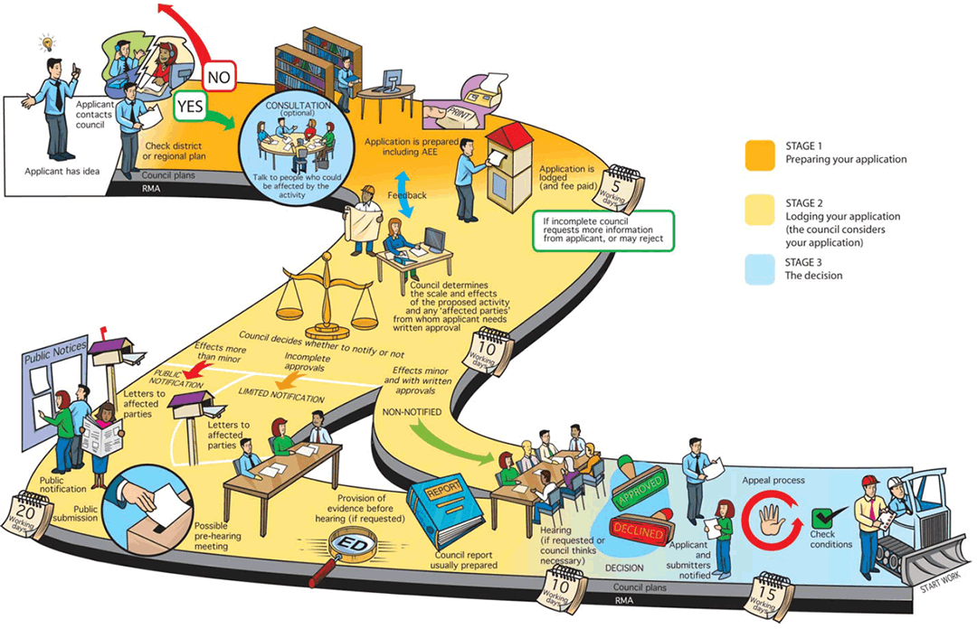
Workflow in ColdFusion
Adobe ColdFusion Summit 2015

Slide 7
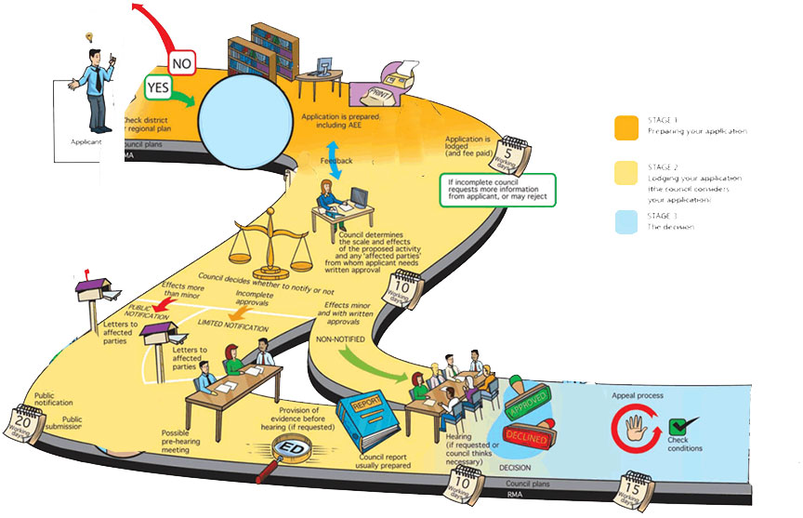
Workflow in ColdFusion
Adobe ColdFusion Summit 2015

Slide 8
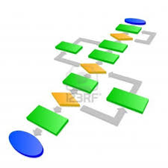
Workflow in ColdFusion
What do I need to know before creating workflow?
Business Requirements
Process Diagram
Workload
Hardware
Availability
Storage
Adobe ColdFusion Summit 2015

Slide 9
Workflow in ColdFusion
To Create workflow in ColdFusion
Download CFWorkflow from Github https://github.com/cfclick/CFWorkflow
Create new Component following specific name convention {name}Activity.cfc
Extend from BaseActivity
Implement IActivity
Adobe ColdFusion Summit 2015

Slide 10
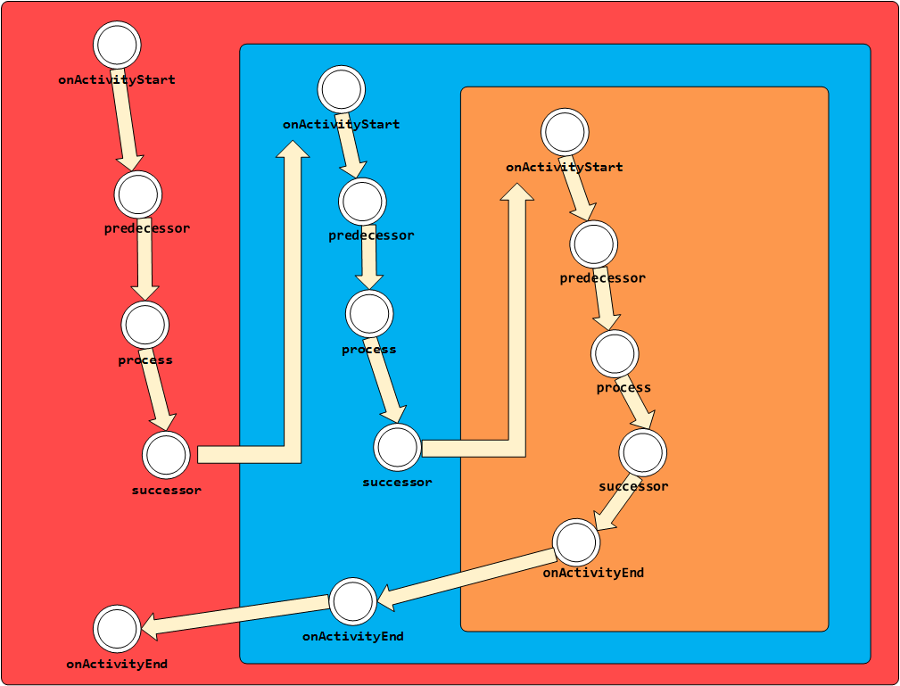
Adobe ColdFusion Summit 2015

Slide 11
Workflow in ColdFusion
DEMO 1
http://localhost/CFSummit2015/Demo/Demo1/TestThreeActivities.cfm
Adobe ColdFusion Summit 2015

Slide 12
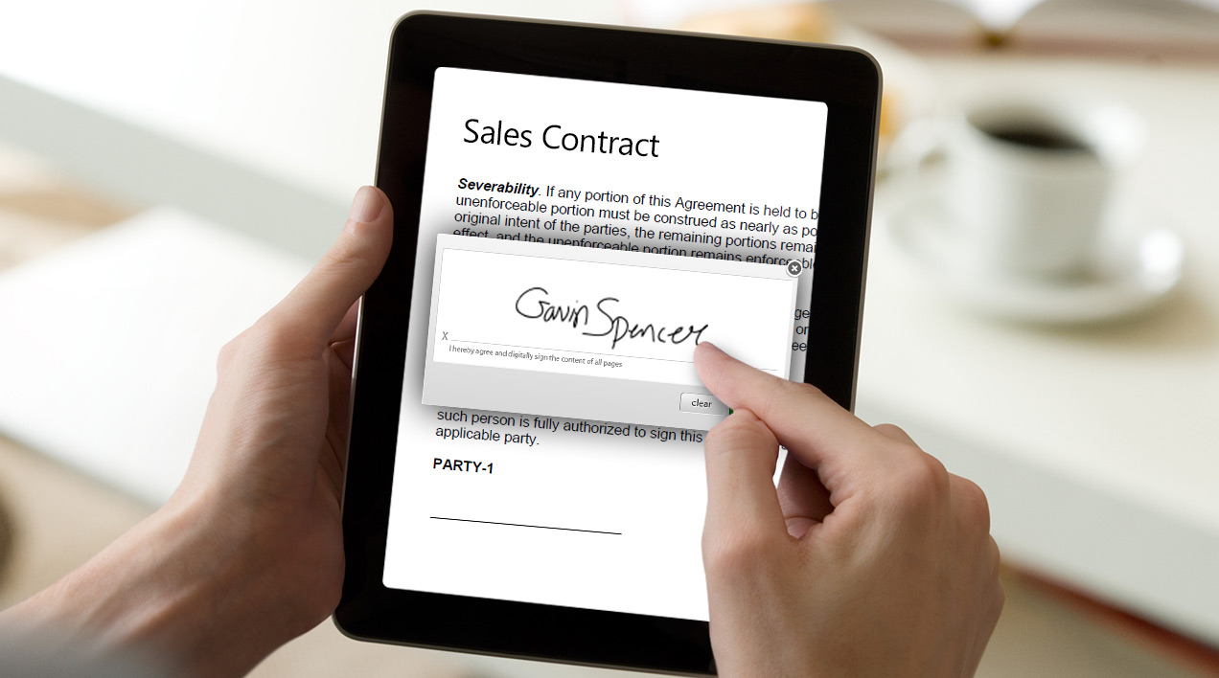
PDF Digital Signatures
Digital signature
Public Key Infrastructure (PKI)
Adobe ColdFusion Summit 2015

Slide 13
PDF Digital Signatures
Digital signature
A digital signature is a mathematical scheme for demonstrating the authenticity of a digital message or document. A valid digital signature gives a recipient reason to believe that the message was created by a known sender.
Public Key Infrastructure (PKI)
Set of people, policies, procedures, hardware, and software used in creating, distributing, managing, and using the digital IDs that contain the public/private key pairs used when signing a PDF. PKI generally refers to the digital ID issuers, users, administrators, and any hardware software used in those workflows.
Adobe ColdFusion Summit 2015

Slide 14
PDF Digital Signatures
Digital ID
An electronic representation of data, based on the ITU-T X.509 v3 standard, associated with a person or entity. It is stored in password-protected file on a computer or network. A Digital ID contains a public key certificate, a private key, and other data.
Public Key Certificate
A file that contains the numeric public key portion of public-private key pair along with associated extensions and attributes used to define the certificates owner, validity period, and usage.
Private Key Certificate
The secret key in a PKI system, used to validate incoming messages and sign outgoing ones. A private key is always paired with its public key during those key generations.
Adobe ColdFusion Summit 2015

Slide 15
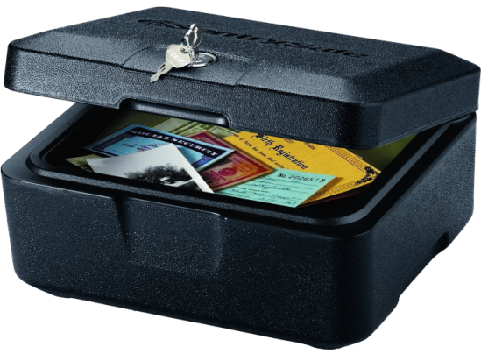
PDF Digital Signatures
What are you talking about?
No worries I promise to explain it!
Special Safe box example
Adobe ColdFusion Summit 2015

Slide 16
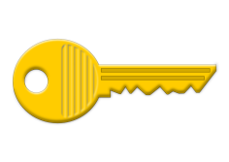
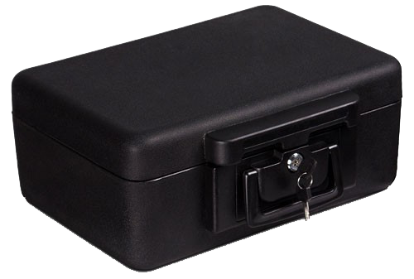

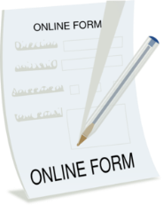

PDF Digital Signatures
Digital signature
Private Key Certificate
Public Key Certificate
Public Key Infrastructure (PKI)
Adobe ColdFusion Summit 2015

Slide 17


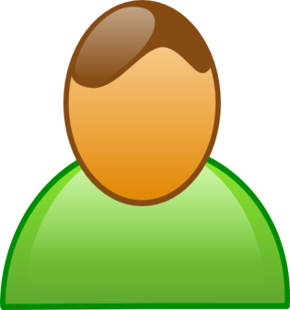

PDF Digital Signatures
Adobe ColdFusion Summit 2015

Slide 18
PDF Digital Signatures
Symmetric key algorithm
Asymmetric key algorithm
Adobe ColdFusion Summit 2015

Slide 19
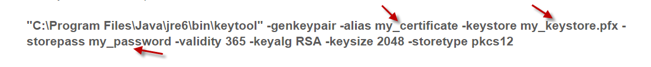
PDF Digital Signatures
How to generate digital certificate?
Adobe Acrobat
Open source tools like openssl or keytool
DigiSigner certificate generation
IIS Server Manager
Many more..
my_keystore.pfx is the key store file. my_password is the password. validity is the number of days your certificate will stay valid. RSA is the algorithm used to generate the cryptographic keys. 2048 is the length of the cryptographic keys. pkcs12 is the format of the key store file.

Slide 20
PDF Digital Signatures
Enter keystore password:
Re-enter new password:
What is your first and last name?
[Unknown]: Shirak Avakian
What is the name of your organizational unit?
[Unknown]: IT
What is the name of your organization?
[Unknown]: CFFlex Technology, INC
What is the name of your City or Locality?
[Unknown]: Glendale
What is the name of your State or Province?
[Unknown]: CA
What is the two-letter country code for this unit?
[Unknown]: US
Is CN=Bruno Specimen, OU=IT, O=iText Software, L=Ghent, ST=OVL, C=BE correct?
[no]: yes
Enter key password for <demo>
(RETURN if same as keystore password):
Adobe ColdFusion Summit 2015

Slide 21
ColdFusion PDF Digital Signatures
ColdFusion 11 has added the following new attributes to the <cfpdf> tag:
readsignaturefields
keystorepassword
unsign
keyalias
unsignall
author
validatesignature
height
signaturefieldname
width
keystore
position
Adobe ColdFusion Summit 2015

Slide 22



ColdFusion PDF Digital Signatures
Action = readsignaturefileds
Reads all the signature fields and returns a query object in the variable
Result of unsigned PDF signature read is query as shown below
Result of signed PDF signature read is query as shown below
Adobe ColdFusion Summit 2015

Slide 23
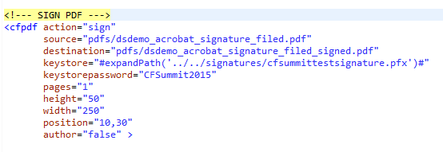
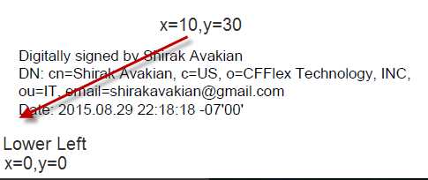
ColdFusion PDF Digital Signatures
Action = sign,unsign,unsignall
Adobe ColdFusion Summit 2015

Slide 24

ColdFusion PDF Digital Signatures
Auther = true
1-Verify document authenticity – confirm the identity of person who signed the document.
2-Verify document integrity – confirm that the document has not been altered in transit.
Author-based signatures provide both of these security services. (ColdFusion Documentation)
Auther = false
Adobe ColdFusion Summit 2015

Slide 25
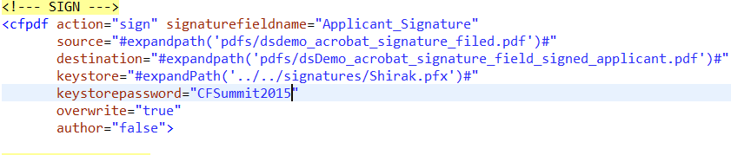
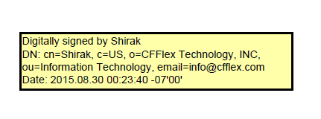

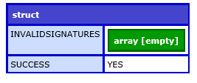
ColdFusion PDF Digital Signatures
Action = sign, signaturefieldname
Sign predefined signature field
Use Adobe Acrobat to create pre defined signature field
Action = validatesignature
Array of Invalid signatures names
Boolean value “yes” “true” if all signature fields are valid
Adobe ColdFusion Summit 2015

Slide 26
DEMO 2
http://localhost/CFSummit2015/Demo/Demo2/index.cfm
http://localhost/CFSummit2015/Demo/Demo2/signed_pdf.cfm
Adobe ColdFusion Summit 2015

Slide 27

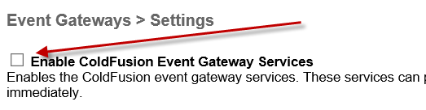

ColdFusion Directory Watcher
Directory Watcher
An internal, one way, gateway. It has a single thread that periodically checks a local directory and sends a message to a CFC when the directory contents change. (ColdFusion Docs)
How to setup directory watcher?
1- ColdFusion Admin – Event Gateway
2- Enable Event Gateway
3- Create new gateway instance
Adobe ColdFusion Summit 2015

Slide 28
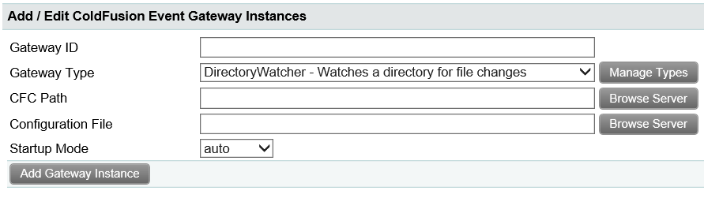
ColdFusion Directory Watcher
Gateway ID : Gateway Name
Gateway Type : Select Directory Watcher gateway
CFC Path : ColdFusion Component that will handle the events
Configuration File: Configuring how to handle directory watcher events Copy directory-watcher.cfg from cfusion\gateway\config to your project folder
Adobe ColdFusion Summit 2015

Slide 29
Putting all together Demo 3 Become Broker
http://localhost/CFSummit2015/BecomeBroker/index.cfm
Adobe ColdFusion Summit 2015

Slide 30
Resources
Adobe
http://help.adobe.com/en_US/acrobat/X/pro/using/WSAC8084C2-14F7-4841-9EF8-92106D22C3DB.w.html
http://www.adobepress.com/articles/article.asp?p=1708161&seqNum=4
Microsoft
https://technet.microsoft.com/en-us/library/cc545901(v=office.12).aspx
Digisigner
https://www.digisigner.com/
Adobe ColdFusion Summit 2015

Slide 31
Q/A
THANK YOU
Don’t leave hold of your common sense. Think about what you’re doing and how the technology can enhance it. Don’t think about technology first. (Esther Dyson)
Adobe ColdFusion Summit 2015

