Slide 1
GM maize productivity in South Africa from 1999-2019
Food Security, Agricultural Productivity, and Trade in Africa
AAEA Annual Meeting 2021
Courtney Cooper, Aaron M. Shew, Jesse B. Tack, Lawton L. Nalley, Petronella Chaminuka, Safiah Maali
8-3-2021

Slide 2
South African context
Food insecurity continues to be a serious concern for many South Africans
In 2018, 11% of individuals and 10% of households in South Africa were vulnerable to hunger
Undernourishment slightly increased from 5% to 6% from 2014 to 2017
In 2014-2015, 22% of households experienced food insecurity due to a severe drought and subsequent food price shocks
Maize serves as a staple food for the majority of the population, specifically for low-income households

Slide 3
introduction
Most research evaluating the impacts of GM crops focuses on the producer benefits of GM input traits or the influence of consumer valuation and acceptance in GM crop adoption
Specifically, the producers that have benefited the most are low-income farmers in developing countries where there are fewer options for pest management and crop vulnerability tends to be higher
Other findings conclude GM input traits have second-order socioeconomic impacts such as labor-savings and environmental benefits
Some skeptics have claimed that there is not clear evidence of GM maize yield gains in South Africa

Slide 4
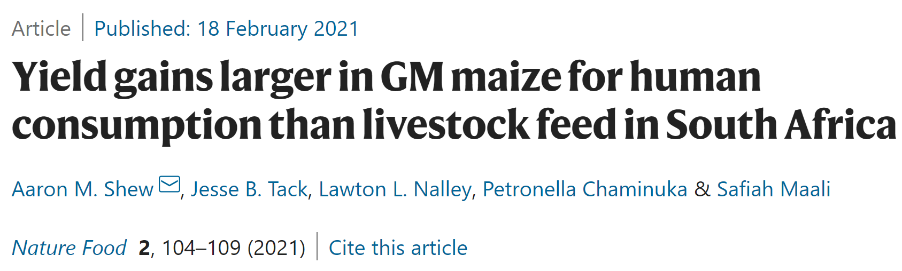
Previous Data and methods
A previous study was conducted on GM maize in South Africa with emphasis on gains for white and yellow maize cultivars.
Data collected from 106 locations and 491 cultivars across 28 years (1980-2009) and contained 58,952 observations.
Data contained both white and yellow maize, with 41% of the data being white maize
Most trials were dryland and rainfed but 17% were irrigated
While the data begins in 1980, GM cultivars do not appear until 1999
Extensive regression modeling with robustness checks were used to estimate heterogeneous GM gains by cultivar and color

Slide 5
Previous results
In the study by Shew et al 2021, yield gains were found in both GM white and yellow maize.
Average GM yield increase was estimated at .42Mt/ha from genetic modification
GM maize also reduced yield risk by 8%
GM yield gains vary under different conditions including by province and under irrigated conditions, but GM yield gains were approximately twice as large for white relative to yellow maize

Slide 6
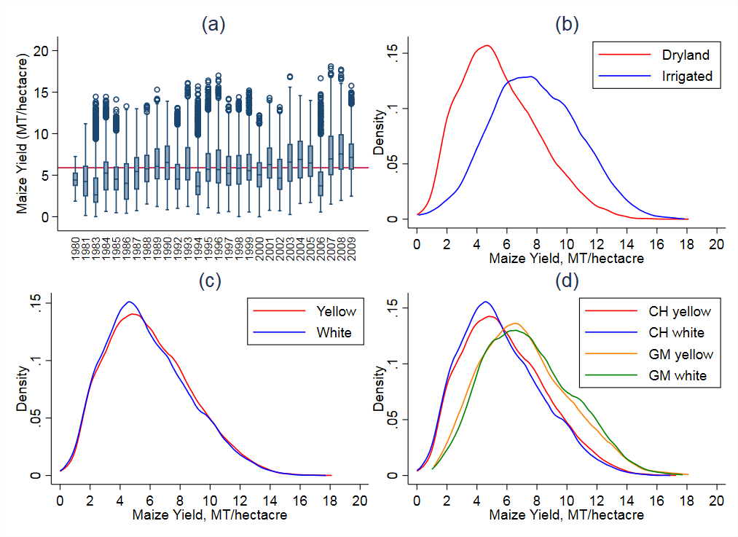

Slide 7
New data available
For our current study, we took the previous data that ranged from 1980-2009 and added recently aggregated data from 2010-2019.
Data were collected from the South African Agricultural Research Council (and we’re very thankful for their collaboration on this project)
The newly aggregated data was compiled and cleaned in the same manner as the previous data and merged into our panel dataset for analysis
Data contain color (white, yellow), GM (Bt, stacked Bt/RR, and conventional), province, year, and yield for observations in the updated panel
Data are missing for the 2015 production year

Slide 8
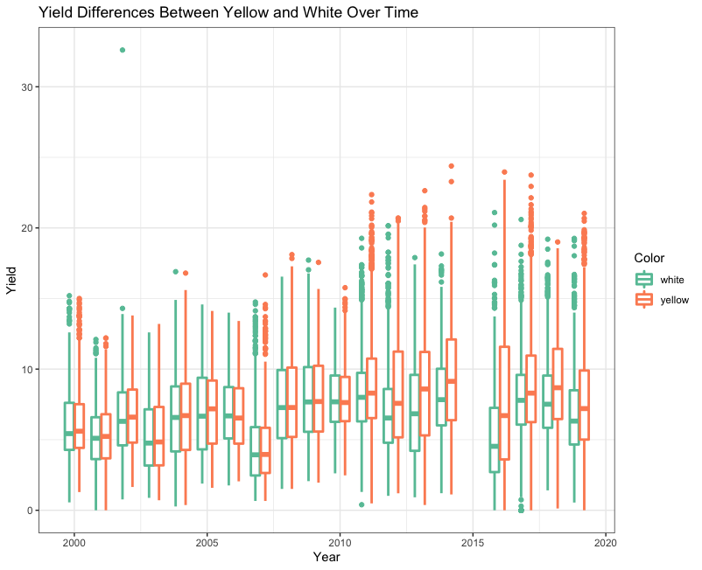
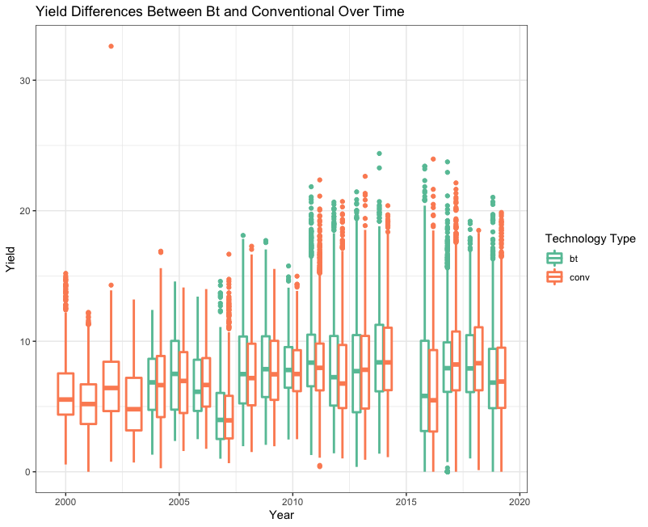
White/yellow yields by year
Bt/Conventional yields by year

Slide 9
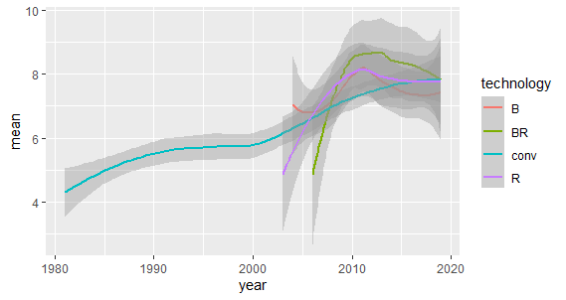

Slide 10
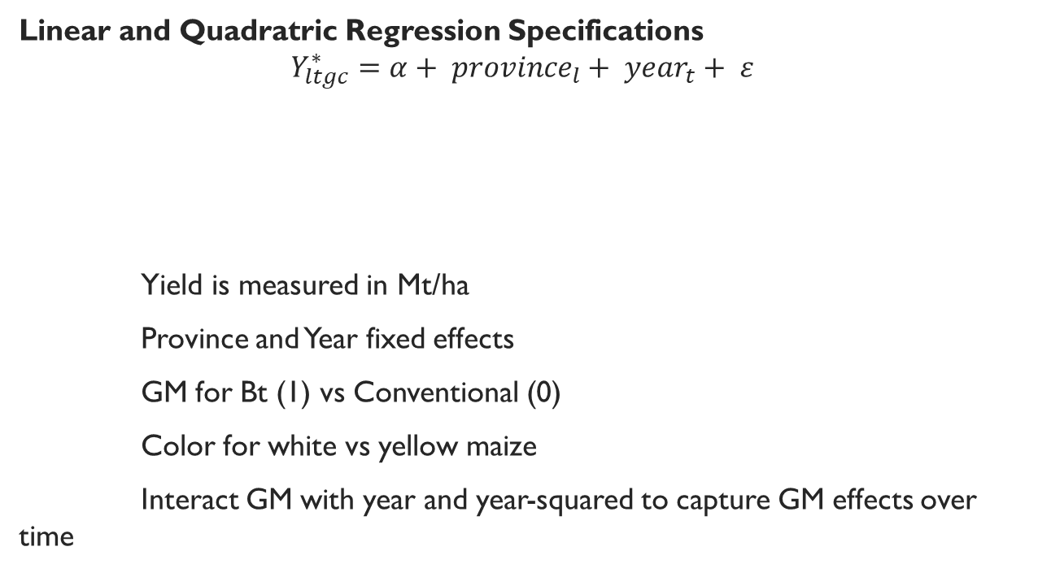

methods
$$yield \sim province+year+GM+color$$
Linear and Quadratric Regression Specifications
$$Y_{ltgc}^{∗}=α+ {province}_{l}+ {year}_{t}+ ε$$
Yield is measured in Mt/ha
Province and Year fixed effects
GM for Bt (1) vs Conventional (0)
Color for white vs yellow maize
Interact GM with year and year-squared to capture GM effects over time
$${}_{}Y∗…$$
$$yield \sim province+year+GM+year∗GM+year squared∗GM+color$$

Slide 11


Linear Regression results
Original Data
Updated Data

Slide 12
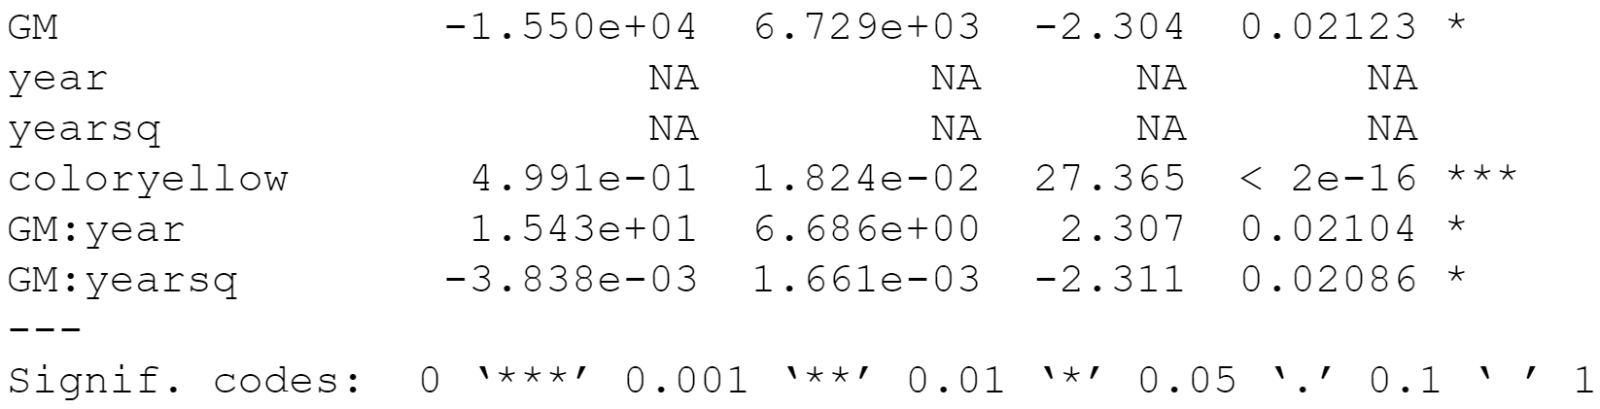
Quadratic Regression results

Slide 13
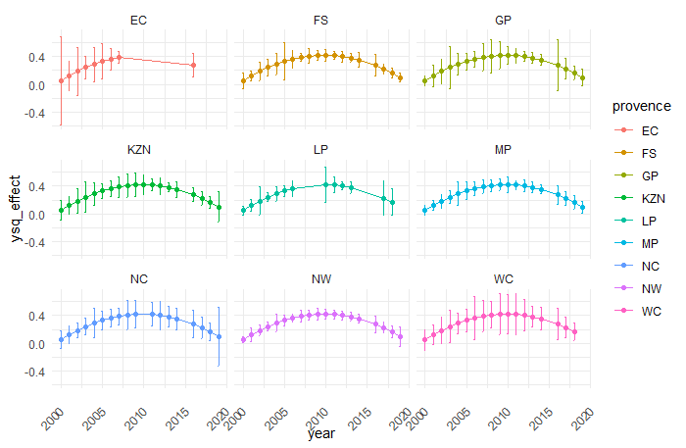
Placeholder for province GM by year effects in the quadratic model

Slide 14
Next steps
Quantify the counterfactual GM growth without insect resistance
Estimating the economic and production impacts of insect resistance
Breakpoint Analysis by province to analyze heterogeneity in insect resistance

Slide 15
Questions
Courtney Cooper- cfcooper@uark.edu
I would like to gratefully acknowledge the South African Agricultural Research Council for providing data for this study.

