Slide 1
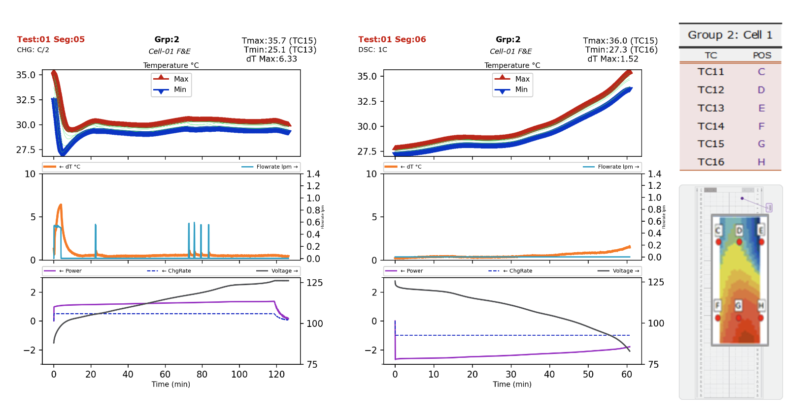
python analysis

Slide 2
DATA ANALYTIC AUTOMATION WITH PYTHON
At Wisk I analyzed the test data of the battery module to evaluate its performance, measure thermal gradients, and identify risks. In Python I designed a template to evcaluate each load case and grouping, computing the key values (Tmax, Tmin, dTmax) and plotting temperatures, coolant flowrate and governing power load. After designing the template seen below, I utilized an API to automatically generate 400+ slides: one for every case and grouping and duty cycle. The key values computed for each case were compiled into single summary table, which I presented with my observations, conclusions and recommendations to the chief engineers at major design review. Ultimatelty the summary table was delivered in the final report, while the plots kept in appendix provided the support to clarify behavior during the tests.

Slide 3
data analytics with python
Header to identify test case (Test 1 – Seg 5), its attributes and conditions (C/2 Charge), and the group being assessed (Group 2 / Cell-01).

Slide 4
data analytics with python
Dashboard Guide
Guiding the dashboard by indicating applied throughput (power) and accumulated mileage (voltage).
Input power-load spedometer; Battery Voltage (indicative of the SoC) odometer.

Slide 5
data analytics with python
Temperature of each signal in the Group with Max & Min highlighted in red & blue, resp. TC of max and min with its value annotated.

Slide 6
data analytics with python
dT (thermal gradient one of the assessed targets) graphed with Coolant Flowrate.

