Slide 1
Deep Linguistic Information in Hybrid Machine Translation
Jan Hajič
Charles University in Prague
Faculty of Mathematics and Physics
Institute of Formal and Applied Linguistics
Czech Republic

Slide 2

Outline: From Data
To an MT System
“DeepBank:” The Prague Czech-English Dependency Treebank (2.0)
  Texts, annotation style(s), alignment, tools
The platform: Treex
TectoMT: hybrid MT English → Czech
  The (old) idea
  Overall design
  Core modules
(A Speculation on) The Future
Dec. 8, 2012
Hybrid MT Workshop - Coling 2012

Slide 3
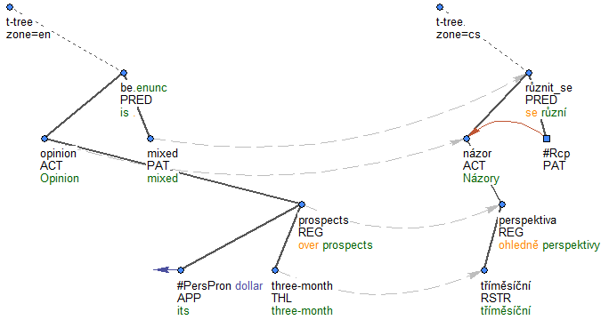
The Prague Czech-English Dependency Treebank (PCEDT) 2.0
Parallel treebank
Aligned trees
Aligned nodes
Dec. 8, 2012
Hybrid MT Workshop - Coling 2012

Slide 4
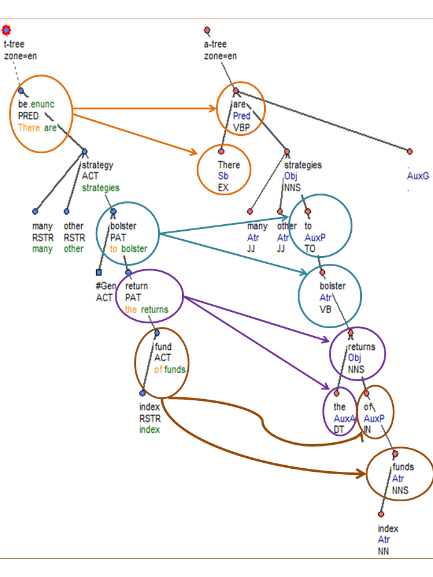
The Prague Czech-English Dependency Treebank (PCEDT) 2.0
surface
syntax
Parallel treebank
Dependency style (“Prague”)
  (surface) syntax
  syntax & semantics (“tectogrammatics”)
syntax &
semantics
(and more)
=
“tectogrammatics”
Dec. 8, 2012
Hybrid MT Workshop - Coling 2012

Slide 5
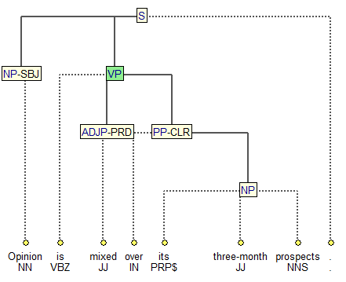
The Prague Czech-English Dependency Treebank (PCEDT) 2.0
Parallel treebank
Dependency style (“Prague”)
  (surface) syntax
  syntax & semantics (“tectogrammatics”)
Penn Treebank translation into Czech
Názory na její tříměsíční perspektivu se různí.
Dec. 8, 2012
Hybrid MT Workshop - Coling 2012

Slide 6
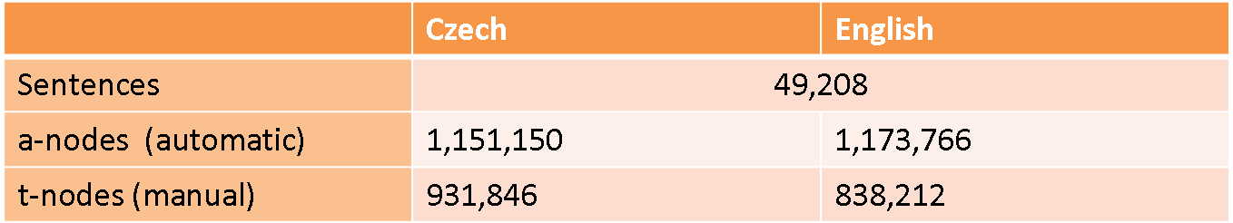
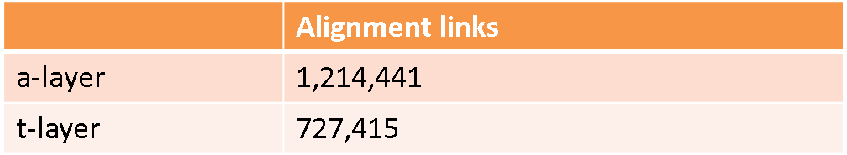
The Prague Czech-English Dependency Treebank (PCEDT) 2.0
Parallel treebank
Dependency style (“Prague”)
  (surface) syntax
  syntax & semantics (“tectogrammatics”)
Penn Treebank translation into Czech
1 million words
Published at LDC, June 2012 (LDC2012T08)
  Also available through LINDAT-Clarin and META-SHARE
Dec. 8, 2012
Hybrid MT Workshop - Coling 2012

Slide 7
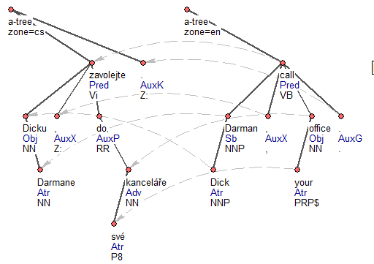
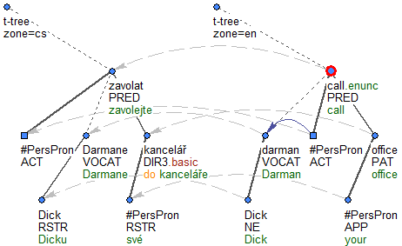

PCEDT 2.0
The Alignment(s)
Czech-English alignments
  Sentence-level (manual, natural due to translation)
    At both syntactic levels
  Word (node) level
    automatic, test section manually corrected (in part)
Dec. 8, 2012
Hybrid MT Workshop - Coling 2012

Slide 8
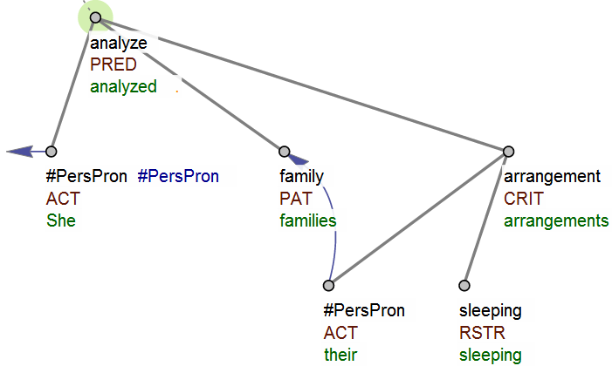
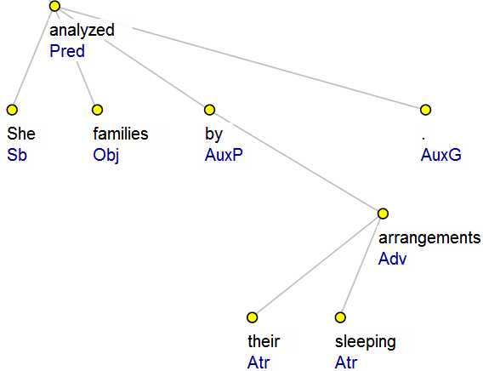
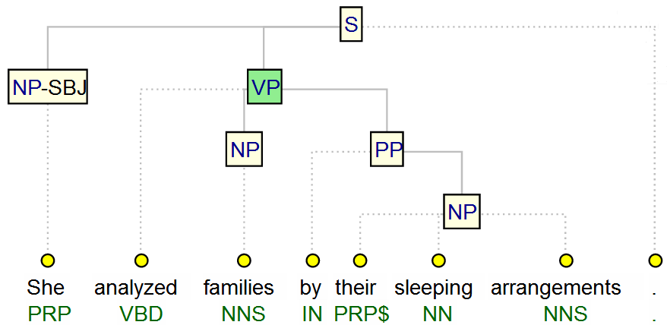
PCEDT 2.0
The Alignment(s)
tectogrammatics
Czech-English alignments
  Sentence-level (manual, natural due to translation)
    At both syntactic levels 1 → 1
  Word (node) level
    automatic, test section manually corrected (in part), m → n
Between annotation levels
  Tectogrammatics to surface syntax
    m → n, incl. 1 → 0
  Surface syntax to word level (1 → 1)
PTB syntax
surface syntax
Dec. 8, 2012
Hybrid MT Workshop - Coling 2012

Slide 9
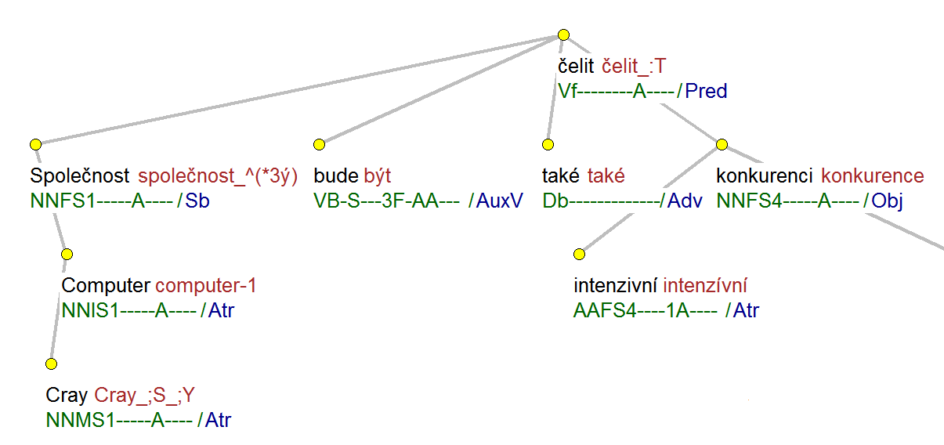
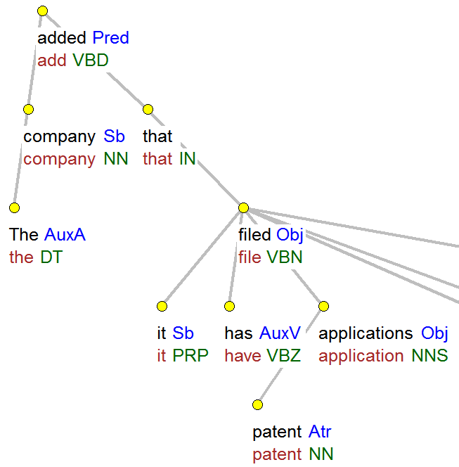
Surface syntax annotation
English
  Dependency (head rules + additions, manual corrections)
  Function label (PDT-style) at all nodes (from PTB + rules)
  Lemmatization + „pure“ POS tags from PTB
  Automatic (from PTB) + a few manual corrections
Czech
  PDT style, no change
  Syntax: automatic (MST); 2000 sent. fully manual for testing
  Lemmatization and tagging: auto
    99%/96%, Spoustová et al. EACL 2009 (COMPOST tagger)
    http://ufal.mff.cuni.cz/compost (Czech, English & other)
  No p-level (of course ☺)
Dec. 8, 2012
Hybrid MT Workshop - Coling 2012

Slide 10
Surface syntax annotation
English
  Dependency (head rules + additions, manual corrections)
  Function label (PDT-style) at all nodes (from PTB + rules)
  Lemmatization + „pure“ POS tags from PTB
  Automatic (from PTB) + a few manual corrections
Czech
  PDT style, no change
  Syntax: automatic (MST); 2000 sent. fully manual for testing
  Lemmatization and tagging: auto
    99%/96%, Spoustová et al. EACL 2009 (COMPOST tagger)
    http://ufal.mff.cuni.cz/compost (Czech, English & other)
  No p-level (of course ☺)
Dec. 8, 2012
Hybrid MT Workshop - Coling 2012

Slide 11
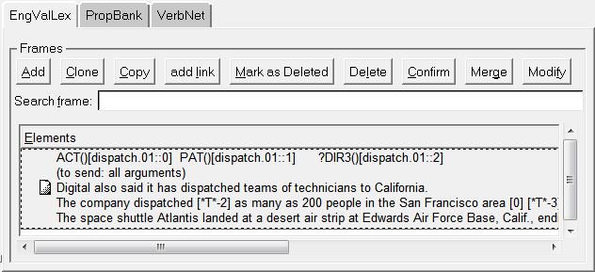
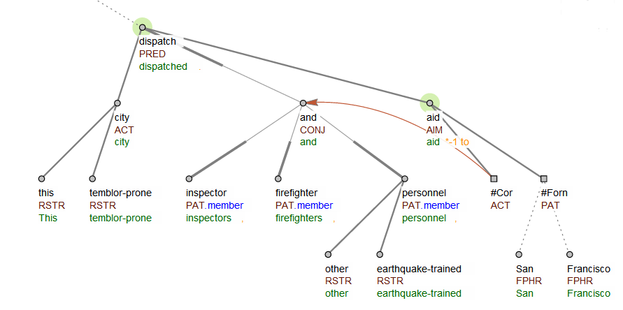
Tectogrammatical annotation
Manual (both languages)
Major features
  Nodes with „autosemantic“ words only (no function words)
    Ellipsis „restored“ (new node for verbal arguments)
  (Semantic) function (dependent → head relation)
    Verb arguments + ca 50 functions for other relations
  Valency lexicons attached (Eng: links to PropBank)
  “Formemes”: prep+case style label (useful in MT and search)
  Co-reference integrated (Eng: BBN + more), Czech: manually
Alignment
  To surface syntax & between Czech and English
This temblor-prone city dispatched inspectors, firefighters and other
earthquake-trained personnel *-1 to aid San Francisco.
Dec. 8, 2012
Hybrid MT Workshop - Coling 2012

Slide 12
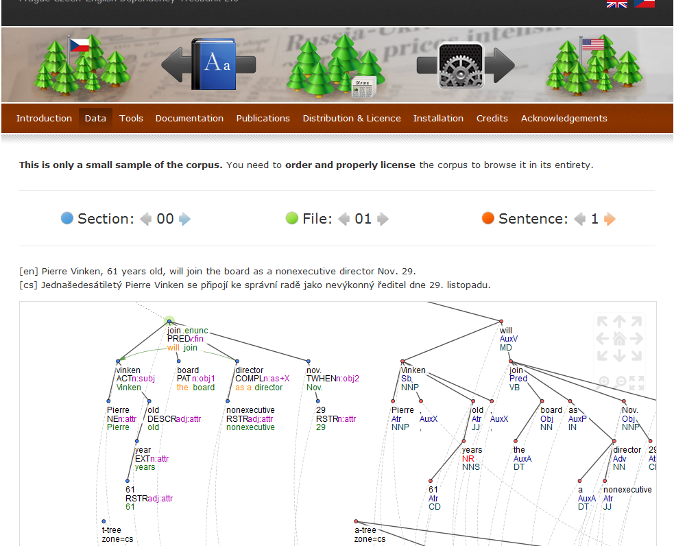
Accompanying Tools
TrEd (http://ufal.mff.cuni.cz/tred)
  Annotation, View/Browse and Search environment
  Open source, perl
  Search and visualization:
    Simple data browser (http://ufal.mff.cuni.cz/pcedt2.0)
    PML-TQ: Powerful query language for complex tree-based annotation
Treex (http://ufal.mff.cuni.cz/treex)
  Modular NLP processing environment
  Easy handling of complex NLP-annotated data
  Modules exists for Czech, English data processing
    incl. 3rd-party tools integrated into Treex
  CPAN-distributed
Dec. 8, 2012
Hybrid MT Workshop - Coling 2012

Slide 13
PCEDT and Tectogrammatics in (hybrid) MT
The famous, (almost) “Vauquois” triangle:
ANALYSIS TRANSFER SYNTHESIS
deep syntax & semantics:
tectogrammatical layer
t-layer
shallow syntax:
analytical layer
a-layer
POS & lemmatization:
morphological
layer
m-layer
w-layer
source language (English) target language (Czech)
Dec. 8, 2012
Hybrid MT Workshop - Coling 2012

Slide 14
Analysis-Transfer-Synthesis
Hybrid System
Over 90 steps: both rule-based and statistical
ANALYSIS TRANSFER SYNTHESIS
Grammatemes, formemes
t-layer
Convert to t-tree
Structural
transfer
Basic morph. categories
Analytical dep. function
a-layer
Agreement
Lexical
transfer
(dictionary)& lexical choice
Parsing (MST)
Add function words
Tagging (Compost)
m-layer
Generate forms
Lemmatization
Concatenate
Tokenization
w-layer
source language (English) target language (Czech)
Dec. 8, 2012
Hybrid MT Workshop - Coling 2012

Slide 15
Example Translation
should
Pred
a-layer
(parse)
+
functions
translation
Sb
be
Obj
.
AuxK
machine
Atr
easy
Pnom
Lemmatized
& POS tagged
machine translation should be easy .
NN NN MD VB JJ .
Tokenized
Machine translation should be easy .
Dec. 8, 2012
Hybrid MT Workshop - Coling 2012

Slide 16
Example Translation
should
Pred
Mark
function
nodes &
edges to
“collapse”
translation
Sb
be
Obj
.
AuxK
machine
Atr
easy
Pnom
Dec. 8, 2012
Hybrid MT Workshop - Coling 2012

Slide 17
Example Translation
be
v:fin
T-tree
backbone
+
formemes
translation
n:subj
easy
adj:compl
machine
n:attr
Dec. 8, 2012
Hybrid MT Workshop - Coling 2012

Slide 18
Example Translation
be
v:fin
Modality=hort
Conditional=1
Tense=PresSim
T-tree
backbone
+
formemes
+
grammatemes
translation
n:subj
Num=sg
easy
adj:compl
DoC=Positive
machine
n:attr
Dec. 8, 2012
Hybrid MT Workshop - Coling 2012

Slide 19
Example Translation
Fill in target
language
equivalents:*
lemmas
formemes
mít
být
v:fin
v:inf
Modality=hort
Conditional=1
Tense=PresSim
převod
překlad
posun
n:1
Num=sg
DoC=Positive
snadný
jednoduchý
adj:compl
n:1
adv:
Transfer
starts:
Clone t-tree
počítač
strojový
stroj
n:2
adj:attr
n:attr
* Dictionary translation: MaxEnt classifier, ~10⁶ features
Dec. 8, 2012
Hybrid MT Workshop - Coling 2012

Slide 20
Example Translation
mít
být
v:fin
v:inf
Modality=hort
Conditional=1
Tense=PresSim
převod
překlad
posun
n:1
Select
best
combination
of lemmas &
Formemes
(HMTM)
Num=sg
DoC=Positive
snadný
jednoduchý
adj:compl
n:1
adv:
počítač
strojový
stroj
n:2
adj:attr
n:attr
Dec. 8, 2012
Hybrid MT Workshop - Coling 2012

Slide 21
Example Translation
mít
Gen=MInanim
C=PastP
Num=sg
Clone
to a-tree,
add core
morphological
& POS tags
+
agreement
+
function words
překlad
Num=sg
Case=1
.
.
by
být
C=inf
snadný
Deg=pos
Case=1
Gen=MInanim
strojový
Deg=pos
Case=1
Gen=MInanim
Dec. 8, 2012
Hybrid MT Workshop - Coling 2012

Slide 22
Example Translation
mít
Gen=MInanim
C=PastP
Num=sg
překlad
Num=sg
Case=1
.
.
by
být
C=inf
snadný
Deg=pos
Case=1
Gen=MInanim
strojový
Deg=pos
Case=1
Gen=MInanim
Rearrange
clitics
Dec. 8, 2012
Hybrid MT Workshop - Coling 2012

Slide 23
Example Translation
měl
překlad
Synthesize
word forms
.
by
být
snadný
strojový
... and flatten
the tree:
(capitalize, space)
Strojový překlad by měl být snadný.
Dec. 8, 2012
Hybrid MT Workshop - Coling 2012

Slide 24
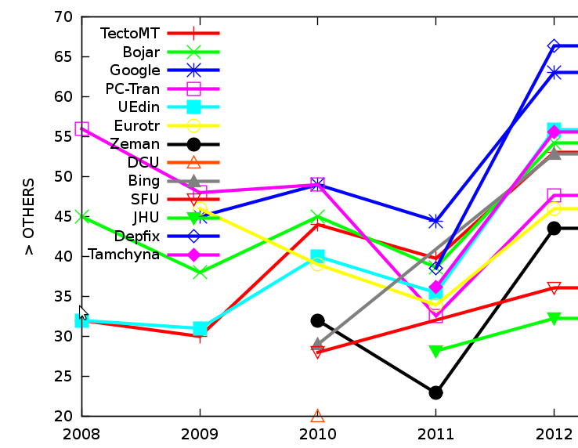
Results
WMT Constrained task en → cs:
  TectoMT, Moses (Prague), Moses (Edinburgh) tied 1st
Unconstrained:
  (subj. eval.)
BLEU
  All < 0.17
Dec. 8, 2012
Hybrid MT Workshop - Coling 2012

Slide 25
The Future
Acknowledgements:
Acknowledgements:
Ministry of Education Czech Rep.
LC536, MSM0021620838
Acknowledgements:
Ministry of Education Czech Rep.
ME09008, 7Ennnn
Acknowledgements:
Czech Science Foundation
GAP406/10/0875
Acknowledgements:
Czech Science Foundation
GPP406/10/P193
Acknowledgements:
Czech Science Foundation
GA405/09/0729
Acknowledgements:
“Information Society” Programme
1ET101120503
Acknowledgements:
Charles Univ. student grants
116310, 158010, 3537/2011
Acknowledgements:
European projects (in part)
034434, 034291, 231720, 247762
Acknowledgements:
Charles University research funds
(“PRVOUK”)
Acknowledgements:
European projects (part)
249119, 257528
Non-isomorphic trees
  Better breakdown to treelets and/or parameter training (than in STSG)
Multiple paths / n-best lists
  At least until statistical components
Combine with Moses (using input lattices)
  Two „languages“: original & Czech by TectoMT
Moses with syntactic and semantic factors
Still more generalized syntax and semantics (AMR/MRS and beyond?)
Dec. 8, 2012
Hybrid MT Workshop - Coling 2012

Slide 26
References
Zdeněk Žabokrtský, Martin Popel: Hidden Markov Tree Model in Dependency-based Machine Translation. In ACL 2009, pp. 145-148
David Mareček, Martin Popel, Zdeněk Žabokrtský: Maximum Entropy Translation Model in Dependency-Based MT Framework. Joint 5th Workshop on Statistical Machine Translation and MetricsMATR, ACL 2010, Uppsala, Sweden, pp. 201-206.
Ondřej Dušek, Zdeněk Žabokrtský, Martin Popel, Martin Majliš, Michal Novák and David Mareček: Formemes in English-Czech Deep Syntactic MT. In WMT’12, Montréal, Canada, pp. 267-274.
Martin Popel, Zdeněk Žabokrtský: TectoMT: Modular NLP Framework. IceTAL 2010, 7th International Conference on Natural Language Processing, Reykjavík, Iceland, pp. 293-304.
TectoMT at WMT 12: http://www.statmt.org/wmt12/pdf/WMT02.pdf
Thank you!
Dec. 8, 2012
Hybrid MT Workshop - Coling 2012

