Slide 1

AMU$EMINT

Slide 2
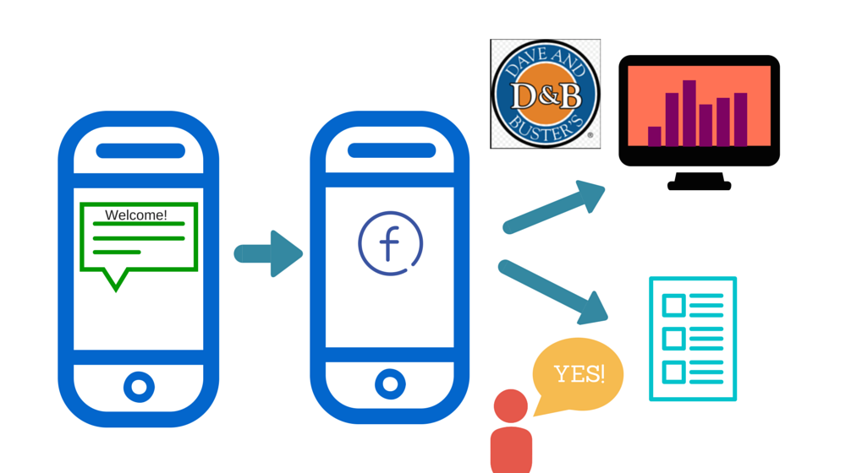
OVERLOOK

Slide 3
FEATURE: NEWS FEED
Comment
Like
Photo

Slide 4
FEATURES: SCAVENGER HUNT
Music
Challenge the user!
Light
Make it harder to see!
Add Credits
Help out your friends!
Notes:
NFC me my play identify user
Mangement mode
# games played
# tickets dispensed
People in the room
show score status
support game player
People outside - reach out social
give credits
reward badges

Slide 5
FEATURES: REWARDS
Beginner
Intermediate
Advanced
LEADERBOARD WITHIN DAVE AND BUSTERS

Slide 6

REVENUE MODEL

Slide 7
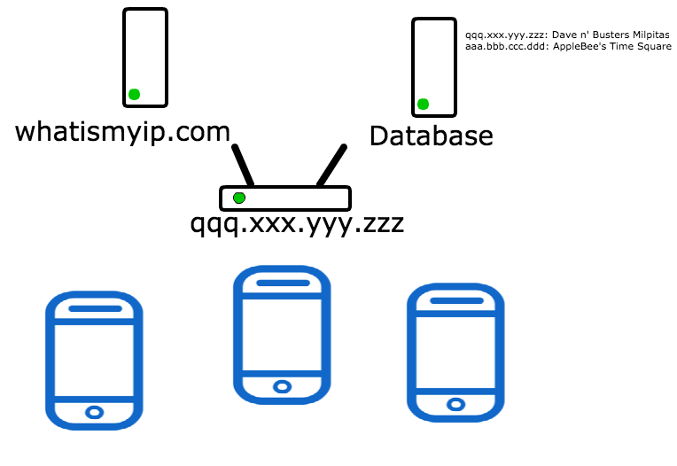
WiFi-based Location Sensitivity

Slide 8
THANK YOU!!

