Slide 1

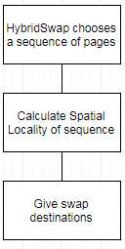
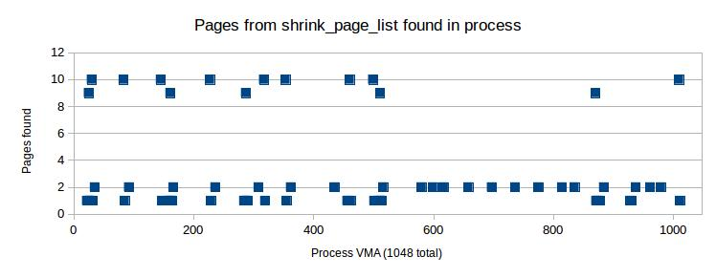
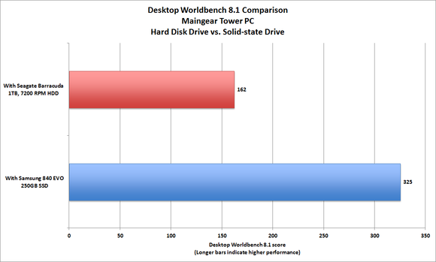
SSD-Aware Virtual Memory Management
Christopher Feener Xuechen Zhang
Washington State University Vancouver
Why is Virtual Memory Management needed?
Our Solution: HybridSwap
Experimental Results
SSD has significant advantages over DRAM, including greater capacity, more power efficient, and lower price per bit
It could potentially be used as an extension of memory
Applications with large working sets could run efficiently on a modestly configured system using both SSDs and disks.
John L. Jacobi. Benchmarks don't lie: SSD upgrades deliver huge performance gains. 2013. http://www.pcworld.com/article/2048120/benchmarks-dont-lie-ssd-upgrades-deliver-huge-performance-gains.html.
Disk manages sequential reads and SSD manages random reads.
SSD provides enhanced performance, while disk allows a longer lifetime for SSD, thus combining the advantages of both.
Pages were from a single call of shrink_page_list.
Number of pages found in each VMA:
Memory Pages
Data: This data is from a single call from shrink_page_list (SPL).
Observations: The vast majority of VMA's had zero pages found by SPL, The rest hovered around 1 or 2, sometimes peaking at 9 or 10, usually at the beginning.
Integration of Temporal Locality and Spatial Locality
Pages with the least temporal locality are the most likely to be swapped out.
Spatial locality must also be used to make certain that swap-in latency and page-fault latency are not increased.
Disk swap manages sequences with strong spatial locality and weak temporal locality, while SSD swap manages page sequences with weak spatial locality.
A variant of the LRU replacement algorithm is used, “similar to the 2Q replacement”.
Conclusion and Future Work
Challenges of VMM using SSDs
Spatial locality can be used in conjunction with temporal locality to determine the optimal means of swapping pages between SSD and disk.
Why we are using SSDs for VMM:
Incorporating SSD into Virtual Memory Management can increase the bandwidth of the swapping system.
Challenges:
Frequent writes to SSD could shorten the lifetime of SSD to a thousandth of normal.
Evaluation of Spatial Locality of Page Sequences
Citations
In order to reduce overhead and minimize time to detect page accesses, HybridSwap only records page accesses when there is a page fault.
The lifetime of a page at swap-out is considered to be the most recent time between page accesses (swap-in and current time).
A sequence of pages is swapped to disk only when both “the difference between any two pages' access times is” less “than the system's current average lifetime,” and “if some anonymous pages in the sequence ... have access times.”
(CHANGE THESE NUMBERS!)
[26] M. Srinivasan and P. Saab. Flashcache: a General Purpose Writeback Block Cache for Linux, 2011. https://github.com/facebook/flashcache.
[22] T. Pritchett and M Thottethodi. Sievestore: A Highly-selective, Ensembel-level Disk cache for Cost-performance. In Proceeding of 37th International Symposium on Computer Architecture, ACM, 2010.
[6] F. Chen, D. Koufaty, and X. Zhang. Hystor: Making the Best Use of Solid State Drives in High Performance systems. In International Conference on Supercomputing, 2011.
[21] H. Payer, M. A. Sanvido, Z. Bandic, and C. M. Kirsch. Combo Drive: Optimizing Cost and Performance in a Heterogeneous Storage Device. In the 1st Workshop on Integrating Solid-State Memory into the Storage Hierarchy, 2009.
[29] X. Zhang, K. Davis, and S. Jiang. iTransformer: Using SSD to Improve Disk Scheduling for High-performance I/O. In the 26th IEEE International Parallel and Distributed Processing Symposium, 2012.
[9] M. B. G. Soundararajan, V. Prabhakaran and T. Wobber. Extending SSD Lifetimes with Disk-based Write Caches. In the 8th USENIX Conference on File and Storage Technologies. USENIX, 2010.
[23] J. Ren and Q. Yang. I-Cash: Intelligently Coupled Array of SSD and HDD. In the 17th IEEE Symposium on High Performance Computer Architecture, 2011.
Existing Solutions
SSD has been used for enhancing the speed of hard disk either by being a buffer cache between DRAM and hard disk (CHANGE THESE NUMBERS!) [26], [22], or by being used in parallel with hard disk [6], [21],[29].
Hard disk has also been used intentionally for reducing SSD writes [9], [23].
Scheduling Page Swapping
In the range of the last N pages in the inactive list of pages, a process's pages are replaced in each swap.
N must be small enough to avoid swapping too many recently used pages, but large enough to add disk efficiency.
Notes:
<number>

Slide 8


